Slide 1
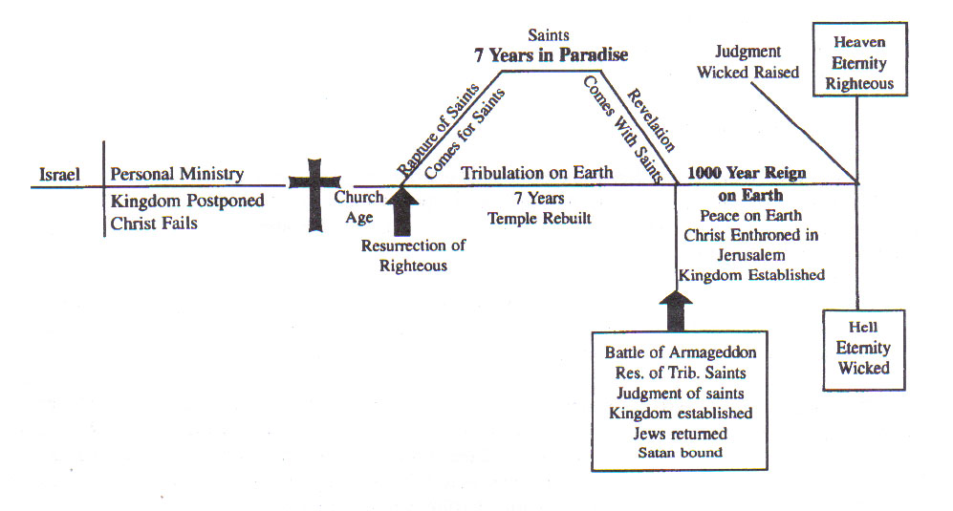
Rupturing The Rapture Text: I Thessalonians 4:13-5:4
Notes:
By Nathan L Morrison for Sunday December 17, 2023
All Scripture given is from NASB unless otherwise stated
For further study, or if questions, please Call: 804-277-1983 or Visit www.courthousechurchofchrist.com
Some points taken from a lesson by Richie Thetford and the BTB Workbook, ‘Then Comes The End’ by Mike Willis

Slide 2
Intro
“The Rapture” is part of the Premillennialist doctrine taught by many religious groups
Occasionally, such false doctrines gain mass media attention, such as “the Rapture” (Not found in Scriptures)
II Timothy 2:24-26: The Lord's bond-servant must not be quarrelsome, but be kind to all, able to teach, patient when wronged, with gentleness correcting those who are in opposition, if perhaps God may grant them repentance leading to the knowledge of the truth, and they may come to their senses and escape from the snare of the devil, having been held captive by him to do his will.
Are we waiting for the Rapture?
Notes:
There is confusion in the world about “end times” due to false doctrines that have been taught.
“The Rapture” is part of the Premillennialist doctrine taught by many religious groups.
Occasionally, such false doctrines gain mass media attention, such as “the Rapture.”
This false doctrine has been shown to be associated with Christianity in films, TV shows, comics, news, books, and just about every kind of media outlet. (The Left Behind series)
Bumper Stickers: “In case of the Rapture, this car will be without a driver!”
The goal of our teaching is to help people escape the lies of Satan and come to the truth.
II Timothy 2:24-26: The Lord's bond-servant must not be quarrelsome, but be kind to all, able to teach, patient when wronged, with gentleness correcting those who are in opposition, if perhaps God may grant them repentance leading to the knowledge of the truth, and they may come to their senses and escape from the snare of the devil, having been held captive by him to do his will.

Slide 3
Defining Premillennialism
“Rapture”: Latin rapere in the Latin Vulgate for the
Greek word harpazō [har-pad'-zo] (G726: “To
snatch, or catch away”) in I Thessalonians 4:17, which is
rendered by the phrase “caught up” in most English
Translations.
What do the Scriptures say in regards to the Rapture (and Premillennialism)?
Notes:
Chart from ‘Then Comes The End,’ Lesson 15, page 68
Rapture definition comes from: www.theopedia.com/Rapture & The Believer’s Bible Commentary on I Thess. 4:17

Slide 4
The Rapture Doctrine Contradicts Scripture
Rapture Doctrine
Claim Christ Came for an Earthly Kingdom
Christ failed and now must make a physical kingdom – John 18:37
Scriptures Say
King Jesus established His Kingdom, the church of Christ
John 18:36: Jesus denied the purpose of a physical kingdom.
Matthew 16:18-19: The church is the kingdom.
Mark 9:1: Kingdom to come while disciples lived.
Acts 2: King Jesus established His kingdom, the church of Christ.
Mark 9:1: And Jesus was saying to them, "Truly I say to you, there are some of those who are standing here who will not taste death until they see the kingdom of God after it has come with power."

Slide 5
The Rapture Doctrine Contradicts Scripture
Rapture Doctrine
Claim Christ Failed to Accomplish His Purpose
If failed 1st time, may fail again next time!
Scriptures Say
God promised Jesus was King and that His plan cannot fail
Psalm 2
Acts 13:32-33: Paul affirmed God fulfilled this promise in Jesus
Acts 13:32-33: "And we preach to you the good news of the promise made to the fathers, that God has fulfilled this promise to our children in that He raised up Jesus, as it is also written in the second Psalm, 'YOU ARE MY SON; TODAY I HAVE BEGOTTEN YOU.'"

Slide 6
The Rapture Doctrine Contradicts Scripture
Rapture Doctrine
Deny Christ Now Ruling on His Throne
Dethrones Christ
Removes Christ’s Priesthood
Convicts the apostles of falsehood
Scriptures Say
Peter & Paul said He was King: “King of kings!” on His throne!
Matthew 28:18; I Timothy 6:15: “King of kings”
Hebrews 4:14-16; 7:17: Jesus is to be Priest on His throne
Acts 2:30-33; I Timothy 6:15
Acts 2:29-36: Peter affirmed He is ruling now on His throne
Colossians 1:13-14: If He is not on His throne, we cannot enter His kingdom: we are still in our sins!
Hebrews 12:2: fixing our eyes on Jesus, the author and perfecter of faith, who for the joy set before Him endured the cross, despising the shame, and has sat down at the right hand of the throne of God.

Slide 7
The Rapture Doctrine Contradicts Scripture
Rapture Doctrine
Deny Christ Came to Die for Us
Makes the death of Christ not part of God's plan, but an accident
Scriptures Say
Peter declared that it was all part of God’s plan!
Acts 2:22-23
Acts 2:22-23: "Men of Israel, listen to these words: Jesus the Nazarene, a man attested to you by God with miracles and wonders and signs which God performed through Him in your midst, just as you yourselves know—this Man, delivered over by the predetermined plan and foreknowledge of God, you nailed to a cross by the hands of godless men and put Him to death.

Slide 8
The Rapture Doctrine Contradicts Scripture
Rapture Doctrine
Deny the church as God's Original Plan for His Kingdom
Denies “the last days” began on Day of Pentecost – Acts 2:16-21
Scriptures Say
The church is God's eternal purpose, not a temporary backup plan
Ephesians 1:3-7: God chose saints in Jesus “before the foundation of the world.”
Ephesians 3:8-12: The church is God's eternal purpose.
Ephesians 3:10-11: so that the manifold wisdom of God might now be made known through the church to the rulers and the authorities in the heavenly places. This was in accordance with the eternal purpose which He carried out in Christ Jesus our Lord,

Slide 9
The Rapture Doctrine Contradicts Scripture
Rapture Doctrine
Claim Signs to Predict the Time of Christ's Coming
Scriptures Say
Jesus said no one knows “the day or the hour” but God the Father
Matthew 24:35-36: Verses 1-35 discuss signs for the fall of Jerusalem; verses 36-51 affirm we cannot know the time of Christ's final coming.
Matthew 24:36: "But of that day and hour no one knows, not even the angels of heaven, nor the Son, but the Father alone.”

Slide 10
The Rapture Doctrine Contradicts Scripture
Rapture Doctrine
Two different resurrections from the dead
A resurrection of the righteous dead at the Rapture
A resurrection of the wicked dead at Judgment 1,007 years later
Scriptures Say
One resurrection of both righteous and wicked the same hour
One resurrection of both righteous and wicked– John 5:28-29; Acts 24:15
Resurrection of believers on “the last day” – John 6:39-40; 11:24
Judgment Day on “the last day” – John 12:48
John 5:28: "Do not marvel at this; for an hour is coming, in which all who are in the tombs will hear His voice...

Slide 11
The Rapture Doctrine Contradicts Scripture
Rapture Doctrine
Teaches multiple comings of Christ
A “quiet, secret” coming of Christ in the Rapture.
Another coming of Christ when He comes to establish His 1,000 year reign.
A final coming of Christ in judgment.
Scriptures Say
One coming of Christ: His coming will begin the Day of Judgment
John 5:28-29: The “shout” of I Thessalonians 4:16 is the voice the dead will hear.
II Thessalonians 1:6-10: When “He is revealed from heaven” and the righteous are “caught up” (I Thessalonians 4:17), the same day the wicked will also be punished!
II Corinthians 5:10: All men must appear before the judgment seat of Christ
I Thess. 4:16: For the Lord Himself will descend from heaven with a shout, with the voice of the archangel and with the trumpet of God, and the dead in Christ will rise first.

Slide 12
The Rapture Doctrine Contradicts Scripture
Rapture Doctrine
Teaches a “quiet, secret” coming of Christ
A “quiet, secret” coming of Christ in the Rapture.
Scriptures Say
Christ’s coming will not be a “secret, quiet” affair but a noisy, loud event
I Thessalonians 4:16: Christ will “descend from heaven with a shout, with the voice of the archangel, and with the trumpet of God.”
II Peter 3:10: The world will be destroyed with a “roar”
Revelation 1:7: “Every eye will see Him!”
I Thess. 4:16: For the Lord Himself will descend from heaven with a shout, with the voice of the archangel and with the trumpet of God, and the dead in Christ will rise first.

Slide 13
The Rapture Doctrine Contradicts Scripture
Rapture Doctrine
Teaches saints who were “Raptured” will return to earth with Christ for His 1,000 year reign
Problems:
Revelation 20:4-5: The saints that reign for 1,000 years are beheaded martyrs!
Revelation 20:6: No mention of earth or Jerusalem!
Can these be guilty of sin during the 1,000 years on earth? (lose their reward?)
Scriptures Say
Jesus won’t step foot on the earth again
I Thessalonians 4:16-17
Saints will meet Him in the clouds (air) and “always be with the Lord!” (No time limit placed on that!
I Thess. 4:17: Then we who are alive and remain will be caught up together with them in the clouds to meet the Lord in the air, and so we shall always be with the Lord.

Slide 14
The Rapture Doctrine Contradicts Scripture
“Rapture”: Latin rapere in the Latin Vulgate for the
Greek word harpazō [har-pad'-zo] (G726: “To
snatch, or catch away”) in I Thessalonians 4:17, which is
rendered by the phrase “caught up” in most English
Translations.
The Premillennial doctrine of the Rapture contradicts God’s word and gives false hopes!
Notes:
Chart from ‘Then Comes The End,’ Lesson 15, page 68
Rapture definition comes from: www.theopedia.com/Rapture & The Believer’s Bible Commentary on I Thess. 4:17

Slide 15
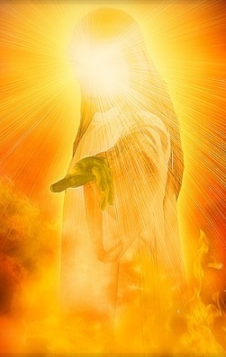
Christ’s 2nd Coming
The central text used to support the Rapture is I Thessalonians 4:13-18
The central text used to refute the Rapture doctrine is I Thessalonians 4:13-18
The text says Christ will return with a “shout, with the voice of the archangel, and the trumpet of God!” (I Thess. 4:16)
There is no distinction made of time, but speaks of one return.

Slide 16
Christ’s 2nd Coming
I Thessalonians 4:13-5:4 speaks of Christ’s 2nd Coming (Acts 1:11) and shows:
I Thessalonians 5:2: Like a “thief in the night”
I Thessalonians 4:16: Christ’s 2nd Coming will be seen and heard by all
I Thessalonians 4:16-17; 5:3: Both the righteous and the wicked will be raised the same “hour”
I Thessalonians 4:13-18; II Thessalonians 1:7-9: Jesus will punish the wicked eternally (Matthew 25:34, 41, 46).
I Thessalonians 4:16-17: Judgment will begin for both the righteous and the wicked – Matthew 16:27; 25:31-46; II Timothy 4:1; Hebrews 9:27
I Thessalonians 4:17: “We shall always be with the Lord” cannot be reduced to 7 years, then for 1,000 years, then for eternity! It means for eternity!

Slide 17
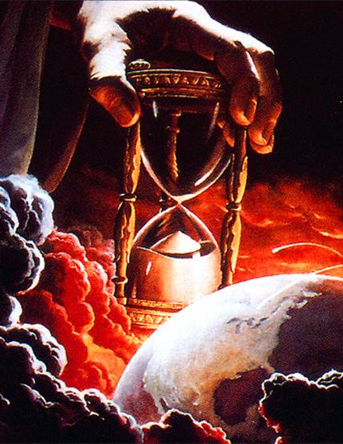
Christ’s 2nd Coming
God knows when Christ will return, & when He returns He will bring both Judgment & Reward with Him! (Hebrews 9:27; II Corinthians 5:10)

Slide 18
Conclusion
Premillennialism and the Rapture part of it are a delusion and false teaching
Those who teach outside of Christ’s teachings do not have God – II John 9-11
We have no need to be confused or misguided, when the Scriptures are very clear as to what will happen when Christ returns for the 2nd time!
II Timothy 2:24-26: The Lord's bond-servant must not be quarrelsome, but be kind to all, able to teach, patient when wronged, with gentleness correcting those who are in opposition, if perhaps God may grant them repentance leading to the knowledge of the truth, and they may come to their senses and escape from the snare of the devil, having been held captive by him to do his will.

Slide 19
Conclusion
We do not wait for the Rapture, but wait for the return of Christ, to be “caught up” in the clouds and meet Him in the air to “always be with the Lord!” (I Thessalonians 4:16-17)
It is this event we are to comfort one another with! (I Thessalonians 4:18)
Let us not be deceived with a dream of a secret “Rapture,” but focus our eyes on the “one hope” of His glorious return with “His mighty angels in flaming fire!”
(II Thessalonians 1:7)

Slide 20
“What Must I Do To Be Saved?”
Hear The Gospel (John 5:24; Romans 10:17)
Believe In Christ (John 3:16-18; John 8:24)
Repent Of Sins (Luke 13:3-5; Acts 2:38)
Confess Christ (Matthew 10:32; Romans 10:10)
Be Baptized (Mark 16:16; Acts 22:16)
Remain Faithful (John 8:31; Revelation 2:10)
For The Erring Saint:
Repent (Acts 8:22), Confess (I John 1:9),
Pray (Acts 8:22)

