Slide 1
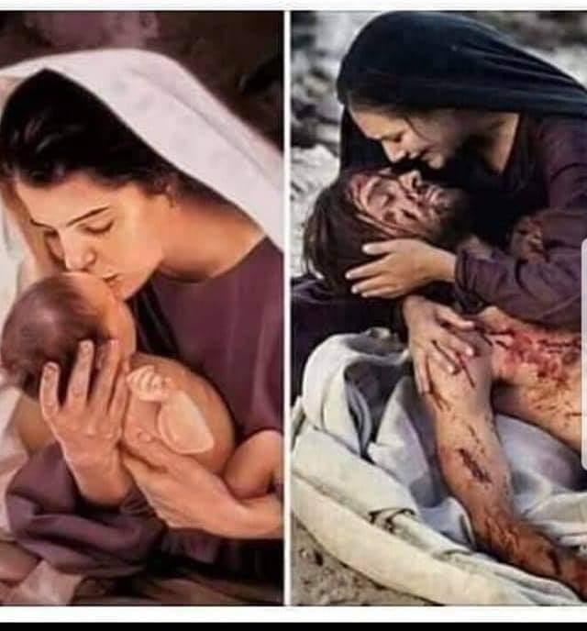
Child Of Promise
Seeing Jesus In The Old Testament
Text:
Genesis 18:10-11; Luke 1:30-31
Notes:
By Nathan L Morrison for Sunday 12/24/2023
All Scripture given is from NASB unless otherwise stated
For further study, or if questions, please Call: 804-277-1983 or Visit: www.courthousechurchofchrist.com
Adapted from a lesson in Seeing Jesus In The Old Testament by Cloyce Sutton

Slide 2
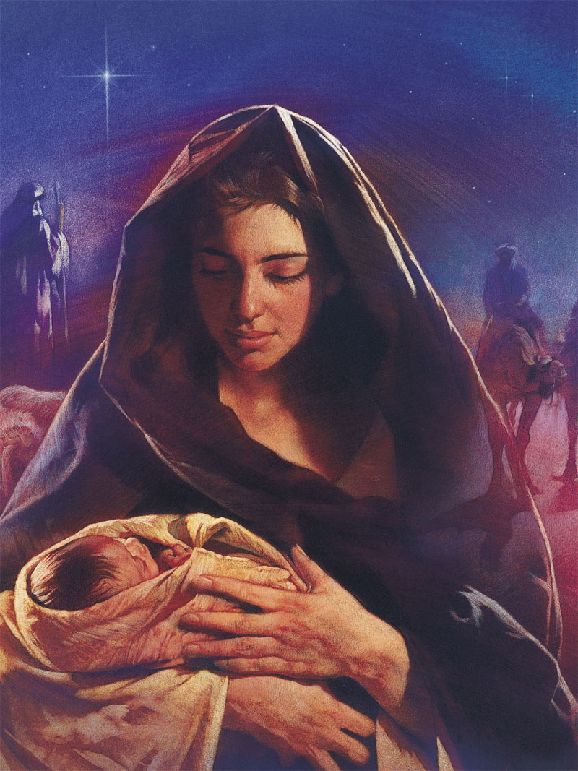
Intro
This time of year the world seeks Jesus.
They seek Jesus in the manger as they focus on His birth.
Jesus said He would be lifted up and draw all men unto Him, speaking about His death, His cross (John 12:32-33).
As people are focused on Jesus let us talk about how He was the Child of Promise that fulfilled the Old Covenant and made it possible for people to obey the gospel and live eternally with Him!
Notes:
This time of year the world seeks Jesus.
They seek Jesus in the manger as they focus on His birth.
There is nothing in the Scriptures to indicate that Jesus was born during the winter months, but it was established as a tradition hundreds of years after His birth.
A.D. 204: ‘Commentary on the Prophet Daniel’ by Hippolytus (170-235 A.D.) claimed Wed March 25 is when Jesus was conceived (Malachi 4:2: “But for you who fear My name, the sun of righteousness will rise with healing in its wings; and you will go forth and skip about like calves from the stall”).
A.D. 221: Sextus Julius Africanus, a historian from Alexandria, Egypt, composed a chronicle of world events that listed the birth of Jesus on December 25th (Said Jesus was conceived March 25).
A.D. 350: Pope Julius I (A.D. 337-352) declared December 25th a holiday (“Feast of the Nativity”) after confirming it was Jesus’ birthday (from the writings of Sextus Julius), thus giving Catholics a reason to celebrate (Malachi 4:2: “Sun of righteousness”).
Jesus said He would be lifted up and draw all men unto Him, speaking about His death, His cross (John 12:32-33).
As people are focused on Jesus let us take the opportunity to talk how He was the Child of Promise that fulfilled the Old Covenant and made it possible for people to obey the gospel and live eternally with Him!
Let us look at the similarities between Isaac and Jesus as both were Children of Promise and both their births and sacrifices were significant for mankind!

Slide 3
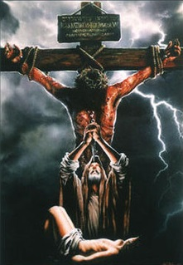
Intro
Let us look at the similarities between Isaac and Jesus as both were Children of Promise and both their births and sacrifices were significant for mankind!
Notes:
This time of year the world seeks Jesus.
They seek Jesus in the manger as they focus on His birth.
There is nothing in the Scriptures to indicate that Jesus was born during the winter months, but it was established as a tradition hundreds of years after His birth.
A.D. 204: ‘Commentary on the Prophet Daniel’ by Hippolytus (170-235 A.D.) claimed Wed March 25 is when Jesus was conceived (Malachi 4:2: “But for you who fear My name, the sun of righteousness will rise with healing in its wings; and you will go forth and skip about like calves from the stall”).
A.D. 221: Sextus Julius Africanus, a historian from Alexandria, Egypt, composed a chronicle of world events that listed the birth of Jesus on December 25th (Said Jesus was conceived March 25).
A.D. 350: Pope Julius I (A.D. 337-352) declared December 25th a holiday (“Feast of the Nativity”) after confirming it was Jesus’ birthday (from the writings of Sextus Julius), thus giving Catholics a reason to celebrate (Malachi 4:2: “Sun of righteousness”).
Jesus said He would be lifted up and draw all men unto Him, speaking about His death, His cross (John 12:32-33).
As people are focused on Jesus let us take the opportunity to talk how He was the Child of Promise that fulfilled the Old Covenant and made it possible for people to obey the gospel and live eternally with Him!
Let us look at the similarities between Isaac and Jesus as both were Children of Promise and both their births and sacrifices were significant for mankind!

Slide 4
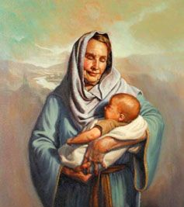
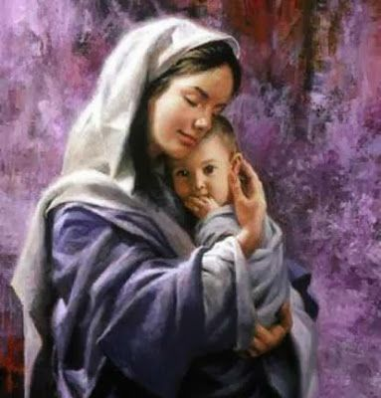
Isaac & Jesus:
Children of Promise

Slide 5
Isaac
Birth Pre-Announced! Sarah past the age of childbearing! | Genesis 18:10-11, 14
Named before birth: Isaac | Genesis 17:19
Miraculous conception: Sarah was advanced in years, past the age of childbearing; Had a son! | Genesis 21:1-7
Son of Promise! Through Isaac would come the Savior! | Genesis 12:3; 21:1-2
Mocked by his brother (Ishmael) | Genesis 21:8-9
Abraham’s “Only Son” / Abraham means “father of a multitude of nations” | Genesis 22:2
Jesus
Birth Pre-Announced! Mary was a virgin! | Luke 1:30-31, 34
Named before birth: Jesus | Matthew 1:21; Luke 1:31
Miraculous conception: Mary was young, a virgin; Had a son! | Matthew 1:18-20; Luke 2:4-5
Son of Promise! Jesus is the Savior of the world! | Genesis 12:3; Matthew 1:18-25; Luke 2:4-7; 8-21
Mocked by His brothers | John 7:1-5
God the Father’s “Only Son” | John 3:16-17
Notes:
Note on both births:
Isaac:
Isaac’s birth through Abraham and Sarah was a promised miracle and a great occasion for joy.
Through Isaac, the promise in Genesis 12:3 was started that through Abraham’s seed all the nations of the earth would be blessed!
Both Ishamel and Isaac are called “Abraham's son” (Genesis 25:12, 19) but only Isaac is the Child of Promise (Genesis 17:15-21).
It is through his seed that the Savior of the world would come!
Jesus:
Jesus’ birth through the Holy Spirit and Mary was a promised miracle and a great occasion for joy, heralded by angels to shepherds! (Luke 2:8-20)
From Isaac, through the tribe of Judah and the line of King David, Jesus was born to earthly parents, establishing His right to rule as King Forever on the throne of David (Luke 1:31-33), and Jesus fulfilled the promise made to Abraham in Genesis 12:3 that in Him all the nations of the earth are blessed! (Galatians 3:26-29)
Jesus is called, “the son of Abraham” (Matthew 1:1).
The Savior of the world has come! (John 1:29)
There was occasion for great joy at the birth of the Child of Promise!

Slide 6
Isaac & Jesus: Children of Promise
Isaac’s birth through Abraham and Sarah was a promised miracle and a great occasion for joy.
Through Isaac, the promise in Genesis 12:3 was started that through Abraham’s seed all the nations of the earth would be blessed!
Both Ishamel and Isaac are called “Abraham's son” (Genesis 25:12, 19) but only Isaac is the Child of Promise (Genesis 17:15-21).
It is through his seed that the Savior of the world would come!
Isaac
Genesis 25:19
Now these are the records of the generations of Isaac, Abraham's son: Abraham became the father of Isaac;

Slide 7
Isaac & Jesus: Children of Promise
Jesus’ birth through the Holy Spirit and Mary was a promised miracle and a great occasion for joy, heralded by angels to shepherds! (Luke 2:8-20)
From Isaac, through the tribe of Judah and the line of King David, Jesus was born to earthly parents, establishing His right to rule as King Forever on the throne of David (Luke 1:31-33), and Jesus fulfilled the promise made to Abraham in Genesis 12:3 that in Him all the nations of the earth are blessed! (Galatians 3:26-29)
Jesus is called, “the son of Abraham” (Matthew 1:1).
The Savior of the world has come! (John 1:29)
Jesus
Matthew 1:1
The record of the genealogy of Jesus the Messiah, the son of David, the son of Abraham:

Slide 8
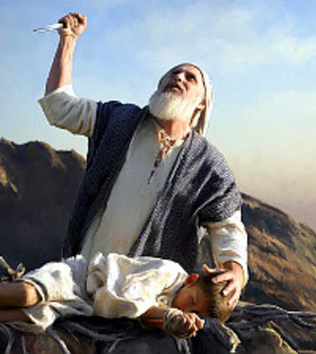
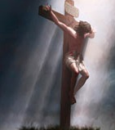
Isaac & Jesus:
Children of Sacrifice

Slide 9
Isaac
Offering of “Only Son” | Genesis 22:2
Offered at same place: Mt. Moriah | Genesis 22:2-3
Three days between condemnation and life | Genesis 22:4
Bore the wood of his own life’s sacrifice | Genesis 22:6
Raised from death to life | Genesis 22:10-12; Hebrews 11:17-19
Jesus
Offering of “Only Son” | Matthew 3:16-17
Offered at same place: Mt. Moriah | II Chronicles 3:1; Mark 15:22
Three days between condemnation and life | Matthew 16:21
Bore the wood of his own life’s sacrifice | John 19:17
Raised from death to life | Matthew 16:21; Luke 24:1-7
Notes:
Note on both offerings:
Isaac:
Abraham called to sacrifice his only son, Isaac, anticipates God the Father sacrificing His Only Son, Jesus!
God sent Abraham to the “land of Moriah” (Genesis 22:2) to a mountain there that God instructed Abraham to go (Genesis 22:14: “In the mount of the LORD it will be provided”).
Because of Abraham’s willingness to offer up his “only son,” his faith, which knew God would raise him up again to fulfill His promises (Hebrews 11:17-19), was tested and was granted the promise again that in his seed all the nations of the earth would be blessed (Genesis 22:16-18).
His offering of Isaac secured Israel’s future (Genesis 22:16-18).
Jesus:
The idea of a father willing to sacrifice his “only son” comes back in the gospels as Jesus begins to predict His death, a sacrifice for sins (Matthew 26:28; John 3:16; 10:17-18).
Mt. Moriah is one of the mountains in the Moriah Mountain Range where Abraham went to offer up Isaac (Genesis 22:2), and where David purchased the Temple land where Solomon built the Temple in Jerusalem (II Chronicles 3:1). So maybe not the exact mountain but the same area that Abraham was willing to offer up Isaac, Jesus was offered up as a “sacrifice for sins for all time,” outside the city gate (Hebrews 9:28; 10:12; 13:12-13).
Because of Jesus’ willingness to offer up Himself as a “sacrifice for sins for all time,” He secured all saints’ future relationship with God and to live eternally with Him in Heaven! (I Peter 2:24; 3:18; 1:3-4)
Jesus saves all those who obey Him! (Hebrews 5:8-9)
The sacrifice of the Child of Promise (both of them) secured a future for God’s people to be with God!

Slide 10
Isaac & Jesus: Children of Sacrifice
Abraham called to sacrifice his only son, Isaac, anticipates God the Father sacrificing His Only Son, Jesus!
God sent Abraham to the “land of Moriah” (Genesis 22:2) to a mountain (Genesis 22:14: “In the mount of the LORD it will be provided”).
Because of Abraham’s willingness to offer up his “only son,” his faith, which knew God would raise him up again to fulfill His promises (Hebrews 11:17-19), was tested and was granted the promise again that in his seed all the nations of the earth would be blessed (Genesis 22:16-18).
His offering of Isaac secured Israel’s future (Genesis 22:16-18).
Isaac
Genesis 22:15-18
15. Then the angel of the LORD called to Abraham a second time from heaven,
16. and said, "By Myself I have sworn, declares the LORD, because you have done this thing and have not withheld your son, your only son,
17. indeed I will greatly bless you, and I will greatly multiply your seed as the stars of the heavens and as the sand which is on the seashore; and your seed shall possess the gate of their enemies.
18. "In your seed all the nations of the earth shall be blessed, because you have obeyed My voice."

Slide 11
Isaac & Jesus: Children of Sacrifice
The idea of a father willing to sacrifice his “only son” comes back in the gospels as Jesus begins to predict His death, a sacrifice for sins (Matthew 26:28; John 3:16; 10:17-18).
Mt. Moriah is where Abraham went to offer up Isaac (Genesis 22:2), and where David purchased the Temple land where Solomon built the Temple in Jerusalem (II Chronicles 3:1). Same area that Abraham was willing to offer up Isaac, Jesus was offered up as a “sacrifice for sins for all time,” outside the city gate (Hebrews 9:28; 10:12; 13:12-13).
Jesus’ “sacrifice for sins for all time” secured all saints’ future relationship with God and to live eternally with Him in Heaven! (I Peter 2:24; 3:18; 1:3-4)
Jesus saves all those who obey Him! (Hebrews 5:8-9)
Jesus
I Peter 3:18
For Christ also died for sins once for all, the just for the unjust, so that He might bring us to God, having been put to death in the flesh, but made alive in the spirit;

Slide 12
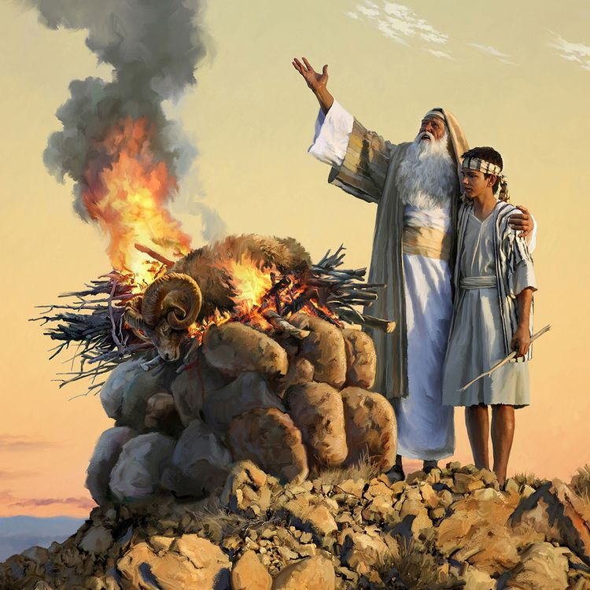
Conclusion
Isaac, The Child of Promise, brought forth the Israelites and the promise of the Savior!

Slide 13
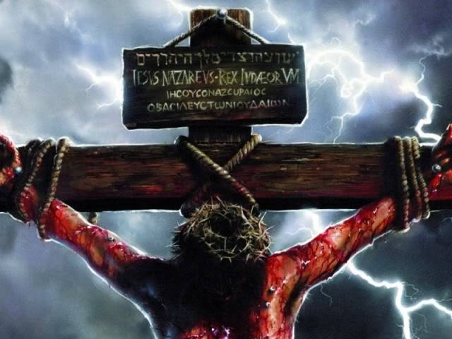
Conclusion
Jesus, the Child of Promise, brought forth salvation and the promise of eternal life in Heaven!

Slide 14
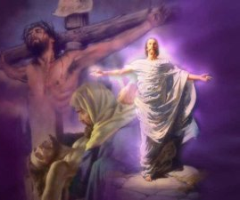
Conclusion
The Scriptures emphasize Christ’s cross, not the manger.
We celebrate and honor His death & sacrifice every first day of the week in the way Jesus wanted to be remembered (Matthew 26:26-29).
His whole life, death, burial, and resurrection is remembered every week!
We believe He was born (Galatians 4:4) but the emphasis is on His death, burial, & resurrection (I Corinthians 15:3-4).
He lived and died so that we may live with Him in eternity! (I Peter 1:3-4; 2:24)

Slide 15
Conclusion
The birth of Jesus shows us God keeps His promises and the cross of Jesus shows us the enormity of sin, and the depths of God’s love
(John 3:16)

Slide 16
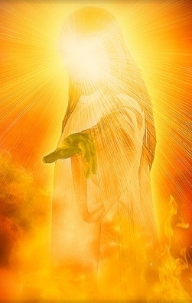
Conclusion
Jesus, the Child of Promise, died for you so that you may live! Have you obeyed His voice?

Slide 17
“What Must I Do To Be Saved?”
Hear The Gospel (John 5:24; Romans 10:17)
Believe In Christ (John 3:16-18; John 8:24)
Repent Of Sins (Luke 13:3-5; Acts 2:38)
Confess Christ (Matthew 10:32; Romans 10:10)
Be Baptized (Mark 16:16; Acts 22:16)
Remain Faithful (John 8:31; Revelation 2:10)
For The Erring Saint:
Repent (Acts 8:22), Confess (I John 1:9),
Pray (Acts 8:22)

