Slide 1
Godly Mothers
Text:
Proverbs 6:20-22
Notes:
By Nathan L Morrison for Sunday 05/14/2023
All Scripture given is from NASU unless otherwise stated
For further study, or if questions, please Call: 804-277-1983 or Visit: www.courthousechurchofchrist.com
Adapted from a Sermon Starter, "Thank God for Godly Mothers," by Mark Posey

Slide 2
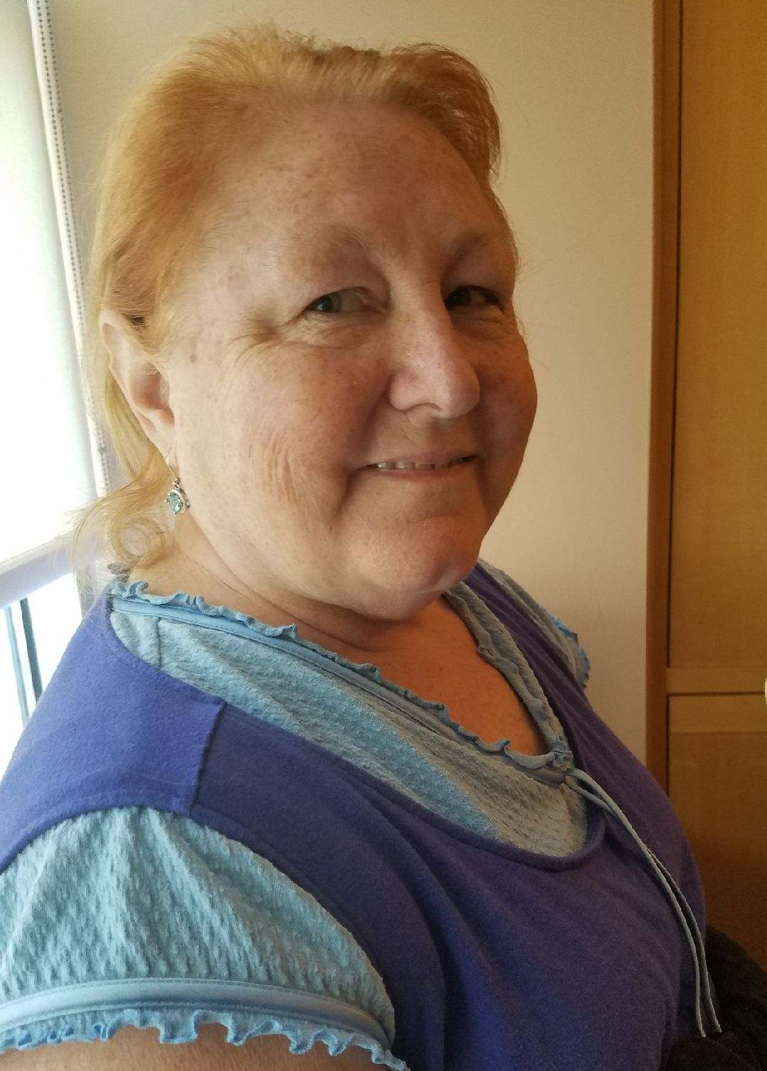
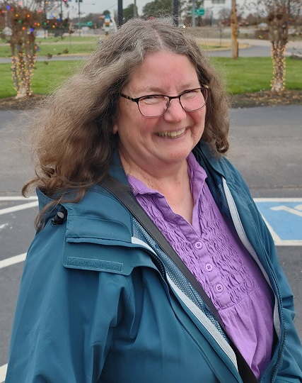
INTRO
The Month of May!
A time when we reflect on and honor our mothers
Let us look at mothers through the lens of God’s word and the godly influence they can have on their families
Mother’s Day is a special one-time event each year, but we should all honor our mothers on a daily basis – especially those who are faithful to God!
Notes:
Images: L-R: Author’s Mom, Mary Morrison, Author’s Mother-in-Law, Susan Krizer
“...JUST A MOM” (Author Unknown) A woman, renewing her driver’s license at the County Clerk ‘s office was asked by the woman recorder to state her occupation. She hesitated, uncertain how to classify herself. “What I mean is,” explained the recorder, “do you have a job or are you just a......?” “Of course I have a job,” snapped the woman. “I’m a Mom.” “We don’t list ‘Mom’ as an occupation; ‘housewife’ covers it,” said the recorder emphatically. I forgot all about her story until one day I found myself in the same situation, this time at our own Town Hall. The Clerk was obviously a career woman, poised, efficient and possessed of a high sounding title like, “Official Interrogator” or “Town Registrar.” “What is your occupation?” she probed. What made me say it? I do not know. The words simply popped out. “I’m a Research Associate in the field of Child Development and Human Relations.” The clerk paused, ball-point pen frozen in midair and looked up as though she had not heard right. I repeated the title slowly emphasizing the most significant words. Then I stared with wonder as my pronouncement was written, in bold, black ink on the official questionnaire. “Might I ask,” said the clerk with new interest, “just what you do in your field?” Coolly, without any trace of fluster in my voice, I heard myself reply, “I have a continuing program of research, (what mother doesn’t) in the laboratory and in the field, (normally I would have said indoors and out). I’m working for my Masters, (first the Lord and then the whole family) and already have four credits (all daughters). Of course, the job is one of the most demanding in the humanities, (any mother care to disagree?) and I often work 14 hours a day, (24 is more like it). But the job is more challenging than most run-of-the-mill careers and the rewards are more of a satisfaction rather than just money.” There was an increasing note of respect in the clerk’s voice as she completed the form, stood up and personally ushered me to the door. As I drove into our driveway, buoyed up by my glamorous new career, I was greeted by my lab assistants – ages 13, 7, and 3. Upstairs I could hear our new experimental model (a 6 month old baby) in the child development program, testing out a new vocal pattern. I felt I had scored a beat on bureaucracy! And I had gone on the official records as someone more distinguished and indispensable to mankind than “just another Mom. “Motherhood” What a glorious career! Especially when there’s a title on the door.

Slide 3
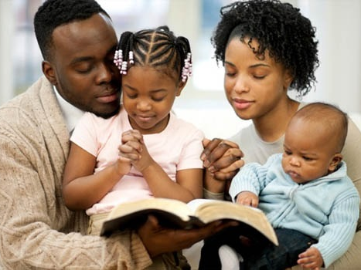
Intro
Proverbs 6:20-22 tells us that fathers and mothers both have a role in training up faithful children!
Mother’s Wisdom is Priceless!

Slide 4
Counsel of Godly Mothers
Proverbs 6:20: “My son, observe the commandment of your father And do not forsake the teaching of your mother”
Ephesians 6:1-3: “Children, obey your parents in the Lord, for this is right”
II Timothy 1:5: Timothy’s mother Eunice and her mother Lois (his grandmother) trained him in the Scriptures (I Timothy 4:6) and instilled in him a “sincere faith”
Be a mother like Eunice that taught Timothy from childhood to have assuring faith in the word of God, which is “able to give you the wisdom that leads to salvation through faith which is in Christ Jesus” (II Timothy 3:14-15)

Slide 5
Counsel of Godly Mothers
Godly Mothers counsel from the wisdom of the word of God!

Slide 6
Connection to Godly Mothers
Proverbs 6:21: “Bind them continually on your heart; Tie them around your neck”
Proverbs 1:8-9: “…do not forsake your mother's teaching…”
Be a mother like Jochebed who put her faith in God into action and saved the life of Moses because she didn’t fear Pharoah’s edict (Hebrews 11:23; Exodus 2:1-4, 8-10)
Be a mother like Hannah who fervently prayed to God (I Samuel 1:9-28) and offered her requests to God

Slide 7
Connection to Godly Mothers
Godly Mothers trust and pray to God and should train their children to also!

Slide 8
Course of Godly Mothers
Proverbs 6:22: “When you walk about, they will guide you; When you sleep, they will watch over you; And when you awake, they will talk to you”
Deuteronomy 11:18-21: “You shall teach them to your sons, talking of them when you sit in your house and when you walk along the road and when you lie down and when you rise up” (v.19)

Slide 9
Course of Godly Mothers
Proverbs 6:22: “When you walk about, they will guide you; When you sleep, they will watch over you; And when you awake, they will talk to you”
Lead (Proverbs 6:22): by wisdom and example
Keep (Proverbs 6:22): watch and guard your children
Teach (Proverbs 6:22): God’s word to your children so that they may walk in them

Slide 10
Course of Godly Mothers
Proverbs 6:22: “When you walk about, they will guide you; When you sleep, they will watch over you; And when you awake, they will talk to you”
Be a mother like Sarah who hoped in God’s promises (Genesis 21:1-3)
Be a mother like Mary who had unwavering dedication to God (Luke 1:38)

Slide 11
Course of Godly Mothers
Godly Mothers can set their children on a godly course of faithfulness by their example!

Slide 12
Conclusion
What if you didn’t grow up with a godly mother, or didn’t know your mother?

Slide 13
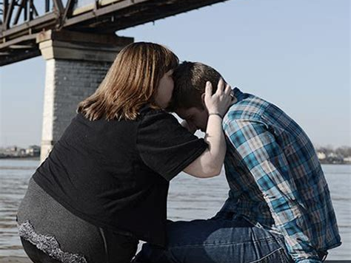
Conclusion
Romans 16:13: “Greet Rufus, chosen in the Lord, and his mother who was also a mother to me” (NET)
Jesus promised His disciples and all who followed Him that if they were to be without family in the world, in Jesus they would have “homes, brothers, sisters, mothers, children…” (Mark 10:30)
Just as older women are instructed to teach younger women in Titus 2:3-5, women, you can become a saint’s “mother in the faith,” thereby following after the example of Rufus’ mother and fulfilling the promise made by Jesus! (Mark 10:30; Luke 8:21)
Notes:
Conclusion
What if you didn’t grow up with a godly mother, or didn’t know your mother?
We don’t know anything about Paul’s biological mother.
But he gave a shoutout to his “mother in the faith” at the end of his letter to the Roman saints. He mentioned 22 names and 6 of those names were women.
Romans 16:13: “Greet Rufus, chosen in the Lord, and his mother who was also a mother to me” (NET).
Jesus promised His disciples and all who followed Him that if they were to be without family in the world, in Jesus they would have “homes, brothers, sisters, mothers, children…” (Mark 10:30).
It is possible that this Rufus mentioned at the end of Romans is the son of Simon of Cyrene, who carried the cross beam of Jesus to Calvary (Mark 15:21).
If that’s the case, then Simon’s wife became a “mother” to Paul.
Just as older women are instructed to teach younger women in Titus 2:3-5, women, you can become a saint’s “mother in the faith,” thereby following after the example of Rufus’ mother and fulfilling the promise made by Jesus! (Mark 10:30; Luke 8:21)

Slide 14
Conclusion
Godly mothers, be an example to your children of making God and His people a priority in your life! Attend services and classes as often as you are able. Let them see your dedication to God!
Godly mothers, be a godly role model to not only your own children but to other saints!

Slide 15
Conclusion
Let us thank God for godly mothers and “mothers in the faith,” for those who have helped shape and guide us to God!
Notes:
Images:
Top: Author’s Mom, Mary Morrison
Bottom: Author’s Mother-in-Law, Susan Krizer

Slide 16
“What Must I Do To Be Saved?”
Hear The Gospel (Jn. 5:24; Rom. 10:17)
Believe In Christ (Jn. 3:16-18; Jn. 8:24)
Repent Of Sins (Lk. 13:3-5; Acts 2:38)
Confess Christ (Mt. 10:32; Rom. 10:10)
Be Baptized (Mk. 16:16; Acts 22:16)
Remain Faithful (Jn. 8:31; Rev. 2:10)
For The Erring Saint:
Repent (Acts 8:22), Confess (I Jn. 1:9),
Pray (Acts 8:22)

