Slide 1
WASHED
Text:
I Corinthians 6:9-11
Notes:
By Nathan L Morrison for Sunday April 23rd, 2023
All Scripture given is from NASU unless otherwise stated
For further study, or if questions, please Call: 804-277-1983 or Visit www.courthousechurchofchrist.com

Slide 2
Intro
Many lessons learned…
Notes:
Intro
2020: Called the Dumpster Fire Year. Lessons we learned:
A pandemic can shut the world down.
Through government overreach we learned our Constitutional Rights aren’t as “unalienable” as we thought (fallout from that playing out in courts still today).
Some people are willing to give up their rights in the name of “safety” and the “greater good.”
Misinformation can come from anywhere.
Masks can divide the country, families and churches.
We stood too close to each other.
We touched our faces way too often.
None of us knew how to wash our hands properly! (Or for how long!)

Slide 3
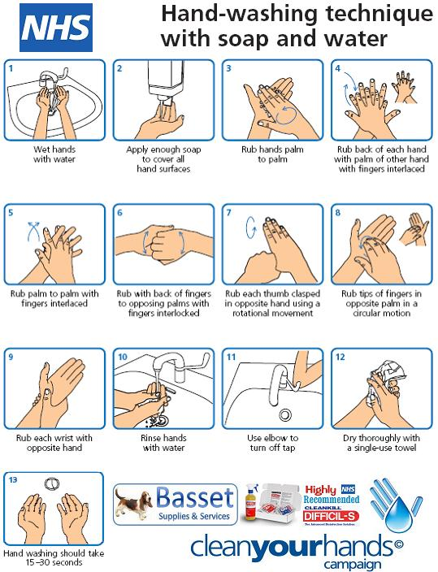
Intro
Washing hands became one of the most important preventative measures we were told to take against COVID-19
Notes:
Washing hands became one of the most important preventative measures we were told to take against COVID-19.
Before COVID-19 most Hand Washing Posters had 5-7 steps.
During and after COVID-19 Hand Washing Posters cropped up with 12-13 steps!
Tons of videos were made to show us how to wash our hands properly!
We were told to wash our hands anywhere from 15-40 seconds; to sing the Happy Birthday Song slowly and then we’re done.
Washing your hands may wash them clean for a moment, until you touch something else.
Washing your hands never fully removes the germs.

Slide 4
Intro
To truly be worry and stress free, God prescribes a way to be washed clean from sin way less complicated than the Hand Washing Posters put out the last three years!

Slide 5
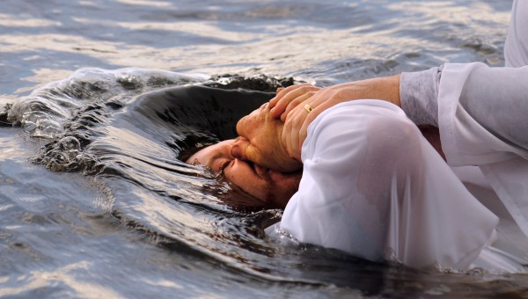
Intro
In a few simple steps, you can be Washed, Sanctified and Justified in Jesus Christ!

Slide 6
The Need To Be Washed
I Corinthians 6:9-10 (I John 3:4, 7-8)
9. Or do you not know that the unrighteous will not inherit the kingdom of God? Do not be deceived; neither fornicators, nor idolaters, nor adulterers, nor effeminate, nor homosexuals,
10. nor thieves, nor the covetous, nor drunkards, nor revilers, nor swindlers, will inherit the kingdom of God.
Notes:
Emphasis in Scripture mine

Slide 7
The Need To Be Washed
Sins involving the abuse or misuse of the body (sexual immorality) – I Corinthians 6:9-10:
Fornication & Adultery
Flee immorality! (I Corinthians 6:13, 18: The body is not for immorality)
The marriage bed is to be held in honor because God will judge fornicators and adulterers (Hebrews 13:5)
Homosexuality & Effeminate
Romans 1:26: Described as being “degrading” (NKJ: “vile”) and “unnatural” (NKJ: “against nature”)
Romans 1:27: Described as “indecent acts” (NKJ: “shameful”) and “error”
Romans 1:28: Described as being “not proper” (NKJ: “not fitting”)
Romans 1 describes same-sex practices as conduct that results from rejecting the Creator! (Rom. 1:25)

Slide 8
The Need To Be Washed
Sins involving the abuse or misuse of things – I Corinthians 6:9-10:
Idolatry, stealing (robbing & swindling), and covetousness/greed
Colossians 3:5: Saints are to “put to death” these evil things in their lives

Slide 9
The Need To Be Washed
Sins of lack of self-control – I Corinthians 6:9-10:
Drunkenness
I Peter 4:3-5: Saints not to engage in such behavior: drunkenness, carousing (that is late-night drinking in the streets), and drinking parties!
Revilers
Verbal abuse at others or blasphemy against God (Galatians 5:20: Outbursts of anger listed as a deed of the flesh!)

Slide 10
The Need To Be Washed
I Corinthians 6:9-10:
The world has been deceived and they teach these things are not only acceptable but should be practiced with impunity! (Romans 2:6-9: The unrighteous will be punished)

Slide 11
The Need To Be Washed
Just as the Corona Virus was a cause to wash our hands, sin is a cause for washing our hearts because it carries an eternal penalty!

Slide 12
We Can Be Washed (Be made clean)
I Corinthians 6:11
11. Such were some of you; but you were washed, but you were sanctified, but you were justified in the name of the Lord Jesus Christ and in the Spirit of our God.
The world teaches many of these practices (I Cor. 6:9-10) are inherent (born with) and cannot be changed from!
I Corinthians 6:11: “Such were some of you!”
Some of the Corinthian brethren came out of these unrighteous backgrounds – we can know that we CAN change our lifestyles!
Notes:
Emphasis in Scripture mine

Slide 13
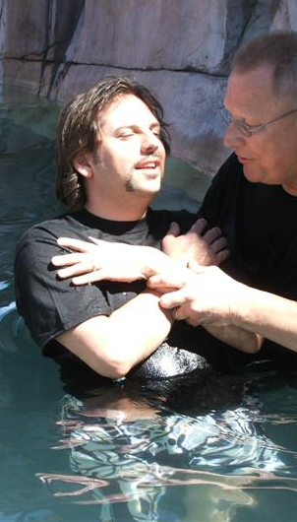
We Can Be Washed (Be made clean)
The Corinthians had been “washed”
Acts 18:8; 22:16; Rev. 1:5 (NKJV); Eph. 5:25-27
The Corinthians had been “sanctified”
I Cor. 1:2
The Corinthians had been “justified”
“Justified by His grace” (Rom. 3:24; Titus 3:7)
“Justified by faith” (Rom. 5:1; Gal. 2:16)
”Justified by His blood” (Rom. 5:9)

Slide 14
We Can Be Washed (Be made clean)
We must know that we CAN change from unrighteous lives to righteous lives for God, that we can be washed and made clean!

Slide 15
How to Wash
 | Jesus’ Teaching
Scriptures | Hear | Believe | Repent | Confess | Baptized | Obedience
Mt. 28:18-20 Mk. 16:15-16 | John 5:24 | John 3:16-18 | Luke 13:3-5 | Mt. 10:32 | Mark 16:16 | John 8:31
The words of Jesus: Hear, Believe, Repent, Confess, be Baptized, Obey (be faithful)
Did others follow that pattern?

Slide 16
Mt. 28:18-20 | Examples Of Conversion |  |  |  |  | Mk. 16:15-16
Examples | Hear | Believe | Repent | Confess | Baptized | Mark 16:16
Pentecost Acts 2:14-41 | 2:37 | 2:37 | 2:38 |  | 2:38, 41 | Believed (2:37) & Baptized (2:41)
Samaritans Acts 8:5-14 | 8:6 | 8:12 |  |  | 8:12 | Believed (8:12) & Baptized (8:12)
Simon Acts 8:13 | 8:6 | 8:13 | 8:9 |  | 8:13 | Believed (8:13) & Baptized (8:13)

Slide 17
Mt. 28:18-20 | Examples Of Conversion |  |  |  |  | Mk. 16:15-16
Examples | Hear | Believe | Repent | Confess | Baptized | Mark 16:16
Eunuch Acts 8:26-39 | 8:34-35 | 8:37 |  | 8:37 | 8:38 | Believed (8:37) & Baptized (8:38)
Saul Acts 9:1-18; 22:10-16; 26:2-21; Gal. 1:23; I Tim. 1:13 | 22:10, 15 | 9:11 | Gal. 1:23 I Tim. 1:13 | 22:10 | 22:16; 9:18 | Believed (9:11: “praying”) & Baptized (9:18)
Cornelius Acts 10:1-48 | 10:33 | 10:43 |  |  | 10:48 | Believed (10:43) & Baptized (10:48)

Slide 18
Mt. 28:18-20 | Examples Of Conversion |  |  |  |  | Mk. 16:15-16
Examples | Hear | Believe | Repent | Confess | Baptized | Mark 16:16
Sergius Paulus Acts 13:4-12 | 13:7 | 13:12 (2:38; 10:43) |  |  |  | Believed (13:12)
Lydia Acts 16:13-15 | 16:14 | 16:15 |  |  | 16:15 | Believed (16:15) & Baptized (16:15)
Jailer Acts 16:25-34 | 16:30 | 16:34 | 16:33 |  | 16:33 | Believed (16:34) & Baptized (16:33)

Slide 19
Mt. 28:18-20 | Examples Of Conversion |  |  |  |  | Mk. 16:15-16
Examples | Hear | Believe | Repent | Confess | Baptized | Mark 16:16
Corinthians Acts 18:8 | 18:8 | 18:8 |  |  | 18:8 | Believed (18:8) & Baptized (18:8)
Galatians Galatians 3:26-27 |  | 3:26 |  |  | 3:27 | Believed (3:26) & Baptized (3:27)
Ephesians Acts 19:4-5 | 19:5 | 19:4 |  |  | 19:5 | Believed (19:4) & Baptized (19:5)
Colossians Col. 1:5-10; 2:11-12 | 1:5-6 | 1:4; 2:12 |  |  | 2:12 | Believed (1:4) & Baptized (2:12)

Slide 20
In all these cases we can see the commission of Jesus to “Go” & “Teach” being fulfilled with the result of men and women believing and being baptized (with an urgency)!

Slide 21
Conclusion
We, like the Corinthians, must know…
One CAN inherit the kingdom of God (Colossians 1:13)
One CANNOT inherit the kingdom of God while enslaved to sin (Romans 6:16, 20, 23).
One CAN change and be washed, sanctified, and justified through the blood of Jesus in obedience to the gospel (Romans 6:17-18, 22-23).

Slide 22
Conclusion
People can improperly wash their hands, in essence just get their hands wet!
People can improperly try to wash their sins away, such as just saying a prayer (no where commanded by God, Jesus, or the apostles), being baptized by pouring or sprinkling, or getting baptized as an infant, or being baptized for any other reason than for the forgiveness of sins (IE: joining a church or for “an outward appearance of an inward grace”)…In essence, just getting wet!
With no other source but the Scriptures we can see one must hear and have faith (believe) and be baptized; and that no other mode of baptism but immersion is recorded!
(All others are added by men)

Slide 23
Conclusion
People can properly wash their hands and it lasts temporarily!
Jesus Himself said, “He who has believed and has been baptized shall be saved” (Mark 16:16)!
When one obeys the gospel by being baptized for forgiveness of sins and into the name of Jesus, the only name that can save (Acts 4:10-12), they are eternally washed! (Must still repent of sins committed)

Slide 24
Conclusion
If you haven’t been Washed, Sanctified and Justified, obey the gospel NOW, recognizing that “now is ‘THE DAY OF SALVATION!’” (II Corinthians 6:2)

Slide 25
“What Must I Do To Be Saved?”
Hear The Gospel (Jn. 5:24; Rom. 10:17)
Believe In Christ (Jn. 3:16-18; Jn. 8:24)
Repent Of Sins (Lk. 13:3-5; Acts 2:38)
Confess Christ (Mt. 10:32; Rom. 10:10)
Be Baptized (Mk. 16:16; Acts 22:16)
Remain Faithful (Jn. 8:31; Rev. 2:10)
For The Erring Saint:
Repent (Acts 8:22), Confess (I Jn. 1:9),
Pray (Acts 8:22)

Slide 26
Additional Material
Tables & Pictures

Slide 28
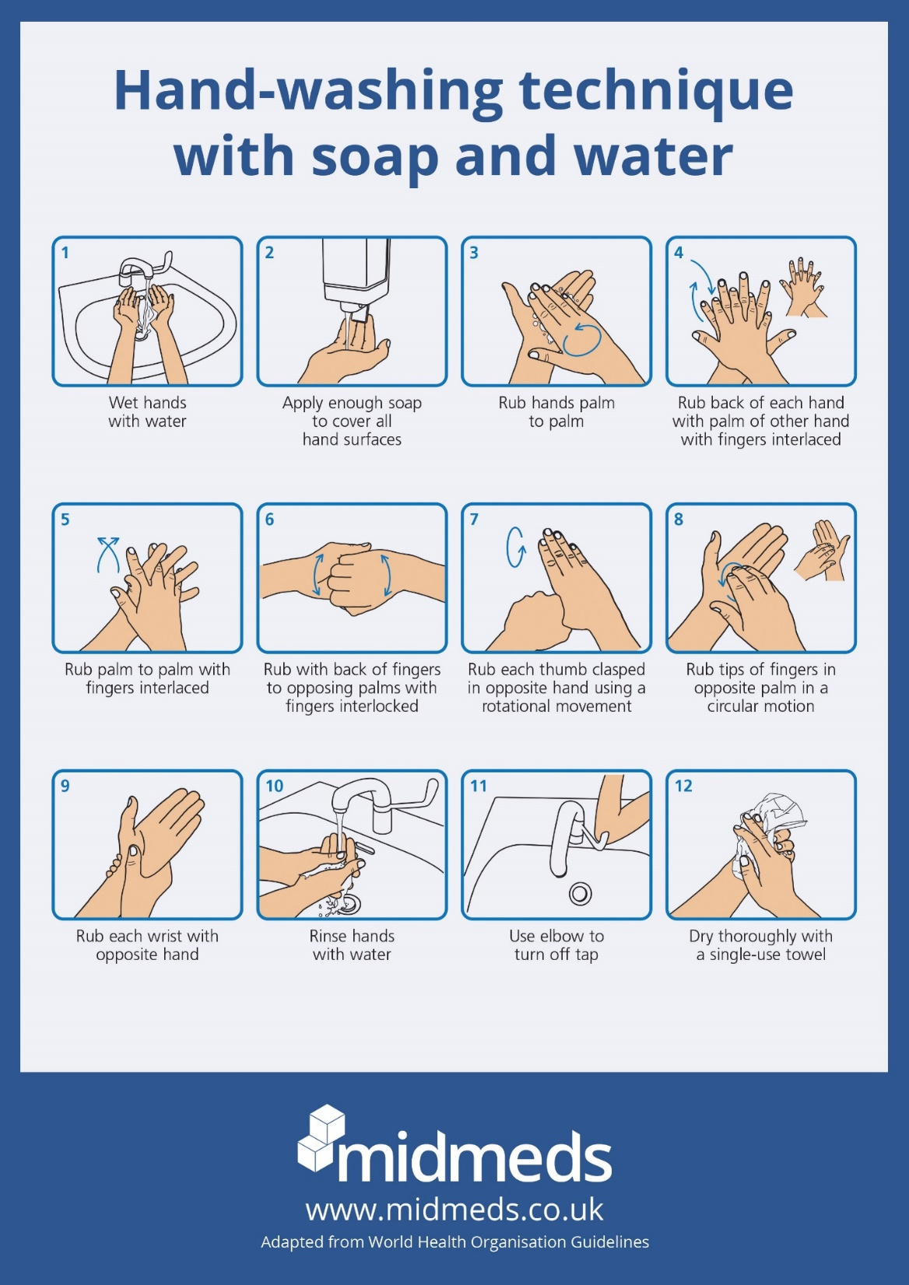

Slide 29
Mt. 28:18-20 | Nathan L Morrison @ www.courthousechurchofchrist.com Examples Of Conversion |  |  |  |  | Mk. 16:15-16
Examples | Hear | Believe | Repent | Confess | Baptized | Mark 16:16
Pentecost Acts 2:14-41 | 2:37 | 2:37 | 2:38 |  | 2:38, 41 | Believed (2:37) & Baptized (2:41)
Samaritans Acts 8:5-14 | 8:6 | 8:12 |  |  | 8:12 | Believed (8:12) & Baptized (8:12)
Simon Acts 8:13 | 8:6 | 8:13 | 8:9 |  | 8:13 | Believed (8:13) & Baptized (8:13)
Eunuch Acts 8:26-39 | 8:34-35 | 8:37 |  | 8:37 | 8:38 | Believed (8:37) & Baptized (8:38)
Saul Acts 9:1-18; 22:10-16; 26:2-21; Gal. 1:23; I Tim. 1:13 | 22:10, 15 | 9:11 | Gal. 1:23 I Tim. 1:13 | 22:10 | 22:16; 9:18 | Believed (9:11: “praying”) & Baptized (9:18)
Cornelius Acts 10:1-48 | 10:33 | 10:43 |  |  | 10:48 | Believed (10:43) & Baptized (10:48)
Sergius Paulus Acts 13:4-12 | 13:7 | 13:12 (2:38; 10:43) |  |  |  | Believed (13:12)
Lydia Acts 16:13-15 | 16:14 | 16:15 |  |  | 16:15 | Believed (16:15) & Baptized (16:15)
Jailer Acts 16:25-34 | 16:30 | 16:34 | 16:33 |  | 16:33 | Believed (16:34) & Baptized (16:33)
Corinthians Acts 18:8 | 18:8 | 18:8 |  |  | 18:8 | Believed (18:8) & Baptized (18:8)
Galatians Galatians 3:26-27 |  | 3:26 |  |  | 3:27 | Believed (3:26) & Baptized (3:27)
Ephesians Acts 19:4-5 | 19:5 | 19:4 |  |  | 19:5 | Believed (19:4) & Baptized (19:5)
Colossians Col. 1:5-10; 2:11-12 | 1:5-6 | 1:4; 2:12 |  |  | 2:12 | Believed (1:4) & Baptized (2:12)

