Slide 1
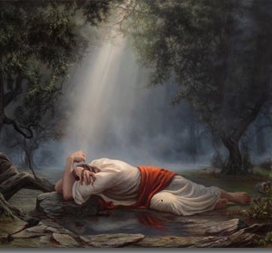
Man Of Sorrows Text: Isaiah 52-53
Notes:
By Nathan L Morrison for Sunday April 9, 2023
All Scripture given is from NASB unless otherwise stated
For further study, or if questions, please Call: 804-277-1983 or Visit www.courthousechurchofchrist.com

Slide 2
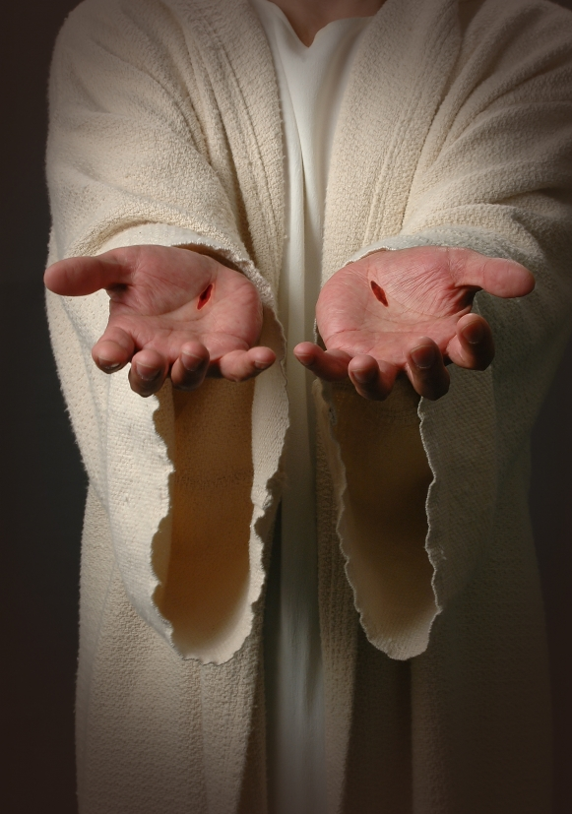
Intro
The Suffering Servant in Isaiah:
The Servant Has A Mission (Isaiah 42:1-7)
The Servant Has Great Difficulties In His Mission (Isaiah 49:1-7)
The Servant Will Suffer (Isaiah 50:4-10)
The next section: Isaiah 53 has often been called the “Suffering Servant” passage, or “Man of Sorrows”

Slide 3
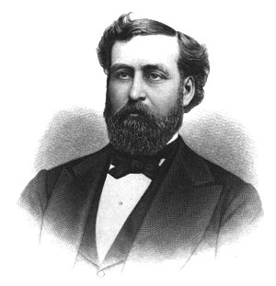
Intro
Philip P. Bliss (1838-1876):
“HALLELUJAH! WHAT A SAVIOR!” (1875)
Philip Paul Bliss was a traveling music teacher.
He became well-known as a hymnist.
Shortly before he died he became a full-time evangelist (Presbyterian).
A month before he died he sang his hymn, “Hallelujah! What A Savior!” to inmates at the Michigan State Prison. (No background story is known on the hymn)
He and his wife, Lucy, were in a tragic train wreck in 1876. Bliss initially survived but went back in to save his wife. Both perished.
The hymn he left behind reminds us of the Suffering Servant, the “Man of Sorrows” from Isaiah 53 and the reason He would suffer!
Notes:
Read the article on Philip P. Bliss (1838-1876)
Sources:
http://franklin-church.org/articles/hymn-studies/81-hallelujah-what-a-savior
http://en.wikipedia.org/wiki/Philip_Bliss
Then Sings My Soul, Book 2, p. 152-155 by Robert J. Morgan

Slide 4
Intro
The Suffering Servant had to suffer to take away the sins of the world!

Slide 5
The Servant Suffers For Sin
Isaiah 52:13: The Servant will be “high and lifted up and greatly exalted”
Resurrection (Rom. 1:3-4)
Ascension (Acts 1:9)
Seated at the right hand of God (Acts 2:33; Heb. 1:3)

Slide 6
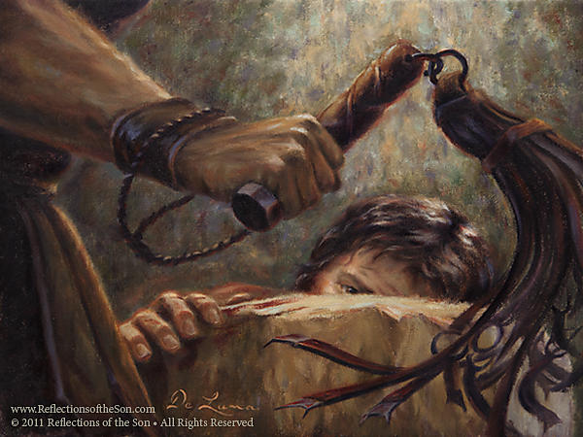
The Servant Suffers For Sin
Isaiah 52:14: “His visage was marred more than any man”
Jesus was scourged (Jn. 19:1)
Roman Scourge: Insides seen on outside (Ps. 22:17)
“By His scourging we are healed” (Isaiah 53:5)
The Servant will not remain in humiliation (Phil. 2:9-11; Acts 3:13-15, 26)

Slide 7
The Servant Suffers For Sin
Isaiah 52:15: He would “sprinkle” many nations
Ritual purity
Jesus fulfilled the promise to Abraham to bless all the nations (Gal. 3:8-14)

Slide 8
The Servant Suffers For Sin
Isaiah 53:1-2: Men would misjudge Him
There was no physical beauty that drew others to Him (Jn. 12:32: His death would draw)

Slide 9
The Servant Suffers For Sin
Isaiah 53:3-4: “He was despised and forsaken of men, a man of sorrows and acquainted with grief”
He was “grieved and distressed” (Mt. 26:37-38)

Slide 10
The Servant Suffers For Sin
Isaiah 53:5: “Pierced” and “crushed” describe a violent and agonizing death
Scourged then crucified
Jesus falls under the weight of the cross beam
Simon of Cyrene is compelled to carry it for Jesus (Lk. 23:26)
Golgotha, the “place of the skull” (Lk. 23:33)

Slide 11
The Servant Suffers For Sin
Isaiah 53:6: The Servant suffers for our sins!
He bore our sins in His body and brought us back to God! (Eph. 2:13-16; I Pet. 2:21-24)

Slide 12
The Servant Suffers For Sin
Isaiah 53:7-8: Oppressed & afflicted (Jn. 10:15-18)
Slain for the transgression of the people, to whom the stroke was due (Isaiah 53:8)
Heb. 12:1-3: For the “joy set before Him” He endured the cross and sat down at the right hand of God!
The “joy” before Him was the redemption of mankind (Eph. 1:7)

Slide 13
The Servant Suffers For Sin
Isaiah 53:9: “They made His grave with the wicked—but with the rich at His death”
Crucified with two thieves (Mk. 15:27)
Buried in the tomb of Joseph of Arimathea (Mt. 27:57)

Slide 14
The Servant Suffers For Sin
Isaiah 53:10-12: Hope and Majesty came from His sorrows
Forgiveness of sin (Jn. 1:29; Eph. 1:7)
Spiritual posterity (Rom. 8:14-17)
“Made intercession for the transgressors” (Lk. 23:34; Heb. 7:25)
He rose from the dead, lives forever & is highly exalted (Is. 52:13; Phil. 2:8-11; Heb. 12:2)
He established the throne of David forever (II Sam. 7:12-16; Acts 2:29-32; Heb. 1:3)

Slide 15
The Servant Suffers For Sin
The “Man of Sorrows” had a mission, would have difficulties and suffering in carrying out that mission, but prevailed and redeemed mankind from their sins and now sits on His throne forever at the right hand of God!

Slide 16
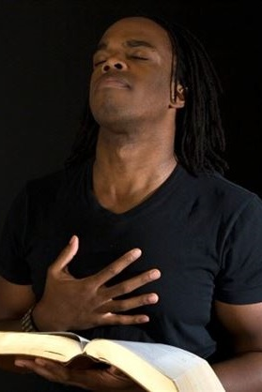
Conclusion
It is exciting to see the prophecy concerning Jesus’ suffering and purpose come to pass, knowing this is what the Ethiopian Eunuch was studying, and what Philip taught him when he “preached Jesus to him” (Acts 8:35)
The fruits and end of the Suffering Servant were the complete reverse of what anyone would have expected!

Slide 17
Conclusion
The hope for today: The empty tomb! (Luke 24:1-7)
Jesus died a Servant, was raised in power, and reigns with ALL authority in heaven and earth, and will one day return to judge the nations as a Mighty King! (Mt. 25:31-46; 28:18-20; Rev. 19:16)

Slide 18
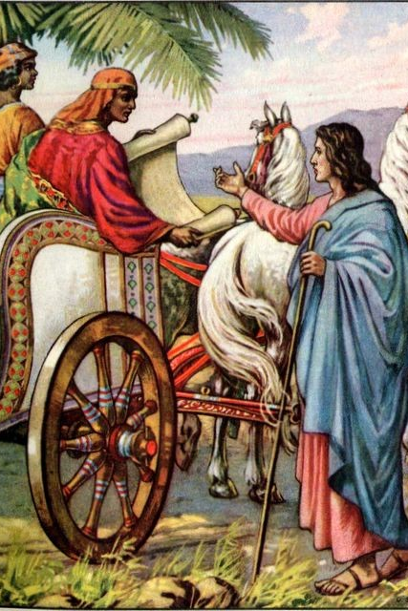
Conclusion
This study of the Son of God (Isaiah 53) converted a Jewish proselyte on his way back to Ethiopia (Acts 8:36-39) and has continued to change lives ever since!

Slide 19
Conclusion
What change will it effect in your life?
Let us shout, “Hallelujah! What a Savior!”

Slide 20
Conclusion
Jesus Christ (the Man of Sorrows, the Suffering Servant) died for your sins!
Have you obeyed the gospel?

Slide 21
“What Must I Do To Be Saved?”
Hear The Gospel (Jn. 5:24; Rom. 10:17)
Believe In Christ (Jn. 3:16-18; Jn. 8:24)
Repent Of Sins (Lk. 13:3-5; Acts 2:38)
Confess Christ (Mt. 10:32; Rom. 10:10)
Be Baptized (Mk. 16:16; Acts 22:16)
Remain Faithful (Jn. 8:31; Rev. 2:10)
For The Erring Saint:
Repent (Acts 8:22), Confess (I Jn. 1:9),
Pray (Acts 8:22)

