Slide 1
Help!
Text:
Philippians 4:10-20
Notes:
By Nathan L Morrison for Sunday 12/04/2022
All Scripture given is from NASB unless otherwise stated
For further study, or if questions, please Call: 804-277-1983 or Visit: www.courthousechurchofchrist.com
Image: Wile E Coyote holding a sign that says, Help! (Image used courtesy of Warner Brothers)

Slide 2
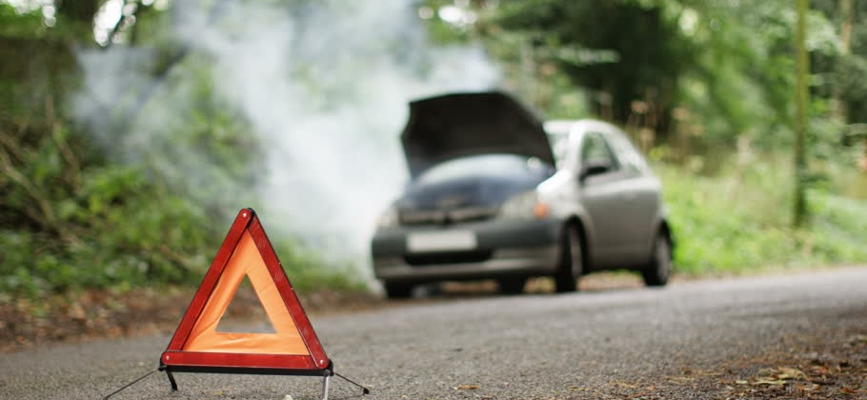
Intro
I need help!
Have you ever had to ask for help?
Have you ever been asked for help?
Have you ever needed help and received it even though you didn’t ask for it?
Have you ever helped out without being asked?

Slide 3
Intro
Christians are to be strong & to help others!
Galatians 6:2
Bear one another's burdens, and thereby fulfill the law of Christ.
Galatians 6:9-10
Let us not lose heart in doing good, for in due time we will reap if we do not grow weary. So then, while we have opportunity, let us do good to all people, and especially to those who are of the household of the faith.
Romans 15:1
Now we who are strong ought to bear the weaknesses of those without strength and not just please ourselves.
Notes:
As Christians we spend time in study and hear that we are to be strong and be willing to help those in need and to look for opportunities to help when the need arises, and to lift up the weak.
Galatians 6:2: Bear one another's burdens, and thereby fulfill the law of Christ.
Galatians 6:9-10: Let us not lose heart in doing good, for in due time we will reap if we do not grow weary. So then, while we have opportunity, let us do good to all people, and especially to those who are of the household of the faith.
Romans 15:1: Now we who are strong ought to bear the weaknesses of those without strength and not just please ourselves.

Slide 4
Intro
Christians are to be strong & to help others!
I Corinthians 16:13
Be on the alert, stand firm in the faith, act like men, be strong.
Ephesians 6:10
Finally, be strong in the Lord and in the strength of His might.
I Thessalonians 5:14
We urge you, brethren, admonish the unruly, encourage the fainthearted, help the weak, be patient with everyone.
Notes:
As Christians we spend time in study and hear that we are to be strong and be willing to help those in need and to look for opportunities to help when the need arises, and to lift up the weak.
Galatians 6:2: Bear one another's burdens, and thereby fulfill the law of Christ.
Galatians 6:9-10: Let us not lose heart in doing good, for in due time we will reap if we do not grow weary. So then, while we have opportunity, let us do good to all people, and especially to those who are of the household of the faith.
Romans 15:1: Now we who are strong ought to bear the weaknesses of those without strength and not just please ourselves.
I Corinthians 16:13: Be on the alert, stand firm in the faith, act like men, be strong.
Ephesians 6:10: Finally, be strong in the Lord and in the strength of His might.
I Thessalonians 5:14: We urge you, brethren, admonish the unruly, encourage the fainthearted, help the weak, be patient with everyone.

Slide 5
Intro
Christians are to be strong & to help others!
Hebrews 12:12-13
Therefore, strengthen the hands that are weak and the knees that are feeble, and make straight paths for your feet, so that the limb which is lame may not be put out of joint, but rather be healed.
Notes:
As Christians we spend time in study and hear that we are to be strong and be willing to help those in need and to look for opportunities to help when the need arises, and to lift up the weak.
Galatians 6:2: Bear one another's burdens, and thereby fulfill the law of Christ.
Galatians 6:9-10: Let us not lose heart in doing good, for in due time we will reap if we do not grow weary. So then, while we have opportunity, let us do good to all people, and especially to those who are of the household of the faith.
Romans 15:1: Now we who are strong ought to bear the weaknesses of those without strength and not just please ourselves.
I Corinthians 16:13: Be on the alert, stand firm in the faith, act like men, be strong.
Ephesians 6:10: Finally, be strong in the Lord and in the strength of His might.
I Thessalonians 5:14: We urge you, brethren, admonish the unruly, encourage the fainthearted, help the weak, be patient with everyone.
Hebrews 12:12-13: Therefore, strengthen the hands that are weak and the knees that are feeble, and make straight paths for your feet, so that the limb which is lame may not be put out of joint, but rather be healed.

Slide 6
Intro
Saints are told to be strong!
To help out whenever we can, to be a burden bearer, to lift up the weak and to encourage the fainthearted!

Slide 7
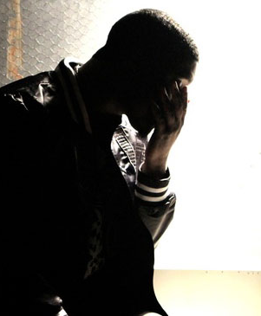
Intro
What about when the strong are weak and need encouraged?
Can anyone say they are strong in the faith 24/7?
How do you ask for help?
How do you tell someone you need encouragement?

Slide 8
Intro
Same traits needed to give & to receive help
Colossians 3:12-14
12. So, as those who have been chosen of God, holy and beloved, put on a heart of compassion, kindness, humility, gentleness and patience;
13. bearing with one another, and forgiving each other, whoever has a complaint against anyone; just as the Lord forgave you, so also should you.
14. Beyond all these things put on love, which is the perfect bond of unity.
If one has a hard, prideful or independent heart so as to not accept help from someone else, then they won’t accept from God, who provided the best help we could get: Jesus!

Slide 9
Intro
All of us at some point in our lives need help and prayers on our behalf and we should ask for it and accept it!

Slide 10
Thanks for the Help!
Wrote to the Philippian saints from a Roman prison
Church at Philippi established by Paul on his 2nd missionary journey
Letter has no rebuke but encouragement and thanksgiving
Paul:
Strong and stalwart in the faith
His letter to the Philippians reads almost like a love letter (1:3-11) or a Mission Report (2:19-30; 4:10-20)
Notes:
Thanks for the Help!
The apostle Paul (Do we think of Paul as strong or weak?) – Strong and stalwart in the faith.
Paul wrote to the Philippian saints from a Roman prison ca. AD 62 (one of the Prison Epistles) – Phil. 1:12-14
His letter contains no rebuke or correction but words of encouragement and thanksgiving.
The Lord’s church at Philippi was established by Paul on his second “missionary” journey in about AD 51 (52) in Acts 16.
He had set out from Antioch of Syria and had traveled by land to revisit the churches, which he had planted on 1st missionary journey (Acts 16:1-10: Timothy joined at Lystra).
They sailed from Troas, and evidently with a favorable wind, crossed the Aegean Sea in 2 days to Neapolis (usually took 5 days), and from there traveled inland to Philippi (Acts 16:11-12).
Philippi did not have enough Jewish citizens to have a synagogue (required 10 married men).
Acts 16:13-15: There was a meeting place for prayer just outside the city by the river (Gangitis) where Paul met Lydia and a group of women – preached the gospel to them!
Lydia & her household became the first European converts (recorded), and were later joined by the jailer & his household (when Paul was released from jail in Acts 16:16-34).
Paul revisited the city on at least two occasions (Acts 20:6; II Corinthians 2:13).
His letter to the Philippians reads almost like a love letter (1:3-11) or a Mission Report (2:19-30; 4:10-20) and contains some of his most personal words recorded by the Holy Spirit.

Slide 11
Thanks for the Help!
Philippians 4:10-20 (vss. 10-15)
10. But I rejoiced in the Lord greatly, that now at last you have revived your concern for me; indeed, you were concerned before, but you lacked opportunity.
11. Not that I speak from want, for I have learned to be content in whatever circumstances I am.
12. I know how to get along with humble means, and I also know how to live in prosperity; in any and every circumstance I have learned the secret of being filled and going hungry, both of having abundance and suffering need.
13. I can do all things through Him who strengthens me.
14. Nevertheless, you have done well to share with me in my affliction.
15. You yourselves also know, Philippians, that at the first preaching of the gospel, after I left Macedonia, no church shared with me in the matter of giving and receiving but you alone;
Notes:
Philippians 4:10-20
He had needed help while preaching and they provided it in abundance, and he was thankful!
The kind of help he needed was financial or other material blessings.
He thanked the saints at Philippi for sending a gift for his needs more than once and said the gift itself wasn't the benefit but their opportunity to share with him benefitted them to the glory of God.
Paul says he learned to be content in whatever circumstances he finds himself.
He said they wanted to help before but lacked opportunity.
Then when he was in Thessalonica they took the opportunity and sent a gift to him more than once by the hands of Epaphroditus, and were the only ones to share with him in that way.
He said their gift amply supplied him and he had an abundance, and their helping him out was a well-pleasing sacrifice to God.
If he had refused help because he was “strong” he would have deprived them of being pleasing to God.
He obviously needed their help because he said in 4:14 that they shared in his “affliction,” so he was in need.
He says their gift of love pleased him and it pleased God and that God will reward them for their generosity.
I Corinthians 9:14: Paul wrote to the saints at Corinth, “So also the Lord directed those who proclaim the gospel to get their living from the gospel.”
How does a preacher do that? From the members of the congregation he works with or from members of other congregations that want to share in that work, such as the saints at Philippi.
A preacher can be what he is from the generosity of the members of the church!

Slide 12
Thanks for the Help!
Philippians 4:10-20 (vss. 16-20)
16. for even in Thessalonica you sent a gift more than once for my needs.
17. Not that I seek the gift itself, but I seek for the profit which increases to your account.
18. But I have received everything in full and have an abundance; I am amply supplied, having received from Epaphroditus what you have sent, a fragrant aroma, an acceptable sacrifice, well-pleasing to God.
19. And my God will supply all your needs according to His riches in glory in Christ Jesus.
20. Now to our God and Father be the glory forever and ever. Amen.
Notes:
Philippians 4:10-20
He had needed help while preaching and they provided it in abundance, and he was thankful!
The kind of help he needed was financial or other material blessings.
He thanked the saints at Philippi for sending a gift for his needs more than once and said the gift itself wasn't the benefit but their opportunity to share with him benefitted them to the glory of God.
Paul says he learned to be content in whatever circumstances he finds himself.
He said they wanted to help before but lacked opportunity.
Then when he was in Thessalonica they took the opportunity and sent a gift to him more than once by the hands of Epaphroditus, and were the only ones to share with him in that way.
He said their gift amply supplied him and he had an abundance, and their helping him out was a well-pleasing sacrifice to God.
If he had refused help because he was “strong” he would have deprived them of being pleasing to God.
He obviously needed their help because he said in 4:14 that they shared in his “affliction,” so he was in need.
He says their gift of love pleased him and it pleased God and that God will reward them for their generosity.
I Corinthians 9:14: Paul wrote to the saints at Corinth, “So also the Lord directed those who proclaim the gospel to get their living from the gospel.”
How does a preacher do that? From the members of the congregation he works with or from members of other congregations that want to share in that work, such as the saints at Philippi.
A preacher can be what he is from the generosity of the members of the church!

Slide 13
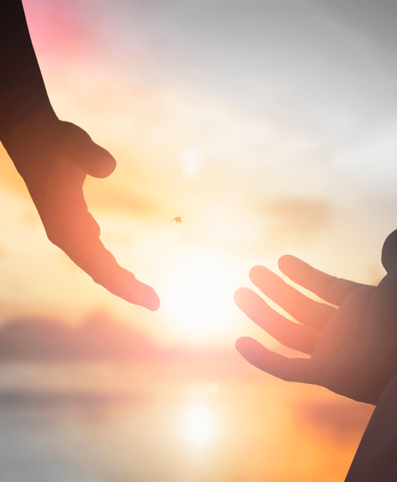
Thanks for the Help
He thanked the saints at Philippi for sending a gift for his needs more than once and said the gift itself wasn't the benefit but their opportunity to share with him benefitted them to the glory of God
Their gift amply supplied him and he had an abundance, and their helping him out was a well-pleasing sacrifice to God
If he had refused help because he was “strong” he would have deprived them of being pleasing to God

Slide 14
A Lesson For Us
If we don't accept help, we deprive someone of the benefit of helping.
Paul was humble and grateful & he praised them and praised God for them.
If we have a humble heart we will accept help, whether we ask for it or not, and if we have a grateful heart we will thank those who helped us and thank God! (Colossians 3:12-14)

Slide 15
Thanks for the Help!
As we may be quick to lend help, let us also have the humble heart to ask for help when we need it!

Slide 16
Thanks for the Prayers!
Ephesians 6:18-20 (He may speak the gospel with boldness)
I Thessalonians 5:25 (Requested prayers)
Colossians 4:2-4 (Opportunity and that he would know how to say it)
II Thessalonians 3:1-2 (To teach and be safe)
Paul wanted brethren to pray for him as he prayed for them!
Notes:
Thanks for the Help!
Thanks for the Prayers!
Paul set the example in praying for the saints and asking for prayers of the saints!
Paul wanted brethren to pray for him as he prayed for them.
Ephesians 6:18-20: Paul stated that we need to pray for all the saints, and he even asked for the prayers of the Ephesians on his behalf: “…pray on my behalf, that utterance may be given to me in the opening of my mouth, to make known with boldness the mystery of the gospel, for which I am an ambassador in chains; that in proclaiming it I may speak boldly, as I ought to speak.”
Paul asked for prayers that he may speak the gospel with boldness!
Colossians 4:2-4: Here, Paul says to pray with alertness and thanksgiving, and then asked the saints at Colosse to pray for him: “…praying at the same time for us as well, that God will open up to us a door for the word, so that we may speak forth the mystery of Christ, for which I have also been imprisoned; that I may make it clear in the way I ought to speak.”
Here, Paul asks for prayers that opportunity for teaching the gospel will arise and that when it does, he and those with him will know how to speak and make it clear!
I Thessalonians 5:15: Paul simply asks, “Brethren, pray for us.”
II Thessalonians 3:1-2: “Finally, brethren, pray for us that the word of the Lord will spread rapidly and be glorified, just as it did also with you; and that we will be rescued from perverse and evil men; for not all have faith.”
a. Paul asks the saints at Thessalonica for their prayers on his behalf and those traveling with him that they would teach the word of God and be kept safe

Slide 17
Thanks for the Prayers!
II Corinthians 1:8-11
8. For we do not want you to be unaware, brethren, of our affliction which came to us in Asia, that we were burdened excessively, beyond our strength, so that we despaired even of life;
9. indeed, we had the sentence of death within ourselves so that we would not trust in ourselves, but in God who raises the dead;
10. who delivered us from so great a peril of death, and will deliver us, He on whom we have set our hope. And He will yet deliver us,
11. you also joining in helping us through your prayers, so that thanks may be given by many persons on our behalf for the favor bestowed on us through the prayers of many.
Notes:
Paul also gave thanks for the prayers lifted up to God on his behalf as well as saints thinking of him.
II Corinthians 1:8-11: For we do not want you to be unaware, brethren, of our affliction which came to us in Asia, that we were burdened excessively, beyond our strength, so that we despaired even of life; indeed, we had the sentence of death within ourselves so that we would not trust in ourselves, but in God who raises the dead; who delivered us from so great a peril of death, and will deliver us, He on whom we have set our hope. And He will yet deliver us, you also joining in helping us through your prayers, so that thanks may be given by many persons on our behalf for the favor bestowed on us through the prayers of many.
Paul thanks the saints at Corinth for their prayers and calls it “help” when he and his companions were in a “life or death” situation that was beyond their strength. They trusted in God but also thanked the saints for their part of praying for them.
I Thessalonians 3:6-10: But now that Timothy has come to us from you, and has brought us good news of your faith and love, and that you always think kindly of us, longing to see us just as we also long to see you, for this reason, brethren, in all our distress and affliction we were comforted about you through your faith; for now we really live, if you stand firm in the Lord. For what thanks can we render to God for you in return for all the joy with which we rejoice before our God on your account, as we night and day keep praying most earnestly that we may see your face, and may complete what is lacking in your faith?
Paul had been afraid that persecution and affliction would tempt the brethren away from the Lord at Thessalonica (2-3:1-5) so he sent Timothy to them, and he brought back a good report of their faith.
Timothy not only brought back a good report of their faith and love for all the saints (1:2-10) but also of their kind thoughts for Paul and his companions. Paul thanked God for them and longed to see them as they longed to see him again.

Slide 18
Thanks for the Prayers!
I Thessalonians 3:6-10
6. But now that Timothy has come to us from you, and has brought us good news of your faith and love, and that you always think kindly of us, longing to see us just as we also long to see you,
7. for this reason, brethren, in all our distress and affliction we were comforted about you through your faith;
8. for now we really live, if you stand firm in the Lord.
9. For what thanks can we render to God for you in return for all the joy with which we rejoice before our God on your account,
10. as we night and day keep praying most earnestly that we may see your face, and may complete what is lacking in your faith?
Notes:
Paul also gave thanks for the prayers lifted up to God on his behalf as well as saints thinking of him.
II Corinthians 1:8-11: For we do not want you to be unaware, brethren, of our affliction which came to us in Asia, that we were burdened excessively, beyond our strength, so that we despaired even of life; indeed, we had the sentence of death within ourselves so that we would not trust in ourselves, but in God who raises the dead; who delivered us from so great a peril of death, and will deliver us, He on whom we have set our hope. And He will yet deliver us, you also joining in helping us through your prayers, so that thanks may be given by many persons on our behalf for the favor bestowed on us through the prayers of many.
Paul thanks the saints at Corinth for their prayers and calls it “help” when he and his companions were in a “life or death” situation that was beyond their strength. They trusted in God but also thanked the saints for their part of praying for them.
I Thessalonians 3:6-10: But now that Timothy has come to us from you, and has brought us good news of your faith and love, and that you always think kindly of us, longing to see us just as we also long to see you, for this reason, brethren, in all our distress and affliction we were comforted about you through your faith; for now we really live, if you stand firm in the Lord. For what thanks can we render to God for you in return for all the joy with which we rejoice before our God on your account, as we night and day keep praying most earnestly that we may see your face, and may complete what is lacking in your faith?
Paul had been afraid that persecution and affliction would tempt the brethren away from the Lord at Thessalonica (2-3:1-5) so he sent Timothy to them, and he brought back a good report of their faith.
Timothy not only brought back a good report of their faith and love for all the saints (1:2-10) but also of their kind thoughts for Paul and his companions. Paul thanked God for them and longed to see them as they longed to see him again.

Slide 19
A Lesson For Us
Paul had a humble and grateful heart -- he prayed for others, asked for prayers on his behalf, & thanked saints for their love towards him.
If we have a humble heart we will ask for prayers when we need strength and help.
If we have a grateful heart we will be thankful to those who prayed for us, and thank God for His blessings.

Slide 20
Thanks for the Prayers!
Let us ask for the prayers of the saints and be thankful for their concern and love for us!

Slide 21
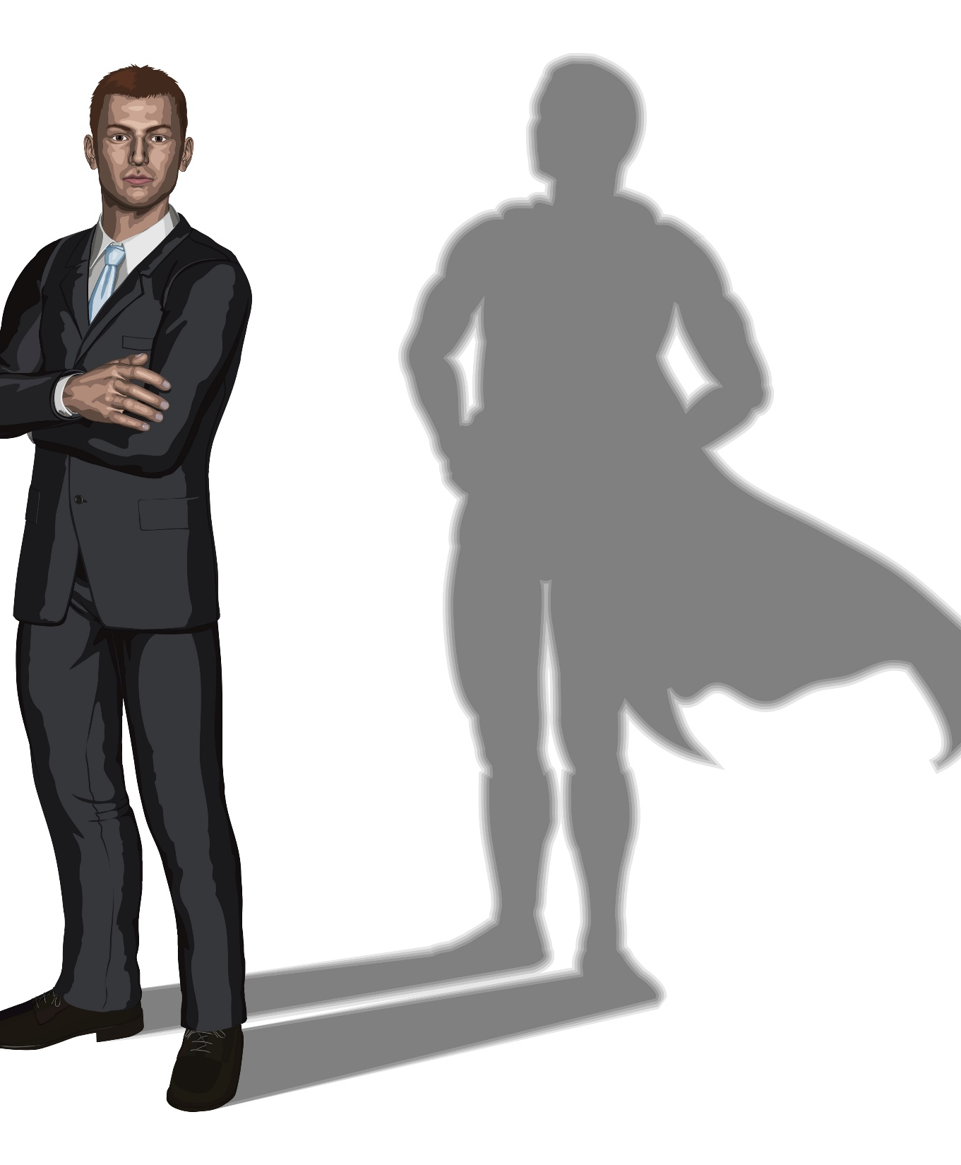
Conclusion
We think of Paul as one of the strong ones, yet he goes on to give thanks for the help and prayers he received!
Do we think any less of Paul for needing help?
Notes:
Don’t think less of the one who needs help for we either have all been there at one time or another or will be!

Slide 22
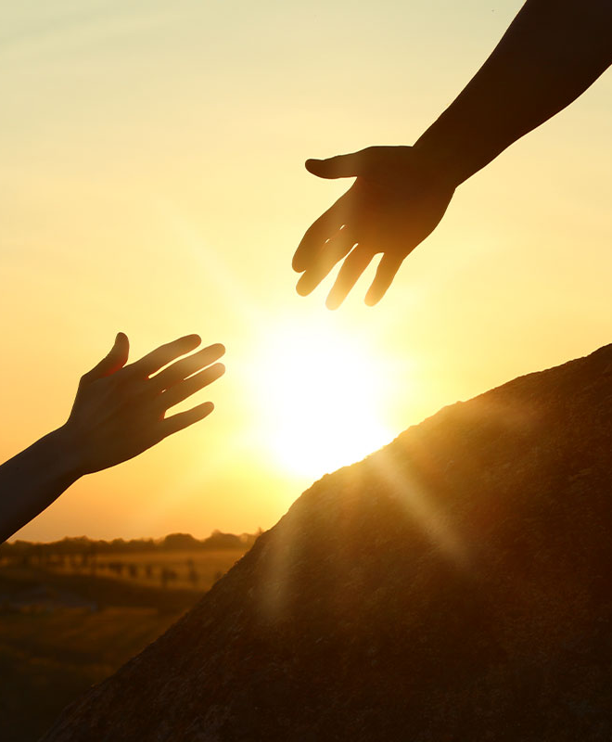
Conclusion
If we are to let others fulfill their role of a burden bearer we need to tell them our cares!
If we are to give others the opportunity to help then we need to be humble enough to ask for help!
Notes:
Don’t think less of the one who needs help for we either have all been there at one time or another or will be!

Slide 23
Conclusion
In all things, whether we are in the season of being the burden bearer or needing a burden bearer, we are to give thanks! (Colossians 3:17)
We are to accept the help from God and accept help from our brethren!

Slide 24
“What Must I Do To Be Saved?”
Hear The Gospel (Jn. 5:24; Rom. 10:17)
Believe In Christ (Jn. 3:16-18; Jn. 8:24)
Repent Of Sins (Lk. 13:3-5; Acts 2:38)
Confess Christ (Mt. 10:32; Acts 8:37)
Be Baptized (Mk. 16:16; Acts 22:16)
Remain Faithful (Jn. 8:31; Rev. 2:10)
For The Erring Saint:
Repent (Acts 8:22), Confess (I Jn. 1:9),
Pray (Acts 8:22)

