Slide 1
Surprises At Judgment
Text:
Matthew 25:34, 41, 46
Notes:
By Nathan L Morrison
All Scripture given is from NASB unless otherwise stated
For further study, or if questions, please Call: 804-277-1983 or Visit www.courthousechurchofchrist.com
Adapted from a lesson by Richie Thetford

Slide 2
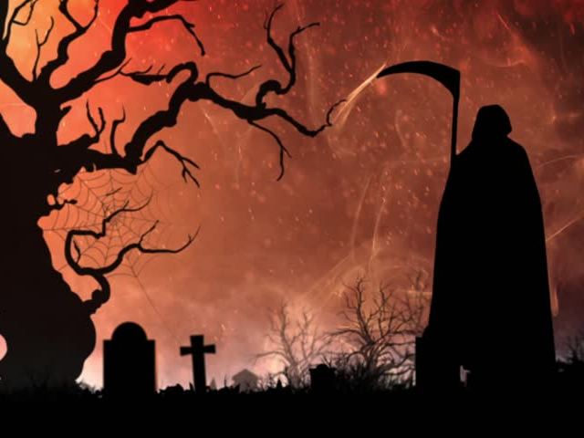
Intro
Funerals get us contemplating the Frailty of Life
Death comes for:
The Faithful
The Lost

Slide 3
Matthew 25:34, 41, 46
Intro
34. "Then the King will say to those on His right, 'Come, you who are blessed of My Father, inherit the kingdom prepared for you from the foundation of the world.
41. "Then He will also say to those on His left, 'Depart from Me, accursed ones, into the eternal fire which has been prepared for the devil and his angels;
46. "These will go away into ETERNAL punishment, but the righteous into ETERNAL life."
Notes:
Emphasis in Scripture Mine

Slide 4
Intro
Eternal: Gr. aionios (G166):
“perpetual (also used of past time, or past and future as well): eternal, eternity, forever, everlasting, world (began); age-long.”
Matthew 25:41, 46
John 3:16
II Thessalonians 1:9
Notes:
Eternal (G166)
aiōnios [ahee-o'-nee-os]
From G165; perpetual (also used of past time, or past and future as well): - eternal, for ever, everlasting, world (began).

Slide 5
Intro
Many people don’t believe in Hell
Others believe the soul dies with the body
Some limit the scope of Hell to “annihilation”
If Hell is for a short time or non-existent, then so is Heaven!
Same word for eternal used of both!
Notes:
Eternal (G166)
aiōnios [ahee-o'-nee-os]
From G165; perpetual (also used of past time, or past and future as well): - eternal, for ever, everlasting, world (began).

Slide 6
Intro
There will be quite a few people surprised at the Judgment of Jesus Christ!

Slide 7
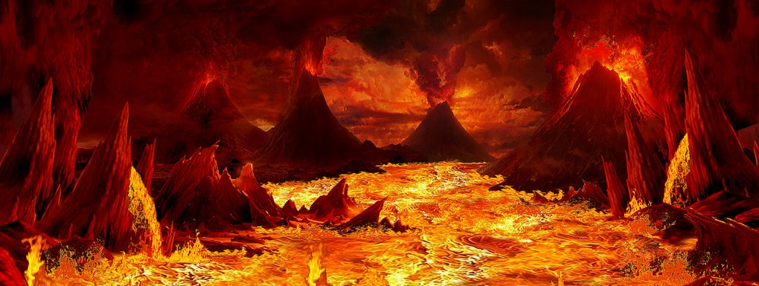
People Found IN Hell
Hell will be filled with:
Immoral & Unbelieving Souls (I Cor. 6:9-10; Rev. 21:8)
Good Moral People (Acts 10:1-2; John 8:24)
Devoutly Religious People (Rom. 10:1-3; Mt. 7:21-23)
Fallen Away Christians (II Pet. 2:20-22; Heb. 6:4-6; 10:26-27)
Lukewarm Christians (Rev. 3:15-16, 19)
Hypocrites (Mt. 23:15)
False Teachers (II John 9)

Slide 8
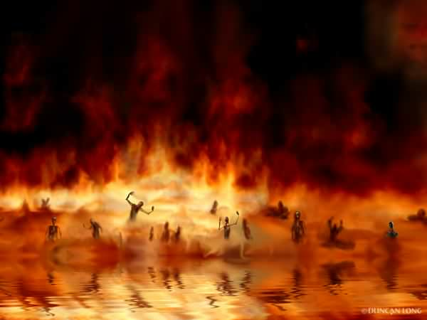
People Found IN Hell
Hell will be filled with:
Immoral & Unbelieving Souls
Good Moral People
Devoutly Religious People
Fallen Away Christians
Lukewarm Christians
Hypocrites
False Teachers
These are the people Christ will part to the left and condemn to the place of eternal punishment reserved for Satan and his angels (Mt. 25:41) –
Quite the eternal company!

Slide 9
People NOT Found In Hell
Unbelievers (Is. 45:23; Rom. 14:11; Phil. 2:9-11)
Faithful Christians (II Tim. 4:7-8; Rev. 2:10)
EVERY KNEE WILL BOW & EVERY TONGUE WILL CONFESS THAT JESUS CHRIST IS LORD! (Philippians 2:9-11)
Wouldn’t you want to NOT be found in Hell?

Slide 10
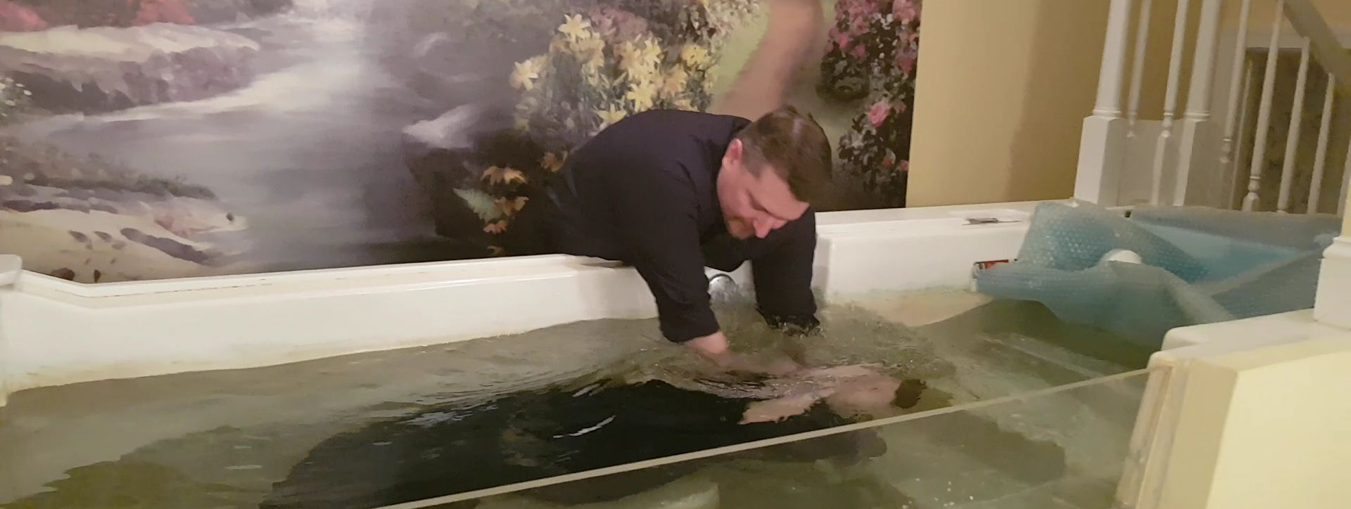
The Solution
The solution requires belief, repentance, and obedience!
To the unbeliever (including those who “fear God” – Acts 10:2)
Obey the gospel to avoid the judgment for not obeying – Heb. 5:9; II Thess. 1:7-9
To the Christian who struggles or sins
Be alert & sober (I Pet. 5:8-9)
Be active (I Cor. 15:58)
Repent and seek forgiveness when you sin! (I Jn. 1:9)

Slide 11
Conclusion
Hell is a scary, eternal abode, and to those who do not fear the Lord, it will become their soul’s eternal home!
We sometimes think only the “terrible people” are going to Hell – and they are!
ALL who do not fully obey Him are terrible in God’s eyes!
We need to remember we will be judged not by man’s standards of goodness, but God’s (Rom. 2:16)

Slide 12
Conclusion
Hell is the punishment we should fear and dread and do all we can to avoid it!
Mt. 7:13-14: Two roads: the broad road leads to destruction (eternal – II Thess. 1:9)

Slide 13
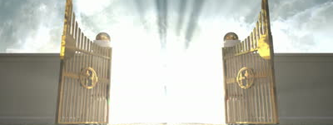
Conclusion
Heaven is the bliss we long for:
Rev. 21:3-4: A home without pain & suffering, no tears or death! (Rom. 2:7)
Rev. 21:7: It is reserved for the one who overcomes! (I Pet. 1:4)
Rev. 22:5: The contrast to the darkness of Hell: no need for light in Heaven for God is the light, and there will never be darkness there!

Slide 14
II Corinthians. 5:10-11
Conclusion
10. For we must all appear before the judgment seat of Christ, so that each one may be recompensed for his deeds in the body, according to what he has done, whether good or bad.
11. Therefore, knowing the fear of the Lord, we persuade men, but we are made manifest to God; and I hope that we are made manifest also in your consciences.

Slide 15
Conclusion
What will be the judgment rendered unto you?
Will your name be recorded in the Lamb’s Book of Life? (Revelation 20:15)
Will you be numbered with those reserved for Hell’s eternity? (Matthew 25:41)

Slide 16
Conclusion
You get to choose where you will spend eternity!
Choose wisely!
Don’t be Surprised!

Slide 17
“What Must I Do To Be Saved?”
Hear The Gospel (Jn. 5:24; Rom. 10:17)
Believe In Christ (Jn. 3:16-18; Jn. 8:24)
Repent Of Sins (Lk. 13:3-5; Acts 2:38)
Confess Christ (Mt. 10:32; Rom. 10:10)
Be Baptized (Mk. 16:16; Acts 22:16)
Remain Faithful (Jn. 8:31; Rev. 2:10)
For The Erring Saint:
Repent (Acts 8:22), Confess (I Jn. 1:9),
Pray (Acts 8:22)

