Slide 1
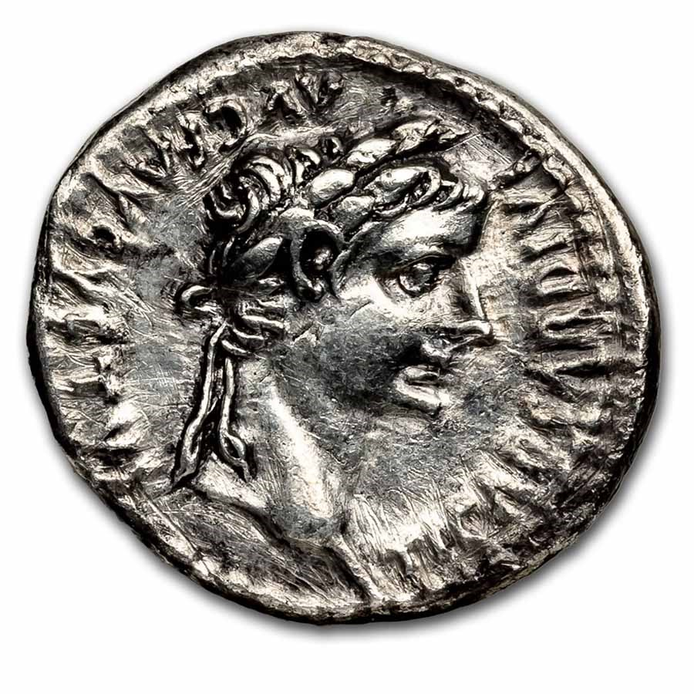
“Render To Caesar…”
Text:
Matthew 22:15-22
Notes:
Prepared by Nathan L Morrison
All Scripture given is from NASB unless otherwise stated
For further study, or if questions, please Call: 804-277-1983 or Visit: www.courthousechurchofchrist.com
Image: Roman Denarius with the likeness of Caesar Tiberius (A.D. 14-37)

Slide 2
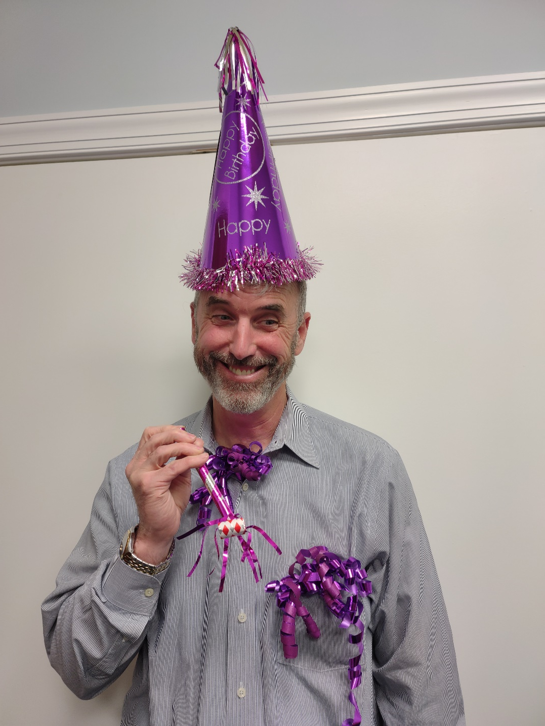
Happy Birthday!
Richard Foy
April 15th
Notes:
Image: Friend of Presenter
Used by permission from Richard Foy, whose birthday is also Tax Day, April 15th

Slide 3
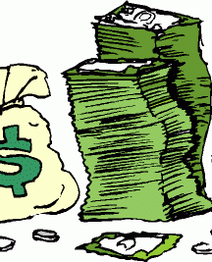
Intro
TAX DAY! April 15th
Many things change over the years…
One thing has not changed: Paying Taxes!
Under the Roman Empire there was a poll tax everyone between 14-65 years of age had to pay simply for existing
Those living in Judea paid two taxes: the Roman taxes and the Temple taxes!
Jesus was no exception – He had to pay taxes while on earth too!
He was asked on a couple of occasions if He paid taxes…

Slide 4
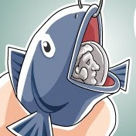
Intro
Matthew 17:24-27
24 When they came to Capernaum, those who collected the two-drachma tax came to Peter and said, "Does your teacher not pay the two-drachma tax?"
25 He said, "Yes." And when he came into the house, Jesus spoke to him first, saying, "What do you think, Simon? From whom do the kings of the earth collect customs or poll-tax, from their sons or from strangers?"
26 When Peter said, "From strangers," Jesus said to him, "Then the sons are exempt.
27 "However, so that we do not offend them, go to the sea and throw in a hook, and take the first fish that comes up; and when you open its mouth, you will find a shekel. Take that and give it to them for you and Me."
If only paying our taxes were so easy, we would all be fishermen!

Slide 5
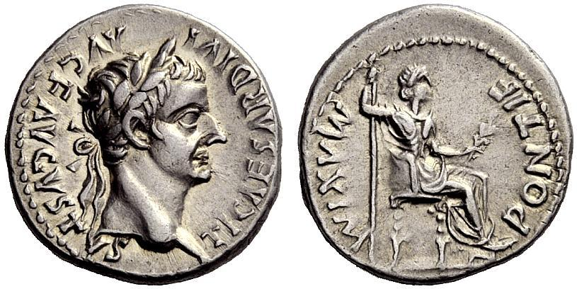
Intro
Matthew 22:17-22
17 "Tell us then, what do You think? Is it lawful to give a poll-tax to Caesar, or not?"
18 But Jesus perceived their malice, and said, "Why are you testing Me, you hypocrites?
19 "Show Me the coin used for the poll-tax." And they brought Him a denarius.
20 And He said to them, "Whose likeness and inscription is this?"
21 They said to Him, "Caesar's." Then He said to them, "Then render to Caesar the things that are Caesar's; and to God the things that are God's."
22 And hearing this, they were amazed, and leaving Him, they went away.
Notes:
Image:
Roman Denarius with the likeness of Caesar Tiberius (A.D. 14-37)
Roman Denarius with the likeness of Caesar Tiberius (A.D. 14-37) depicting both front and reverse

Slide 6
Intro
The lesson for us is this: it doesn’t matter who the government is, we will pay taxes to keep it!

Slide 7
One Can Know the Things That Belong to “Caesar”
How would the people know what should be given to Caesar?
Luke 2:1: Caesar would give instructions (census).
Caesar would say when, where, and how much
He had people who collected the taxes called “Publicans”
The Jews hated the publicans and considered them as sinners and as low as Gentiles
The Jews paid taxes to their kings (I Samuel 8:10-18) – they must have forgotten that!
Notes:
Roman Denarius with Tiberius on the front (AD 14-37)

Slide 8
One Can Know the Things That Belong to “Caesar”
When a new Caesar took the throne, usually he changed the currency to his likeness (Matthew 22:20-21), which at this time was Caesar Tiberius (A.D. 14-37)
The money with the face of the old Caesar was still valid, but they tried to phase it out as fast as possible.
The people would know to whom they were paying taxes
Taxes are still around today and as citizens we are expected to pay taxes! (I Peter 2:12-20)

Slide 9
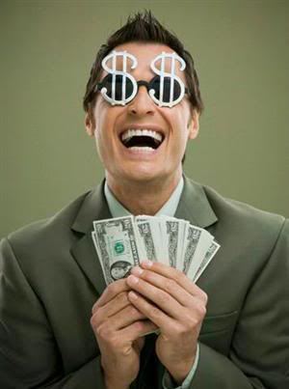
Jesus Said to Pay Taxes (“Render to Caesar”)
There are those who teach that because saints are citizens of Heaven (Philippians 3:20) they are exempt from paying earthly taxes!
(Matthew 22:21: This is not taught in the word of God!)

Slide 10
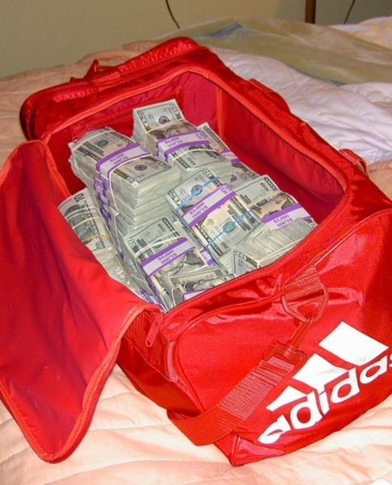
Jesus Said to Pay Taxes (“Render to Caesar”)
Paul said saints are to pay taxes for four reasons in Romans 13:1-7:
Romans 13:5: There are consequences if one resists the government (“wrath”)
Romans 13:5: The conscience of the Christian should be clear (Phil. 2:15; I Pet. 2:12-20)
Romans 13:6: Governments are called “servants of God”
Romans 13:7: We are to render to all what is due them: taxes, custom, fear, & honor

Slide 11
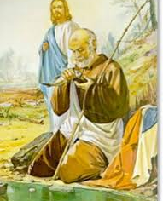
Jesus Said to Pay Taxes (“Render to Caesar”)
Even our Lord paid taxes while here on earth and expected it of His disciples (Matthew 17; 22)
To be above reproach, for a good conscience, to be in subjection to the authorities, and be in obedience to God, saints pay taxes!

Slide 12
Jesus also Said, Give to God! (“Render to God”)
Matthew 22:21: Note the word “things” – “The things that are God’s”
How would the people know what belongs to God?
Psalms 1:1-2: God has revealed His word (Law).
Ephesians 3:1-6: The revelation can be understood.

Slide 13
Jesus also Said, Give to God! (“Render to God”)
In the same way, as we give back to the government that which belongs to the government, we give back to God the things that are God’s!
I Corinthians 6:19-20: We are not our own but bought with a price (I Peter 1:18-19)
A Christian belongs to God completely (Mark 12:30)

Slide 14
Jesus also Said, Give to God! (“Render to God”)
We are to glorify God in our bodies:
Romans 6:12-13: Can one do that if the body is made an instrument of unrighteousness?
I Corinthians 6:18: If the body is used for fornication, we not only sin against God but against our own bodies

Slide 15
Jesus also Said, Give to God! (“Render to God”)
We are to glorify God in our thoughts/mind:
Philippians 4:7-8: Think pure and holy thoughts (Let God dwell in our hearts)

Slide 16
Jesus also Said, Give to God! (“Render to God”)
We are to glorify God in our giving back as He has prospered us:
I Corinthians 16:1-2: Paul established a pattern of giving to God on the first day of the week as we have been prospered
James 1:17: All good things come from God.
As the Jews were to tithe a 10th of their goods (Leviticus 27:30-32; Numbers 18:21-32), we are to give back as we have prospered (I Cor. 16:2) and as we purpose in our heart (II Corinthians 9:7).

Slide 17
Jesus also Said, Give to God! (“Render to God”)
The fundamental difference::
One must pay taxes or suffer consequences.
One must choose to serve God or suffer consequences.
Just as we are to give to earthly authority, we are to give ourselves to God in godly living!

Slide 18
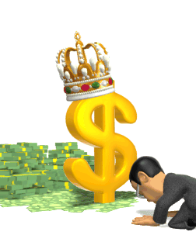
Conclusion
Jesus taught His disciples to pay taxes
Think of the people who “render to Caesar” his things, but who, as yet, have not “rendered to God” what rightfully belongs to Him
Do we give to Caesar and leave God out? (The ungodly, law-abiding citizens do that)

Slide 19
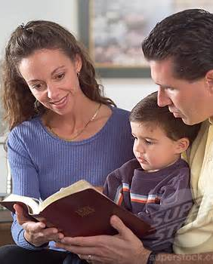
Conclusion
The ungodly give to “Caesar,” but the righteous will give to “Caesar” and to God!
When we pay our taxes and live as upright citizens, we give unto God our obedience
It’s about choices: what we choose to do with the things God has entrusted to us and how we give them back as pleasing service to Him
(Romans 12:1; II Peter 3:10-14)

Slide 20
Conclusion
Do we give to “Caesar” the things that are Caesar’s?
Do we give to God the things that are God’s?

Slide 21
“What Must I Do To Be Saved?”
Hear The Gospel (Jn. 5:24; Rom. 10:17)
Believe In Christ (Jn. 3:16-18; Jn. 8:24)
Repent Of Sins (Lk. 13:3-5; Acts 2:38)
Confess Christ (Mt. 10:32; Rom. 10:10)
Be Baptized (Mk. 16:16; Acts 22:16)
Remain Faithful (Jn. 8:31; Rev. 2:10)
For The Erring Saint:
Repent (Acts 8:22), Confess (I Jn. 1:9),
Pray (Acts 8:22)

