Slide 1
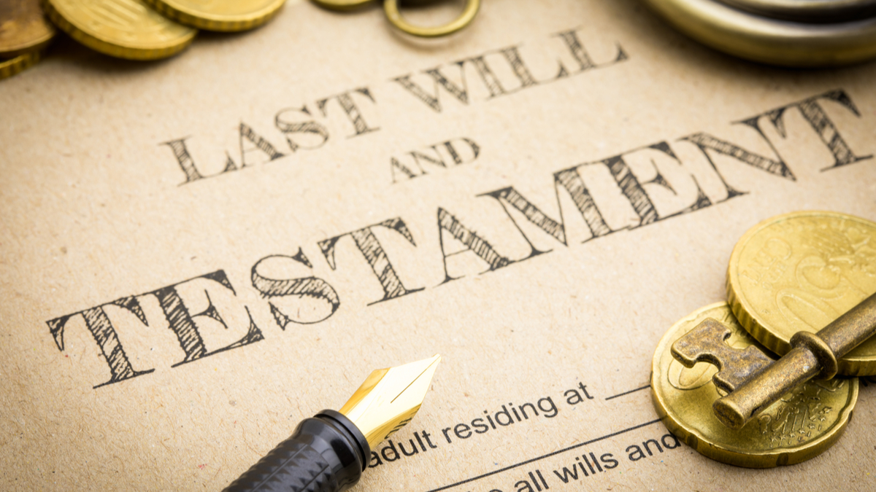
An Inheritance: Study On Original Sin Text: I Peter 1:3-5
Notes:
By Nathan L Morrison for Sunday 04/03/2022
All Scripture given is from NASB unless otherwise stated
For further study, or if questions, please Call: 804-277-1983 or Visit: www.courthousechurchofchrist.com
Some points from Lesson 6 & Lesson 9 of Basic Bible Doctrine Book 3 by Robert Harkrider

Slide 2
Inheritance: We can inherit physical things of value and traits from our family
Intro
Inheritance:
There are things that we don’t inherit from our family
The spiritual question of inheritance today is whether or not we inherit Adam’s sin?

Slide 3
Intro
We know that if we are faithful, there is an inheritance of eternal life from God!
I Peter 1:3-5
Blessed be the God and Father of our Lord Jesus Christ, who according to His great mercy has caused us to be born again to a living hope through the resurrection of Jesus Christ from the dead, to obtain an inheritance which is imperishable and undefiled and will not fade away, reserved in heaven for you, who are protected by the power of God through faith for a salvation ready to be revealed in the last time.
What do the Scriptures say about our inheritance?

Slide 4
Origins of Original Sin | Consequences | Scriptures used to Support Original Sin | Scriptures on Children’s Innocence & Personal Accountability
Augustine of Hippo (354–430), who 1st used the phrase, “original sin”
Infant Baptism – Happening as early as the 2nd – 3rd c. A.D.)
Matthew 19:13-14
Matthew 19:13-14; 18:3
Pelagius (350-425), a British monk who refuted the teachings of Augustine
Tertullian (160-220) wrote against infant baptisms
Psalm 51:5
II Samuel 12:15-23
Catholic Church’s Council of Trent (1545–1563) affirmed mankind inherits Adam’s sinful nature
As early as A.D. 400 Augustine used the universal practice of infant baptism as proof of original sin
Psalm 58:1-5
Ezekiel 18:20
Catholic Catechism
Sprinkling or Pouring
Romans 3:10-18
Romans 14:12
John Calvin (1509-1564) taught Original Sin as “Total Depravity”
“Christenings” & “Dedications”
Romans 5:12-19
II Corinthians 5:10

Slide 5
Who Should Be Baptized?
Those who are taught, who hear the word of God – Mt. 28:18-20; Acts 18:8; 19:4-5; Rom. 10:14, 17
Those who believe – Mark 16:16; Acts 8:12-13, 36-37; 18:8; 19:4-5 (Rom. 10:8-13)
Those who repent of their sins – Acts 2:38
Those who confess Jesus is the Son of God – Acts 8:36-37 (Rom. 10:8-10)
Those who receive the word of God – Acts 2:41; 8:12-14
Those who wish to enter the one body (church) through the one baptism – I Cor. 12:13 (Eph. 4:4-6)
Those who want their sins forgiven and to be saved! – Mark 16:16; Acts 2:38; 22:16

Slide 6
Conclusion
Infants are innocent and cannot obey all the commands that precede baptism!
Those who have been baptized as infants are in the same condition as the Ephesian disciples of John the Immerser in Acts 19:1-5!
When they realized they were not baptized into Jesus they immediately were baptized into His name.
You can be baptized into Jesus for the forgiveness of your sins!
Original Sin and Calvin’s Total Depravity are false teachings that are contradictory to the teachings found in the Scriptures!
You have not inherited sin, nor will you be held accountable for Adam’s sin, but you will be held accountable for what you have done!

Slide 7
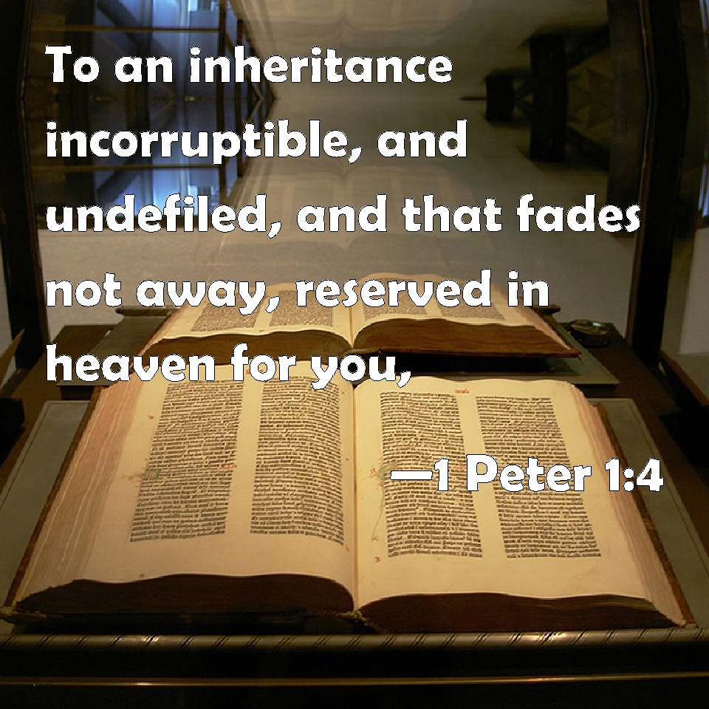
Conclusion
If you want to inherit the blessings and promises of eternal life from God (I Peter 1:3-5), you can obey the gospel NOW by repenting of your sins and being baptized in the name of Jesus for the forgiveness of your sins!

Slide 8
“What Must I Do To Be Saved?”
Hear The Gospel (Jn. 5:24; Rom. 10:17)
Believe In Christ (Jn. 3:16-18; Jn. 8:24)
Repent Of Sins (Lk. 13:3-5; Acts 2:38)
Confess Christ (Mt. 10:32; Rom. 10:10)
Be Baptized (Mk. 16:16; Acts 22:16)
Remain Faithful (Jn. 8:31; Rev. 2:10)
For The Erring Saint:
Repent (Acts 8:22), Confess (I Jn. 1:9),
Pray (Acts 8:22)

Slide 9
Additional Material

Slide 10
Table of An Inheritance: Study Of Original Sin

Slide 11
Origins of Original Sin | Consequences | Scriptures used to Support Original Sin | Scriptures on Children’s Innocence & Personal Accountability
By Nathan L Morrison
Augustine of Hippo (354–430), who 1st used the phrase, “original sin”
Infant Baptism – Happening as early as the 2nd – 3rd c. A.D.)
Matthew 19:13-14
Matthew 19:13-14; 18:3
Pelagius (350-425), a British monk who refuted the teachings of Augustine
Tertullian (160-220) wrote against infant baptisms
Psalm 51:5
II Samuel 12:15-23
Catholic Church’s Council of Trent (1545–1563) affirmed mankind inherits Adam’s sinful nature
As early as A.D. 400 Augustine used the universal practice of infant baptism as proof of original sin
Psalm 58:1-5
Ezekiel 18:20
Catholic Catechism
Sprinkling or Pouring
Romans 3:10-18
Romans 14:12
John Calvin (1509-1564) taught Original Sin as “Total Depravity”
“Christenings” & “Dedications”
Romans 5:12-19
II Corinthians 5:10

Slide 12
Picture of An Inheritance: Study Of Original Sin

Slide 13
Notes:
I used the printed-out picture as a handout during the lesson

