Slide 1
ALL Text: Mark 12:30
Notes:
By Nathan L Morrison
All Scripture given is from NASB unless otherwise stated
For further study, or if questions, please Call: 804-277-1983 or Visit www.courthousechurchofchrist.com
Adapted from an article by Josh Welch

Slide 2
Intro
Idiom:
“Everything but the kitchen sink!”
The little word “all” packs a powerful punch.
It includes everything and leaves out nothing.

Slide 3
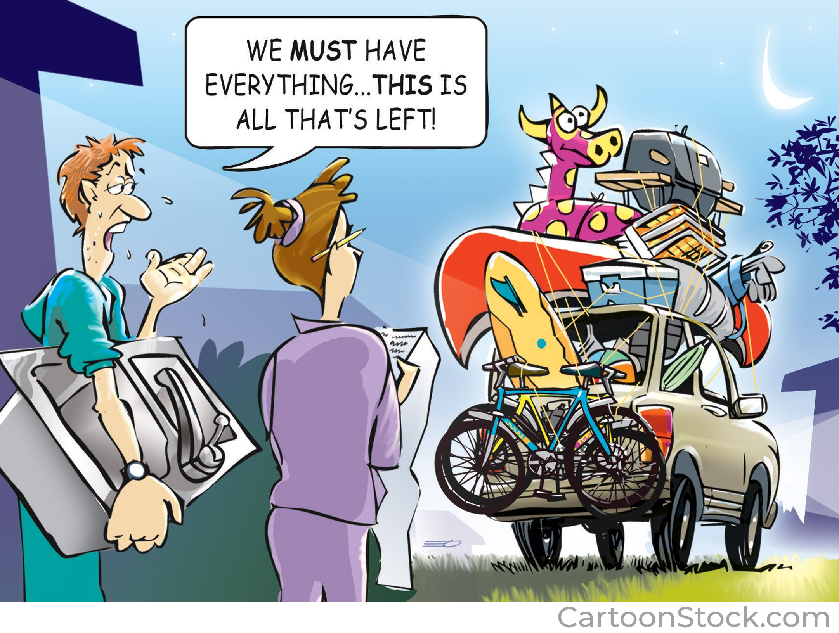
Intro
“ALL”:
“Everything, even the kitchen sink!”
The little word “all” packs a powerful punch.
It includes everything and leaves out nothing.
Notes:
Image: CS209608
Used by permission through Purchased License from cartoonstock.com: 532971

Slide 4
Intro
We see the word, “ALL,” show up in many cases in the Scriptures where it has relevance to our spiritual life
“ALL”

Slide 5
Significance of “ALL”
When God makes the threefold promise to Abraham (land, nation, seed) He concludes…
Genesis 12:3
“And I will bless those who bless you, And the one who curses you I will curse. And in you ALL the families of the earth will be blessed."
Notes:
Emphasis in Scripture mine
When God makes the threefold promise to Abraham (land, nation, seed) He concludes, “And in you ALL the families of the earth shall be blessed” (Genesis 12:3).

Slide 6
Significance of “ALL”
We are in need of this blessing from God because…
Romans 3:23
“for ALL have sinned and fall short of the glory of God."
Notes:
Emphasis in Scripture mine
We are in need of this blessing from God because “ALL have sinned and fall short of the glory of God…” beginning with Adam (Romans 3:23)
Romans 3:9-18 (Statement that ALL are in sin, both Jew & Gentile)
Rom 3:9 What then? Are we better than they? Not at all; for we have already charged that both Jews and Greeks are all under sin;
Rom 3:10 as it is written, "THERE IS NONE RIGHTEOUS, NOT EVEN ONE; (Psalm 14:1)
Rom 3:11 THERE IS NONE WHO UNDERSTANDS, THERE IS NONE WHO SEEKS FOR GOD; (Psalm 14:2)
Rom 3:12 ALL HAVE TURNED ASIDE, TOGETHER THEY HAVE BECOME USELESS; THERE IS NONE WHO DOES GOOD, THERE IS NOT EVEN ONE." (Psalm 14:3)
Rom 3:13 "THEIR THROAT IS AN OPEN GRAVE, WITH THEIR TONGUES THEY KEEP DECEIVING,“ (Psalm 5:9) "THE POISON OF ASPS IS UNDER THEIR LIPS"; (Psalm 140:3)
Rom 3:14 "WHOSE MOUTH IS FULL OF CURSING AND BITTERNESS"; (Psalm 10:7)
Rom 3:15 "THEIR FEET ARE SWIFT TO SHED BLOOD, (Isaiah 59:7)
Rom 3:16 DESTRUCTION AND MISERY ARE IN THEIR PATHS, (Isaiah 59:7)
Rom 3:17 AND THE PATH OF PEACE THEY HAVE NOT KNOWN." (Isaiah 59:8)
Rom 3:18 "THERE IS NO FEAR OF GOD BEFORE THEIR EYES." (Psalm 36:1)

Slide 7
Significance of “ALL”
Psalm 103:1-5
A Psalm of David.
Bless the LORD, O my soul, And all that is within me, bless His holy name.
Bless the LORD, O my soul, And forget none of His benefits;
Who pardons ALL your iniquities, Who heals ALL your diseases;
Who redeems your life from the pit, Who crowns you with lovingkindness and compassion;
Who satisfies your years with good things, So that your youth is renewed like the eagle.
Though our sins separate us from God, God is to be praised…
Notes:
Emphasis in Scripture mine
Though our sins separate us from God, God is to be praised “Who forgives ALL your iniquities, Who heals ALL your diseases...Who satisfies your years with good things” (Psalm 103:1-5).

Slide 8
Significance of “ALL”
Romans 5:18
“So then as through one transgression there resulted condemnation to ALL men, even so through one act of righteousness there resulted justification of life to ALL men."
God offers to bless all through Jesus since…
Notes:
Emphasis in Scripture mine
God offers to bless all through Jesus since “through one Man’s righteous act the free gift came to ALL men, resulting in justification of life” (Romans 5:18).

Slide 9
Significance of “ALL”
This gospel or “good news” should be shared as far and wide as possible. Jesus says…
Mark 16:15
And He said to them, "Go into ALL the world and preach the gospel to ALL creation."
Notes:
Emphasis in Scripture mine
This gospel or “good news” should be shared as far and wide as possible. Jesus says, “Go into ALL the world and preach the gospel to every creature” (Mark 16:15).

Slide 10
Significance of “ALL”
Jude 3
“Beloved, while I was making every effort to write you about our common salvation, I felt the necessity to write to you appealing that you contend earnestly for the faith which was once for ALL handed down to the saints."
There is no other plan for God to save mankind but through Jesus.
So, we must…
Notes:
Emphasis in Scripture mine
There is no other plan for God to save mankind but through Jesus. So, we must “contend earnestly for the faith which was once for ALL delivered to the saints” (Jude 3).

Slide 11
Significance of “ALL”
I Timothy 2:1-4
First of all, then, I urge that entreaties and prayers, petitions and thanksgivings, be made on behalf of ALL men,
for kings and ALL who are in authority, so that we may lead a tranquil and quiet life in ALL godliness and dignity.
This is good and acceptable in the sight of God our Savior,
who desires ALL men to be saved and to come to the knowledge of the truth."
Because the gospel is our only hope, we ought to pray “for ALL” because…
Notes:
Emphasis in Scripture mine
Because the gospel is our only hope, we ought to pray “for ALL” because “this is good and acceptable in the sight of God our Savior, who desires ALL men to be saved” (I Timothy 2:1-4).
• Acts 10:34-35
• Romans 1:16-17
• The gospel is for ALL!

Slide 12
Significance of “ALL”
Mark 12:30
“AND YOU SHALL LOVE THE LORD YOUR GOD WITH ALL YOUR HEART, AND WITH ALL YOUR SOUL, AND WITH ALL YOUR MIND, AND WITH ALL YOUR STRENGTH.”
Obeying Jesus is honoring the first and great commandment to…
Notes:
Emphasis in Scripture mine
Obeying Jesus is honoring the first and great commandment to “love the Lord your God with ALL your heart, with ALL your soul, with ALL your mind, and with ALL your strength” (Mark 12:30).
Jesus wants all of you! Can’t leave out the kitchen sink!

Slide 13
Significance of “ALL”
Once you fully surrender yourself to the Lord, you will find yourself able to do “all things” He asks of you…
Philippians 4:13
“I can do ALL things through Him who strengthens me.”
Notes:
Emphasis in Scripture mine
Once you fully surrender yourself to the Lord, you will find yourself able “to do ALL things through Christ who strengthens me”-- that is, “all things” He asks of you (Philippians 4:13).

Slide 14
Significance of “ALL”
II Corinthians 5:10
“For we must ALL appear before the judgment seat of Christ, so that each one may be recompensed for his deeds in the body, according to what he has done, whether good or bad.”
A Judgment is fixed…
Notes:
Emphasis in Scripture mine
A Judgment is fixed, in which “we must ALL appear before the judgment seat of Christ, so that each one may be recompensed for his deeds in the body, according to what he has done, whether good or bad” (II Corinthians 5:10)

Slide 15
Significance of “ALL”
Because ALL have sinned (Romans 3:23) and ALL will be judged (II Corinthians 5:10), the gospel is for ALL (I Timothy 2:1-4) and calls ALL people to repent…
II Peter 3:9
“The Lord is not slow about His promise, as some count slowness, but is patient toward you, not wishing for any to perish but for ALL to come to repentance.”
Notes:
Emphasis in Scripture mine
Because ALL have sinned (Romans 3:23) and ALL will be judged (II Corinthians 5:10), the gospel is for ALL (I Timothy 2:1-4) and calls ALL people to repent! “The Lord is not slow about His promise, as some count slowness, but is patient toward you, not wishing for any to perish but for ALL to come to repentance” (II Peter 3:9).

Slide 16
Significance of “ALL”
even saints sin and fall short of the glory of God so we are to confess our sins to each other (James 5:16), confess to God, repent and seek forgiveness…
I John 1:9
“If we confess our sins, He is faithful and righteous to forgive us our sins and to cleanse us from ALL unrighteousness.”
Notes:
Emphasis in Scripture mine
Even saints sin and fall short of the glory of God so we are to confess our sins to each other (James 5:16), confess to God, repent and seek forgiveness. “If we confess our sins, He is faithful and righteous to forgive us our sins and to cleanse us from ALL unrighteousness” (I John 1:9).

Slide 17
Significance of “ALL”
Acts 17:30-31
“Therefore having overlooked the times of ignorance, God is now declaring to men that ALL people everywhere should repent, because He has fixed a day in which He will judge the world in righteousness through a Man whom He has appointed, having furnished proof to all men by raising Him from the dead.”
even saints sin and fall short of the glory of God so we are to confess our sins to each other (James 5:16), confess to God, repent and seek forgiveness…
Notes:
Emphasis in Scripture mine
Even saints sin and fall short of the glory of God so we are to confess our sins to each other (James 5:16), confess to God, repent and seek forgiveness.
“Therefore having overlooked the times of ignorance, God is now declaring to men that ALL people everywhere should repent, because He has fixed a day in which He will judge the world in righteousness through a Man whom He has appointed, having furnished proof to all men by raising Him from the dead” (Acts 17:30-31).

Slide 18
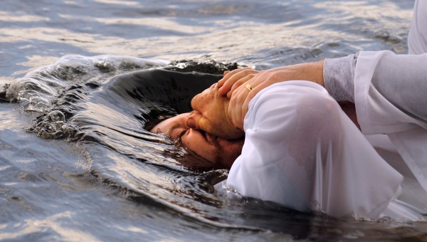
If you want to have “EVERY spiritual blessing in the heavenly places in Christ” (Eph. 1:3) and to “ALWAYS be with the Lord” (I Thess. 4:17), then obey the gospel today!

Slide 19
“Love…God with ALL your heart, with ALL your soul, with ALL your mind, and with ALL your strength!” (Mark 12:30)

Slide 20
“What Must I Do To Be Saved?”
Hear The Gospel (Jn. 5:24; Rom. 10:17)
Believe In Christ (Jn. 3:16-18; Jn. 8:24)
Repent Of Sins (Lk. 13:3-5; Acts 2:38)
Confess Christ (Mt. 10:32; Rom. 10:10)
Be Baptized (Mk. 16:16; Acts 22:16)
Remain Faithful (Jn. 8:31; Rev. 2:10)
For The Erring Saint
Repent (Acts 8:22), Confess (I Jn. 1:9),
Pray (Acts 8:22)

