Slide 1
The Last Meal
Text:
Colossians 3:16-17
Notes:
By Nathan L Morrison
All Scripture given is from NASB unless otherwise stated
For further study, or if questions, please Call: 804-277-1983 or Visit www.courthousechurchofchrist.com

Slide 2
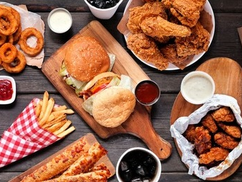
Intro
Have you ever thought about what your last meal might be?
What it might say about you?
Many prisons allow death row inmates a last meal before execution
Some people don’t get to plan their last meal, because life is fragile and can end in a host of tragic ways

Slide 3
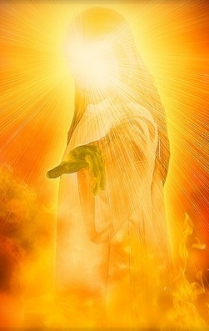
Intro
What would God think of your last eternal meal…
Would God condemn you on your steady diet of:
Worldly things
Worldly cares
Human Philosophy
Man-made religions, creeds and traditions
Would God commend you for your steady diet of:
The Bread of Heaven
The Eternal Water of Life
Things that are honorable and pure
Spiritual things that focus one’s eyes on Heaven
If you were to meet God today in judgment, what would He say about your last meal?

Slide 4
Last Meal of Worldly Feast
Matthew 16:26
I John 2:15-17
Jude 1:19
Worldly Allurements

Slide 5
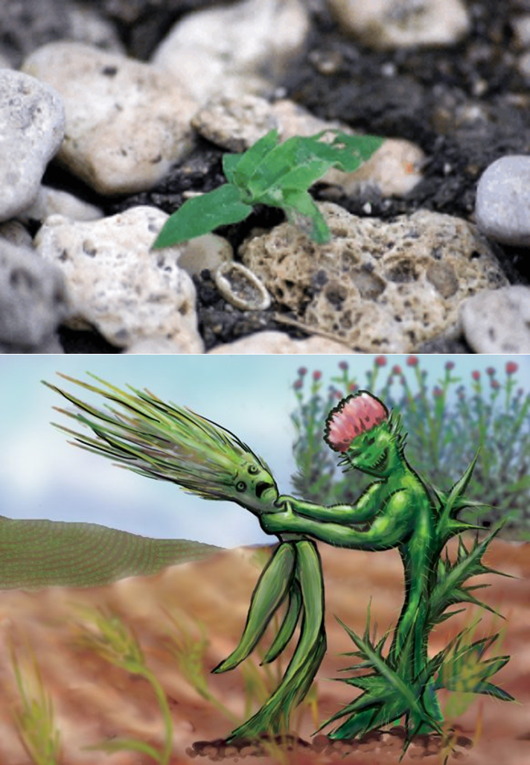
Last Meal of Worldly Feast
Matthew 13:22
Mark 4:18-19
Luke 8:14
Worldly Cares

Slide 6
Last Meal of Worldly Feast
I Corinthians 1:19-21
I Corinthians 3:18-20
I Timothy 6:20-21
Human Philosophy

Slide 7
Last Meal of Worldly Feast
Matthew 15:13-14
I Corinthians 3:11
Galatians 1:6-9
Man-made Religions (Creeds & Traditions)

Slide 8
Last Meal of Worldly Feast
Feasting on worldly things starves the soul and makes one unfruitful and can cause one to lose their soul!
Worldly Allurements
Worldly Cares
Human Philosophy
Man-made Religions

Slide 9
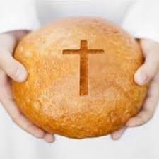
Last Meal of Eternal Feast
John 6:35
Colossians 3:16-17
Bread of Heaven

Slide 10
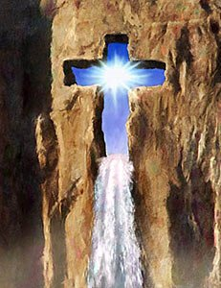
Last Meal of Eternal Feast
John 4:12-14
Revelation 22:17
Eternal Water

Slide 11
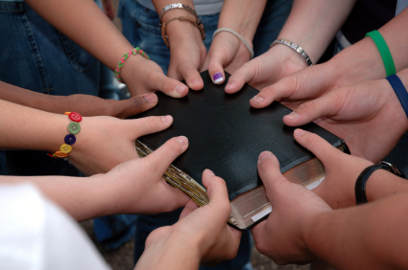
Last Meal of Eternal Feast
Philippians 4:8
Titus 2:11-14
Things that are honorable and pure

Slide 12
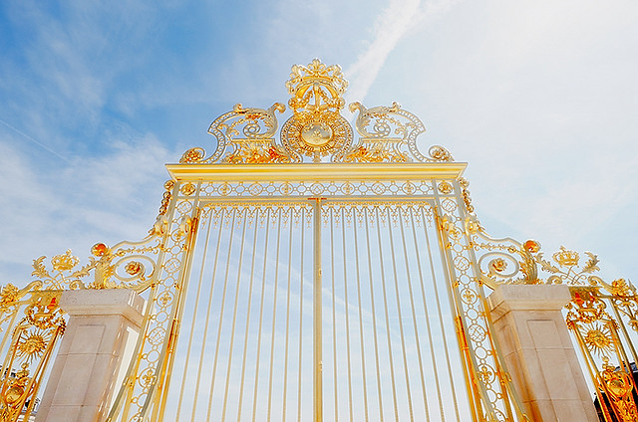
Last Meal of Eternal Feast
Colossians 3:1-3
Hebrews 12:1-3
Spiritual things that focus one’s eyes on Heaven

Slide 13
Last Meal of Eternal Feast
Feasting on eternal things feeds the soul and focuses one on Heaven!
Bread of Heaven
Eternal Water
Things that are honorable and pure
Spiritual things that focus one’s eyes on Heaven

Slide 14
Colossians 3:16-17
Conclusion
Let the word of Christ richly dwell within you, with all wisdom teaching and admonishing one another with psalms and hymns and spiritual songs, singing with thankfulness in your hearts to God. Whatever you do in word or deed, do all in the name of the Lord Jesus, giving thanks through Him to God the Father.

Slide 15
Conclusion
We may not all get to choose our last physical meal, but we, in a time of resolutions, can resolve to choose a diet of an eternal feast with eternal rewards!
Will God say of you, “He/She ate poorly” or will He say, “He/She was well fed”?

Slide 16
“What Must I Do To Be Saved?”
Hear The Gospel (Jn. 5:24; Rom. 10:17)
Believe In Christ (Jn. 3:16-18; Jn. 8:24)
Repent Of Sins (Lk. 13:3-5; Acts 2:38)
Confess Christ (Mt. 10:32; Rom. 10:10)
Be Baptized (Mk. 16:16; Acts 22:16)
Remain Faithful (Jn. 8:31; Rev. 2:10)
For The Erring Saint:
Repent (Acts 8:22), Confess (I Jn. 1:9),
Pray (Acts 8:22)

