Slide 1
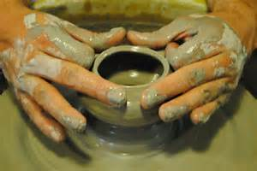
Have Thine Own Way, Lord
Text:
Romans 8:29-30
Notes:
By Nathan L Morrison
All Scripture given is from NASB unless otherwise stated
For further study, or if questions, please Call: 804-277-1983 or Visit: www.courthousechurchofchrist.com
"Have Thine Own Way, Lord” by Adelaide Addison Pollard (1907)

Slide 2
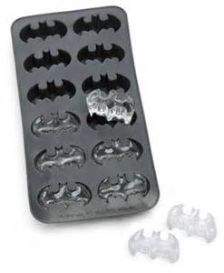
Intro
Patterns or formulas are designed to be followed to
produce the desired product
Patterns & formulas can be altered to fit the need – based on the one following (IE: Recipes)
Molds are used to conform a substance into the desired image or product!
Molds cause something to change into the likeness of the mold.
Our lives are to conform to the image of
Christ – to fit the mold! (Rom. 8:29-30; Gal. 3:27)

Slide 3
Romans 8:28-30
Intro
28. And we know that God causes all things to work together for good to those who love God, to those who are called according to His purpose.
29. For those whom He foreknew, He also predestined to become conformed to the image of His Son, so that He would be the firstborn among many brethren;
30. and these whom He predestined, He also called; and these whom He called, He also justified; and these whom He justified, He also glorified.

Slide 4

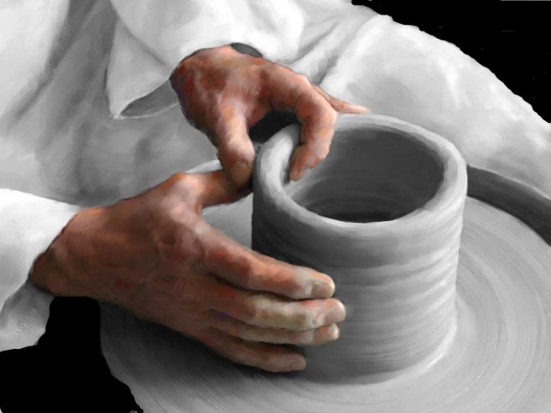
Intro
We are to imitate Christ & walk in love
(I Cor. 11:1; Eph. 5:1-2)
“Conform” (Romans 8:29)
“Signifies having the same form as another” (Vine).
God used the imagery of a potter and
clay to illustrate man being molded into what God intended – Isaiah 64:8

Slide 5
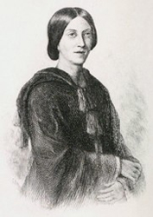
Intro
Adelaide Addison Pollard (1862-1934):
“Have Thine Own Way, Lord” (1907)
Adelaide Addison Pollard was born Nov. 27, 1862, into a Presbyterian family.
She was a talented writer of both prose and poetry and produced many religious articles and hymns.
Despite being sick, she traveled all over speaking on the importance of Bible teaching.
After becoming discouraged at a failed trip to Africa, she attended a prayer meeting, and heard someone say, “It’s all right, Lord! It doesn’t matter what you bring into our lives. Just have your own way with us.”
Thinking about these words on her way home, she put the hymn on paper before retiring that night in 1902 and it was published in 1907 with the tune, “Adelaide” by George Coles Stebbins (1846-1945).
Some people want to fit God into the mold of their lives, but God says our lives must fit the mold of His Son!
Notes:
Read the article on Adelaide A Pollard
Sources:
http://hymnstudiesblog.wordpress.com/2008/06/11/quothave-thine-own-way-lordquot/

Slide 6
God is the Potter, Man is the Clay
“Have Thine own way, Lord, Have Thine own way! Thou art the Potter, I am the clay.
Mold me and make me After Thy will, While I am waiting, Yielded and still.”
Rom. 8:29; 9:20-21: God is the potter & we are the clay!
Romans 9:20-21
On the contrary, who are you, O man, who answers back to God? The thing molded will not say to the molder, "Why did you make me like this," will it? Or does not the potter have a right over the clay, to make from the same lump one vessel for honorable use and another for common use?
Jeremiah 18:3-4
Then I went down to the potter's house, and there he was, making something on the wheel.
But the vessel that he was making of clay was spoiled in the hand of the potter; so he remade it into another vessel, as it pleased the potter to make.
Isaiah 64:8
But now, O LORD, You are our Father, We are the clay, and You our potter; And all of us are the work of Your hand.

Slide 7


God is the Potter, Man is the Clay
“Have Thine own way, Lord, Have Thine own way! Thou art the Potter, I am the clay.
Mold me and make me After Thy will, While I am waiting, Yielded and still.”
Romans 6:13-16: To conform to the Son, we must have the attitude, “Have Thine own way, Lord!”
Becoming God’s person cannot be achieved by:
Psychology
Philosophy
Human Theology
We will only fit God’s mold by “conforming to the image” of Christ! (Romans 8:29)

Slide 8
Submit to God and Be Washed from Sin
“Have Thine own way, Lord, Have Thine own way! Search me and try me, Master, today! Whiter than snow, Lord, Wash me just now, As in Thy presence Humbly I bow.”
Psalm 139:23-24
Search me, O God, and know my heart; Try me and know my anxious thoughts; And see if there be any hurtful way in me, And lead me in the everlasting way.
Isaiah 1:18-20
18. "Come now, and let us reason together," Says the LORD, "Though your sins are as scarlet, They will be as white as snow; Though they are red like crimson, They will be like wool.
19. "If you consent and obey, You will eat the best of the land;
20. "But if you refuse and rebel, You will be devoured by the sword." Truly, the mouth of the LORD has spoken.
Mk. 16:16; Acts 22:16; I Cor. 6:11; Rev. 7:14: Obedience
Rom. 12:1-2: Transforming of the mind
Mt. 15:7-9: Rules & rituals, without a change of heart, will not produce a Christ-like life!

Slide 9
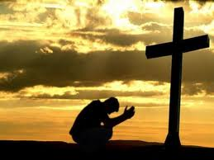
Submit to God and Be Washed from Sin
“Have Thine own way, Lord, Have Thine own way! Search me and try me, Master, today! Whiter than snow, Lord, Wash me just now, As in Thy presence Humbly I bow.”
Philippians 2:10
We must humbly bow before Him in complete submission to His will (Either we will in this life willingly, or we will be forced to our knees as conquered enemies).
So many people want to conform God’s word into their mold and transform it to what’s convenient and comfortable to them!
The child of God will transform his/her life by the renewing of their mind (thoughts)!

Slide 10
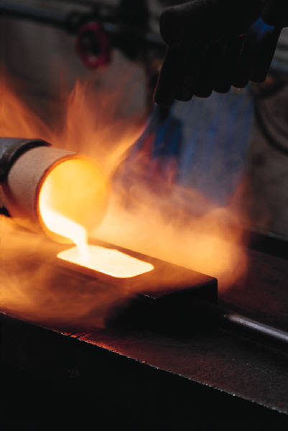
Christ Living In Us
“Have Thine own way, Lord, Have Thine own way! Hold o’er my being Absolute sway! Fill with Thy Spirit Till all shall see Christ only, always, Living in me.”
Christ wants to hold over our being absolute sway or rule in our hearts (Colossians 3:15)
He also wants us to be filled with the influence of His Spirit (Ephesians 5:18)
Galatians 2:20 (Matthew 5:16)
I have been crucified with Christ; and it is no longer I who live, but Christ lives in me; and the life which I now live in the flesh I live by faith in the Son of God, who loved me and gave Himself up for me.

Slide 11
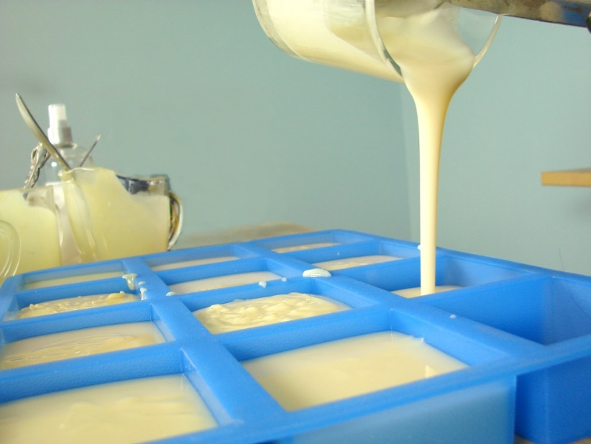
Christ Living In Us
“Have Thine own way, Lord, Have Thine own way! Hold o’er my being Absolute sway! Fill with Thy Spirit Till all shall see Christ only, always, Living in me.”
Colossians 3:9-11
9. Do not lie to one another, since you laid aside the old self with its evil practices,
10. and have put on the new self who is being renewed to a true knowledge according to the image of the One who created him--
11. a renewal in which there is no distinction between Greek and Jew, circumcised and uncircumcised, barbarian, Scythian, slave and freeman, but Christ is all, and in all.
Rom. 6:1-7; Gal. 3:27-28: We must get into Christ. (Baptism)
Col. 1:27: He must be in us.
I Pet. 2:21: He is our example (pattern).

Slide 12
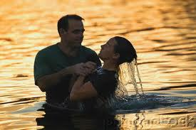
Christ Living In Us
“Have Thine own way, Lord, Have Thine own way! Hold o’er my being Absolute sway! Fill with Thy Spirit Till all shall see Christ only, always, Living in me.”
More than a pattern (formula) to be
followed, it is a mold we must fit into!
(The pattern to follow can only be
accomplished if we fit His mold)
If we are in Christ, others around
us will see Christ in us!

Slide 13
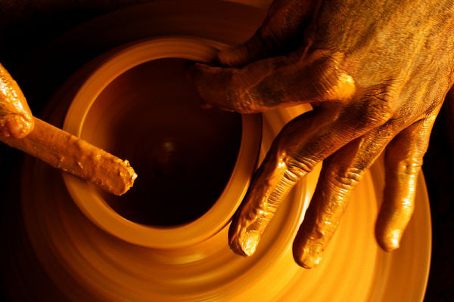
Conclusion
Philippians 3:20-21 (I John 3:1-3: We’ll be like Him!)
20. For our citizenship is in heaven, from which also we eagerly wait for a Savior, the Lord Jesus Christ;
21. who will transform the body of our humble state into conformity with the body of His glory, by the exertion of the power that He has even to subject all things to Himself.
Too many people spend their whole lives pursuing their
own goals and doing what they want to do rather than
taking time to seek what God would have them do!
The life of a saint must be one of complete submission to the will of God – recognizing the Potter and clay relationship to God

Slide 14
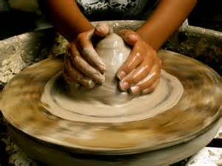
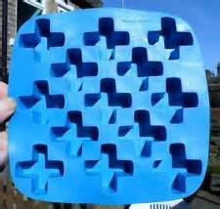
Conclusion
This attitude of submission is well exemplified by the plea,
“Have Thine Own Way, Lord!”
We must conform to His image NOW if we want to be conformed to His glory for eternity! (Philippians 3:21)

Slide 15

“What Must I Do To Be Saved?”
Hear The Gospel (Jn. 5:24; Rom. 10:17)
Believe In Christ (Jn. 3:16-18; Jn. 8:24)
Repent Of Sins (Lk. 13:3-5; Acts 2:38)
Confess Christ (Mt. 10:32; Rom. 10:10)
Be Baptized (Mk. 16:16; Acts 22:16)
Remain Faithful (Jn. 8:31; Rev. 2:10)
For The Erring Saint:
Repent (Acts 8:22), Confess (I Jn. 1:9),
Pray (Acts 8:22)

