Slide 1
David Found Distress & Sorrow Text: Psalm 116
Notes:
By Nathan L Morrison
All Scripture given is from NASB unless otherwise stated
For further study, or if questions, please Call: 804-277-1983 or Visit www.courthousechurchofchrist.com
Adapted from an article by Roger Shouse

Slide 2
Intro
Psalm 116:3
“The cords of death encompassed me and the terrors of Sheol came upon me; I found distress and sorrow.”
As dark and as sad as Psalm 116:3 looks, reading the rest of the chapter shows us the deliverance God provided and the thankfulness within its author’s heart (very possibly David)

Slide 3
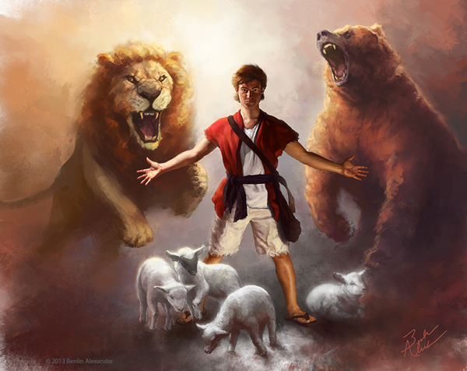
Intro
how many times in David’s life did death encompass him?
he fought a lion and a bear (I Samuel 17:34-37)
He faced Goliath, the Philistine giant and champion of Gath (I Samuel 17)
Saul threw spears at David (I Samuel 18:10-11; 19:9-10)
there was the dowry of 100 Philistine foreskins (I Samuel 18:25)
On the run from Saul, he had many close encounters with Saul’s army and the Philistines
Later in life, Absalom, his own son, tried to kill him (II Samuel 15-18)
David looked into the eyes of death more than once!
Notes:
Image: David Defends His Sheep by Benlin Alexander (2013)

Slide 4
Intro
Most of us live fairly safe every day
The “terrors of Sheol” is something that most of us don’t face

Slide 5
Intro
Psalm 116:3
“The cords of death encompassed me and the terrors of Sheol came upon me; I found distress and sorrow.”
“I found distress and sorrow”
That’s something we know
David found them. I found them. Many people found them.
Once you find them, what do you do with them?

Slide 6
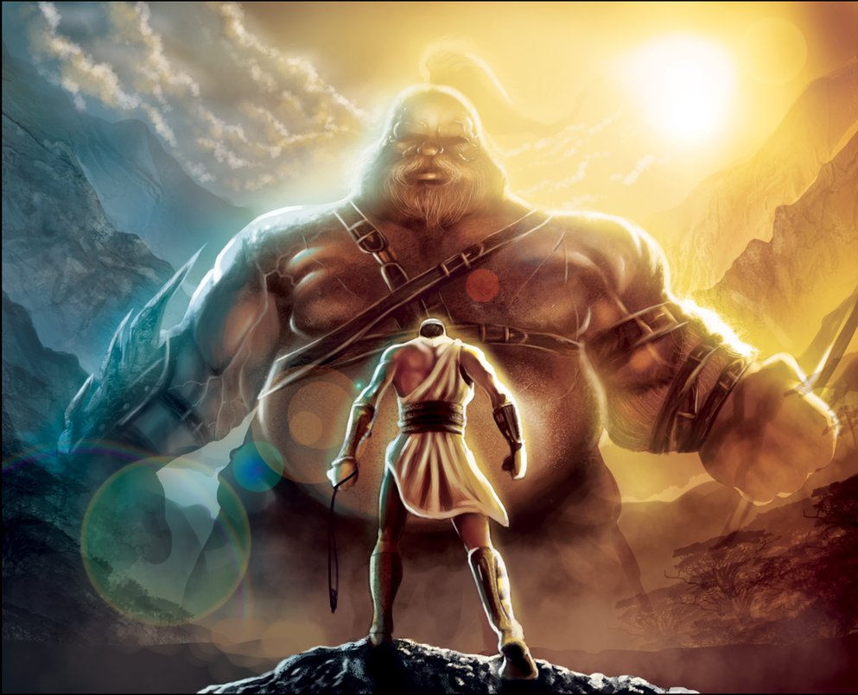
Intro
David looked into the face of death more than once and he knew the “terrors of Sheol”
David found “distress & sorrow”
What did he do with them?

Slide 7
David Prayed
Psalm 116:4
Then I called upon the name of the LORD: “O LORD, I beseech You, save my life!”
Psalm 116:4

Slide 8
David Prayed
Psalm 40:1
I waited patiently for the LORD; And He inclined to me and heard my cry.
Psalm 116:4
Psalm 86:3
Be gracious to me, O Lord, For to You I cry all day long.

Slide 9
David Prayed
Don’t wait until you have exhausted every option before you pray
Pray first
Pray hard
Lay the problems before the Lord
Let the Lord know that death is terrifying you
Psalm 116:4
David prayed; he cried out to God to save him

Slide 10
David Prayed
Tell the Lord of your distress and sorrow!
Take it to the Lord in prayer!
(Philippians 4:6-7; I Peter 5:6-7)
Psalm 116:4
David prayed; he cried out to God to save him

Slide 11
David Gave Thanks
Psalm 116:6
The LORD preserves the simple; I was brought low, and He saved me.
Psalm 116:8
For You have rescued my soul from death, My eyes from tears, My feet from stumbling.
Psalm 116:6, 8, 17
Psalm 116:17
To You I shall offer a sacrifice of thanksgiving, And call upon the name of the LORD.

Slide 12
David Gave Thanks
Psalm 40:2
He brought me up out of the pit of destruction, out of the miry clay, And He set my feet upon a rock making my footsteps firm.
Psalm 116:6, 8, 17
Psalm 86:12-13
I will give thanks to You, O Lord my God, with all my heart, And will glorify Your name forever. For Your lovingkindness toward me is great, And You have delivered my soul from the depths of Sheol.

Slide 13
David Gave Thanks
David prayed and God answered.
He understood that the power wasn’t within himself.
It was the Lord who rescued him.
He not only knew that, but he thanked the Lord because of that!
Psalm 116:6, 8, 17
David was thankful that he was saved by God

Slide 14
David Gave Thanks
Thank the Lord for answered prayer in your life and for the blessings He has bestowed! (Colossians 3:17; I Thessalonians 5:16-18)
Psalm 116:6, 8, 17
David was thankful that he was saved by God

Slide 15
David Honored & Obeyed God
Psalm 116:9
I shall walk before the LORD In the land of the living.
Psalm 116:9

Slide 16
David Honored & Obeyed God
Psalm 40:16
Let all who seek You rejoice and be glad in You; Let those who love Your salvation say continually, “The LORD be magnified!”
Psalm 116:9
Psalm 86:11
Teach me Your way, O LORD; I will walk in Your truth; Unite my heart to fear Your name.

Slide 17
David Honored & Obeyed God
I shall walk before the Lord (v. 9)
I will call upon the name of the Lord (v. 13)
I will pay my vows (v. 14)
I am Your servant (v. 16)
I will praise the Lord (v. 19)
Psalm 116:9
David honored God by obeying Him

Slide 18
David Honored & Obeyed God
Having been rescued by God, David felt compelled to honor God and stay with God! So should we!
(Mark 12:30; II John 6)
Psalm 116:9
David honored God by obeying Him

Slide 19
Conclusion
Three simple things: Prayer, Thankfulness, Honoring God
When distress finds you and sorrow follows you, this is what you need to do
Don’t allow distress and sorrow to ruin your relationship with God.
Don’t allow those ugly twins to keep you from praising God and worshiping Him

Slide 20
Conclusion
Psalm 40:17
Since I am afflicted and needy, Let the Lord be mindful of me. You are my help and my deliverer; Do not delay, O my God.
David said of his plight that he was “afflicted and needy” but called on God to save him
Psalm 70:5
But I am afflicted and needy; Hasten to me, O God! You are my help and my deliverer; O LORD, do not delay.

Slide 21
Conclusion
David said of his plight that he was “afflicted and needy” but called on God to save him
Psalm 86:1
Incline Your ear, O LORD, and answer me; For I am afflicted and needy.
Psalm 116:10
I believed when I said, “I am greatly afflicted.”

Slide 22
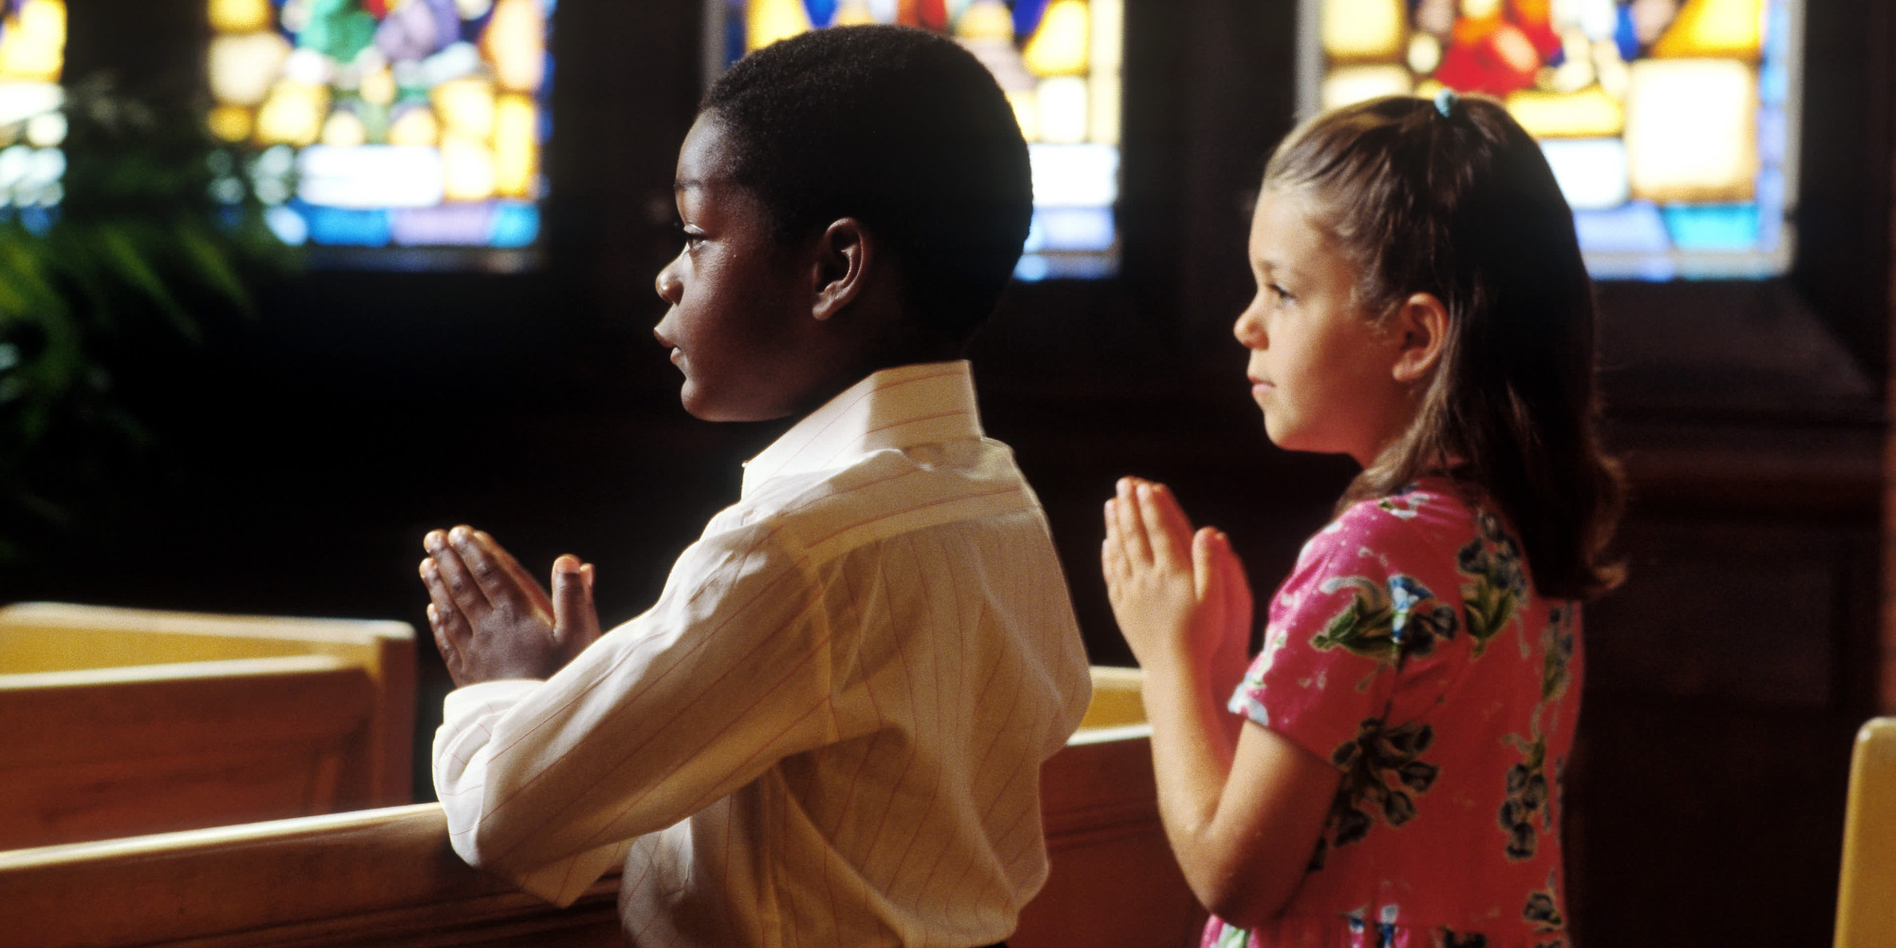
draw closer to God!
Conclusion
David didn’t pull away from God when he found “distress and sorrow” to such a degree that he was “afflicted and needy”
James 4:6-10
James 4:8: “Draw near to God and He will draw near to you”
David drew closer to God!

Slide 23
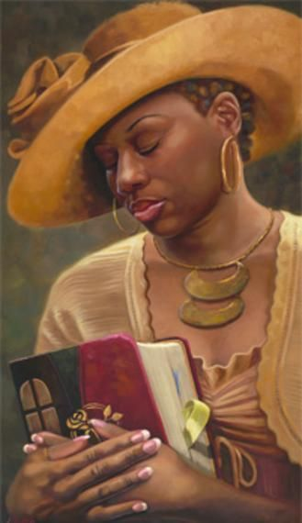
Conclusion
Distress and sorrow will either cripple your faith or it will propel it to soar to new heights!
The choice is up to you.
Are you reaching out to God or ignoring Him?

Slide 24
Conclusion
Psalm 40:8-10
I delight to do Your will, O my God; Your Law is within my heart. I have proclaimed glad tidings of righteousness in the great congregation; Behold, I will not restrain my lips, O LORD, You know. I have not hidden Your righteousness within my heart; I have spoken of Your faithfulness and Your salvation; I have not concealed Your lovingkindness and Your truth from the great congregation.
Do you allow distress and sorrow to keep you home or do you get out to serve Him?

Slide 25
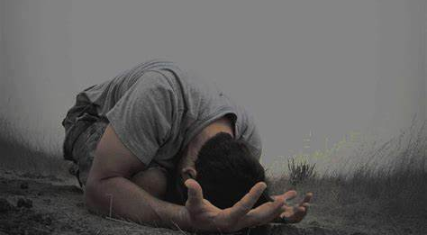
David found distress and sorrow. I have found distress and sorrow…and, so will you! What will you do when you find them?

Slide 26
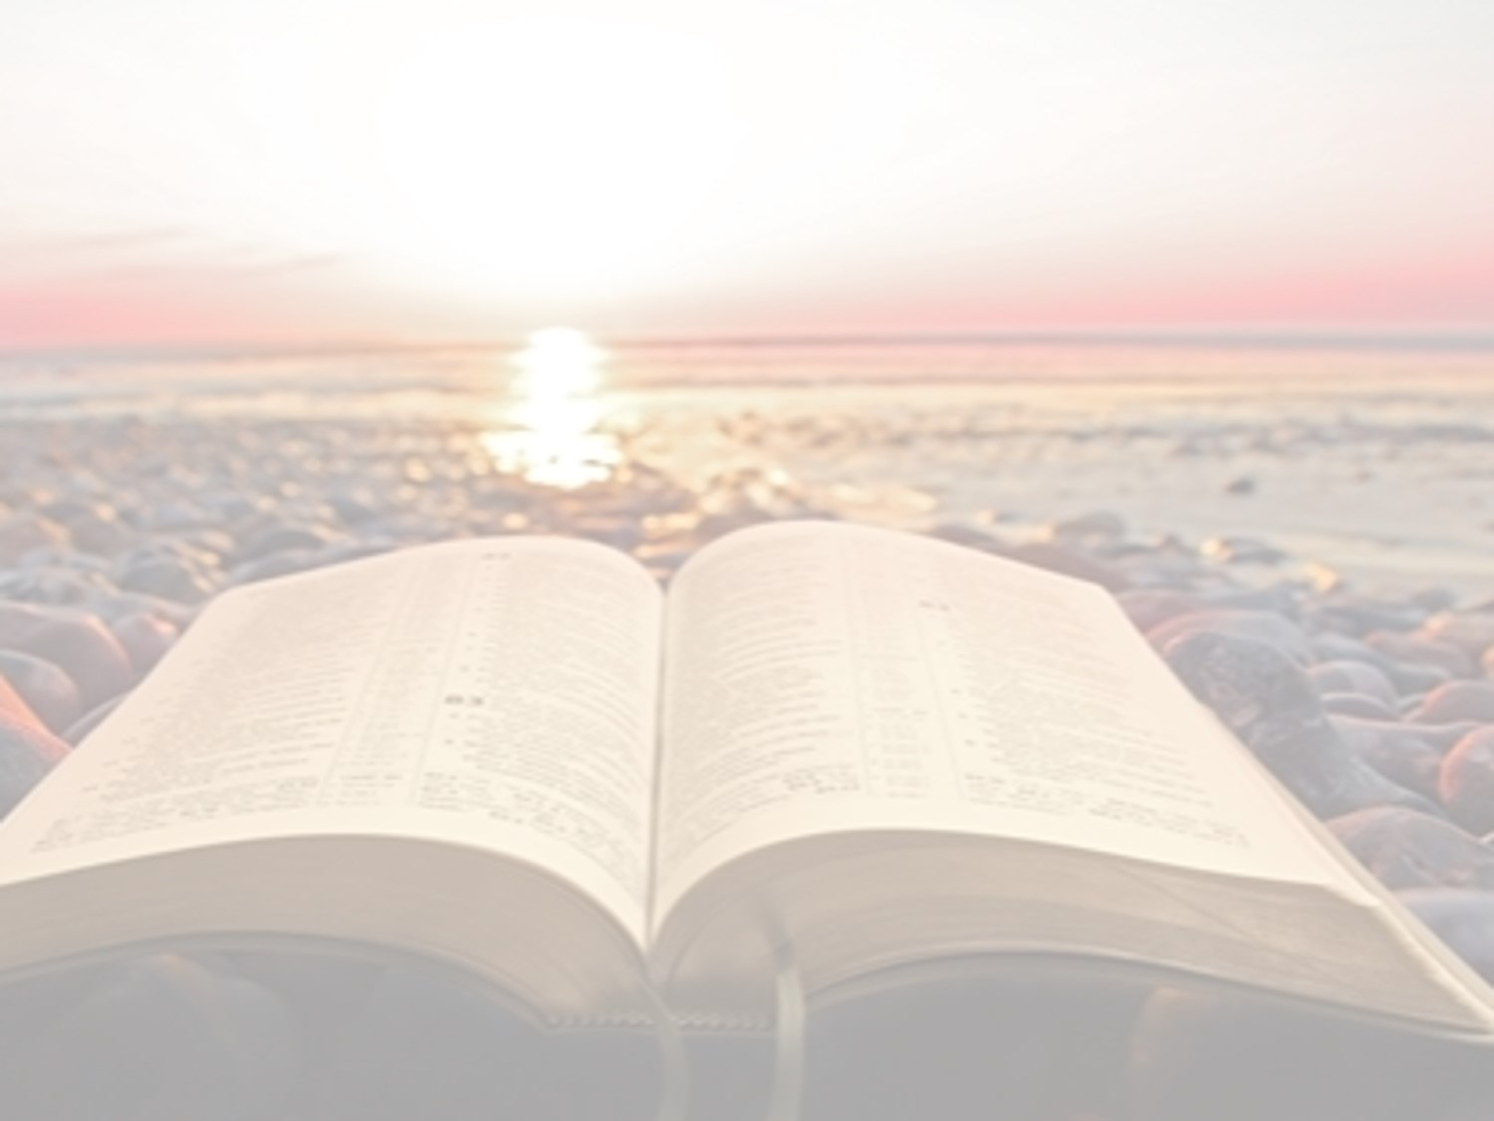
“What Must I Do To Be Saved?”
Hear The Gospel (Jn. 5:24; Rom. 10:17)
Believe In Christ (Jn. 3:16-18; Jn. 8:24)
Repent Of Sins (Lk. 13:3-5; Acts 2:38)
Confess Christ (Mt. 10:32; Rom. 10:10)
Be Baptized (Mk. 16:16; Acts 22:16)
Remain Faithful (Jn. 8:31; Rev. 2:10)
For The Erring Saint
Repent (Acts 8:22), Confess (I Jn. 1:9),
Pray (Acts 8:22)

