Slide 1
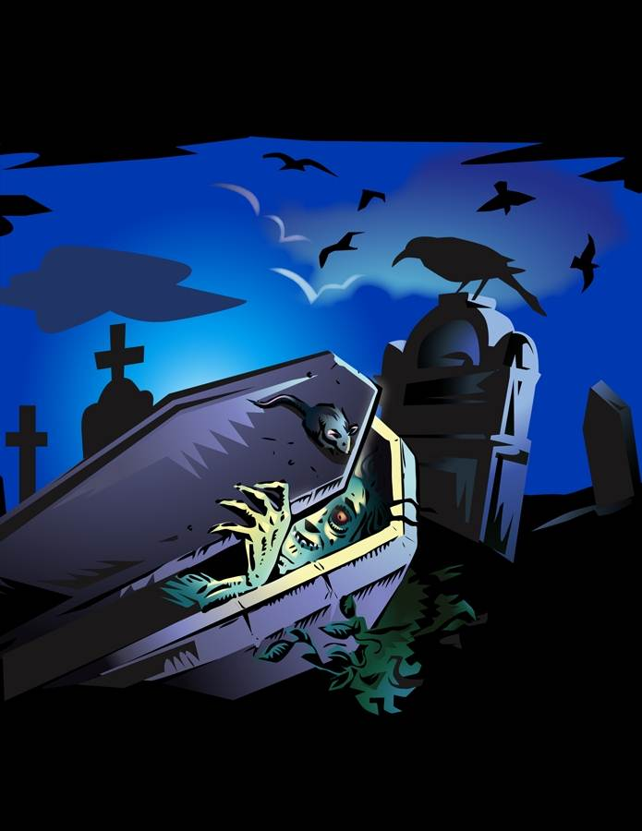
Fighting Crucified Zombies
Text:
Colossians 3:1-5
Notes:
By Nathan L Morrison
All Scripture given is from NASU unless otherwise stated
For further study, or if questions, please Call: 804-277-1983 or Visit: www.courthousechurchofchrist.com

Slide 2
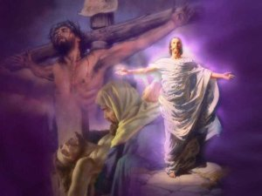
Intro
Jesus lived, died and was buried, and then rose from the dead (I Cor. 15:1-4)

Slide 3
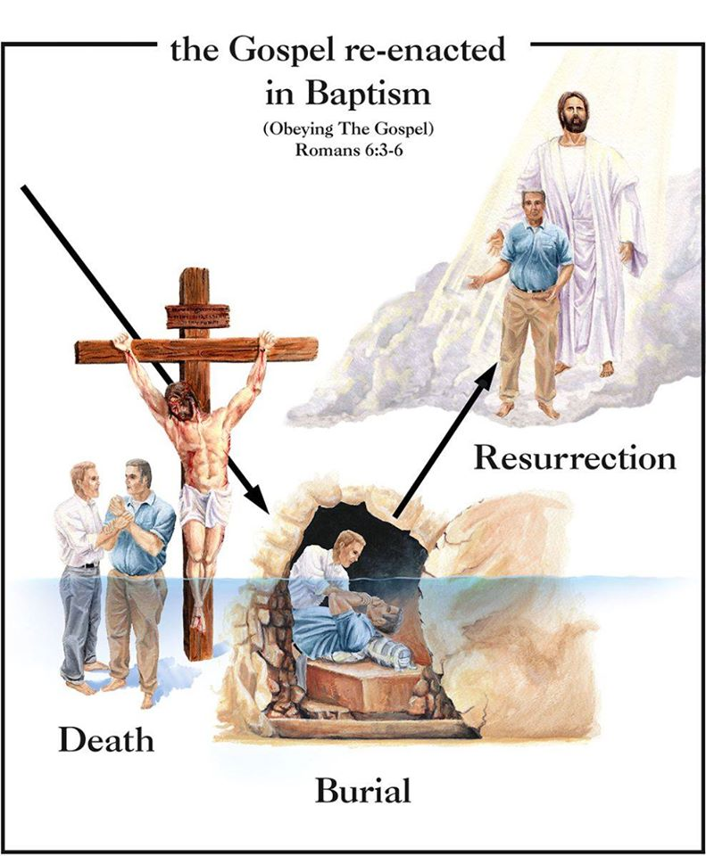
Intro
Romans 6:1-7
1. What shall we say then? Are we to continue in sin so that grace may increase?
2. May it never be! How shall we who died to sin still live in it?
3. Or do you not know that all of us who have been baptized into Christ Jesus have been baptized into His death?
4. Therefore we have been buried with Him through baptism into death, so that as Christ was raised from the dead through the glory of the Father, so we too might walk in newness of life.
5. For if we have become united with Him in the likeness of His death, certainly we shall also be in the likeness of His resurrection,
6. knowing this, that our old self was crucified with Him, in order that our body of sin might be done away with, so that we would no longer be slaves to sin;
7. for he who has died is freed from sin.
Notes:
Emphasis in Scripture mine!

Slide 4
Intro
Colossians 3:1-4
1. Therefore if you have been raised up with Christ, keep seeking the things above, where Christ is, seated at the right hand of God.
2. Set your mind on the things above, not on the things that are on earth.
3. For you have died and your life is hidden with Christ in God.
4. When Christ, who is our life, is revealed, then you also will be revealed with Him in glory.
Notes:
Emphasis in Scripture mine!

Slide 5
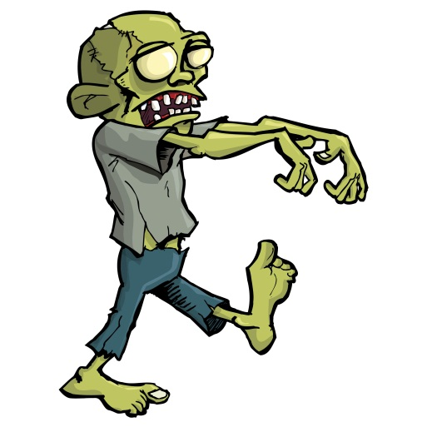
Intro
Zombies in pop-culture:
Risen undead, decayed(-ing), rotted corpses seeking one thing: Brains!
Rom. 7:21-25: We have a constant battle for control of our minds, a war of two natures: The flesh with its desires and the spirit that desires to do good.
Rom. 8:5-8: Sometimes that “old self” who was “crucified” rises up in our lives.
The “crucified zombie” wants our brains, that is, to control our mind, to act on its lusts!
Not just bad habits, but the old self is ugly, grotesque, and is dangerous!

Slide 6
Intro
Colossians 3:5 (NKJV)
Therefore put to death your members which are on the earth: fornication, uncleanness, passion, evil desire, and covetousness, which is idolatry.
Saints often must fight crucified zombies!
(An inner battle that must be won!)
Notes:
Emphasis in Scripture mine!

Slide 7
Dead to Sin, Alive In Christ
Colossians 3:3: For you have died and your life is hidden with Christ in God.
“Death” is separation:
Js. 2:26: Physical death is the separation of the spirit from the body.
Eph. 2:1: Spiritual death is man’s spirit separated from God by sin.
We can be dead in sin, or dead to sin (Romans 6:1-7)
Col. 3:3: “Dead” also indicates the relationship of the Christian to the world and its lusts.
Col. 3:7: Dying to the old life is choosing to no longer live in sin (slaves to sin) but live in righteousness (slaves of obedience) – Rom. 6:16-18
The problem: Sin didn’t die!
(Rom. 7:21-23: War of two natures)
Our “life” must be “hidden in Christ” (Col. 3:3)
Gal. 2:20: Our old self must be “crucified with Christ” so our new self can live by faith in Christ!
Notes:
Emphasis in Scripture mine!

Slide 8
Dead to Sin, Alive In Christ
Colossians 3:3: For you have died and your life is hidden with Christ in God.
We must be dead to sin to truly live in Christ!
Notes:
Emphasis in Scripture mine!

Slide 9
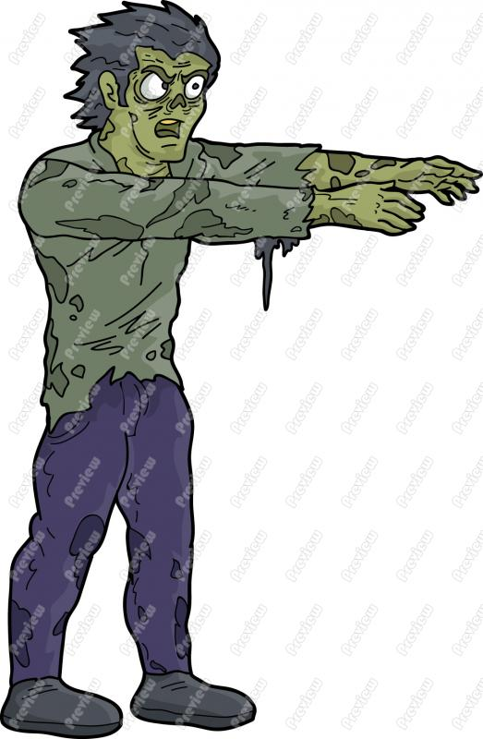
Fighting Crucified Zombies
Colossians 3:5 (NKJV): Therefore put to death your members which are on the earth: fornication, uncleanness, passion, evil desire, and covetousness, which is idolatry.
Col. 3:5: Those who have died (Col. 3:3) are told to “put to
death” (NKJV) certain things
Gal. 5:24: “Now those who belong to Christ Jesus have crucified the flesh with its passions and desires.”
Rom. 8:12-14: If “you are putting to death the deeds of the body, you will live.”
Sometimes the old self doesn’t stay dead and needs to be fought and killed all over again!
Notes:
Emphasis in Scripture mine!

Slide 10
Fighting Crucified Zombies
Colossians 3:5 (NKJV): Therefore put to death your members which are on the earth: fornication, uncleanness, passion, evil desire, and covetousness, which is idolatry.
Immorality (NASU)/Sexual Immorality (NET)/Fornication (NKJV)
I Cor. 6:13-20 (6:15-16, 18)
Heb. 13:4
Saints are to “put it to death!”
Notes:
Emphasis in Scripture mine!

Slide 11
Fighting Crucified Zombies
Colossians 3:5 (NKJV): Therefore put to death your members which are on the earth: fornication, uncleanness, passion, evil desire, and covetousness, which is idolatry.
Immorality (Fornication)
Impurity (NASU)/Uncleanness (NKJV)
Rom. 1:18-32 (1:24, 26-27)
Mt. 5:27-28; 15:19
Eph. 5:3
Saints are to “put it to death!”
Notes:
Emphasis in Scripture mine!

Slide 12
Fighting Crucified Zombies
Colossians 3:5 (NKJV): Therefore put to death your members which are on the earth: fornication, uncleanness, passion, evil desire, and covetousness, which is idolatry.
Immorality (Fornication)
Impurity (Uncleanness)
Passion (NASU)/Shameful Passion (NET)
Eph. 5:4
James 1:14-15
Saints are to “put it to death!”
Notes:
Emphasis in Scripture mine!

Slide 13
Fighting Crucified Zombies
Colossians 3:5 (NKJV): Therefore put to death your members which are on the earth: fornication, uncleanness, passion, evil desire, and covetousness, which is idolatry.
Immorality (Fornication)
Impurity (Uncleanness)
Passion (Shameful)
Evil desire
James 1:21
Saints are to “put it to death!”
Notes:
Emphasis in Scripture mine!

Slide 14
Fighting Crucified Zombies
Colossians 3:5 (NKJV): Therefore put to death your members which are on the earth: fornication, uncleanness, passion, evil desire, and covetousness, which is idolatry.
Immorality (Fornication)
Impurity (Uncleanness)
Passion (Shameful)
Evil desire
Greed (NASU)/Covetousness (NKJV) & Idolatry
Eph. 5:3-5
I Thess. 1:9; I John 5:21
Saints are to “put it to death!”
Notes:
Emphasis in Scripture mine!

Slide 15
Fighting Crucified Zombies
Colossians 3:5 (NKJV): Therefore put to death your members which are on the earth: fornication, uncleanness, passion, evil desire, and covetousness, which is idolatry.
Immorality (Fornication)
Impurity (Uncleanness)
Passion (Shameful)
Evil desire
Greed (Covetousness) & Idolatry
Being alive in Christ requires saints to “put to death” the sinful ways of the old self!
Notes:
Emphasis in Scripture mine!

Slide 16
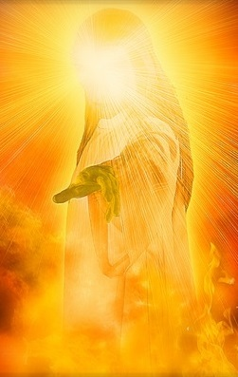
Motivation To Live In Christ
Colossians 3:4, 8-11
Colossians 3:8-11: Realization of what God in Christ has done for us – Col. 1:13-14; 3:1
Confidence in what Christ will do for us – Col. 3:4
“Lay aside the old self” (Col. 3:9)
“Put on the new self” (Col. 3:10)
Replace evil with good (Col. 3:12-17)
For our lives to be truly “hidden in Christ” (Col. 3:3) we must “put to death” the sinful practices of the world!
Notes:
Emphasis in Scripture mine!

Slide 17
Conclusion
God’s demand does not fit the view of grace some have that says you can go on sinning and God will still take care of you
Romans 6:1-2
1. What shall we say then? Are we to continue in sin so that grace may increase?
2. May it never be! How shall we who died to sin still live in it?
Whatever is in your life that belongs to your “old self” “put it to death!”
(Colossians 3:5)

Slide 18
“What Must I Do To Be Saved?”
Hear The Gospel (Jn. 5:24; Rom. 10:17)
Believe In Christ (Jn. 3:16-18; Jn. 8:24)
Repent Of Sins (Lk. 13:3-5; Acts 2:38)
Confess Christ (Mt. 10:32; Rom. 10:10)
Be Baptized (Mk. 16:16; Acts 22:16)
Remain Faithful (Jn. 8:31; Rev. 2:10)
For The Erring Saint
Repent (Acts 8:22), Confess (I Jn. 1:9),
Pray (Acts 8:22)

