Slide 1
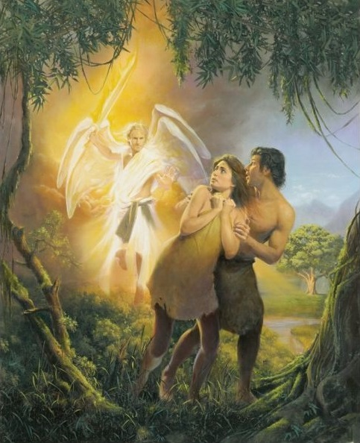
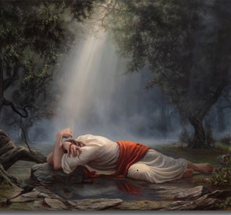
A Tale Of Two Gardens
Text: I Corinthians 15:21-22, 45
Notes:
By Nathan L Morrison
All Scripture is from NASB unless otherwise stated
For further study, or if questions, please Call: 804-277-1983 or Visit www.courthousechurchofchrist.com
Based on a lesson by Ron Halbrook

Slide 2
Intro
I Corinthians 15:21-22, 45
21. For since by a man came death, by a man also came the resurrection of the dead.
22. For as in Adam all die, so also in Christ all will be made alive.
45. So also it is written, "The first MAN, Adam, BECAME A LIVING SOUL." The last Adam became a life-giving spirit.

Slide 3
Intro
Two gardens with two very different outcomes affected the whole world! (I Corinthians 15:21-22, 45)
The Garden of Eden: Where life began, where sin entered the world and introduced death to all creation!
The Garden of Gethsemane: Where a sinless life was weighed down with sorrow over the sins of the world, where an innocent death would bring forth eternal life!

Slide 4
Intro
Which garden do you choose to remain in: Death or Life?

Slide 5
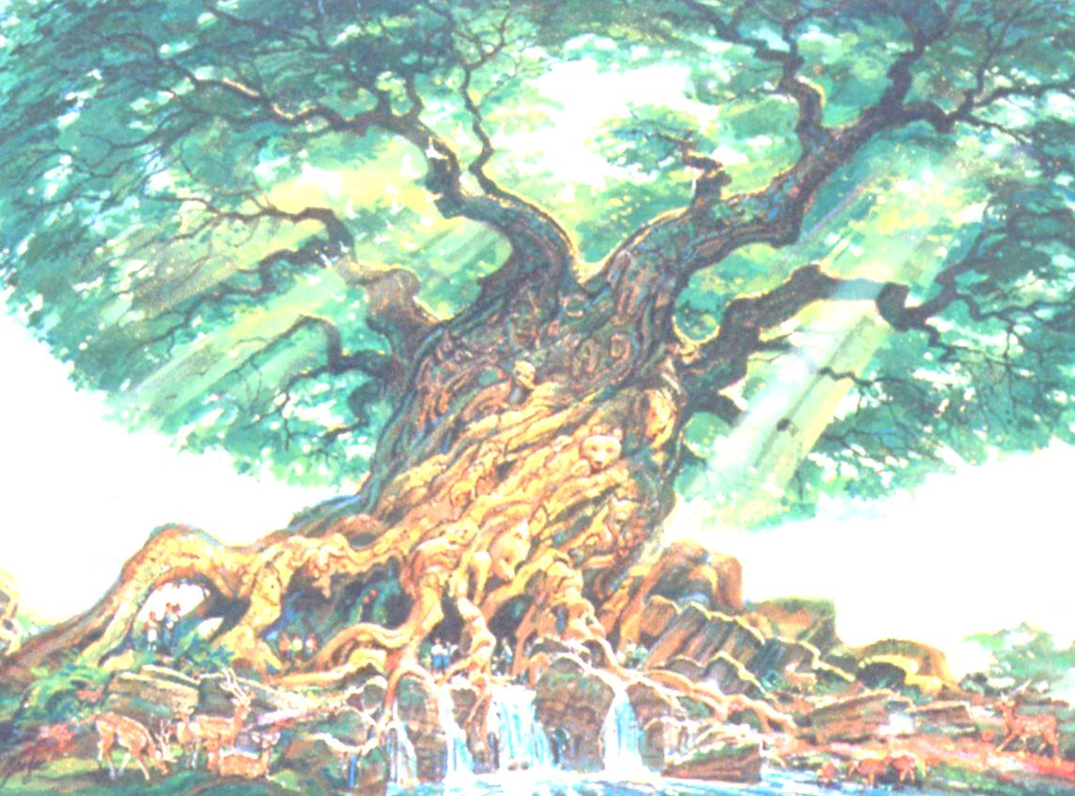
Eden (Garden of Death) | YOU | Gethsemane (Garden of Life) | YOU
Man has free will to love & obey or reject God
(John 14:15)
Though formerly dead in sins, Jesus makes us alive with Him (Eph. 2:4-10)
A place of sorrow (Gen. 3:16-17)
A place of sorrow (Mk. 14:34; Lk. 22:45
A place of willing choices (Gen. 2:16-17; 3:1-6)
Outside of Jesus Christ is sin and death and spiritual darkness (Eph. 2:1-3)
A place of willing choices Matt. 26:53-54; Jn. 18:6-9; 10:17-18
Christ was the perfect sacrifice and died for your sins so you can live eternally with Him (Heb. 9:24-28; 10:10-12, 14; Rom. 6:23)
God's word was spoken here (Gen. 2:15-18; 3:8-19)
Will you obey Him?
(Acts 2:38-41)
God's word was spoken here (Matt. 26:38, 41-42, 44, 50-56; Jn. 18:6-9)
The guilty were expelled from this garden (Gen. 3:24)
The Innocent was led from this garden (Matt. 26:57; Mark 14:53)
Are you washed in His blood? (Acts 22:16; I Cor. 6:9-11; Eph. 1:7)
The actions in this garden resulted in souls lost (Gen. 2:17; 3:3; Rom. 5:12, 14)
The actions in this garden resulted in souls saved (Rom. 5:8-9; Matt. 20:28; Heb. 2:9)
Spiritual death resulted here (Gen. 3:3; Rom. 5:12; 6:23; I Cor. 15:21-22)
Spiritual life resulted from here (Jn. 3:16; 20:31; Rom. 6:22; I Cor. 15:21-22)
Those in this garden were living but would die (I Cor. 15:45; Heb. 9:27)
The One in this garden was life-giving, never to die again (I Cor. 15:45; Rom. 6:9)
Notes:
Those in this garden were living but would die (I Cor. 15:45; Heb. 9:27
By Nathan L Morrison

Slide 6
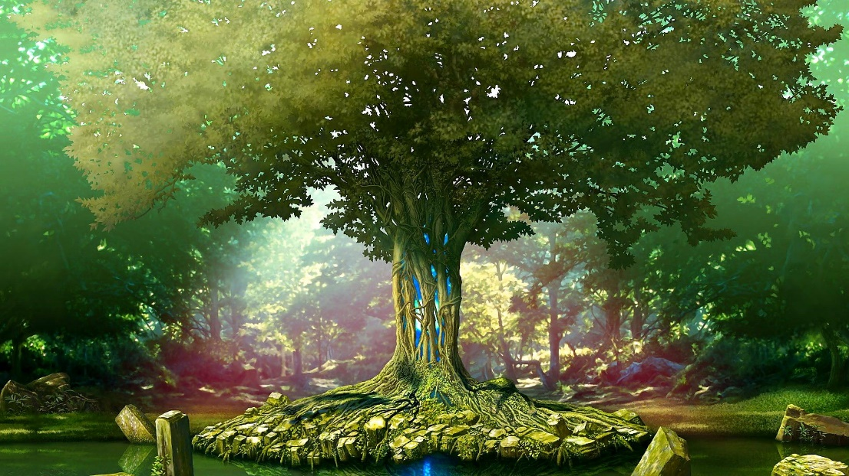
Conclusion
Sin resulted in spiritual death, and with the loss of the Tree of Life brought forth physical death!
The Tree of Life was once lost to men but can now be found in Jesus Christ!
Rev. 2:7: To Ephesus: “To him who overcomes, I will grant to eat of the tree of life which is in the Paradise of God.”
Rev. 22:1-4, 14, 17: The water of life & the tree of life – It is Jesus Who can bring us from a garden of death to the Garden of Life (Paradise) and offer it freely to His faithful saints!

Slide 7
Conclusion
Revelation 22:1-4
1. Then he showed me a river of the water of life, clear as crystal, coming from the throne of God and of the Lamb,
2. in the middle of its street. On either side of the river was the tree of life, bearing twelve kinds of fruit, yielding its fruit every month; and the leaves of the tree were for the healing of the nations.
3. There will no longer be any curse; and the throne of God and of the Lamb will be in it, and His bond-servants will serve Him;
4. they will see His face, and His name will be on their foreheads.

Slide 8
Conclusion
Revelation 22:14, 17
14. Blessed are those who wash their robes, so that they may have the right to the tree of life, and may enter by the gates into the city.
17. The Spirit and the bride say, "Come." And let the one who hears say, "Come." And let the one who is thirsty come; let the one who wishes take the water of life without cost.

Slide 9
Conclusion
A Tale Of Two Gardens
Those who obey Him (saints) will be given the right to the Tree of Life and enjoy the Garden of Paradise (new Eden) God has waiting for the faithful!

Slide 10
“What Must I Do To Be Saved?”
Hear The Gospel (Jn. 5:24; Rom. 10:17)
Believe In Christ (Jn. 3:16-18; Jn. 8:24)
Repent Of Sins (Lk. 13:3-5; Acts 2:38)
Confess Christ (Mt. 10:32; Rom. 10:10)
Be Baptized (Mk. 16:16; Acts 22:16)
Remain Faithful (Jn. 8:31; Rev. 2:10)
For The Erring Saint:
Repent (Acts 8:22), Confess (I Jn. 1:9),
Pray (Acts 8:22)

Slide 11
Additional Material
Editable Table
&
Picture

Slide 12
Eden (Garden of Death) | YOU | Gethsemane (Garden of Life) | YOU
 | By Nathan L Morrison
Man has free will to love & obey or reject God
(John 14:15)
Though formerly dead in sins, Jesus makes us alive with Him (Eph. 2:4-10)
A place of sorrow (Gen. 3:16-17)
A place of sorrow (Mk. 14:34; Lk. 22:45
A place of willing choices (Gen. 2:16-17; 3:1-6)
Outside of Jesus Christ is sin and death and spiritual darkness (Eph. 2:1-3)
A place of willing choices Matt. 26:53-54; Jn. 18:6-9; 10:17-18
Christ was the perfect sacrifice and died for your sins so you can live eternally with Him (Heb. 9:24-28; 10:10-12, 14; Rom. 6:23)
God's word was spoken here (Gen. 2:15-18; 3:8-19)
Will you obey Him?
(Acts 2:38-41)
God's word was spoken here (Matt. 26:38, 41-42, 44, 50-56; Jn. 18:6-9)
The guilty were expelled from this garden (Gen. 3:24)
The Innocent was led from this garden (Matt. 26:57; Jn. 18:13)
Are you washed in His blood? (Acts 22:16; I Cor. 6:9-11; Eph. 1:7)
The actions in this garden resulted in souls lost (Gen. 2:17; 3:3; Rom. 5:12, 14)
The actions in this garden resulted in souls saved (Rom. 5:8-9; Matt. 20:28; Heb. 2:9)
Spiritual death resulted here (Gen. 3:3; Rom. 5:12; 6:23; I Cor. 15:21-22)
Spiritual life resulted from here (Jn. 3:16; 20:31; Rom. 6:22; I Cor. 15:21-22)
Those in this garden were living but would die (I Cor. 15:45; Heb. 9:27)
The One in this garden was life-giving, never to die again (I Cor. 15:45; Rom. 6:9)
Notes:
Those in this garden were living but would die (I Cor. 15:45; Heb. 9:27
By Nathan L Morrison

