Slide 1
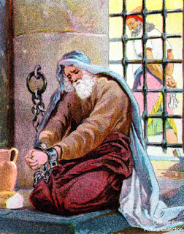
Manasseh’s Hope
Text:
II Chronicles 33:1-17

Slide 2
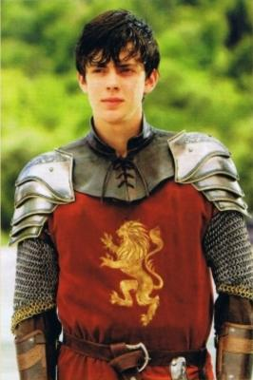
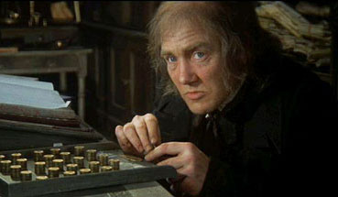
Intro
In all genres of storytelling some of the greatest successes have been stories of redemption
Why do such stories capture
our attention and our hearts?
People love a story of redemption (even in
fiction): the rise and fall of a person
Notes:
Images L – R:
Ebeneezer Scrooge from Charles Dickens’ ‘A Christmas Story’: Portrayed by Albert Finney
Edmund Pevensie from C.S. Lewis’ The Chronicles of Narnia: Portrayed by Skandar Keynes
Darth Vader/Anakin Skywalker from George Lucas’ Star Wars Series: Anakin portrayed by Hayden Christiansen

Slide 3
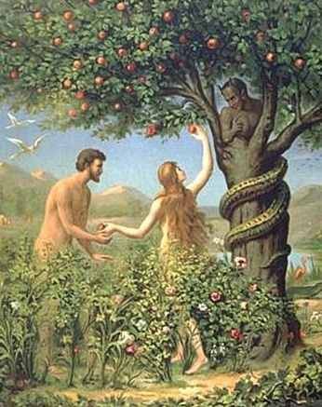
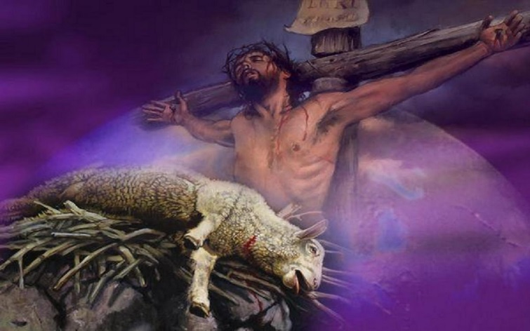
Intro
Why do we love such a story?
As Christians it is our story: Christ died and shed His blood to redeem us! (Eph. 1:7)
Redemption means = “to buy back,” “to purchase.”
The main theme in God’s Word from the beginning is one of Redemption
The redemption of mankind from the fall of man in the Garden of Eden!
We sold ourselves to sin and Jesus bought us back with His own blood!
(I Pet. 1:18-19)

Slide 4
Intro
King Manasseh
II Chr. 33:1-10: The sins of Manasseh.
II Kings 21:10-16: The judgment of the Lord on Manasseh (prophecy).
II Chr. 33:11: The fulfillment of the prophecy concerning Manasseh.
A sad end to the son of the righteous King Hezekiah!

Slide 5
Intro
In Manasseh’s life we see the tragic rise and fall of a king, but in his despair, there was hope!

Slide 6
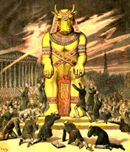
Manasseh’s Sins
During the reign of King Hezekiah, Manasseh’s father, Israel (Northern Kingdom) was carried off into captivity by Assyria in 721 B.C.
The reasons for their punishment are given in II Kings 17:7-23:
They built high places (altars) all across the land to other gods.
They built golden calves and altars and shrines to Baal and the Asherim.
They worshiped the whole host of heaven.
They served false gods and sacrificed their children as burnt offerings to them.
They practiced witchcraft and entreated Mediums and other false magic.

Slide 7
Manasseh’s Sins
Israel’s sins parallel Manasseh’s sins (II Chronicles 33:1-10)!
II Kings 21:16: He “shed very much innocent blood until he had filled Jerusalem from one end to another.”
Jewish tradition says Isaiah the prophet was killed by being sawn in two – Heb. 11:37
God deported the nation of Israel for all the same sins Manasseh caused Judah to commit in a very short period of time.
Foreshadowing Judah’s judgment later (Jeremiah 52; II Kings 24:3-4), God had him deported to Babylon (under Assyrian rule) – II Chronicles 33:11
Sound familiar?

Slide 8
Manasseh’s Sins
How could such a person as Manasseh ever be redeemed?
We can look at our own lives and ask the same question:
“How could I ever be redeemed from the things I have done?”
There was Hope: Manasseh’s tale did not end in a Babylonian prison!

Slide 9
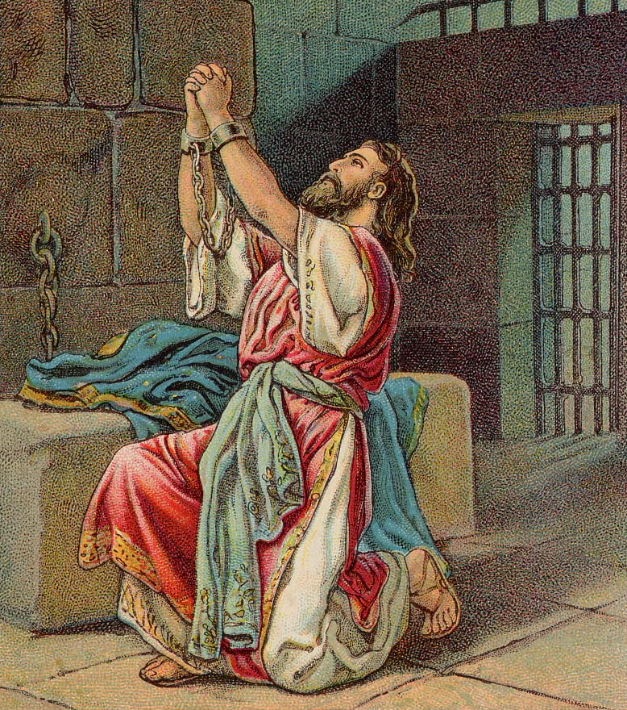
Manasseh’s Redemption
Manasseh had been captured and led away as a slave to the city of Babylon (Under Assyrian rule).
II Chr. 33:12-13: Manasseh prayed to God from a repentant heart. He humbled himself before God!
God heard his prayer and restored him to his kingdom. God brought him home.
Could a man like Manasseh be redeemed, who “shed very much innocent blood”? He was by the mercy of God!
This tells us: Israel could have been redeemed too, but they did not heed the prophets, nor did they humble themselves before God!

Slide 10
Manasseh’s Redemption
Manasseh lived the part of the Prodigal Son in the parable Jesus told in Luke 15:11-32:
Manasseh lived according to his own will & did what was right in his own eyes, with the inheritance from his father (he inherited a kingdom!)
He found himself in a foreign land, separated from his Heavenly Father.
He found himself at the bottom of the barrel; his own strength had failed him.
He humbled himself and was restored back to his family with full honors.
We see in Manasseh the spiritual application of that story: He humbled himself in prayer, coming back to God. God heard him and restored him to his full position of power.

Slide 11
Manasseh’s Redemption
God has made the same promise to us – I John 1:9
In this, Manasseh is an example for us:
When we find ourselves in the pit of sin, enemies of Christ, we need to have the heart of Manasseh – He “humbled” himself before the Lord.
There was Hope:
A repentant heart can be redeemed and restored!

Slide 12
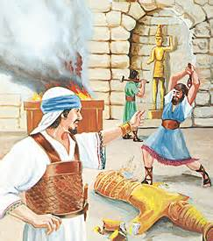
Manasseh’s Reformation
Manasseh was restored to his kingdom
He demonstrates what true repentance is: A change of heart
II Chr. 33:14-17:
The city of Jerusalem had fallen into disrepair, and he orders the walls rebuilt.
He removed the idols and altars, including the altars from the Temple and didn’t just move them to storage, but he had them thrown outside the city over the city walls.
He sacrificed peace and thanks offerings to the Lord and commanded the people to serve God.
The people could see from his actions he wasn’t just saying it, but that he meant it!

Slide 13
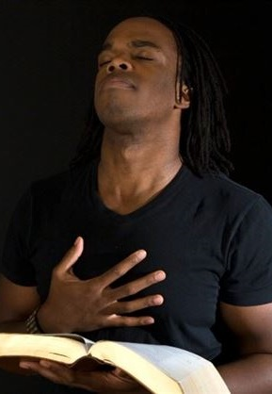
Manasseh’s Reformation
The Lord expects a repentant heart to make changes!
Matthew 3:8: John the Immerser told the crowds to “bear fruits in keeping with repentance.”
Acts 26:19-20: Paul declared to Jews & Gentiles that they should perform “deeds consistent with repentance” (NET)
There was Hope:
A repentant heart can reform and change their lives completely!

Slide 14
Conclusion
Manasseh’s hope is your hope!
Your sins: We have all sinned (Rom. 3:23; Js. 1:14-16) – Our sins separate us from God
Your redemption: Christ shed His blood to redeem us, to purchase back our souls (Eph. 1:7; I Pet. 1:18-19) – When we repent & obey the gospel, we belong to Jesus
Your reformation: Must no longer live as our former ways (Matt. 3:8; Acts 26:20) – Must “bear fruit in keeping with repentance”

Slide 15
Conclusion
There was hope for Manasseh, there’s hope for you!
Have you been redeemed?

Slide 16
“What Must I Do To Be Saved?”
Hear The Gospel (Jn. 5:24; Rom. 10:17)
Believe In Christ (Jn. 3:16-18; Jn. 8:24)
Repent Of Sins (Lk. 13:3-5; Acts 2:38)
Confess Christ (Mt. 10:32; Rom. 10:10)
Be Baptized (Mk. 16:16; Acts 22:16)
Remain Faithful (Jn. 8:31; Rev. 2:10)
For The Erring Saint:
Repent (Acts 8:22), Confess (I Jn. 1:9),
Pray (Acts 8:22)

