Slide 1

001.1 - Holy, Holy, Holy - 1.2
End of Verse 1

Slide 2
Deborah, the Mother of Israel
Judges 4 & 5

Slide 3
The Psalmist is Hated…
I went about as though I grieved for my friend or my brother; I bowed my head in grief as though weeping for my mother.”
Psalm 35:14

Slide 4
Mothers are a big deal…

Slide 5
The Children of Israel lived as though they had no mother…
Judges 2:10; 17:6
Judges 4:1

Slide 6
Deborah, the Mother of Israel

Slide 7
Deborah, the Mother of Israel
I. Voice of Wisdom –Judges 4:4-5
II. Pillar of Support– Judges 4:6-10
III. An Encouragement– Judges 4:12-14
The Song of Deborah- Judges 5:1-31

Slide 8
Deborah, the Mother of Israel
We are living in a world full of people who live as though they have no mother…

Slide 9
Deborah, the Mother of Israel
Mothers in Faith
Mary– John 19:26-27
Rufus’ Mother– Romans 16:13
Older Women in the Church– 1 Timothy 5:1

Slide 10
Deborah, the Mother of Israel
Women Today Must Be…
A Voice of Wisdom
Proverbs 31:26; 2 Timothy 1:5; 3:15
Proverbs 4:5-13

Slide 11
Deborah, the Mother of Israel
Women Today Must Be…
A Pillar of Support
Genesis 2:18; Romans 16:1-2, 3-4, 6, 12, 13

Slide 12
Deborah, the Mother of Israel
Women Today Must Be…
An Encouragement
Ephesians 6:13-17; Ephesians 3:10; Hebrews 11:32

Slide 13
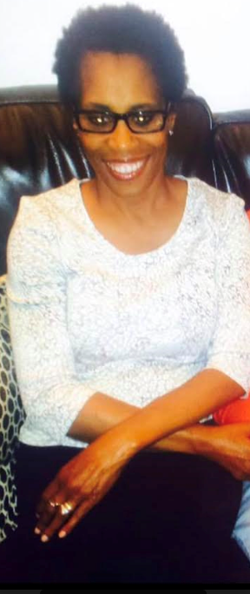
LINDA IRIS RUFFIN
January 2, 1963– September 9, 2015

Slide 14
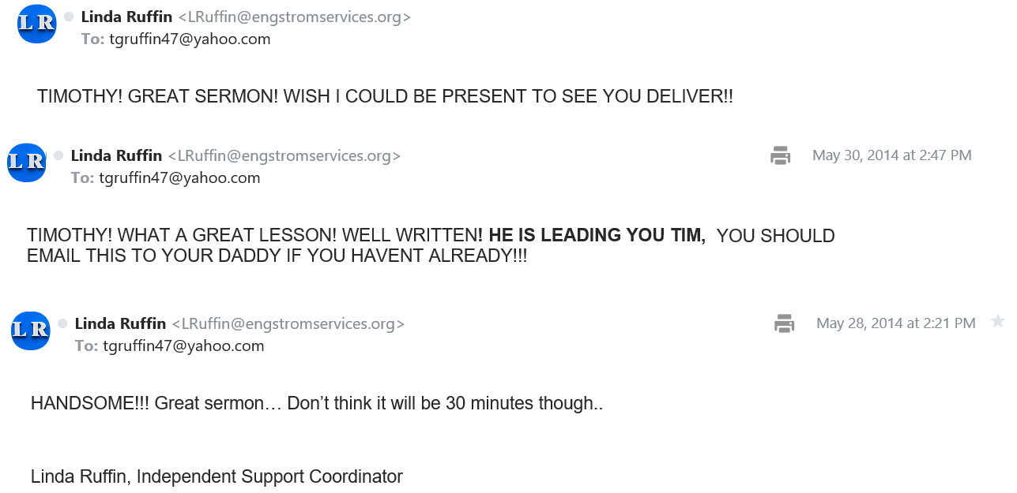

Slide 15

Deborah, the Mother of Israel
Women Today Must Be…
An Encouragement
Ephesians 6:13-17; Ephesians 3:10
Hebrews 11:32

