Slide 1
“Behold, the Man!”
John 19:1-5

Slide 2
“Behold, the Man!” John 19:1-5
Two Men Are On Trial

Slide 3
“Behold, the Man!” John 19:1-5
“I am innocent of this man’s blood;
see to it yourselves.”
Matthew 27:24

Slide 4
“Behold, the Man!” John 19:1-5
Jesus is Scourged.
John 19:1

Slide 5
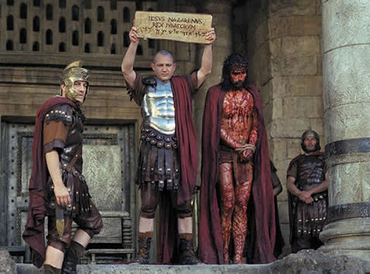
“Behold, the Man!”
John 19:5

Slide 6
“Behold, the Man!” John 19:1-5
Jesus Was Man
John 1:1-3, 14
Philippians 2:6-8

Slide 7
“Behold, the Man!” John 19:1-5
Jesus was a man who experienced the same physical, emotional, and spiritual challenges that we face today.

Slide 8
“Behold, the Man!” John 19:1-5
Jesus Was Man Who…
Experienced Physical Weaknesses
Hunger: Matthew 4:2; Matthew 21:18

Slide 9
“Behold, the Man!” John 19:1-5
Jesus Was Man Who…
Experienced Physical Weaknesses
Thirst: John 4:7; John 19:28

Slide 10
“Behold, the Man!” John 19:1-5
Jesus Was Man Who…
Experienced Physical Weaknesses
Fatigue: John 4:6; Mark 6:31; Mark 4:38

Slide 11
“Behold, the Man!” John 19:1-5
Jesus Was Man Who…
Had Emotions
Anger: Matthew 23:27, 33; John 2:13-17

Slide 12
“Behold, the Man!” John 19:1-5
Jesus Was Man Who…
Had Emotions
Compassion: Mark 1:41; Mark 6:34; 8:2; Luke 7:13

Slide 13
“Behold, the Man!” John 19:1-5
Jesus Was Man Who…
Had Emotions
Sorrow: Isaiah 53:3; John 11:28-36;
Mark 14:34; Luke 22:39-44

Slide 14
“Behold, the Man!” John 19:1-5
What’s the Point?
In spite of His physical and emotional challenges, Jesus always remained faithful to His Father.

Slide 15
“Behold, the Man!” John 19:1-5
Jesus Remained Faithful to God
Philippians 2:6-8; Hebrews 5:7-9
Ephesians 1:22;
Revelation 3:21; 5:4-7; 22:13; 19:16

Slide 16
“Behold, the Man!” John 19:1-5
The Merciful & Faithful High Priest
“Since therefore the children share in flesh and blood, He Himself likewise partook of the same things, that through death, He might destroy the one who has the power of death, that is, the devil, and deliver all those who through fear of death were subject to lifelong slavery… Therefore, He had to be made like His brothers in every respect, so that He might become a merciful and faithful high priest in the service of God, to make propitiation for the sins of the people. For because He Himself suffered when tempted, He is able to help those who are being tempted.”
Hebrews 2:14-18; 4:14-16

Slide 17
“Behold, the Man!” John 19:1-5
The Merciful & Faithful High Priest
“Since then we have a Great High Priest who has passed through the heavens, Jesus, the Son of God, let us hold fast our confession. For we do not have a High Priest who is unable to sympathize with our weaknesses, but One who in every respect has been tempted as we are, yet without sin. Let us then with confidence draw near to the throne of grace, that we may receive mercy and find grace to help in time of need.”
Hebrews 4:14-16

