Slide 1
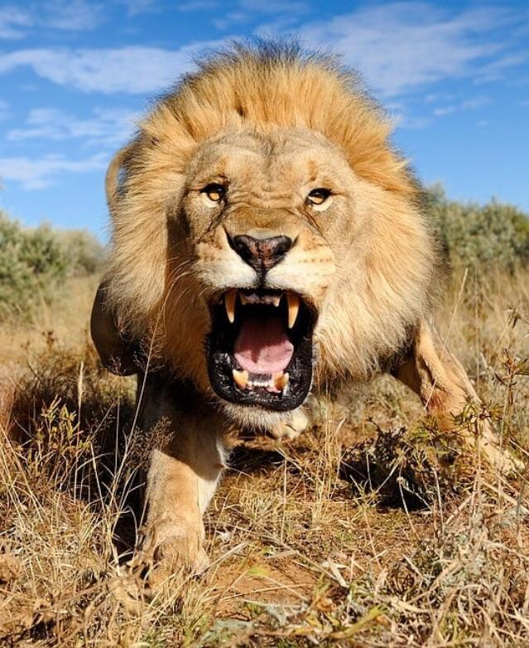
Standing fearless in fearful times
1 Peter 5:8-9

Slide 2
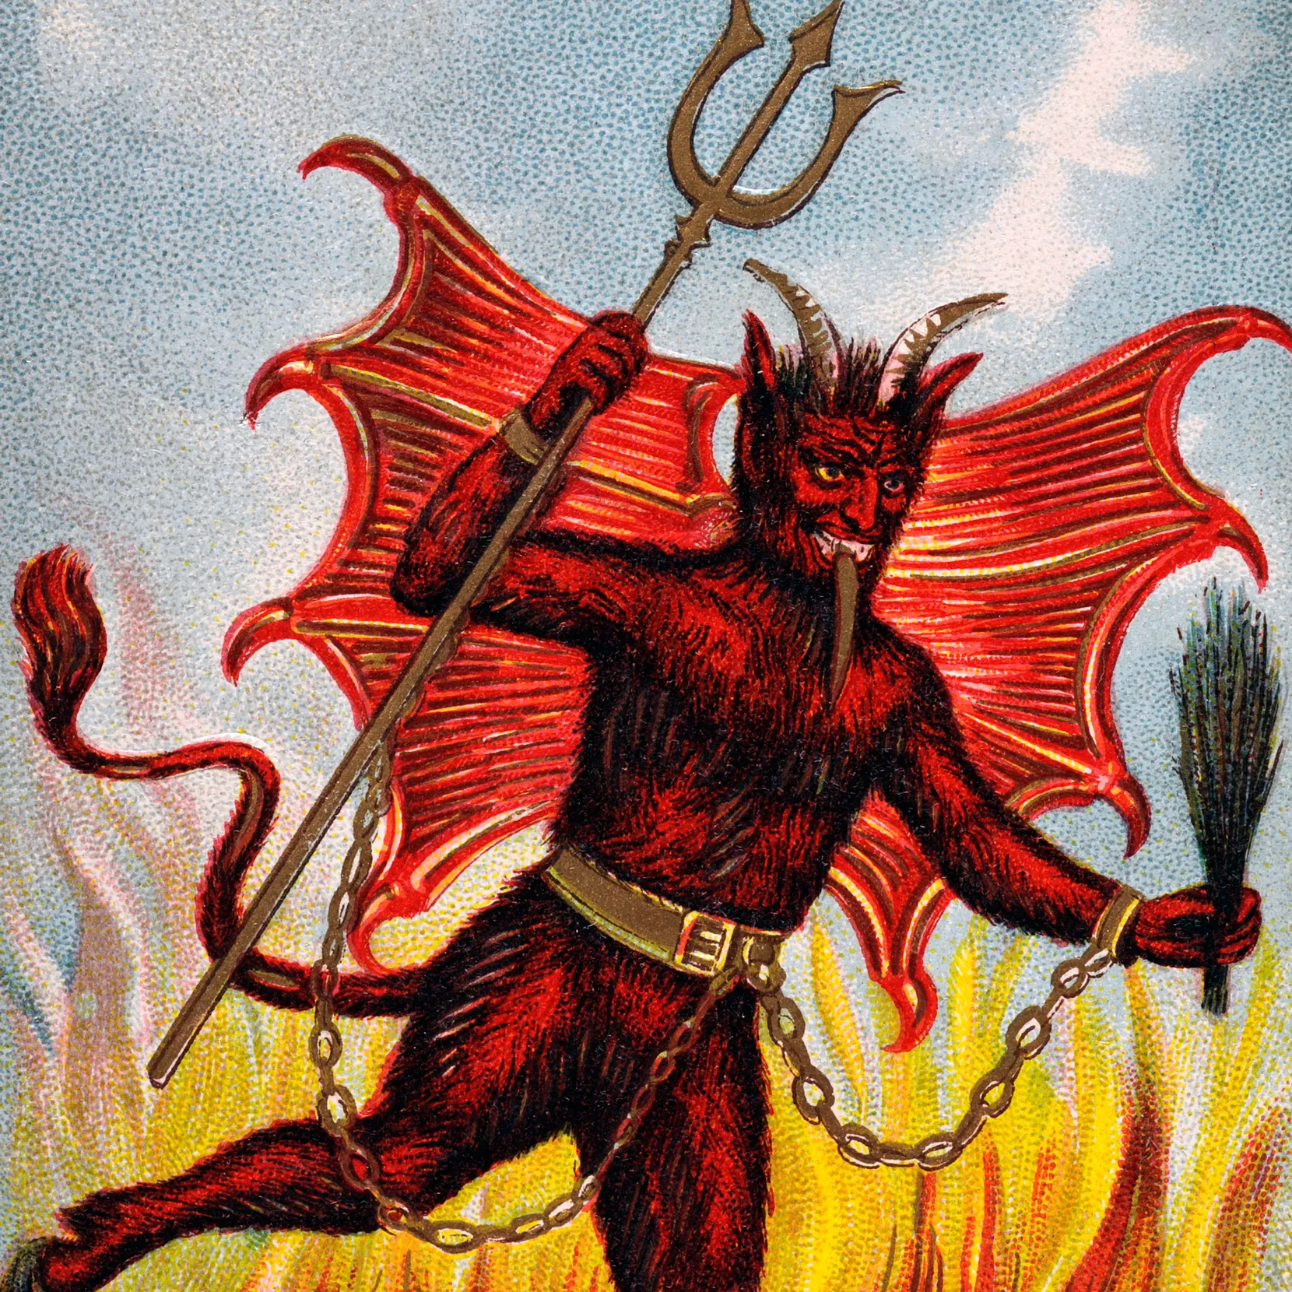
Expository of 1 peter 5:8,9
The “traditional” view of this verse is that it is a simple a warning to watch ourselves and beware of temptations by Satan.
I would propose a slightly different, but more applicable view.
To support this proposition, it is vital to examine the full context of this passage, the epistle of 1 Peter.
Be sober-minded; be watchful. Your adversary the devil prowls around like a roaring lion, seeking someone to devour. Resist him, firm in your faith, knowing that the same kinds of suffering are being experienced by your brotherhood throughout the world.
(1 Peter 5:8-9 ESV)

Slide 3
Summary of 1 peter
The epistle was written by Peter around 63-64 A.D. to Gentile Christians who were or would be experiencing hardships for their faith.
Nero’s ban and persecution began in July of 64 (or 67), if it had not already begun it was imminent.
Peter indicates he was writing from “Babylon” (Romans 5:13). This is generally believed to be a reference to Rome.
Chapter One addresses the salvation wrought by Jesus Christ.
Peter reminds his brethren this inheritance in Christ was incorruptible, undefiled and would not fade away (1:4).
He braces them for trials that would last “a little while” but reminds them they are kept by the power of God (1:6).
He charges them to “be holy” (1:15), trust God will who will judge impartially (1:17) and reminds them to love one another (1:22).

Slide 4
Summary of 1 peter
Chapter two begins with the command to lay aside all malice, guile, hypocrisy, envy and evil speaking (2:1).
Desire the pure milk of the word (2:2),
Offer up spiritual sacrifices (2:5)
Abstain form fleshly lusts which war against the soul (2:11)
From 2:13-3:12 He addresses the importance of submission
To government 2:13
To masters (2:18)
And in marriage (3:1-12)

Slide 5
Summary of 1 peter
Beginning in verse 13 of chapter three, the focus of the letter changes to suffering:
Christ’s example of suffering 3:18-22
The consequence of following Christ and the expectation of judgement and suffering (4:1-6)
He gives specific commands regarding suffering (4:7-19)
Note especially 4:12-17
He enjoins the elders to shepherd the flock, and the flock, young people specifically to submit to the elders.
Then in this context of suffering comes the text of our lesson this evening.

Slide 6
Expository of 1 peter 5:8,9
You are being watched, hunted…
Hunted by those who would accuse you, hunted by those who would destroy you.
Be sober-minded; be watchful. Your adversary the devil prowls around like a roaring lion, seeking someone to devour. Resist him, firm in your faith, knowing that the same kinds of suffering are being experienced by your brotherhood throughout the world.
(1 Peter 5:8-9 ESV)

Slide 7
The Defamation of Christians
In the 1st Century
“They are incestuous”
“They are cannibals”
“They are atheists”
“They are traitors”
“They are revolutionaries”

Slide 8
Importance of holiness
You are being watched! – 1 Peter 1:15-17; 1 Peter 2:11-12
You are children of God! – 1 Peter 2:1-3
You are Living Stones – 1 Peter 2:4-5
You are a Chosen Generation – 1 Peter 2:9-10
You were Called to This – 1 Peter 3:8-9
Your Holiness will be a Witness – 3:13-16
We Have Wasted Enough Time – 4:3-6
To Partake of Christ’s Suffering – 4:12-16

Slide 9
The Defamation of Christians
In the 1st Century
In the 21st Century
“They are incestuous”
“They are cannibals”
“They are atheists”
“They are traitors”
“They are revolutionaries”
“They are homophobes”
“They are xenophobes”
“They are bigots”
“They are misogynists”
“They are ‘deniers’”

Slide 10
Objective vs. subjective judgment
OBJECTIVE
SUBJECTIVE
It is Divine
It is Immutable
It is Righteous
It is Healthy
It is Just
It is Demonic – James 3:13-18
It is Unstable – Jeremiah 17:9
It is Hypocritical – Matt. 7:1-6
It is Destructive – Romans1:18-32
It is Unjust – Proverbs 20:23

Slide 11
Victory In Jesus Romans 8:31-39
“IF GOD IS FOR US, WHO CAN BE AGAINST US?”
Tribulation?
Distress
Persecution
Famine
Nakedness
Peril
Sword
Death
Life
Angels
Principalities
Powers
Things Present
Things to Come
Height
Depth
Any Other Created Thing
“YET IN ALL THESE THINGS WE ARE MORE THAN CONQUERORS THROUGH HIM WHO LOVED US.”

