Slide 1
A Father’s Charge To His Son
Text:
I Chronicles 28:9-10
Notes:
Prepared by Nathan L Morrison
All Scripture given is from NASB unless otherwise stated
For further study, or if questions, please Call: 804-277-1983 or Visit: www.courthousechurchofchrist.com
Adapted from a lesson by Richie Thetford

Slide 2
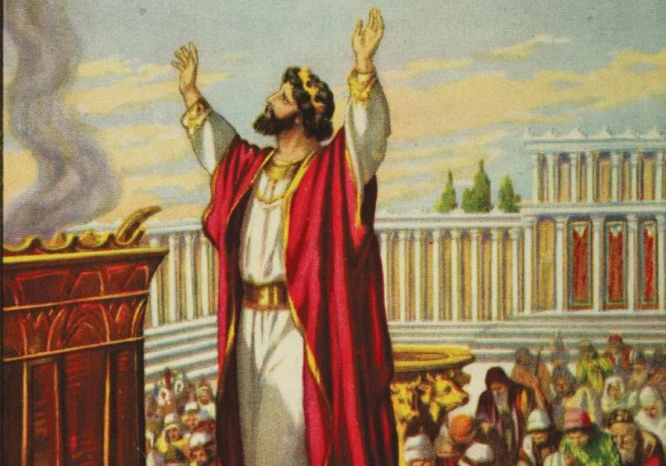
Intro
I Chronicles 28:1-8
David had a great desire to “build a permanent home for the ark of the covenant of the Lord” (28:2)
He had prepared to build it but God told him since he was a “man of war” he was not permitted (28:3)
David gathered all the people together to announce to them God had chosen Solomon to build the temple, and then he charged the people to keep God’s laws (28:8)

Slide 3
Intro
I Chronicles 28:9-10
9. "As for you, my son Solomon, know the God of your father, and serve Him with a whole heart and a willing mind; for the LORD searches all hearts, and understands every intent of the thoughts. If you seek Him, He will let you find Him; but if you forsake Him, He will reject you forever.
10. "Consider now, for the LORD has chosen you to build a house for the sanctuary; be courageous and act."

Slide 4
Intro
Parents may not all be royalty today, but they do leave behind a legacy!
What do you pass down to your children?
What have you taught them that they will take into adulthood?
Although made to an ancient king, David’s charge to
his son contains lessons for today!

Slide 5
“Know the God of Your Father”
David knew the importance of knowing God
Judges 21:25
Hosea 4:6
How can your children know God today?
Ephesians 6:4
I John 2:3-4
III John 4: John said, “I have no greater joy than this, to hear of my children walking in the truth.”
Teach your children to know the God you serve!

Slide 6
“Serve Him with a Whole Heart and a Willing Mind”
Service to God has always been required of men
I Chronicles 29:19: David prayed (29:10ff) for his son, Solomon, that he would have “a perfect heart to keep Your commandments, Your testimonies and Your statutes, and to do them all.”
A “perfect heart” is a “whole heart” (ESV).
James 1:21-22: Those who have a “willing mind” to serve God will, in humility, receive the word of God that can save one’s soul, & obey (Heb. 5:9)

Slide 7
“Serve Him with a Whole Heart and a Willing Mind”
Our service to God must be a wholehearted service!
Parents: What do your children see?
Mk. 12:30: “And you shall love the Lord your God with all your heart and with all your soul and with all your mind and with all your strength.”
Do your children see you serve God with a “whole heart” or a “compromising heart”?
Do they see you serve God with a “whole heart” or a “convenient heart”?

Slide 8
“Serve Him with a Whole Heart and a Willing Mind”
Teach your children to serve God from a whole heart and a willing mind!

Slide 9
“The Lord Searches (& Understands) All Hearts”
God said this to Samuel when choosing David as king – I Sam. 16:7
Man judges by appearance but God judges the heart!
I Sam. 16:12-13: David is anointed King!
I Sam. 13:14: David is the man “after God’s own heart”
In the Psalms, David welcomed the search of God (Ps. 139:23-24)

Slide 10
“The Lord Searches (& Understands) All Hearts”
God has always sought the hearts of men and held them accountable!
Gen. 6:5: Mankind in Noah’s time was punished
Mt. 15:19-20: Man is defiled because of evil thoughts
Rom. 14:12; II Cor. 5:10: Man will one day give an account!
Heb. 4:12: The word of God is “able to judge the thoughts and intentions of the heart!”
Teach your children to adorn their hearts with righteousness!

Slide 11
“If You Seek Him, He Will Let You Find Him”
The Jews were told they could seek and find God if they searched for Him with all their hearts (Jeremiah 29:13)
Ps. 119:2: David said a blessing is in store for those that “seek Him with all their heart.”
King Josiah, as a youth, sought after “the God of his father David” and made reforms! (II Chronicles 34:3)

Slide 12
“If You Seek Him, He Will Let You Find Him”
Acts 17:27: The apostle Paul told the Athenians to seek God and they could find Him
Matthew 7:7-8: Jesus said those who seek will find

Slide 13
“If You Seek Him, He Will Let You Find Him”
What is promised to those who seek after the Lord?
Romans 2:7: Eternal life! The promise of life is eternal life! (II Tim. 1:1)
Who or what are YOU seeking?
Teach your children to seek after God and His ways!

Slide 14
“If You Forsake Him, He Will Reject You Forever”
Joshua 24:20: Joshua warned Israel of this consequence
I Samuel 13:13-14; 15:26: Samuel taught this harsh lesson to Saul
Matthew 10:32-33: Must confess Jesus, not deny Him
Jn. 12:42-43: The Jewish rulers denied Him, though they knew Him!
Mt. 26:74-75: Peter sinned when he denied Jesus 3 times!
Jn. 12:48: Jesus’ word will judge those who reject Him!
II Thess. 1:7-9: Penalty of rejecting God is an eternity away from His presence

Slide 15
“If You Forsake Him, He Will Reject You Forever”
Heb. 13:5: If we DO the will of God, He has promised to never leave or forsake us
Hebrews 5:9: He saves those who obey Him
Teach your children to serve God, & not reject Him, to hold fast to His word!

Slide 16
Conclusion
David’s charge to Solomon in I Chr. 28:9-10 is still great advice today!
Fathers & Mothers: Teach your children these truths while they are young (Josiah), and even as adults they need to be reminded of them (Solomon) – It’s never too late!
Parents: Don’t just say these things but live it and let your children see how to be faithful to God by your faithful example!

Slide 17
Conclusion
David’s charge to Solomon sums up the life of a faithful child of God no matter what time-period it is!

Slide 18
“What Must I Do To Be Saved?”
Hear The Gospel (Jn. 5:24; Rom. 10:17)
Believe In Christ (Jn. 3:16-18; Jn. 8:24)
Repent Of Sins (Lk. 13:3-5; Acts 2:38)
Confess Christ (Mt. 10:32; Rom. 10:10)
Be Baptized (Mk. 16:16; Acts 22:16)
Remain Faithful (Jn. 8:31; Rev. 2:10)
For The Erring Saint:
Repent (Acts 8:22), Confess (I Jn. 1:9),
Pray (Acts 8:22)

