Slide 1
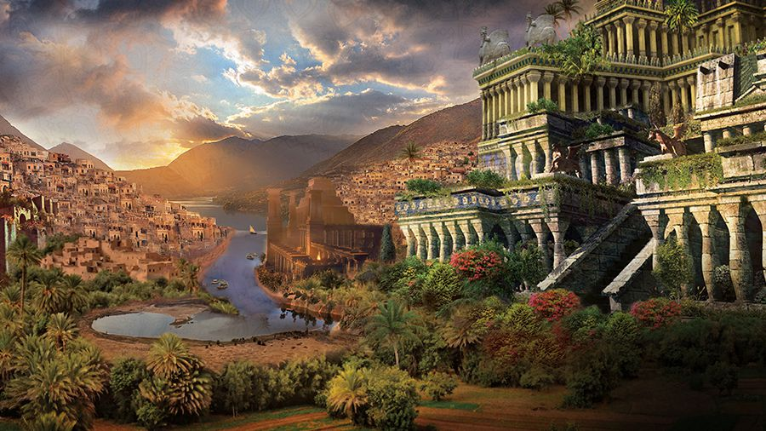
When Babylon is Home

Slide 2
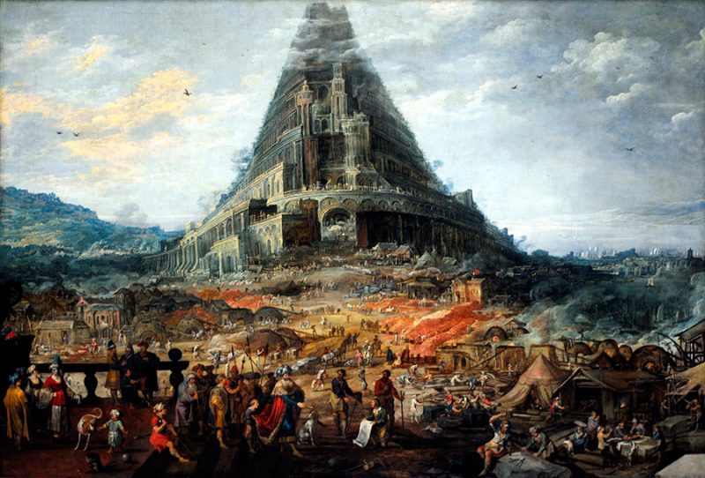
The Tower of Babel

Slide 3
The Tower of Babel
Early effort to thwart the plan of God
And you, be fruitful and multiply, increase greatly on the earth and multiply in it.” – Genesis 9:7
Then they said, “Come, let us build ourselves a city and a tower with its top in the heavens, and let us make a name for ourselves, lest we be dispersed over the face of the whole earth.” (11:4)

Slide 4
The Tower of Babel
Early effort to thwart the plan of God
God would not be thwarted!
Confused their language
Name of place becomes Babel
Remainder of Old Testament, word is translated Babylon
Becomes synonymous with a nation in rebellion against God
So the Lord dispersed them from there over the face of all the earth,
and they left off building the city.

Slide 5
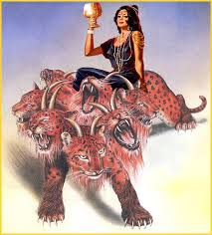
Babylon in Revelation

Slide 6
Then one of the seven angels who had the seven bowls came and said to me, “Come, I will show you the judgment of the great prostitute who is seated on many waters, with whom the kings of the earth have committed sexual immorality, and with the wine of whose sexual immorality the dwellers on earth have become drunk.” And he carried me away in the Spirit into a wilderness, and I saw a woman sitting on a scarlet beast that was full of blasphemous names, and it had seven heads and ten horns. The woman was arrayed in purple and scarlet, and adorned with gold and jewels and pearls, holding in her hand a golden cup full of abominations and the impurities of her sexual immorality. And on her forehead was written a name of mystery: “Babylon the great, mother of prostitutes and of earth's abominations.” And I saw the woman, drunk with the blood of the saints, the blood of the martyrs of Jesus – Revelation 17:1-6

Slide 7
Biblical Babylon
Government grown drunk on its own power
Refusal to recognize God as supreme
“Religion” absconded to advance power of government
Persecution of the people of God

Slide 8
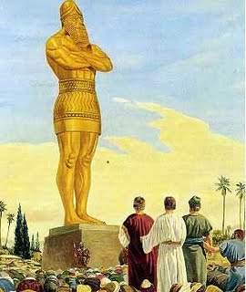
Three Boys in Babylon

Slide 9
Three Boys in Babylon
King Nebuchadnezzar made an image of gold, whose height was sixty cubits and its breadth six cubits. He set it up on the plain of Dura, in the province of Babylon. ² Then King Nebuchadnezzar sent to gather the satraps, the prefects, and the governors, the counselors, the treasurers, the justices, the magistrates, and all the officials of the provinces to come to the dedication of the image that King Nebuchadnezzar had set up. ³ Then the satraps, the prefects, and the governors, the counselors, the treasurers, the justices, the magistrates, and all the officials of the provinces gathered for the dedication of the image that King Nebuchadnezzar had set up. And they stood before the image that Nebuchadnezzar had set up.
“Religion” Commandeered

Slide 10
Three Boys in Babylon
. ⁴ And the herald proclaimed aloud, “You are commanded, O peoples, nations, and languages, ⁵ that when you hear the sound of the horn, pipe, lyre, trigon, harp, bagpipe, and every kind of music, you are to fall down and worship the golden image that King Nebuchadnezzar has set up. ⁶ And whoever does not fall down and worship shall immediately be cast into a burning fiery furnace.” ⁷ Therefore, as soon as all the peoples heard the sound of the horn, pipe, lyre, trigon, harp, bagpipe, and every kind of music, all the peoples, nations, and languages fell down and worshiped the golden image that King Nebuchadnezzar had set up.
“Religion” Commandeered
People readily obey

Slide 11
Three Boys in Babylon
“Religion” Commandeered
People readily obey
Three take a stand
¹² There are certain Jews whom you have appointed over the affairs of the province of Babylon: Shadrach, Meshach, and Abednego. These men, O king, pay no attention to you; they do not serve your gods or worship the golden image that you have set up.”

Slide 12
Three Boys in Babylon
¹³ Then Nebuchadnezzar in furious rage commanded that Shadrach, Meshach, and Abednego be brought. So they brought these men before the king. ¹⁴ Nebuchadnezzar answered and said to them, “Is it true, O Shadrach, Meshach, and Abednego, that you do not serve my gods or worship the golden image that I have set up? ¹⁵ Now if you are ready when you hear the sound of the horn, pipe, lyre, trigon, harp, bagpipe, and every kind of music, to fall down and worship the image that I have made, well and good. But if you do not worship, you shall immediately be cast into a burning fiery furnace. And who is the god who will deliver you out of my hands?”
“Religion” Commandeered
People readily obey
Three take a stand
King rejects God

Slide 13
Three Boys in Babylon
“Religion” Commandeered
People readily obey
Three take a stand
King rejects God
Three reject Babylon
Respectfully
Resolutely
Unswervingly
¹⁶ Shadrach, Meshach, and Abednego answered and said to the king, “O Nebuchadnezzar, we have no need to answer you in this matter. ¹⁷ If this be so, our God whom we serve is able to deliver us from the burning fiery furnace, and he will deliver us out of your hand, O king. ¹⁸ But if not, be it known to you, O king, that we will not serve your gods or worship the golden image that you have set up.”

Slide 14
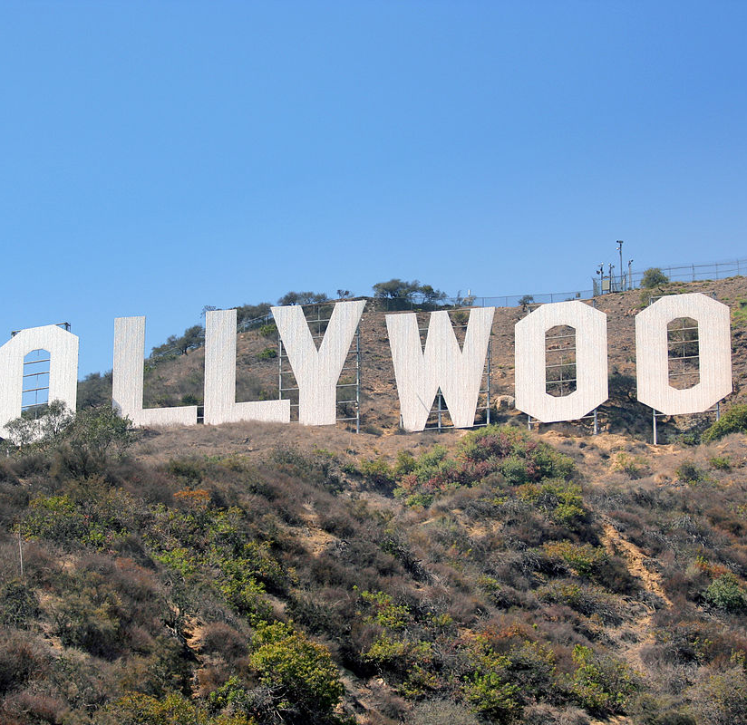
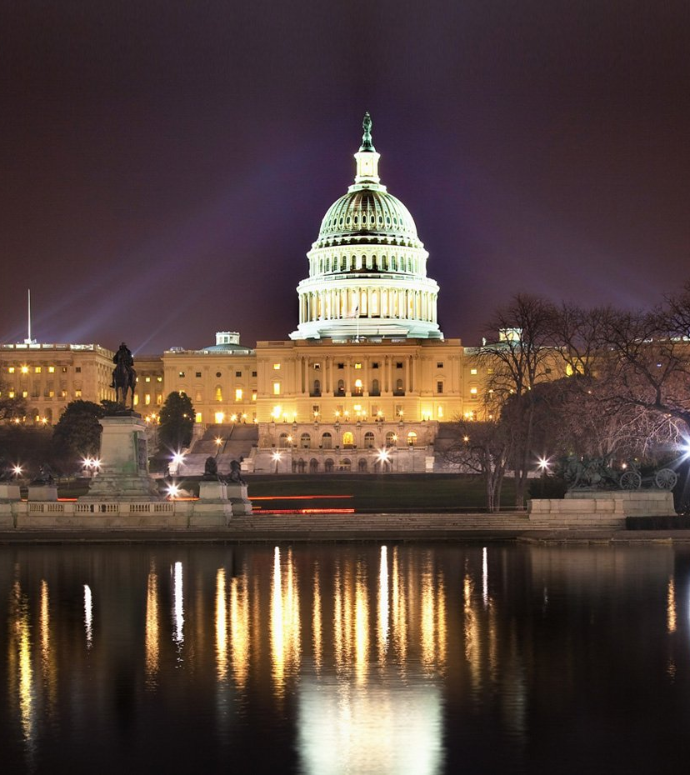
Living in Babylon

Slide 15
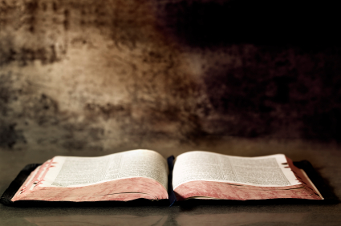
Living in Babylon
She who is at Babylon, who is likewise chosen, sends you greetings, and so does Mark, my son
Be subject for the Lord's sake to every human institution, whether it be to the emperor as supreme, ¹⁴ or to governors as sent by him to punish those who do evil and to praise those who do good. ¹⁵ For this is the will of God, that by doing good you should put to silence the ignorance of foolish people. ¹⁶ Live as people who are free, not using your freedom as a cover-up for evil, but living as servants of God. ¹⁷ Honor everyone. Love the brotherhood. Fear God. Honor the emperor. – I Peter 5:13;2:13-17
Respectful

Slide 16
Living in Babylon
She who is at Babylon, who is likewise chosen, sends you greetings, and so does Mark, my son
Be subject for the Lord's sake to every human institution, whether it be to the emperor as supreme, ¹⁴ or to governors as sent by him to punish those who do evil and to praise those who do good. ¹⁵ For this is the will of God, that by doing good you should put to silence the ignorance of foolish people. ¹⁶ Live as people who are free, not using your freedom as a cover-up for evil, but living as servants of God. ¹⁷ Honor everyone. Love the brotherhood. Fear God. Honor the emperor. – I Peter 5:13;2:13-17
Respectful
Christians submitting to “unchristian” leadership
No rebellion; diminishing
In speech – spoken/virtual

Slide 17
Living in Babylon
‘I know where you dwell, where Satan's throne is. Yet you hold fast my name, and you did not deny my faith even in the days of Antipas my faithful witness, who was killed among you, where Satan dwells./ Only hold fast what you have until I come./ I am coming soon. Hold fast what you have, so that no one may seize your crown. -- Revelation 2:13,25; 3:11
Resolute
Respect is not changing doctrine
Beware of entanglements
Political parties do not save
Media/entertainment do not encourage resolve
“State religion” not from God
Do not be conformed to this world, but be transformed by the renewal of your mind, that by testing you may discern what is the will of God, what is good and acceptable and perfect – Romans 12:2

Slide 18
Living in Babylon
‘Do not fear what you are about to suffer. Behold, the devil is about to throw some of you into prison, that you may be tested, and for ten days you will have tribulation. Be faithful unto death, and I will give you the crown of life./He who has an ear, let him hear what the Spirit says to the churches. The one who conquers will not be hurt by the second death.’/And they have conquered him by the blood of the Lamb and by the word of their testimony, for they loved not their lives even unto death./He will wipe away every tear from their eyes, and death shall be no more, neither shall there be mourning, nor crying, nor pain anymore, for the former things have passed away.”/But as for the cowardly, the faithless, the detestable, as for murderers, the sexually immoral, sorcerers, idolaters, and all liars, their portion will be in the lake that burns with fire and sulfur, which is the second death.”
Unswerving
Raging beasts are dangerous
Thank God for freedom
Prepare for freedom’s removal
But I am not ashamed, for I know whom I have believed, and I am convinced that he is able to guard until that day what has been entrusted to me – II Timothy 1:12

