Slide 1
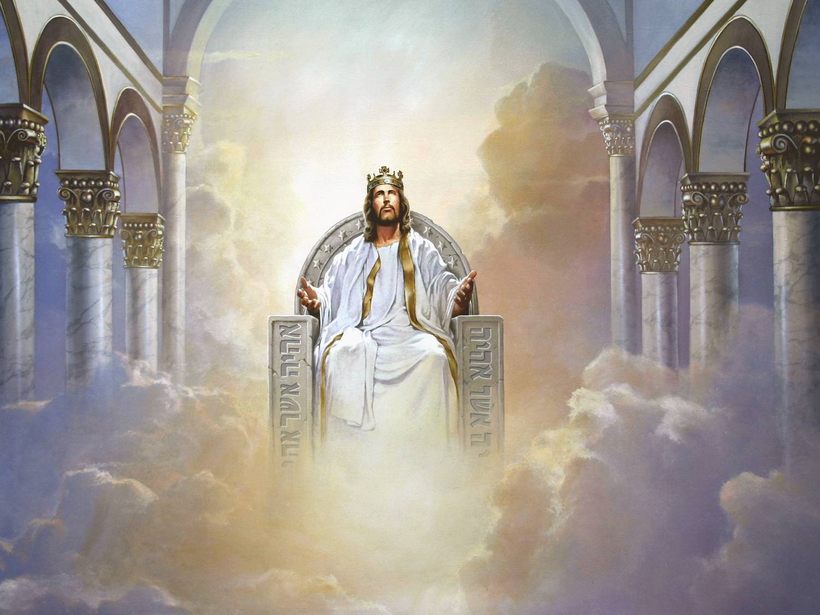
A Tale Of Two Kings: David & Jesus Text: Matthew 21:9; Mark 11:10; Revelation 22:16
King Jesus
Notes:
By Nathan L Morrison for Sunday 04/25/2021
All Scripture given is from NASB unless otherwise stated
For further study, or if questions, please Call: 804-277-1983 or Visit: www.courthousechurchofchrist.com
Additional helps at the end of the presentation

Slide 2
Two kings who changed God’s people and made a mark on the world!
Intro
King David
The 2nd king over Israel
The one who set a righteous standard for all the kings who came after him (I Kings 15:1-5; II Kings 18:1-3; 22:1-2)
King Jesus
The earthly son of David (Luke 1:32)
He is the King of kings and Lord of lords (I Timothy 6:14-15)
Demands all people repent & obey Him! (Acts 17:30-31)
Standard all men will be judged by (Romans 2:16)

Slide 3
There are several amazing similarities between these two kings!
Intro
King David
A man after God’s own heart (Acts 13:22) – No other physical king like him!
62 chapters in the Bible throughout the OT & NT mention his name
II Samuel 1-10 tell of David’s triumphs
II Samuel 11 tells of David’s big sin and beginning of his family tragedies
II Samuel 12-24 tells of David’s family and nation problems
King Jesus
The Son of God who died for the sins of the world (John 1:49; I Peter 3:18) – No other King like Him!
Spoken of by the prophets, foretold throughout the OT (Acts 3:18-26)
The Lord Himself and His chosen apostles foretold events and preached repentance & judgment (II Peter 3:1-2, 9-13)
He is the final voice and authority from God (Matthew 28:18; Hebrews 1:1-3)

Slide 4
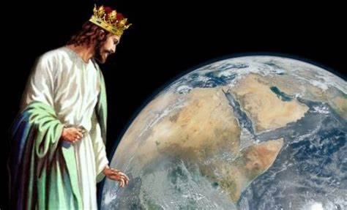
Jesus is the King of kings and Lord of lords, and the world needs to heed His voice!
Intro

Slide 5
Attribute | King David | King Jesus | YOU
Coming King
Prophesied
(Zech. 9:9; Mt. 21:5,9), & Born (Mt. 2:2)
The King has come! Will you obey Him?
(Acts 2:38-41)
Anointed king by the prophet Samuel
(I Sam. 16:13)
Crucified King
Not literally, but troubled by his family & nation
(II Sam. 13; 15-18; 20; I Kings 1)
Literally crucified, handed over by His own people
(John 1:11; 19:6, 16-18, 19, 30)
Christ died for your sins. Are you washed in His blood? (Acts 22:16; I Cor. 6:9-11)
Crowned King
By suffering He was crowned with glory & honor (John 19:2-3; Heb. 2:7-10;
I Tim. 6:14-15)
Annointed 3 times!
(I Sam. 16:1-13;
II Sam. 2:1-7; 5:1-5)
Do you crown Him in your life?
(Heb. 1:1-4; Gal. 2:20; II Pet. 1:5-11)
Conquering King
Conquered flesh & spiritual! (John 5:22-29; Heb. 2:14-15; 4:15; II Thess. 1:7-9; Rev. 20)
Jesus is coming!
Will you stand to right or to left?
(Mt. 25:31-46; Heb. 9:27-28; Rom. 14:12-13)
A Warrior King!
(II Sam. 1-10;
I Chr. 18:1-13)
By Nathan L Morrison

Slide 6
Conclusion
Some differences between these two mighty kings:
King David
David died and was buried, and his tomb was well known – Acts 2:29; 13:36
David died and was buried, having fulfilled God’s purpose (Acts 13:36)
King Jesus
Jesus died and was buried but His tomb was empty – Acts 2:30-36; 13:37
Jesus died and was buried but has risen, exalted to the right hand of God, where He waits for the right time to return and execute judgment on the world (II Corinthians 5:10)

Slide 7
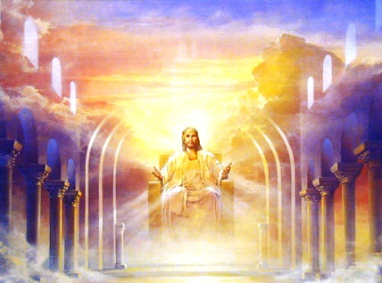
Conclusion
You will give an account to The Eternal King!
(Romans 14:12-13; Philippians 2:9-11)
Let us live for Him now so we can live with Him forever!

Slide 8
“What Must I Do To Be Saved?”
Hear The Gospel (Jn. 5:24; Rom. 10:17)
Believe In Christ (Jn. 3:16-18; Jn. 8:24)
Repent Of Sins (Lk. 13:3-5; Acts 2:38)
Confess Christ (Mt. 10:32; Rom. 10:10)
Be Baptized (Mk. 16:16; Acts 22:16)
Remain Faithful (Jn. 8:31; Rev. 2:10)
For The Erring Saint:
Repent (Acts 8:22), Confess (I Jn. 1:9),
Pray (Acts 8:22)

Slide 10
Table of A Tale Of Two Kings: David & Jesus

Slide 11
Attribute | King David | King Jesus | YOU
Coming King
Prophesied
(Zechariah 9:9; Matthew 21:5,9), & born (Matthew 2:2)
Anointed king by the prophet Samuel
(I Samuel 16:13)
The King has come!
Will you obey Him?
(Acts 2:38-41)
Crucified King
Christ died for your sins so you can live eternally with Him. Are you washed in His blood?
(Acts 22:16;
I Corinthians 6:9-11)
Not literally, but troubled by his family & nation
(II Samuel 13; 15-18; 20; I Kings 1)
Literally crucified, handed over by His own people
(John 1:11; John 19:6, 16-18, 19, 30)
Crowned King
By His suffering on the cross He was crowned with glory & honor
(John 19:2-3;
Hebrews 2:7-10;
I Timothy 6:14-15)
Jesus sits at the right hand of God.
Do you crown Him in your life?
(Hebrews 1:1-4; Galatians 2:20; II Peter 1:5-11)
Crowned 3 times!
(I Samuel 16:1-13;
II Samuel 2:1-7; 5:1-5)
Conquering King
Conquered the flesh and the spiritual!
(John 5:22-29; Hebrews 2:14-15; 4:15;
II Thessalonians 1:7-9; Revelation 20)
Jesus is coming again for reward & judgment.
Where will you stand? His right or to His left?
(Matthew 25:31-46; Hebrews 9:27-28; Romans 14:12-13)
A Warrior King!
(II Samuel 1-10;
I Chronicles 18:1-13)
By Nathan L Morrison

Slide 12
Picture of A Tale Of Two Kings: David & Jesus

Slide 13
Notes:
I used the printed-out picture as a handout during the lesson

