Slide 1
A Love Story
Text: Ruth
Notes:
By Nathan L Morrison
All Scripture given is from NASB unless otherwise stated
For further study, or if questions, please Call: 804-277-1983 or Visit www.courthousechurchofchrist.com
Points taken from multiple sources, notably from lessons by Lloyd Stilley and Jerry Gifford

Slide 2
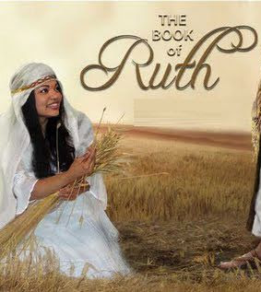
Intro
The Book of Ruth is said to be the most beautiful short story ever written.
It’s an account of anxiety, fear, love, and commitment that goes from despair and the darkness of one’s soul to joy and hope.
It begins with despair and ends with delight!

Slide 3
Intro
When Benjamin Franklin was the Ambassador to France, he occasionally attended the Infidels Club -- a group that spent most of its time searching for and reading literary masterpieces. On one occasion Franklin read the book of Ruth to the club, but changed the names in it so it would not be recognized as a book of the Bible, which they mocked and held in derision. When he finished, the listeners were unanimous in their praise. They raved that it was one of the most touching stories they’d ever heard and begged him to print it so the public could read it, or that he tell them where he had run across such a remarkable literary masterpiece. He grinned and said, “It is already in print, it is a part of the Bible you ridicule.”
Notes:
Sources:
https://mountaineagle.com/stories/ruth-the-widow-who-found-redemption,20648

Slide 4
Intro
The short book of Ruth is for people who wonder where God is when one tragedy after another pounds their faith
It is for people who wonder whether a life of integrity in tough times is worth it.
It is a story for people who can't imagine that anything great could ever come of their ordinary lives.
The story is not of a leader or deliverer like Moses or Joshua, or a larger-than-life judge like Samson, or about a great king the likes of Saul or David, but of ordinary people trying to eek out an existence among God’s people.

Slide 5
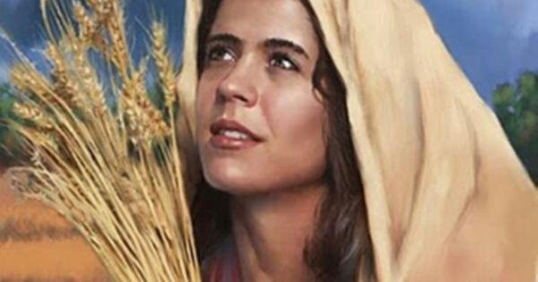
Intro
Ruth is more than just a love story but also a story of faith, hope & redemption that still resounds with us today!

Slide 6
Ruth: A Love Story
Scene 1: Suffering and Hidden Hope
Ruth chapter 1

Slide 7
Scene 1: Suffering and Hidden Hope
Ruth 1 tells us that during the days of the judges there was a famine in the land of Judah
Elimelech, his wife Naomi, and their two sons Mahlon and Chilion, left Bethlehem and traveled 30-60 miles, about 7-10 days, to the land of Moab, where they stayed for 10 years.
Elimelech died and the two sons each married Moabite women, Orpah and Ruth.
Both sons died, leaving their two young widows in the care of their widowed mother.
Naomi began the journey back from Moab to her home in Bethlehem and implored them to go back to their own country, which Orpah accepts and tearfully leaves.

Slide 8
1st Love Story

Slide 9
Scene 1: Suffering and Hidden Hope
1st Love Story
Ruth tells Naomi, “where you go, I will go, and where you lodge, I will lodge. Your people shall be my people, and your God, my God. Where you die, I will die, and there I will be buried. Thus may the LORD do to me, and worse, if anything but death parts you and me” (Ruth 1:16-17).

Slide 10
Scene 1: Suffering and Hidden Hope
Despair & Gloom
Naomi was simply too depressed to let herself feel any comfort.
As she enters Bethlehem, the women in town see this haggard woman and ask, “Is this Naomi?” (1:19). The name Naomi means “beautiful.”
But such a name mocked her now. She answers back in 1:20-21: “Do not call me Naomi (“beautiful”); call me Mara (“bitter”), for the Almighty has dealt very bitterly with me. I went away full, and the Lord has brought me back empty. Why call me Naomi, when the Lord has testified against me and the Almighty has brought calamity upon me?”
Scene 1 ends in despair and gloom. Convinced that God is against her, Naomi expressed her hopelessness so much that she couldn't even see the rays of hope peeking through the clouds – the famine was over and she had a loving, loyal daughter-in-law.

Slide 11
Scene 1: Suffering and Hidden Hope
For the children of the Lord, it is always true: weeping may endure for the night, but shout of joy comes in the morning! (Psalm 30:5)

Slide 12
Ruth: A Love Story
Scene 2: Romance and the Grace of God
Ruth chapter 2:1-22

Slide 13
Scene 2: Romance & the Grace of God
Ruth 2:1-22 covers one 24-hour day in the lives of Naomi and Ruth
Ruth 2:1: Introduction of Boaz, a worthy man of the clan of Elimelech, he had a reputation as a godly man of character and kindness.
Ruth 2:3: We find a hungry Ruth who goes out to glean with the poor. This was in accordance with the Law of Moses (Lev. 19:9; Lev. 23:22; Deut. 24:19).
She had no deliberate plan about which field she would work.
But what on the surface to her appears to be a wild coincidence, Ruth just happens to find herself in the field of this man Boaz, a close relative!

Slide 14
2nd Love Story

Slide 15
Scene 2: Romance & the Grace of God
2nd Love Story
Boaz spots this cute Moabitess gleaning with the poor and it appears it was love at first sight!
He goes out of his way to show her favor:
He told Ruth to stay in his fields and with his maids and to drink from the servants’ water (2:8-9)
Looked into her background (2:11-12: she sought refuge under God’s wings [H3671]
Fed her a huge lunch (2:14)
He gave secret instructions to his workers to deliberately drop some sheaves for her (2:15-16)
By evening Ruth had gleaned an “ephah” of barley! (About 30 pounds!)

Slide 16
Scene 2: Romance & the Grace of God
Ruth 2:19-22: When Ruth goes home to Naomi and recounts the details, the lights suddenly click on for Naomi
When she heard that the name of their benefactor was Boaz, her mourning turned to dancing!
“May he be blessed of the LORD who has not withdrawn his kindness to the living and to the dead!” (2:20)
Naomi also said to her, “The man is our relative, he is one of our closest relatives” (2:20: The ESV says, “one of our redeemers” from the Hebrew “kinsman-redeemer”)

Slide 17
Scene 2: Romance & the Grace of God
God’s care for His people
Ruth 2:23: “So she kept close to the young women of Boaz, gleaning until the end of the barley and wheat harvests. And she lived with her mother-in-law.”
After such mourning and grief, one day changed their outlook, and now Ruth stays in Boaz’s fields with his servants until the end of the Barley Harvest.
Barley was harvested from late March through late April, wheat from late April to late May (NET Full Notes, O. Borowski, Agriculture in Ancient Israel, 88, 91).

Slide 18
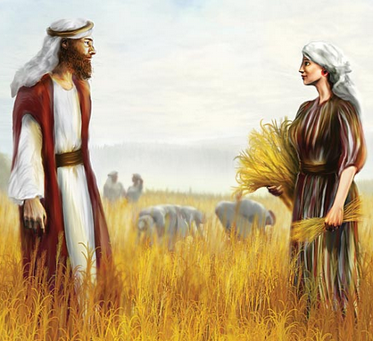
Scene 2: Romance & the Grace of God
Paul says for those that love the Lord, God works things out for their good (Romans 8:28), and we certainly see God’s care for His people in the book of Ruth!

Slide 19
Ruth: A Love Story
Scene 3: Renewed Hope and a Risky Proposal
Ruth chapter 3

Slide 20
Scene 3: Renewed Hope and a Risky Proposal
Ruth 3:1-5: A match-making mother
Naomi realized what Ruth could not have known -- She understood both the kinsman's obligation to marry the widow of a close relative and the interest that Boaz obviously had in Ruth.
Notice her concern for Ruth (3:1): “My daughter, should I not seek rest for you, that it may be well with you?”
Naomi offered two types of counsel to Ruth (3:3-4):
First, she told her to fix herself up (3:3): No more mourning clothes or work clothes – put on her best dress
Second, Naomi told her to make herself known to Boaz (3:4): After he is asleep, sneak up, uncover his feet, and then lie down! “He will tell you what to do!” (3:4)
Ruth complied, saying, “All that you say I will do” (3:5)

Slide 21
3rd Love Story

Slide 22
Scene 3: Renewed Hope and a Risky Proposal
3rd Love Story
Ruth 3:6-13: A midnight meeting and unusual proposal.
Ruth follows through with the rendezvous at destination “grain heap.”
When Boaz turns over in the middle of the night and awakens, he discovers a woman lying at his feet and wants to know who she is.
Ruth identifies herself and then says in 3:9: “So spread your covering over your maid, for you are a close relative.”
This was Ruth's subtle way of making a marriage proposal.
She humbly says, “There is a family link in the Mosaic Law that you are obligated to. But I want you to know that if you would have me as your wife, I will agree.”

Slide 23
Scene 3: Renewed Hope and a Risky Proposal
3rd Love Story
“Take your maidservant under your wing” (NKJ: 3:9) was like saying “Take me, I'm yours.”
The word “wings” in Ruth 2:12 is the plural of the same word here translated “wing” (NKJ) or “covering” (NAS) in Ruth 3:9
“For you are a close relative” indicated something more. “Close relative” in this circumstance under the Mosaic Law meant, “kinsman-redeemer.”
According to Mosaic Law, a kinsman had the responsibility to marry Ruth to preserve the inheritance of Elimelech (Deut. 25:5-10).

Slide 24
Scene 3: Renewed Hope and a Risky Proposal
3rd Love Story
While she had a legal right to make this request, consider how unusual it is:
A woman proposed to a man
A young person proposed to an older individual
A field laborer proposed to a field owner
A foreigner proposed to a citizen

Slide 25
Scene 3: Renewed Hope and a Risky Proposal
3rd Love Story
An unusual promise (3:10-11):
After praising her for not chasing after younger guys, he tells Ruth not to worry. He will do all that she requested (v.11).
He will redeem her from widowhood!
He goes on to say that Ruth was worth it for she was “virtuous” (NKJ), “excellent” (NAS) – 3:11
Proverbs 31:10 (NKJ): “Who can find a virtuous wife? For her worth is far above rubies.”

Slide 26
Scene 3: Renewed Hope and a Risky Proposal
An obstacle to their love and happiness (3:12-13)
Legally, another man could have served as the “kinsman-redeemer.”
This shows Boaz was already thinking of this moment! He truly loved her!
His love is greater than this problem.
Despite the obstacles, Boaz was determined to see Ruth cared for even if it meant losing her himself (3:13).
Notice that he even made this vow before “the Lord.” Now that's real love.
He already knew the problem! – He wanted to marry her and had already checked into the details of getting it done!

Slide 27
Scene 3: Renewed Hope and a Risky Proposal
Ruth 3:14-18: Boaz now does two additional things to confirm his love and intentions…
First, He protected her reputation
At harvest time prostitutes were known to go to the threshing floor and proposition the laborers.
Boaz did everything he could to avoid even the hint of impropriety by Ruth or himself: He was honorable.
Second, He paid a dowry to Naomi
The grain was for Naomi. It was like a down payment or earnest that guaranteed his intention.
Ruth may not have understood its significance but Naomi certainly did. After she saw the grain (3:17), she knew his intentions perfectly (3:18): “The man will not rest until he has settled it today.”

Slide 28
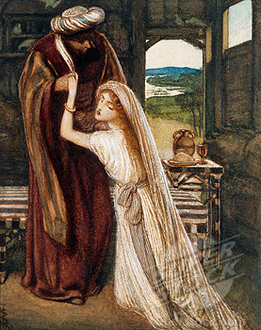
Scene 3: Renewed Hope and a Risky Proposal
Within a couple of months the dark and despairing circumstances of these two widows who trusted in God was turning to a hope that neither of them could even imagine!

Slide 29
Ruth: A Love Story
Scene 4: The Sandal Exchange and the Savior
Ruth chapter 4

Slide 30
Scene 4: The Sandal Exchange and the Savior
Ruth 4:1-12
The next morning, Boaz skillfully presents the situation to the nearer kinsman, and the man gives Boaz his sandal, a symbolic way of saying that the transfer of right was accomplished.
And so it was that a foreigner from a condemned country was brought into a covenant relationship with God.
A mirror situation with Boaz’s parents: Salmon and Rahab (condemned to die in Jericho!), a Canaanite prostitute who made a covenant with God’s people and who is in the line of Jesus (Matthew 1:5) and whose faith is held up as an example for Christians (Hebrews 11:31; James 2:25)!

Slide 31
4th Love Story

Slide 32
Scene 4: The Sandal Exchange and the Savior
4th Love Story
Ruth 4:13-22: Boaz and Ruth were married!
Naomi was cared for the rest of her life (Ruth 4:14-17).
Naomi was blessed among the women of Bethlehem! No longer “mara” (bitter).
During one of the darkest times in Israel's history, a most unlikely young lady gives birth to a boy named Obed, who would later father a son named Jesse, who would beget David, the king who would bring Israel back to God and the ancestor to the Messiah, who is Jesus Christ!
Ruth, the Moabitess, like Rahab the Canaanite, is in the physical line of Jesus Christ, foreshadowing the blessings to all the nations of earth as promised to Abraham and fulfilled in Jesus! (Genesis 12:3; Acts 11:18; Galatians 3:26-29).

Slide 33
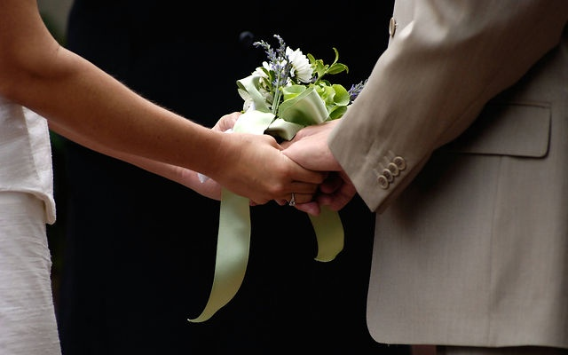
Scene 4: The Sandal Exchange and the Savior
The story of Ruth is a story of everyday people trusting in God and God blessing them!

Slide 34
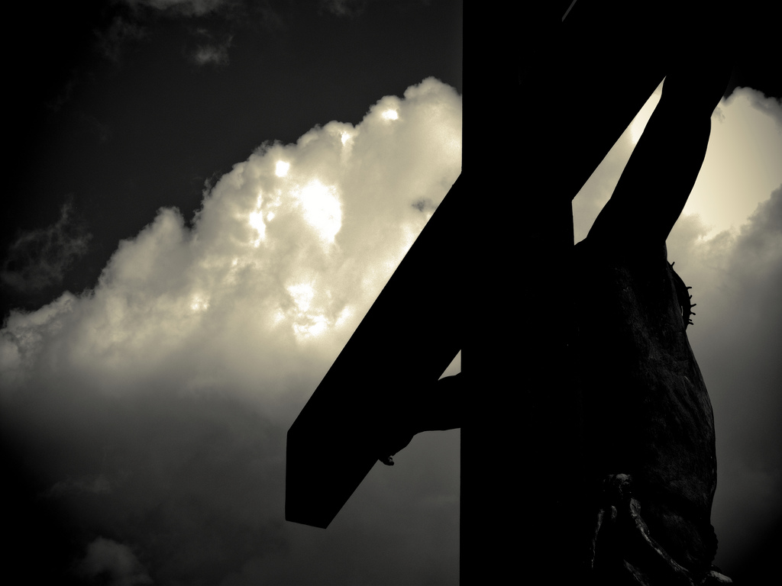
The ultimate theme of this story is redemption
A Parable of Divine Love
Ruth, as a young widow, was essentially sentenced to poverty and hardship unless someone redeemed her from this plight (Like the lost sinner outside of Christ)
Redemption on a small scale that mirrors God's loving plan of redemption on a large scale!

Slide 35
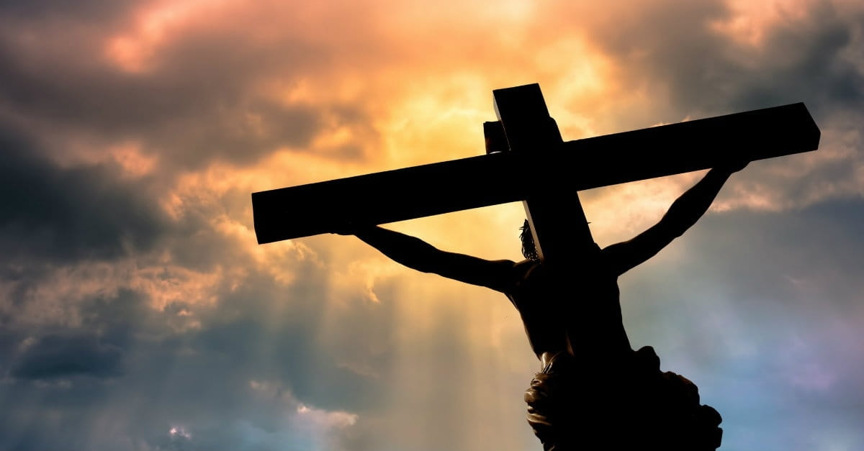
Naomi – The loving parent (God)
A Parable of Divine Love
She longed for her child's redemption and made a plan of redemption
Redemption was only possible because of a relationship to the redeemer (Boaz to Elimelech, 4:3)

Slide 36
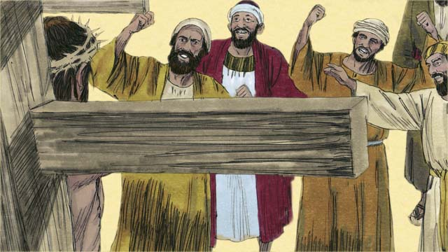
Ruth – The lost sinner
A Parable of Divine Love
She could do nothing to save herself
She responded to Boaz’s grace (2:2, 10, 13)
She repented of her past (3:3 She removed the garments of mourning which represented her past)
She requested that He redeem her (3:9)
She received both the promise of redemption (3:11) and a pledge for the future redemption (3:15)

Slide 37
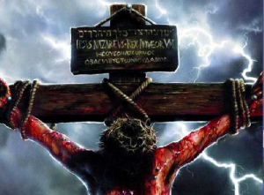
Boaz – The Lord Jesus
A Parable of Divine Love
He was worthy to redeem her (3:9: a kinsman-redeemer; see Phil. 2:5-11 about Jesus)
He was willing to redeem her (3:11)
He was waiting to redeem her (3:13)

Slide 38
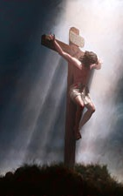
God made a plan of redemption and to those who obey His Son they receive redemption and eternal life! (John 3:16; Ephesians 1:7)
A Parable of Divine Love

Slide 39
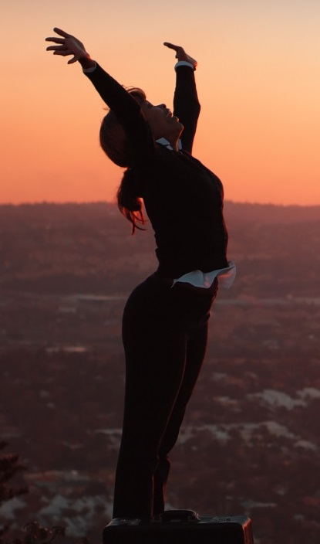
Conclusion
Ruth and Orpah help us see the options…
Orpah had started out to follow Naomi but then bailed (Mark 4:16-19)
Ruth said, “Where you go, I go, your God is my God” (Mark 4:20)

Slide 40
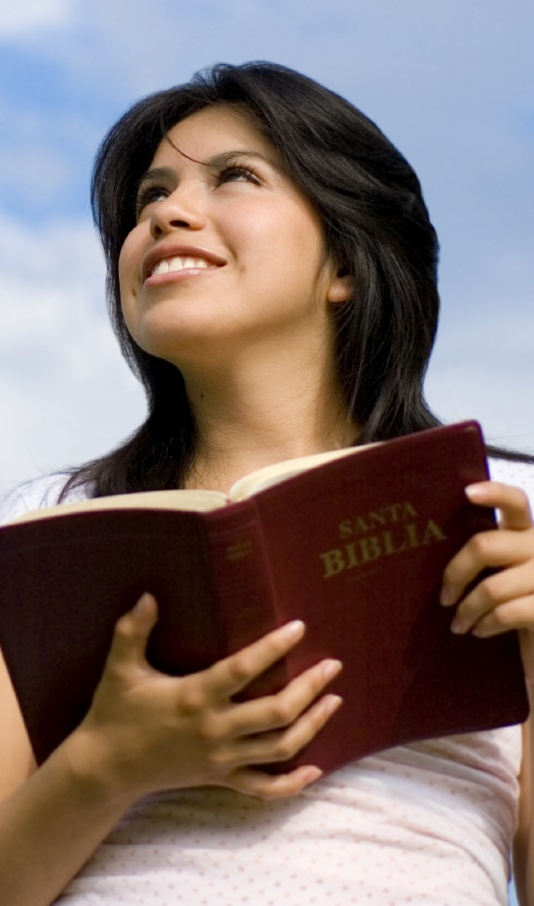
Conclusion
God doesn't want a half-hearted commitment!
He's looking for people today who will trust in Him enough to say, “Your God will be my God”

Slide 41
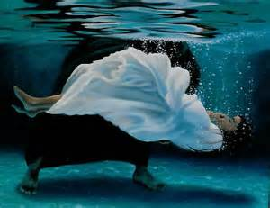
Conclusion
Are you ready to obey & trust Him today?

Slide 42
“What Must I Do To Be Saved?”
Hear The Gospel (Jn. 5:24; Rom. 10:17)
Believe In Christ (Jn. 3:16-18; Jn. 8:24)
Repent Of Sins (Lk. 13:3-5; Acts 2:38)
Confess Christ (Mt. 10:32; Rom. 10:10)
Be Baptized (Mk. 16:16; Acts 22:16)
Remain Faithful (Jn. 8:31; Rev. 2:10)
For The Erring Saint:
Repent (Acts 8:22), Confess (I Jn. 1:9),
Pray (Acts 8:22)

