Slide 1
The Ultimate Rescue Mission
Text:
Galatians 1:3-5
Notes:
By Nathan L Morrison
All Scripture given is from NASB unless otherwise stated
For further study, or if questions, please Call: 804-277-1983 or Visit www.courthousechurchofchrist.com

Slide 2
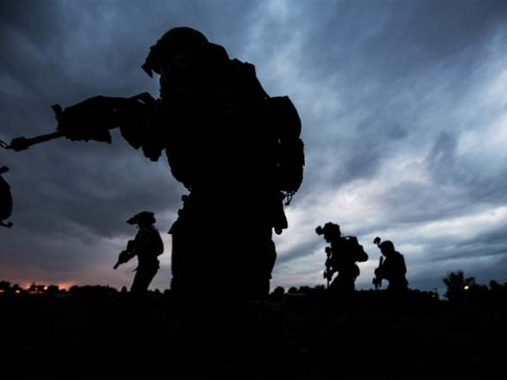
Intro
April 8-12, 2009: U.S. Navy SEAL snipers ended the five-day ordeal of Captain Richard Phillips, a merchant ship captain of the Maersk Alabama, who was taken hostage by pirates on April 8, 2009. Capt. Phillips was rescued uninjured while the 3 pirates who held him on a lifeboat were all killed.
April 10, 2009: Five people held hostage on their sailboat by pirates were rescued by French military resulting in one of the hostages dying but the pirates subdued with some killed.
We all love a good rescue story, especially when the mission is successful!
Notes:
April 8-12, 2009: U.S. Navy SEAL snipers ended the five-day ordeal of Captain Richard Phillips, a merchant ship captain of the Maersk Alabama, who was taken hostage by pirates on April 8, 2009. Capt. Phillips was rescued uninjured while the 3 pirates who held him on a lifeboat were all killed. (https://www.wired.com/2012/10/navy-seals-pirates/)
April 10, 2009: Five people held hostage on their sailboat by pirates were rescued by French military resulting in one of the hostages dying but the pirates subdued with some killed. (https://www.theguardian.com/world/2009/apr/10/hostage-killed-as-french-storm-pirate-yacht)
Many rescue attempts end in failure or end in the loss of the lives of the hostages.
In these events, the ones needing saved welcomed their deliverers.

Slide 3
Intro
Biblical examples of “Great Rescues”
Abraham rescued Lot from the king of Elam – Gen. 14
God rescued Israel from Egyptian slavery through the leadership of Moses – Ex. 3:7-9
David rescued his family and families of all his men from Amalekites – I Sam. 30
God rescued Daniel from the Lions in the lion’s den – Dan. 6:16, 20-22
Christ rescued the world from sin and darkness – Col. 1:13; I Thess. 1:10
While most welcome a physical deliverer, many reject the most important: Spiritual!
Notes:
Image courtesy of theswordbearer.org

Slide 4
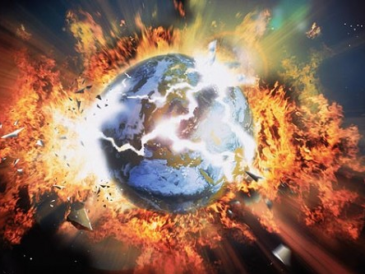
Intro
The world was, and is, in need of saving because it is corrupt and set for destruction
I Jn. 2:15-17: The world with all its temptations & lusts is “passing away”
II Pet. 3:10-12: The world will be destroyed by fire!
Rom. 6:17-20; II Tim. 2:26: Men are slaves to sin, held captive by Satan

Slide 5
Galatians 1:3-5
Intro
3. Grace to you and peace from God our Father and the Lord Jesus Christ,
4. who gave Himself for our sins so that He might rescue us from this present evil age, according to the will of our God and Father,
5. to whom be the glory forevermore. Amen.

Slide 6
Intro
God sent His Son on the “Ultimate Rescue Mission” to save man from the slavery of sin
Galatians 1:3-5
Many reject Him and His salvation: cannot save those who do not wish to be saved!
God sent the world a Rescuer and demonstrated His love for mankind for all time!

Slide 7
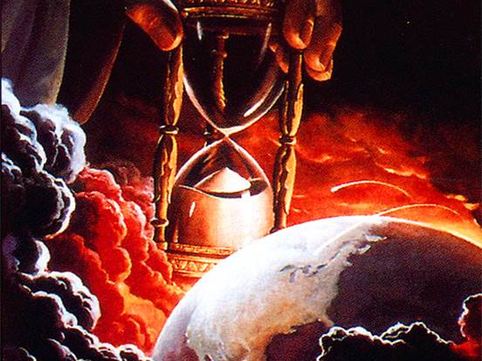
The Confusion Of The World

Slide 8
The Confusion Of The World
The Ultimate Rescue Mission Saves From…
Eph. 4:17-19: The world is morally confused
Gal. 6:7-8; Eph. 4:17-19; I Tim. 4:2; Eph. 2:1-3
Eph. 4:14: The world is doctrinally confused
Carried by “every wind of doctrine, by the trickery of men, by craftiness in deceitful scheming”

Slide 9
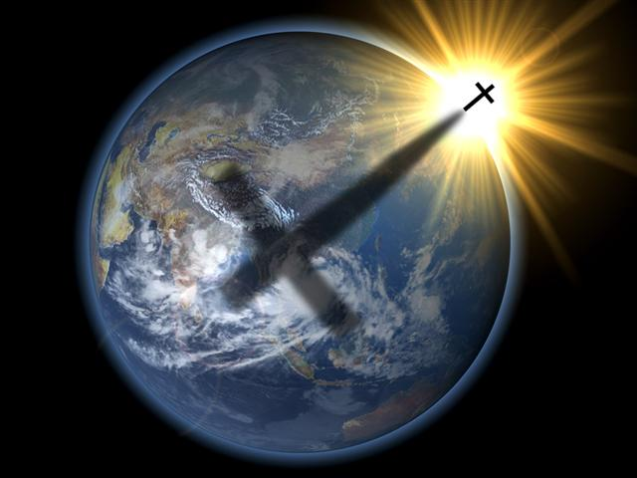
The Lord Jesus Christ is the hope for a confused world!
Eph. 4:20-24: The truth of Christ sets one free! (John 8:32)
One can know the truth and be free from the confusion of the world’s teachings!

Slide 10
The Confusion Of The World
The Ultimate Rescue Mission Saves From…
The Corruption Of The World

Slide 11
The Confusion Of The World The Corruption Of The World
Acts 2:40 (Phil. 2:14-16); I Jn. 5:19 (I Jn. 5:20); Eph. 4:22

Slide 12
The Lord Jesus Christ can save men from the corruption of the world!
Rev. 1:5: He “released us from our sins by His blood.”
Heb. 9:13-14: He can cleanse the conscience of the guilt of sin.
Heb. 1:1-3: He died to purge men from sin. He “made purification of sins.”
I Pet. 1:22-23: This cleansing comes when men obey the truth of the gospel.
The blood of Christ cleanses our sins, purifies our lives, and rescues us from the corruption of the world!

Slide 13
The Confusion Of The World
The Ultimate Rescue Mission Saves From…
The Corruption Of The World
The Condemnation Of The World

Slide 14
The Confusion Of The World The Corruption Of The World The Condemnation Of The World
The Ultimate Rescue Mission Saves From…
Jn. 3:17: The world is in need of saving, of rescuing
Eph. 5:6: God’s wrath is coming on the “children of disobedience.”
Heb. 10:26-31; Gal. 6:7-8; Eph. 4:17-19

Slide 15
The Lord Jesus Christ offers deliverance from the punishment reserved for worldly people!
Rom. 8:1: In Christ men escape the condemnation of sin!
Rom. 3:24: In His death by the grace of God we are justified!
Rom. 5:9: Through the blood of Christ we are justified and saved from the wrath of God!
Only in Christ is salvation found, no other name by which we are saved! (Acts 4:10-12)

Slide 16
Conclusion
The answer to the world’s need is not found in government or political parties, but in Jesus Christ, who is the Rescuer, the Lamb of God who takes away the sin of the world! (John 1:29)
Accomplish the ultimate rescue mission, once for all time! (Heb. 10:10-14)
Rescue you from darkness and bring you into His kingdom! (Col. 1:13)
Rescue you from the wrath of God! (I Thess. 1:10)
Save you from confusion, corruption, and from condemnation! (Gal. 1:4)
Jesus Died To…

Slide 17
Conclusion
Do you welcome your Rescuer?
To get “into Christ,” one is baptized into Christ and then is clothed with Him
(Gal. 3:27)
Live your life for Him so you can live eternally with Him!

Slide 18
“What Must I Do To Be Saved?”
Hear The Gospel (Jn. 5:24; Rom. 10:17)
Believe In Christ (Jn. 3:16-18; Jn. 8:24)
Repent Of Sins (Lk. 13:3-5; Acts 2:38)
Confess Christ (Mt. 10:32; Rom. 10:10)
Be Baptized (Mk. 16:16; Acts 22:16)
Remain Faithful (Jn. 8:31; Rev. 2:10)
For The Erring Saint:
Repent (Acts 8:22), Confess (I Jn. 1:9),
Pray (Acts 8:22)

