Slide 1
Image Of God
Text:
Genesis 1:26-27
Notes:
By Nathan L Morrison
All Scripture given is from NASB unless otherwise stated
For further study, or if questions, please Call: 804-277-1983 or Visit www.courthousechurchofchrist.com
“Imago Dei” is Latin for “Image of God”

Slide 2
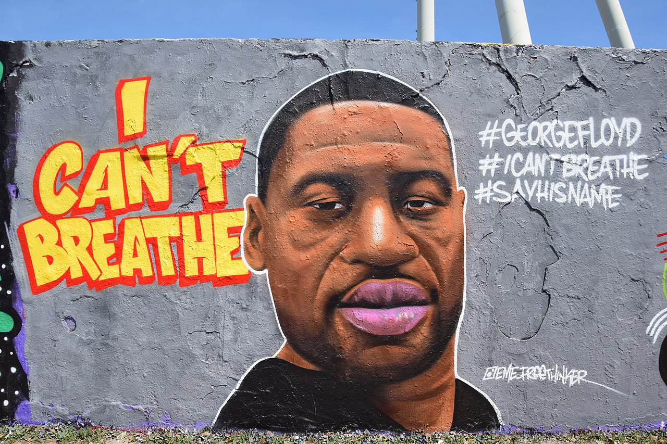
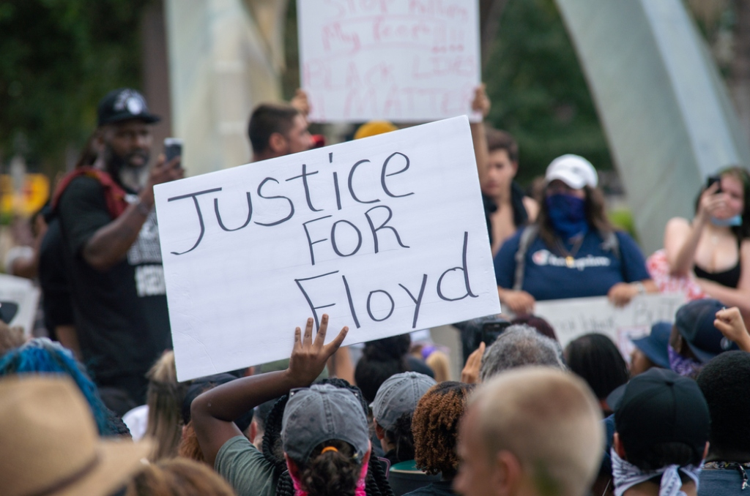
Intro
The May 25, 2020 death of George Floyd, a 46 year old African American man, by a white police officer, Derek Chauvin, in Minneapolis, MN, sparked protests across the nation!
Videos showed Officer Chauvin brutally arrest Floyd, then after he rear-restrained him he knelt on his neck for 8 minutes and 46 seconds (He murdered him in the street!)
Peaceful protests continue across the nation, but in some places rioting and looting!
These events have highlighted the racial injustices and unrest in our country and deepens the divide between people!
Notes:
https://www.nytimes.com/2020/05/31/us/george-floyd-investigation.html
https://abcnews.go.com/US/timeline-impact-george-floyds-death-minneapolis/story?id=70999322
https://www.cnn.com/2020/06/01/us/george-floyd-independent-autopsy/index.html
https://www.usatoday.com/story/news/nation/2020/06/01/george-floyd-independent-autopsy-findings-released-monday/5307185002/
https://www.nbcnews.com/news/us-news/george-floyd-tested-positive-coronavirus-april-autopsy-says-n1224396

Slide 3
Intro
"The second is this, 'YOU SHALL LOVE YOUR NEIGHBOR AS YOURSELF.' There is no other commandment greater than these."
(Mark 12:31)
"Treat others the same way you want them to treat you."
(Luke 6:31)

Slide 4
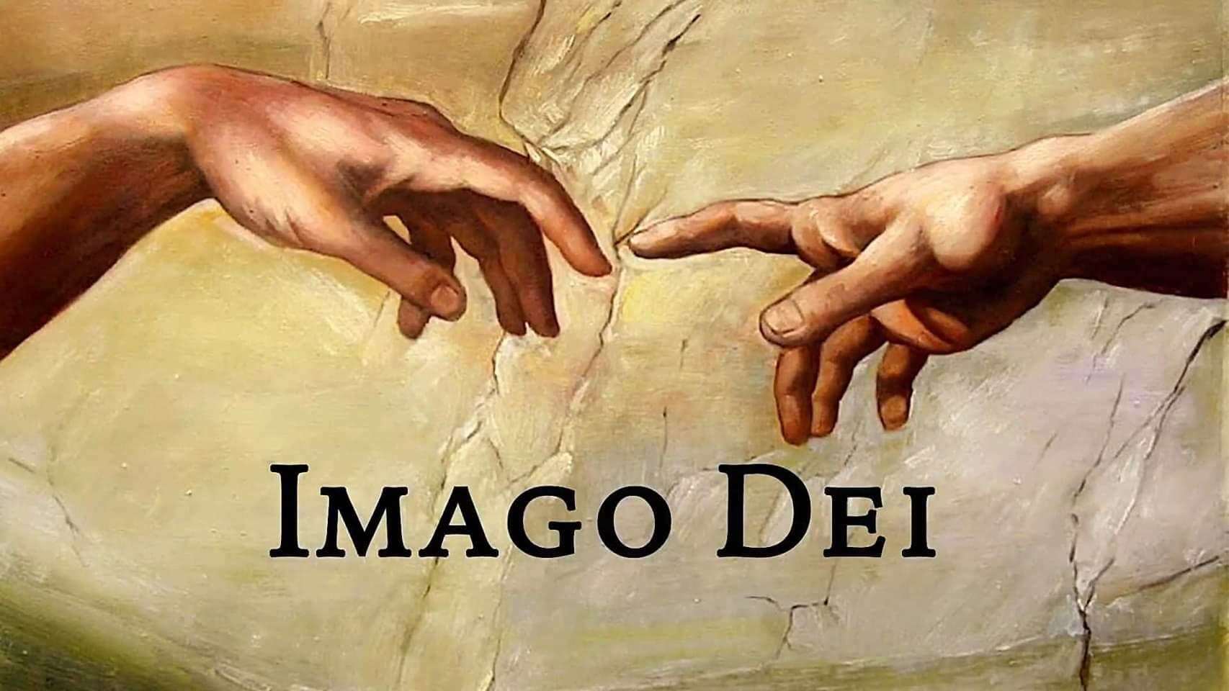
Intro
Then God said, "Let Us make man in Our image, according to Our likeness; and let them rule over the fish of the sea and over the birds of the sky and over the cattle and over all the earth, and over every creeping thing that creeps on the earth." God created man in His own image, in the image of God He created him; male and female He created them. (Genesis 1:26-27)
Notes:
Image on Right: Interracial Couple

Slide 5
Intro
and He made from one man every nation of mankind to live on all the face of the earth, having determined their appointed times and the boundaries of their habitation. (Acts 17:26)
The world can heal and be a better place if people treat one another as they want to be treated and recognize all people everywhere are made in the image of God!
Notes:
Image: Filipino Couple

Slide 6
Jews & Gentiles
The Jews were chosen as God’s special people (Deut. 7:6; 14:2)
As such, they adopted a superiority attitude towards all other nations.
In the time of Jesus there were really only two “races”: Jews & Gentiles (Greeks)
Gentile in Hebrew and Greek means a foreigner, specifically, a non-Jewish foreign national.
Matthew 10:5-6: The disciples were sent to preach to the Jews and were not to go to the Gentiles or the Samaritans at that time
Later they were sent into the whole world to all the nations – Mt.28:18-20; Acts 1:8).
Racism existed in the minds of the Jews, God’s people, and Jesus came to change that!
Notes:
Image: Jewish Couple

Slide 7
Jesus Came to Bless Both Jews & Gentiles
The O.T. contains clues that one day the Gentiles will be blessed by God
The widow of Sidon blessed by God during the famine – I Kings 17:10-24
Naaman the Leper of Syria healed by God – II Kings 5
Jesus used both these examples to show the Israelites that God had blessed Gentiles before and that history was about to repeat itself (Luke 4:24-27)
God’s compassion on Nineveh, the capital city of Assyria – Book of Jonah
Isaiah’s prophecy was that all nations will hear the word of God proclaimed from Jerusalem (Isaiah 2:1-2; Acts 2)
Notes:
Image: Arabic Couple

Slide 8
Jesus Came to Bless Both Jews & Gentiles
Jesus said He came to both Jews (first) and to the Gentiles
Luke 2:29-32: Simeon said Jesus would fulfill prophecy to bring salvation to both Gentiles and the Jews! (Is. 42:6; 49:6)
Mt. 12:15-21: Jesus came in fulfillment of Isaiah 42:1-4 to give the Gentiles hope! (Luke 4:24-27)
John 10:16: Jesus spoke of bringing in another flock to the Jewish flock to make “one flock with one shepherd.”
Eph. 2:11-22: Jews & Gentiles were reconciled together and to God in Christ’s blood and made into “one new man”
There is NO division in Jesus and His church, but “one new man!”
Notes:
Image: Asian Couple

Slide 9
The New Race
The One Flock: The New Race
anonymous A.D. 2nd c. writer that wrote to explain the Christian life to a pagan named Diognetus, and in his introduction stated,
“You would also like to know the source of the loving affection that they have for each other. You wonder, too, why this new race or way of life has appeared on earth now and not earlier.” (Epistle to Diognetus, 1.1)
Notes:
Source: https://www.newadvent.org/fathers/0101.htm
Image: White Couple

Slide 10
The New Race
“This New Race” is how the early Christians identified themselves
I Corinthians 10:32: “Give no offense either to Jews or to Greeks or to the church of God.”
“This new race”: For Paul, there were three “races”: Jews, Gentiles, and Christians
The same gospel that reconciles us to God in Christ also reconciles us to one another in Christ (Ephesians 2:13-16).
Notes:
Source: https://www.newadvent.org/fathers/0101.htm
Image: Black Couple

Slide 11
The New Race
One flock, one new man, one body in Christ
Gal. 3:26-29 (emphasis on 3:28): In Christ there is no difference of degree in racial or social status, just oneness! “This new race”
The world is filled with hate, fear and distrust revolving around race and ethnicity.
God calls us to be different from the world, and indeed to transform it!
Notes:
Source:
https://www.facebook.com/shane.scott.777/notes?lst=709224676%3A1378873380%3A1591298166
https://www.facebook.com/shane.scott.777/posts/10222223770888071
Image: Hispanic Couple

Slide 12
The New Race
Something “New”
II Cor. 5:17: In Christ one is a “new creature.”
Gal. 6:15: “For neither is circumcision (Jews) anything, nor uncircumcision (Gentiles/Greeks), but a new creation (this new race).”
Heb. 10:20: Called to “a new and living way.”
As part of this new race saints are called to a new and living way, to be different from the world, and for our priorities to be Christ and the gospel!
Notes:
Image: Indian Couple – Saif-Kareena

Slide 13
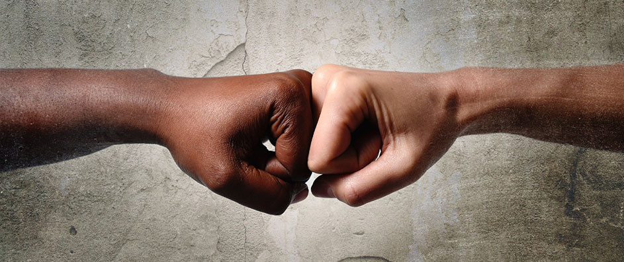
Conclusion
Something “new” and “one in Christ” means prejudices and racism, and all the emotions that go with those things: fear and hate, don’t belong in the saint’s heart
Acts 10:34-35: Peter said, “I most certainly understand now that God is not one to show partiality, but in every nation the man who fears Him and does what is right is welcome to Him!”
Romans 2:11: Paul wrote, “For there is no partiality with God.”
James 2:9: James wrote, “But if you show partiality, you are committing sin and are convicted by the law as transgressors.”

Slide 14
Conclusion
Love your neighbor as yourself! (Mark 12:31)
Treat others the same way you want to be treated! (Luke 6:31)
Listen & empathize to those who are hurting! (Romans 12:15; James 1:19)
Be the change you want to see in others, the country, and the world! (II Corinthians 5:17)

Slide 15
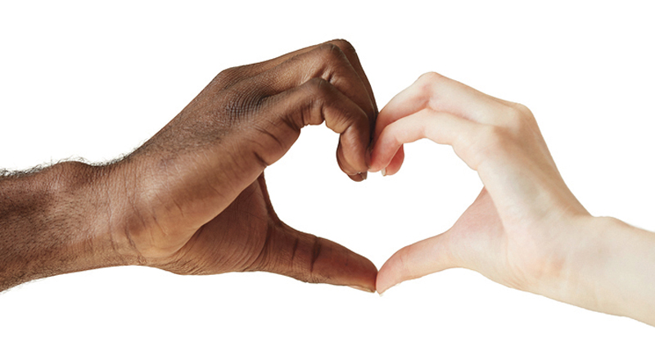
Conclusion
We need to have the mindset that all people matter to God and are worthy of our time, love and concern (II Timothy 2:24-26) because all men and women are created in the image of God! (Genesis 1:26-27)
All of humanity needs the gospel!
It can transform hearts and minds into what Jesus Christ wants them to be: Loving and kind! (Col. 3:12-14)

Slide 16
Conclusion
Let us in humility of mind think of others as more important than ourselves (Phil. 2:3-4) and labor for the kingdom in love and concern for others, teaching them to obey the gospel and be forgiven of their sins, and become “a new creature” that is part of “this new race!”

Slide 17
“What Must I Do To Be Saved?”
Hear The Gospel (Jn. 5:24; Rom. 10:17)
Believe In Christ (Jn. 3:16-18; Jn. 8:24)
Repent Of Sins (Lk. 13:3-5; Acts 2:38)
Confess Christ (Mt. 10:32; Rom. 10:10)
Be Baptized (Mk. 16:16; Acts 22:16)
Remain Faithful (Jn. 8:31; Rev. 2:10)
For The Erring Saint:
Repent (Acts 8:22), Confess (I Jn. 1:9),
Pray (Acts 8:22)

