Slide 1
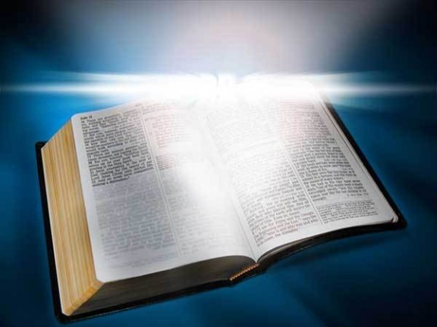
Desire Life!
Text:
I Peter 3:8-12
Notes:
By Nathan L Morrison
All Scripture given is from NASB unless otherwise stated
For further study, or if questions, please Call: 804-277-1983 or Visit www.courthousechurchofchrist.com

Slide 2
intro
Moses
Choose life in order
that you may live
(Deut.
30:19)
Deut. 30:11-20
Life & Death,
Blessing & Curse
Farewell Address
(Deut. 28-30)
Their desire for life and to see good days was tied to their obedience and love for God!
Obedience & Love go together!
By loving the LORD your God, by obeying His voice! (Deut. 30:20)
I John 5:2-3
By this we know that we love the children of God, when we love God and observe His commandments.
For this is the love of God, that we keep His commandments; and His commandments are not burdensome.

Slide 3
Intro
II Tim. 1:1
1. Paul, an apostle of Jesus Christ by the will of God, according to the promise of life which is in Christ Jesus,
I Pet. 3:8-12
8. To sum up, all of you be harmonious, sympathetic, brotherly, kindhearted, and humble in spirit;
9. not returning evil for evil or insult for insult, but giving a blessing instead; for you were called for the very purpose that you might inherit a blessing.
10. For, "THE ONE WHO DESIRES LIFE, TO LOVE AND SEE GOOD DAYS, MUST KEEP HIS TONGUE FROM EVIL AND HIS LIPS FROM SPEAKING DECEIT.
11. "HE MUST TURN AWAY FROM EVIL AND DO GOOD; HE MUST SEEK PEACE AND PURSUE IT.
12. "FOR THE EYES OF THE LORD ARE TOWARD THE RIGHTEOUS, AND HIS EARS ATTEND TO THEIR PRAYER, BUT THE FACE OF THE LORD IS AGAINST THOSE WHO DO EVIL."

Slide 4
Intro
Do you desire life?
To love life involves proper relationships with:
Others (I Peter 3:8-11)
The Lord (I Peter 3:12)
If you desire life and love to see good days then love and obey the Lord with your whole heart!
Notes:
COVID-19 Lockdown has…
Made opportunities for families to spend more time together
Made opportunities for spouses to spend more time together
Made it possible to spend more time reading or studying God’s word, and do it together as a family

Slide 5
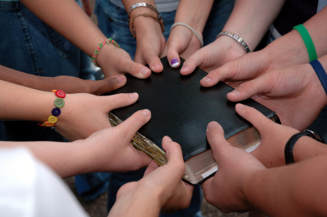
Love The Brethren
I Peter 3:8
8. To sum up, all of you be harmonious, sympathetic, brotherly, kindhearted, and humble in spirit;
“Harmonious”
Phil. 1:27; I Cor. 12:12-14, 27
“Sympathetic”
Rom. 12:15; Gal. 6:2; Col. 3:12-14
“Brotherly, Kindhearted”
I Jn. 4:20-21; Jn. 13:34
“Humble in spirit”
Js. 4:6-8; I Pet. 5:5
A loving relationship with the brethren is a great way to enjoy life!
Notes:
Emphasis in Scriptures mine!

Slide 6
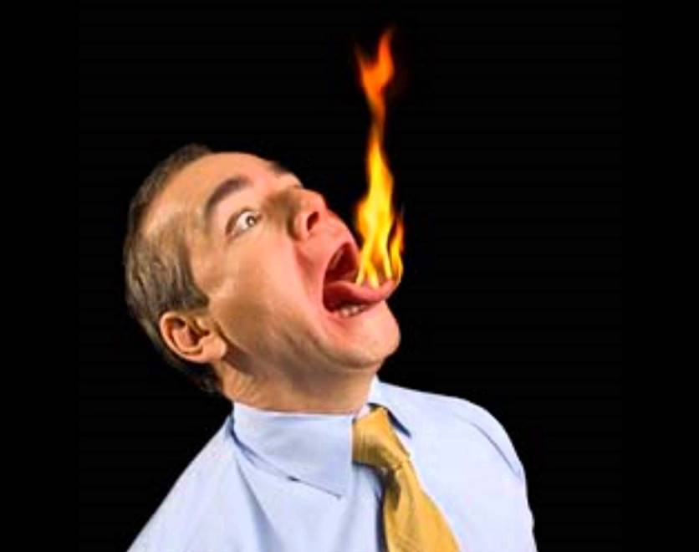
Control the Tongue
I Peter 3:9-10
not returning evil for evil or insult for insult, but giving a blessing instead; for you were called for the very purpose that you might inherit a blessing.
For, "THE ONE WHO DESIRES LIFE, TO LOVE AND SEE GOOD DAYS, MUST KEEP HIS TONGUE FROM EVIL AND HIS LIPS FROM SPEAKING DECEIT.
Life is much more pleasant when we restrain our
tongues and build each other up!
the tongue can cause much hurt!
Js. 3:5-6, 9-10
keep the tongue from evil
Js. 1:19; 3:8-9
Must not have lips of deceit
Col. 4:6
Notes:
Emphasis in Scriptures mine!

Slide 7
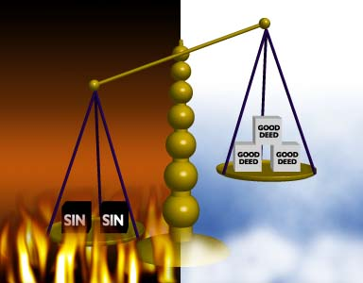
Turn Away From Evil
I Peter 3:11
11. "HE MUST TURN AWAY FROM EVIL AND DO GOOD; HE MUST SEEK PEACE AND PURSUE IT.
To do evil is the opposite of righteous (I Pet. 3:12)
Heb. 5:14; Gal. 5:19-21
One way to depart from evil is by “doing good”
Gal. 6:10; Eph. 2:10 (Titus 2:14); Mt. 7:21-23 (Col. 3:17)
To receive the “promise of life”
(II Tim. 1:1), we need to “turn away from evil and do good!”
Notes:
Emphasis in Scriptures mine!

Slide 8
Seek Peace
I Peter 3:11
11. "HE MUST TURN AWAY FROM EVIL AND DO GOOD; HE MUST SEEK PEACE AND PURSUE IT.
“seek peace and pursue it”
There are some who evidently encourage strife!
Jesus said it is possible to be “peacemakers” (With others)
Matthew 5:9
In Christ we have peace with God
Rom. 5:1; Eph. 2:14-16
To have peace in this life is to know God and obey His Son, and thus have peace for eternity!
Notes:
Emphasis in Scriptures mine!

Slide 9
Pray to God
I Peter 3:12
12. "FOR THE EYES OF THE LORD ARE TOWARD THE RIGHTEOUS, AND HIS EARS ATTEND TO THEIR PRAYER, BUT THE FACE OF THE LORD IS AGAINST THOSE WHO DO EVIL."
To truly desire and love life one must continually pray to God, the Giver of all good things!
(Js. 1:17)
The righteous are to pray
Prayer to God is a privilege; one the wicked (unrighteous) do not have!
Prayer is God’s antidote for anxiety & brings peace
Phil. 4:6-7; Lk. 18:1; I Jn. 3:21-22; 5:14-15; II Cor. 12:7-10; Eph. 3:20-21; Rom. 8:28
Pray at all times!
I Thess. 5:17; Eph. 6:18
Notes:
Emphasis in Scriptures mine!

Slide 10
Conclusion
Israel
They lost their land due to unfaithfulness as they chose the curses Moses set before them
(Deut. 28-30)
Many prosperous years in the Promised Land
II Kings 17:6-23: Israel destroyed
The “face of the Lord” is against those who do evil (I Peter 3:12; Isaiah 59:1-2)
Sin created a barrier between man and God!
II Chr. 36:14-21: Judah went into captivity for 70 years
Isaiah 59:1-2
Behold, the LORD'S hand is not so short That it cannot save; Nor is His ear so dull That it cannot hear.
But your iniquities have made a separation between you and your God, And your sins have hidden His face from you so that He does not hear.

Slide 11
Psalm 34:11-22
Come, you children, listen to me; I will teach you the fear of the LORD.
Who is the man who desires life And loves length of days that he may see good?
Keep your tongue from evil And your lips from speaking deceit.
Depart from evil and do good; Seek peace and pursue it.
The eyes of the LORD are toward the righteous And His ears are open to their cry.
The face of the LORD is against evildoers, To cut off the memory of them from the earth.
The righteous cry, and the LORD hears And delivers them out of all their troubles.
The LORD is near to the brokenhearted And saves those who are crushed in spirit.
Many are the afflictions of the righteous, But the LORD delivers him out of them all.
He keeps all his bones, Not one of them is broken.
Evil shall slay the wicked, And those who hate the righteous will be condemned.
The LORD redeems the soul of His servants, And none of those who take refuge in Him will be condemned.

Slide 12
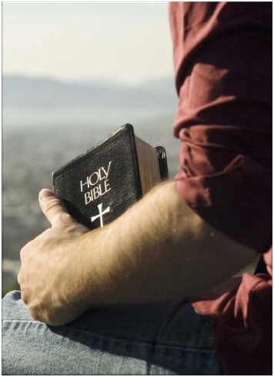
Conclusion
Life is opportunity!
Every day is an opportunity to choose life or death (eternal), the blessing or the curse!
Every day is another day for God to be glorified!
Do you desire life and love to see good days?
Love God with your whole heart, soul, mind, and strength (Mark 12:30)
Remain obedient to God to enjoy life now and receive an eternal life with Him
Choose life!

Slide 13
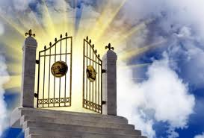
Conclusion
Desire life (in Christ are the promises
and blessings of life) and love to see
“good days!”

Slide 14
“What Must I Do To Be Saved?”
Hear The Gospel (Jn. 5:24; Rom. 10:17)
Believe In Christ (Jn. 3:16-18; Jn. 8:24)
Repent Of Sins (Lk. 13:3-5; Acts 2:38)
Confess Christ (Mt. 10:32; Rom. 10:10)
Be Baptized (Mk. 16:16; Acts 22:16)
Remain Faithful (Jn. 8:31; Rev. 2:10)
For The Erring Saint:
Repent (Acts 8:22), Confess (I Jn. 1:9),
Pray (Acts 8:22)

