Slide 1

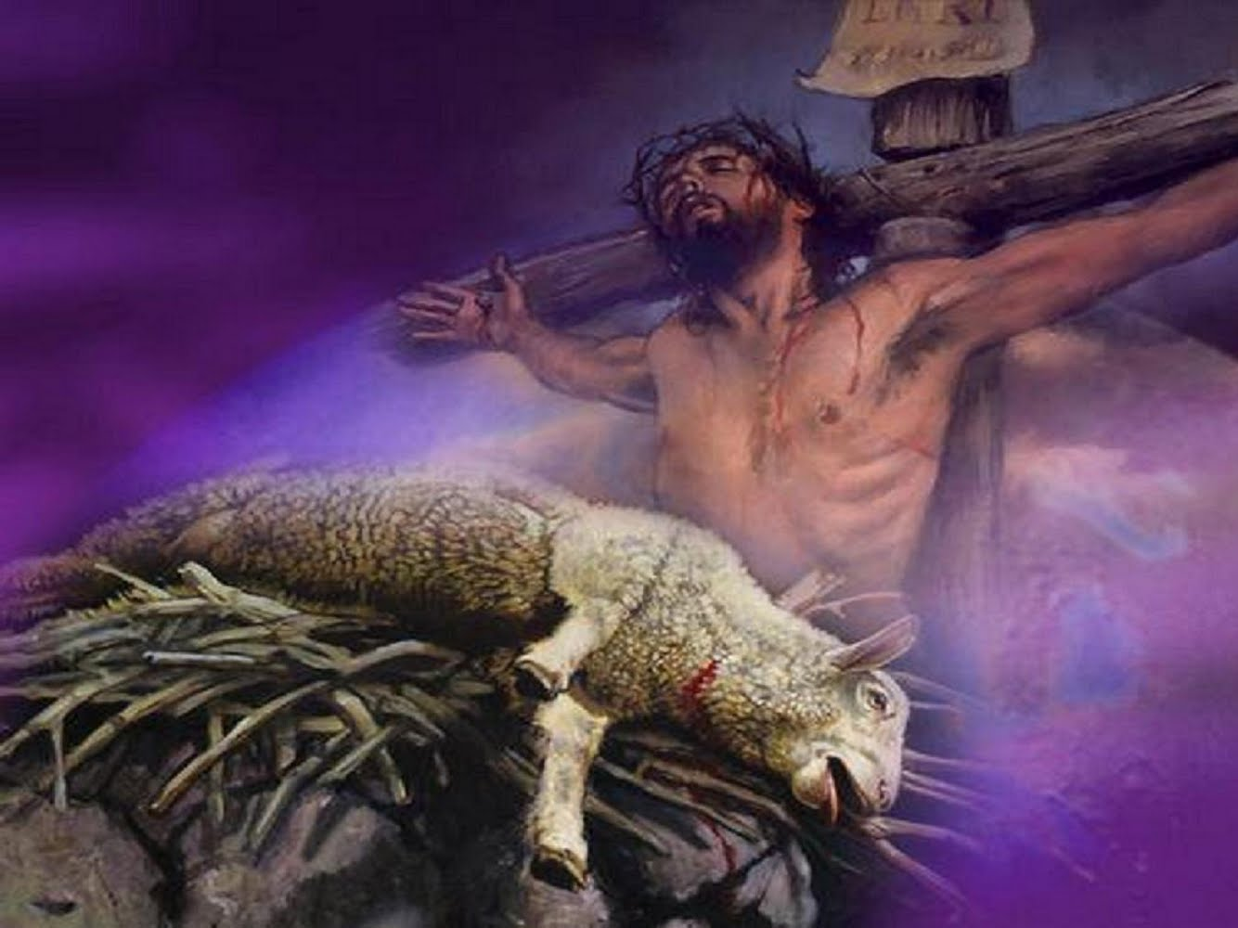
Passover (Ex.12:1-20; 23:15; 34:18; Deut. 16:1-8) | Jesus, our Passover (Mark 14:12; I Cor. 5:7)
A year-old male lamb without defect (Ex. 12:5; Lev. 22:20-21) | Jesus, the Lamb of God, was sinless, without blemish (John 1:29; I Pet. 1:19; Heb. 4:15; Rev. 5:6)
Its bones are not to be broken (Ex. 12:46; Num. 9:12) | Jesus’ bones were not broken (Ps. 34:20; John 19:31-37)
The blood of the lamb caused the “destroyer” to pass over the house, thus sparing them from death (Ex. 12:12-13, 23) | The blood of Jesus, the Lamb of God, washes away sin, and gives life to believers, escaping eternal death (Mt. 26:28; Acts 22:16; Rom. 6:23; Eph. 1:7; Heb. 9:12, 14)
The annual Passover commemorated God delivering the Jews from the bondage of slavery in Egypt (Ex. 12:17, 24-28) | The weekly Lord’s Supper commemorates the death of Jesus and deliverance from the bondage of sin (Rom. 6:15-23; Eph. 1:7)
They were to observe the Passover to remember coming out of Egypt (Ex. 23:15; 34:18; Deut. 16:1-8) | Saints observe the Lord’s Supper to remember Jesus’ sacrifice and proclaim His death till He comes again (I Cor. 11:23-26)

Slide 2
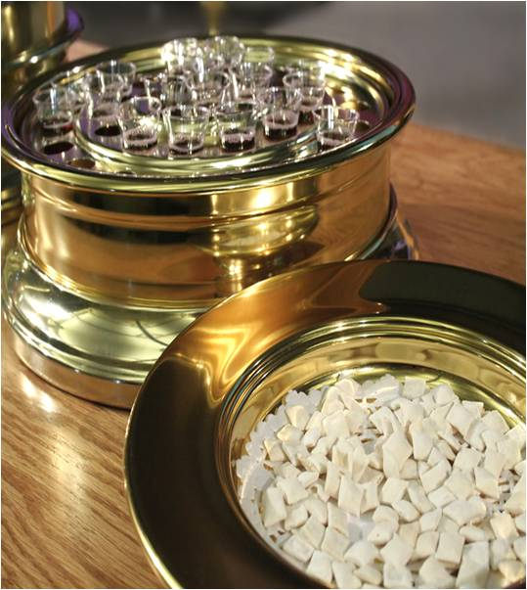
Luke 22:19
19 And when He had taken some bread and given thanks, He broke it and gave it to them, saying, "This is My body which is given for you; do this in remembrance of Me."

Slide 3
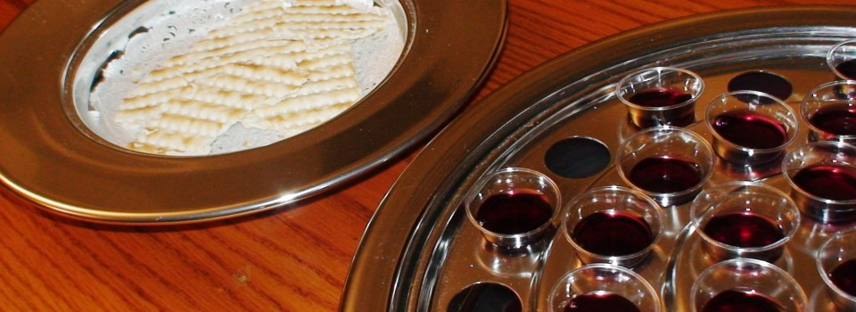
Matthew 26:27-28
27 And when He had taken a cup and given thanks, He gave it to them, saying, "Drink from it, all of you;
28 for this is My blood of the covenant, which is poured out for many for forgiveness of sins.

