Slide 1

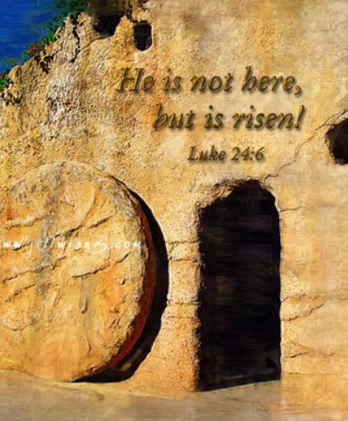
Luke 24:1-5
1 But on the first day of the week, at early dawn, they came to the tomb bringing the spices which they had prepared.
2 And they found the stone rolled away from the tomb,
3 but when they entered, they did not find the body of the Lord Jesus.
4 While they were perplexed about this, behold, two men suddenly stood near them in dazzling clothing;
5 and as the women were terrified and bowed their faces to the ground, the men said to them, "Why do you seek the living One among the dead?

Slide 2
Luke 24:6-9
6 "He is not here, but He has risen. Remember how He spoke to you while He was still in Galilee,
7 saying that the Son of Man must be delivered into the hands of sinful men, and be crucified, and the third day rise again."
8 And they remembered His words,
9 and returned from the tomb and reported all these things to the eleven and to all the rest.

Slide 3
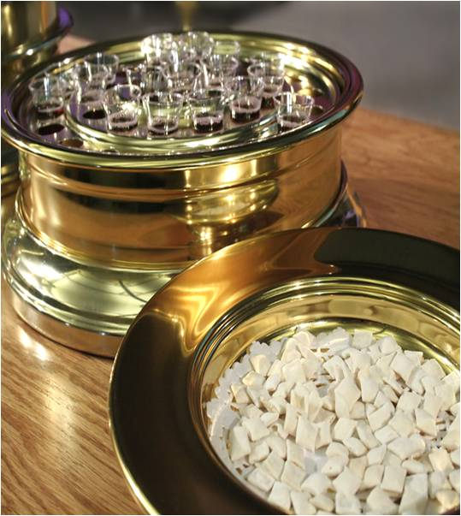
Luke 22:19
19 And when He had taken some bread and given thanks, He broke it and gave it to them, saying, "This is My body which is given for you; do this in remembrance of Me."

Slide 4
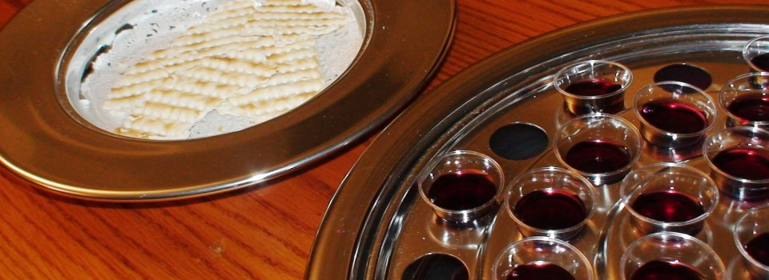
Matthew 26:27-28
27 And when He had taken a cup and given thanks, He gave it to them, saying, "Drink from it, all of you;
28 for this is My blood of the covenant, which is poured out for many for forgiveness of sins.

