Slide 1
Calvary Part 3: Christ In The Center
Text:
Philippians 1-4
Notes:
Prepared by Nathan L Morrison
All Scripture given is from NASB unless otherwise stated!
For further study, or if questions, please Call: 804-277-1983 or Visit www.courthousechurchofchrist.com

Slide 2
Intro
There were three crosses at Calvary (Golgotha)…
Matthew 27:38
38. At that time two robbers were crucified with Him, one on the right and one on the left.
Mark 15:27
27. They crucified two robbers with Him, one on His right and one on His left.
Luke 23:33
33. When they came to the place called The Skull, there they crucified Him and the criminals, one on the right and the other on the left.
John 19:18
18. There they crucified Him, and with Him two other men, one on either side, and Jesus in between.

Slide 3
Intro
Teaching the gospel focuses on the cross of Christ
I Corinthians 2:2
2. For I determined to know nothing among you except Jesus Christ, and Him crucified.
Acts 8:35
35. Then Philip opened his mouth, and beginning from this Scripture he preached Jesus to him.

Slide 4
Intro
Teaching the gospel focuses on the cross of Christ
Acts 10:39-43 (I Corinthians 15:3-4; Mark 16:16; Acts 2:38; 10:48)
39 "We are witnesses of all the things He did both in the land of the Jews and in Jerusalem. They also put Him to death by hanging Him on a cross.
40 "God raised Him up on the third day and granted that He become visible,
41 not to all the people, but to witnesses who were chosen beforehand by God, that is, to us who ate and drank with Him after He arose from the dead.
42 "And He ordered us to preach to the people, and solemnly to testify that this is the One who has been appointed by God as Judge of the living and the dead.
43 "Of Him all the prophets bear witness that through His name everyone who believes in Him receives forgiveness of sins."

Slide 5
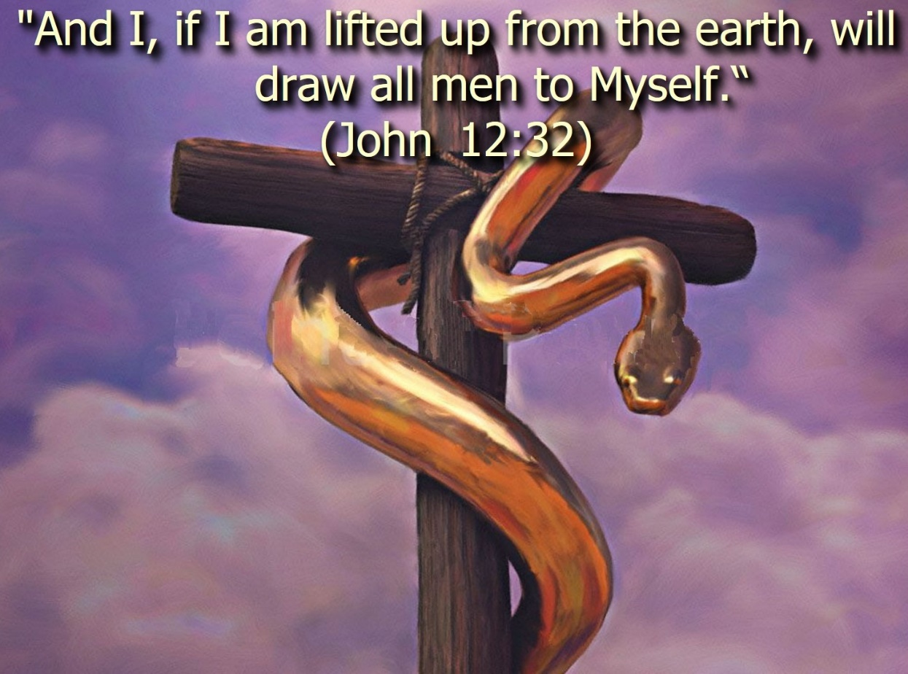
Intro
John 3:13-15
13. "No one has ascended into heaven, but He who descended from heaven: the Son of Man.
14. "As Moses lifted up the serpent in the wilderness, even so must the Son of Man be lifted up;
15. so that whoever believes will in Him have eternal life.
As Christ’s cross was center (Lk. 23:33; Jn. 19:18),
so is Christ to be the center of our lives!

Slide 6
Christ Is the Purpose of My Life
Phil. 1:21-24:
21. For to me, to live is Christ and to die is gain.
22. But if I am to live on in the flesh, this will mean fruitful labor for me; and I do not know which to choose.
23. But I am hard-pressed from both directions, having the desire to depart and be with Christ, for that is very much better;
24. yet to remain on in the flesh is more necessary for your sake.
Paul said “to live is Christ” – He is our purpose for living!
With many, life is: money, power, worldly pleasures, & flattery (vanity).
“Living is Christ, dying is gain.”
For saints, Christ is in the center of our lives!
Gal. 2:20:
20. "I have been crucified with Christ; and it is no longer I who live, but Christ lives in me; and the life which I now live in the flesh I live by faith in the Son of God, who loved me and gave Himself up for me.
I live to die for Christ, as He died to make me live!

Slide 7
Christ Is the Purpose of My Life
What about death?
Means more of Christ (“To die is gain.”)
Phil. 3:8: Paul spoke of gaining Christ. Possessions meant nothing next to Christ!
Heb. 2:9, 14-15: Death should hold no terrors for the believer.
Phil. 4:11-13: He longed to be with Christ, but was also satisfied with life below – For he had all strength in Christ.
As saints, Christ ought to be the purpose of your life!

Slide 8
Christ Is the Pattern of My Life
Phil. 2:5-8:
5. Have this attitude in yourselves which was also in Christ Jesus,
6. who, although He existed in the form of God, did not regard equality with God a thing to be grasped,
7. but emptied Himself, taking the form of a bond-servant, and being made in the likeness of men.
8. Being found in appearance as a man, He humbled Himself by becoming obedient to the point of death, even death on a cross.
Christ’s human form is a lesson in humility
John says the Word became flesh. (Jn. 1:14)
He gave up the glory of Heaven to redeem us!
Heb. 4:14-16: As He possessed the real attributes of Deity, so He also took up the real attributes of a bondservant.

Slide 9
Christ Is the Pattern of My Life
Heb. 5:8-9: Jesus was obedient even in death
He cried aloud when He felt alone on the cross. (Mt. 27:46)
His body on the cross was accursed. (Deut. 21:23; Gal. 3:13-14)
I Cor. 1:20-25: The Jews stumbled at the cross, the Greek thought it foolishness, but to the believer it is power unto salvation!
We need to obediently follow Christ in all things:
Doctrine
Practice
Conduct
Speech
Christ’s life is the perfect pattern (example) for my life!
(I Pet. 2:21-25)

Slide 10
Christ Is the Prize of My Life
Phil. 3:12-14
12. Not that I have already obtained it or have already become perfect, but I press on so that I may lay hold of that for which also I was laid hold of by Christ Jesus.
13. Brethren, I do not regard myself as having laid hold of it yet; but one thing I do: forgetting what lies behind and reaching forward to what lies ahead,
14. I press on toward the goal for the prize of the upward call of God in Christ Jesus.
Perfect:
Gr. teleios (G5046) – “Complete (in various applications of labor, growth, mental and moral character, etc.); completeness: of full age, man, perfect.”
Though not “complete” Paul “pressed on” to the prize
The verb literally means, “I pursue” or “I follow after.”
Paul was in the pursuit of Christ
Christ had changed him from a persecutor to an apostle. (Acts 22:3-5)

Slide 11
Christ Is the Prize of My Life
Paul’s goal is still ahead – he pictured it as a chase!
He does not forget his former career, but he does not allow his immediate past to lull him into a sense of false security.
He could not count on former achievements to carry him through life to Christ – but had to continue pressing on!
I Cor. 9:24: The prize belongs to those who run!
24. Do you not know that those who run in a race all run, but only one receives the prize? Run in such a way that you may win.
Paul was thinking of the crown of righteousness
(II Tim. 4:8) – Are you?

Slide 12
Christ Is the Power of My Life
Phil. 4:12-13:
12. I know how to get along with humble means, and I also know how to live in prosperity; in any and every circumstance I have learned the secret of being filled and going hungry, both of having abundance and suffering need.
13. I can do all things through Him who strengthens me.
Paul uses the word “strengthens” to describe Christ’s relationship to him
I Tim. 1:12: He recognized that his strength comes from Christ!
II Tim. 4:17: God strengthened him to endure so that the Gentiles would hear the gospel. He was even rescued from the mouth of the lions!
Eph. 6:10: The armor of God is to give strength to all Christians!
Paul yielded his way and found joy in God’s way
Men can kill him, but they cannot deprive him of the love & power of Christ in his life. (Mt. 10:28; Rom. 8:35-39)
Paul’s life was victorious because he let the word of Christ
dwell within him and rule in his life!

Slide 13
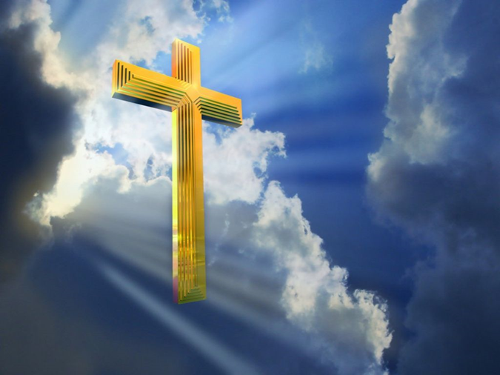
Conclusion
Paul says our lives are enhanced and enriched by the
grace of Christ when we submit to His will and live for
Him!
Christ is the Purpose of my life
Christ is the Pattern of my life
Christ is the Prize of my life
Christ is the Power of my life
Christ was center at Calvary (Lk. 23:33; Jn. 19:18), is
center in preaching (Acts 8:35; I Cor. 2:2), and should
be the center of our lives (Gal. 2:20)!

Slide 14
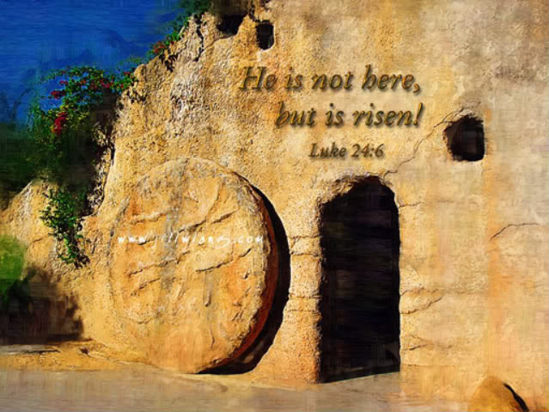
Conclusion
Jesus was crucified at Calvary, but the tomb was empty the 3rd day for He had risen (Luke 24:5-7)!
Jesus rose from the dead and proclaimed light to the Jews and Gentiles (Acts 26:23)!

Slide 15
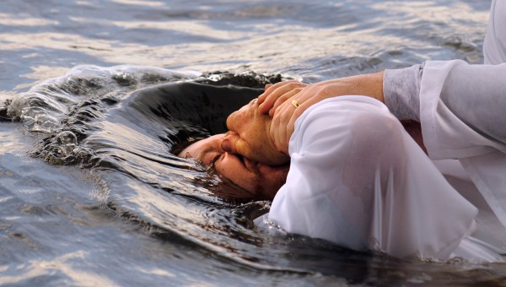
Conclusion
To share in that glory, to share in Christ’s death, burial and resurrection, we must be baptized, putting to death the old self of sin (Rom. 6:6), being buried with Him and raising from the water to walk in newness of life! (Romans 6:3-4)
Have you made Jesus Christ the center of your life?

Slide 16
“What Must I Do To Be Saved?”
Hear The Gospel (Jn. 5:24; Rom. 10:17)
Believe In Christ (Jn. 3:16-18; Jn. 8:24)
Repent Of Sins (Lk. 13:3-5; Acts 2:38)
Confess Christ (Mt. 10:32; Rom. 10:10)
Be Baptized (Mk. 16:16; Acts 22:16)
Remain Faithful (Jn. 8:31; Rev. 2:10)
For The Erring Saint:
Repent (Acts 8:22), Confess (I Jn. 1:9),
Pray (Acts 8:22)

