Slide 1
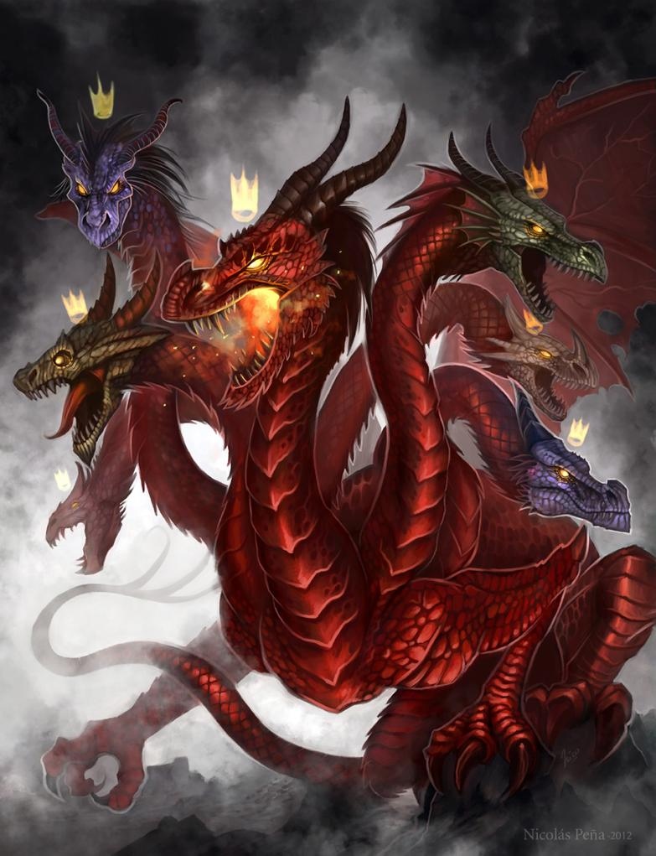
Nots In Satan’s Tale
Text: Genesis 3:1-6
Notes:
By Nathan L Morrison
All Scripture is from NASB unless otherwise stated
For further study, or if questions, please Call: 804-277-1983 or Visit www.courthousechurchofchrist.com
Adapted from a lesson by Richie Thetford

Slide 2

Intro
Genesis 2:16-17; 3:1-5
When talking to Eve, the serpent (Rev. 12:9: Satan) just added the one word “NOT” to the command of God.
A word that brought death, sorrow and all its woe to all of mankind!
Genesis 2:16-17
16. The LORD God commanded the man, saying, "From any tree of the garden you may eat freely;
17. but from the tree of the knowledge of good and evil you shall not eat, for in the day that you eat from it you WILL surely die."
Genesis 3:4
4. The serpent said to the woman, "You surely will NOT die!
Notes:
Emphasis in Scripture mine!

Slide 3
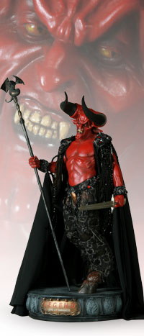
Intro
There have been many images of the devil as conceived of by man
He’s pictured as a beast-like-man with a long tail, dangerous horns, cloven hoofs, and a three-pronged pitchfork in his hands, and powerful muscles.
Where in the Scriptures did they ever get the material for those pictures?

Slide 4
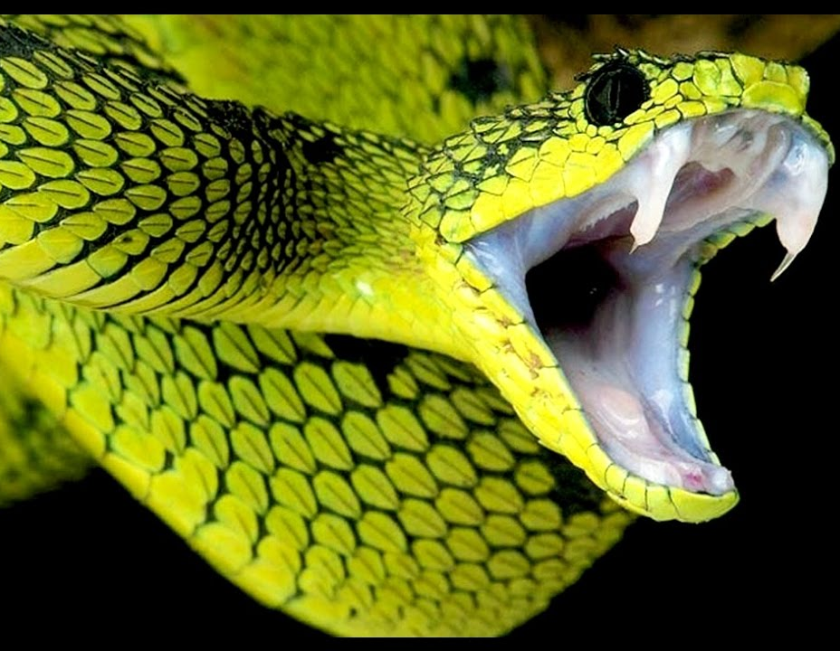
Intro
Genesis 3:1
1. Now the serpent was more crafty than any beast of the field which the LORD God had made. And he said to the woman, "Indeed, has God said, 'You shall not eat from any tree of the garden'?"
Gen. 3:1: He is pictured as a serpent (Rev. 12:9)

Slide 5

Intro
I Peter 5:8
8. Be of sober spirit, be on the alert. Your adversary, the devil, prowls around like a roaring lion, seeking someone to devour!
I Peter 5:8: He is pictured as a roaring lion

Slide 6
Intro
Revelation 12:3
3. Then another sign appeared in heaven: and behold, a great red dragon having seven heads and ten horns, and on his heads were seven diadems.
Rev. 12:3-4, 9; 20:2: He is pictured as a great red dragon with 7 heads, 10 horns, 7 crowns, and a sweeping tail
Scarier than the horned man-beast creature man has thought of!

Slide 7

Intro
II Corinthians 11:14
14. No wonder, for even Satan disguises himself as an angel of light.
II Corinthians 11:14-15: Satan himself is transformed into an angel of light – thus he appears in deceit and disguise!
Perhaps the scariest form of Satan!

Slide 8

You Surely Will NOT Die
Genesis 2:16-17
16. The LORD God commanded the man, saying, "From any tree of the garden you may eat freely;
17. but from the tree of the knowledge of good and evil you shall not eat, for in the day that you eat from it you WILL surely die."
Satan to Eve: “Has God said, 'You shall not eat from any tree of the garden'?” (Gen. 3:1)
Satan to Eve: “You surely will NOT die!” (Gen. 3:4)
Notes:
Emphasis in Scripture mine!

Slide 9
You Surely Will NOT Die
Genesis 2:16-17; 3:1-6
Because of the sin of Adam and Eve, we are in a world of death (Romans 5:12)
Genesis 3:6 (John 8:44)
Good food (I John 2:16: Lust of the flesh)
Eye appeal (I John 2:16; Lust of the eyes)
Desired wisdom (I John 2:16: Boastful pride of life)
Satan just added one little word “NOT” that brought the penalty of God upon man!

Slide 10
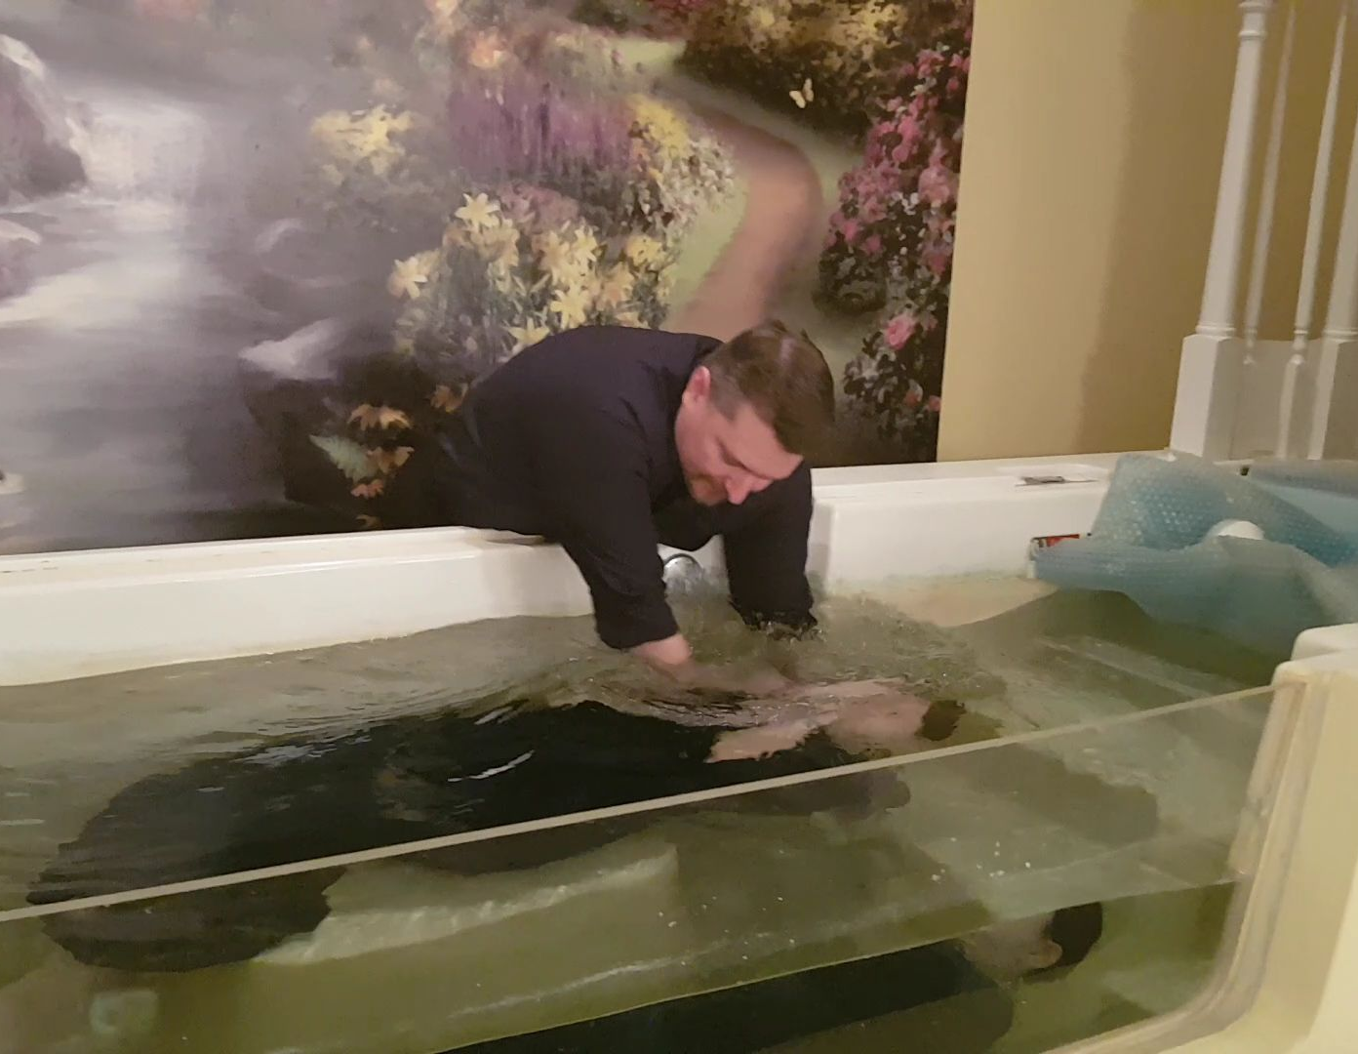
He That Believes And Is NOT Baptized Will Be Saved
Mark 16:16
16. "He who has believed and has been baptized shall be saved; but he who has disbelieved shall be condemned.
Acts 2:38 (I Pet. 3:21)
38. Peter said to them, "Repent, and each of you be baptized in the name of Jesus Christ for the forgiveness of your sins; and you will receive the gift of the Holy Spirit.
Satan to man: “He that believes and is NOT baptized will be saved.”
Satan to man: Just say a “Sinner’s Prayer” or “Invite Jesus into your heart”
Satan has deceived men into teaching others to believe and NOT be baptized!

Slide 11
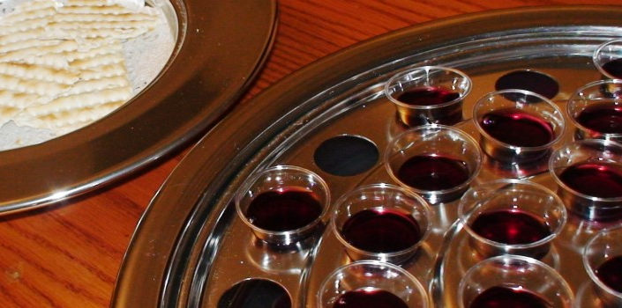
The Lord’s Supper Is NOT Important
I Corinthians 10:16
16. Is not the cup of blessing which we bless a sharing in the blood of Christ? Is not the bread which we break a sharing in the body of Christ?
Satan, through servants disguised as servants of light, deceives men into thinking it is NOT important to remember Jesus Christ the way He instituted!
Acts 20:7
(I Cor. 11:17-30; 16:1-2)
7. On the first day of the week, when we were gathered together to break bread, Paul began talking to them, intending to leave the next day, and he prolonged his message until midnight.
Satan’s Deceit: Some people hold communion every quarter, twice a year, any day they please, and some like in Corinth, turn it into a feast! (I Cor. 11:22, 34)
  Some substitute whatever they want for the unleavened bread & the fruit of the vine (Luke 22:7, 18)

Slide 12
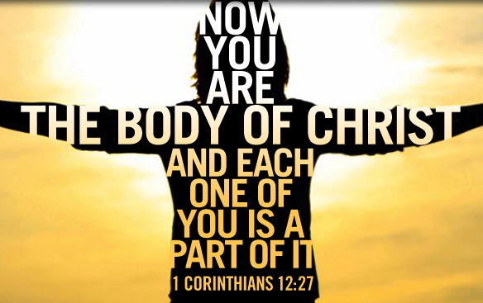
Salvation Is NOT In The Church
Ephesians 5:23, 25
23. For the husband is the head of the wife, as Christ also is the head of the church, He Himself being the Savior of the body.
25. Husbands, love your wives, just as Christ also loved the church and gave Himself up for her,
Acts 20:28
28. "Be on guard for yourselves and for all the flock, among which the Holy Spirit has made you overseers, to shepherd the church of God which He purchased with His own blood.
Satan’s Deceit: The church is not essential to salvation, one church is as good as another, you can be an “island Christian”

Slide 13
Salvation Is NOT In The Church
Matthew 16:18
18. "I also say to you that you are Peter, and upon this rock I will build My church; and the gates of Hades will not overpower it.
Acts 2:47 (NKJV)
47. praising God and having favor with all the people. And the Lord added to the church daily those who were being saved.
Satan’s Deceit: One does NOT have to be in the church in order to be saved; Join the church of your choice

Slide 14
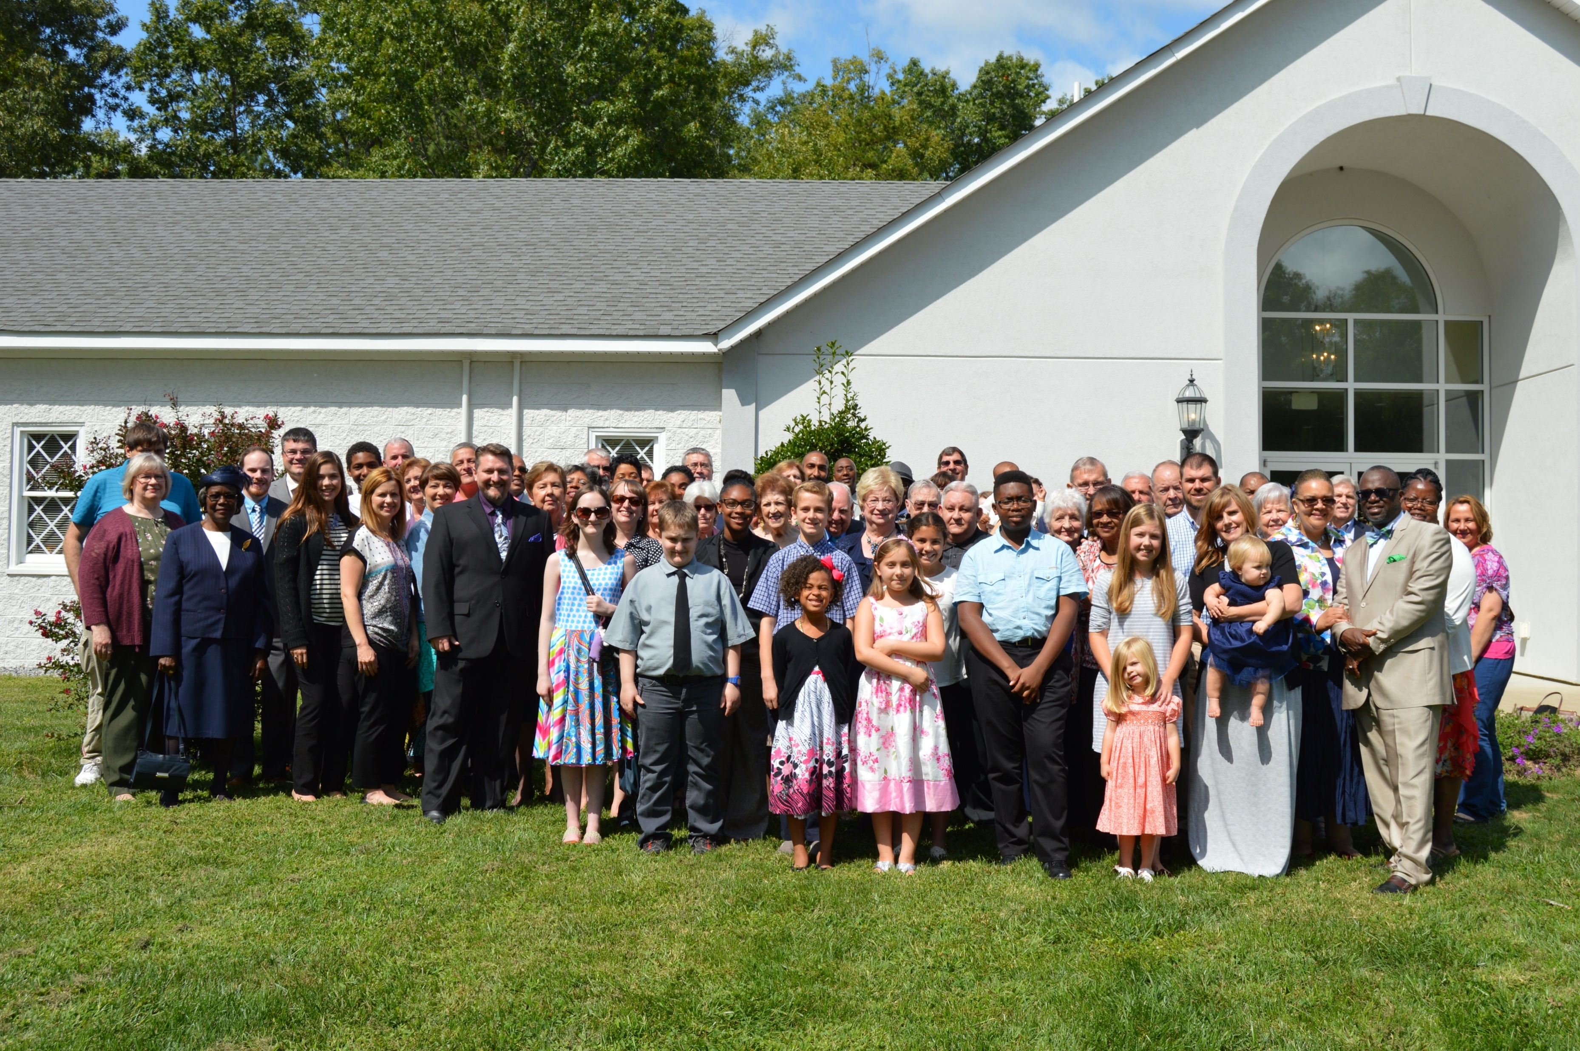
Salvation Is NOT In The Church
Ephesians 5:23, 25; Acts 20:28; Matthew 16:18; Acts 2:47
One must be in the church Christ died for in order to be saved! (Eph. 1:22-23; Acts 2:47)
Acts 20:28: Christ’s blood bought the church.
I Peter 1:18-19: The church is made up of people bought from sin by His blood
By saying salvation is NOT in the church, Satan says Christ’s death was unnecessary!
If the death of Christ was necessary, then His church is essential because the church identifies people saved from sin by the blood of Christ!

Slide 15
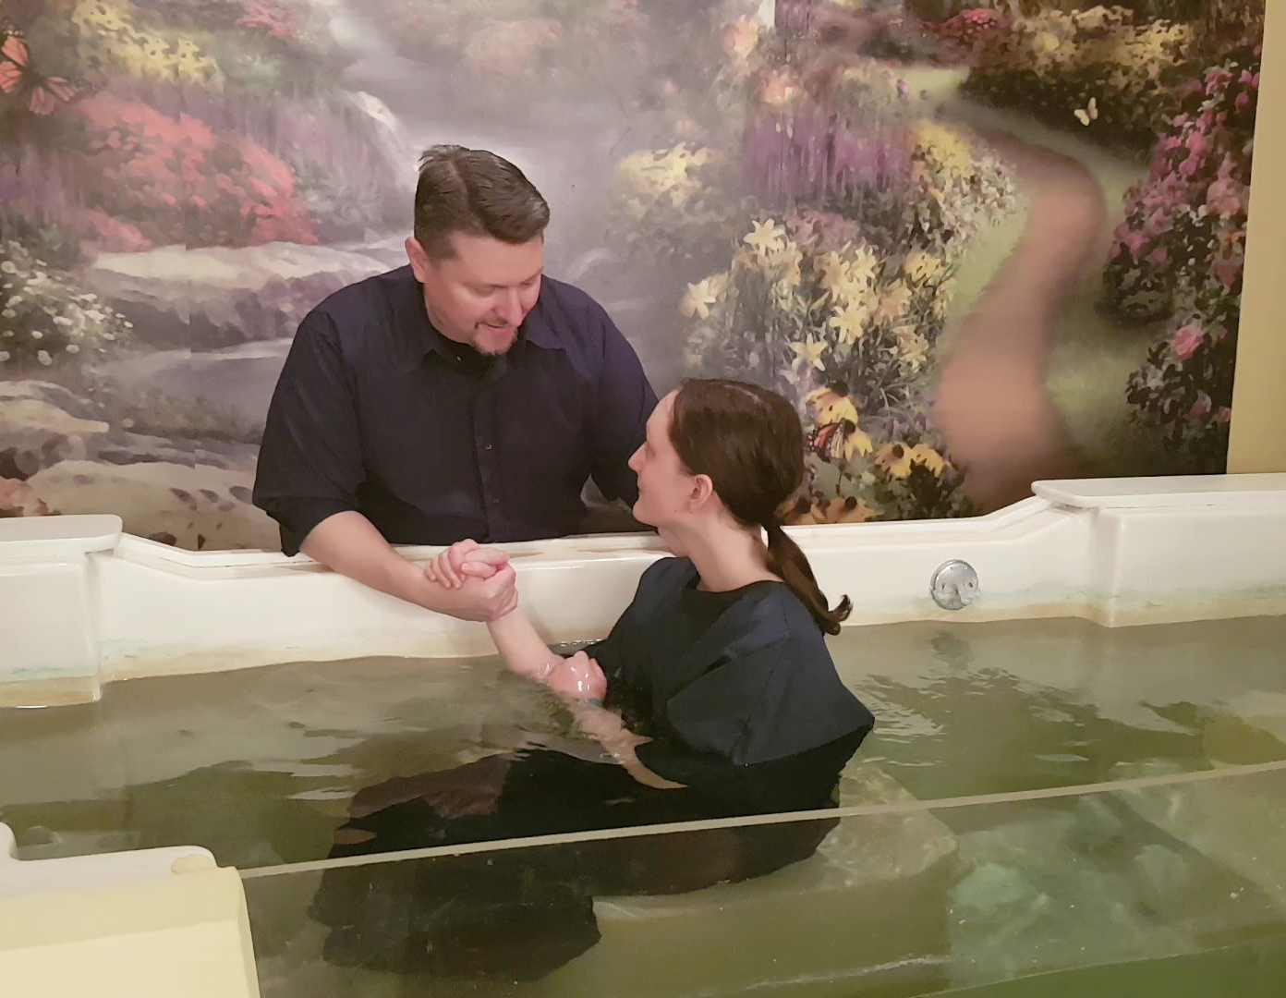
You Are NOT Ready To Obey The Gospel
James 4:17 (Romans 3:23;6:23)
17. Therefore, to one who knows the right thing to do and does not do it, to him it is sin.
Acts 22:16
16. 'Now why do you delay? Get up and be baptized, and wash away your sins, calling on His name.'
Satan’s Deceit: Try to get you to reason that you must wait to obey the gospel
  Take time to sow your wild oats before you obey the gospel
  Take time to study more and become an expert on the Scriptures before you obey the gospel
Satan convinces some that they are NOT ready to commit to God –
When will they be?

Slide 16
Conclusion
Any one of these five NOTS in the devil’s tale will condemn our souls forever in eternity
The devil contradicts and blasphemes every one of the commandments of the gospel of Christ!
The condemnation of Christ awaits all who fail to obey the gospel of the Son of God
II Thessalonians 1:6-9
6. For after all it is only just for God to repay with affliction those who afflict you,
7. and to give relief to you who are afflicted and to us as well when the Lord Jesus will be revealed from heaven with His mighty angels in flaming fire,
8. dealing out retribution to those who do not know God and to those who do not obey the gospel of our Lord Jesus.
9. These will pay the penalty of eternal destruction, away from the presence of the Lord and from the glory of His power,
The truth of God’s word will expose the lies of Satan if one will but hear and obey!

Slide 17

“What Must I Do To Be Saved?”
Hear The Gospel (Jn. 5:24; Rom. 10:17)
Believe In Christ (Jn. 3:16-18; Jn. 8:24)
Repent Of Sins (Lk. 13:3-5; Acts 2:38)
Confess Christ (Mt. 10:32; Rom. 10:10)
Be Baptized (Mk. 16:16; Acts 22:16)
Remain Faithful (Jn. 8:31; Rev. 2:10)
For The Erring Saint:
Repent (Acts 8:22), Confess (I Jn. 1:9),
Pray (Acts 8:22)

