Slide 1
What Kind Of Life?
Text:
Romans 14:12;
II Corinthians 5:10
R.I.P.
Notes:
By Nathan L Morrison
All Scripture given is from the NASB, unless otherwise stated
For further study, or if questions, please Call: 804-277-1983 or Visit www.courthousechurchofchrist.com
Based on a lesson by Ken Weliever

Slide 2
Intro
Your Name Here
(Birth – Death)
This Photo by Unknown Author is licensed under CC BY-SA

Slide 3
Intro
Your Name Here
(Birth – Death)
This Photo by Unknown Author is licensed under CC BY-SA

Slide 4
Intro
Your Name Here
(Birth – Death)
A Faithful Servant of God
This Photo by Unknown Author is licensed under CC BY-SA

Slide 5
Intro
Saints and all people are warned
to prepare to meet God –
Rom. 14:12; II Cor. 5:10

Slide 6
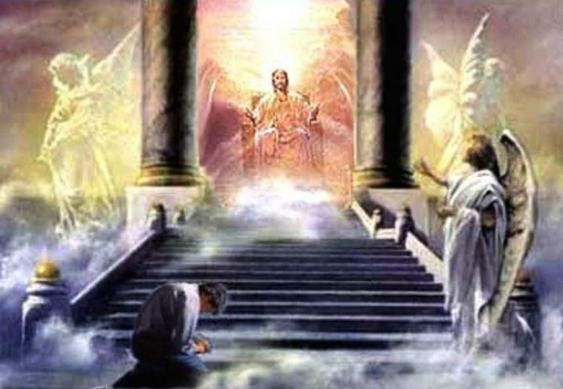
Intro
We will give an account for that dash and the life it represents: What kind of life did we live?
Romans 2:16
16. on the day when, according to my gospel, God will judge the secrets of men through Christ Jesus.
Romans 14:12
12. So then each one of us will give an account of himself to God.
II Corinthians 5:10
10. For we must all appear before the judgment seat of Christ, so that each one may be recompensed for his deeds in the body, according to what he has done, whether good or bad.

Slide 7
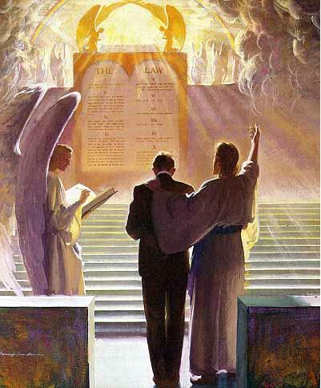
Intro
I Peter 4:17-19
17. For it is time for judgment to begin with the household of God; and if it begins with us first, what will be the outcome for those who do not obey the gospel of God?
18. AND IF IT IS WITH DIFFICULTY THAT THE RIGHTEOUS IS SAVED, WHAT WILL BECOME OF THE GODLESS MAN AND THE SINNER?
19. Therefore, those also who suffer according to the will of God shall entrust their souls to a faithful Creator in doing what is right.
When we meet God and stand at the Judgment Seat of Christ (II Cor. 5:10) we will give an account for that dash!
What kind of life do you live?

Slide 8
How Will You Answer?
What is the Center of Your Life?
A Question of Worship!
II Chr. 14:4: “seek the LORD God of their fathers, and to observe the law and the commandment.”
Mt. 6:33: “seek first the kingdom of God and His righteousness.”
Rom. 14:8: “Whether we live or die, we are the Lord’s.”
Phil. 1:21: “For to me, to live is Christ, and to die is gain.”
Eccl. 12:13-14 (NKJ–Mk. 12:30)
13. Let us hear the conclusion of the whole matter: Fear God and keep His commandments, For this is man's all.
14. For God will bring every work into judgment, Including every secret thing, Whether good or evil.
My Purpose in Life is to Glorify God! –
Are you focused on glorifying God?
Eph. 3:21: Saints are to glorify Christ in the church!

Slide 9
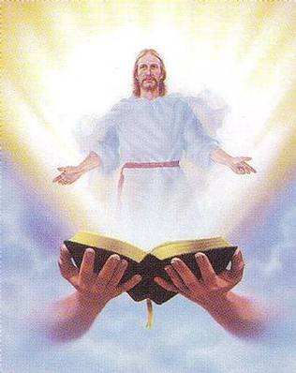
How Will You Answer?
What is the Character of Your Life?
A Question of Discipleship!
Eccl. 12:13-14 (NKJ): fear God and keep His commandments is man’s all!
Eph. 2:10; Titus 2:11-14: “Zealous for good deeds”
I Cor. 11:1: We are to imitate Christ! (Eph. 5:1; I Pet. 2:21)
Phil. 2:15-16; Titus 2:11-14; II Pet. 3:10-12: Saints to be holy and godly
Phil. 2:15-16
15. so that you will prove yourselves to be blameless and innocent, children of God above reproach in the midst of a crooked and perverse generation, among whom you appear as lights in the world,
16. holding fast the word of life, so that in the day of Christ I will have reason to glory because I did not run in vain nor toil in vain.
My Purpose in Life is to Become Like Christ! –
Are you focused on becoming Christ-like?

Slide 10
How Will You Answer?
What is the Service of Your Life?
A Question of Service – to God and Man!
Serve God
Rom. 12:3-8
Serve One Another out of Love
II Cor. 9:12-15; Gal. 5:13; I Pet. 4:8-11
Phil. 2:3-4; Rom. 12:9-13: In serving God we will serve one another!
Phil. 2:3-4
Do nothing from selfishness or empty conceit, but with humility of mind regard one another as more important than yourselves;
4. do not merely look out for your own personal interests, but also for the interests of others.
My Purpose in Life is to Serve Others! –
Are you focused on serving others?

Slide 11
How Will You Answer?
What is the Fellowship of Your Life?
A Question of Association!
Eph. 3:14-15; Rom. 8:14-17; I Tim. 3:15: saints are members of God’s family
Mk. 10:28-30; Rom. 12:10; Gal. 6:10
I Cor. 15:33: It is important who we associate with!
Rom. 12:5; I Cor. 12:27: Saints are part of the body of Christ (church)
Eph. 5:23; Col. 1:18
Rom. 12:5
so we, who are many, are one body in Christ, and individually members one of another.
I Cor. 12:27
27. Now you are Christ's body, and individually members of it.
My Purpose in Life is to Be in the Body of Christ! –
Are you focused on the fellowship of God’s people?

Slide 12
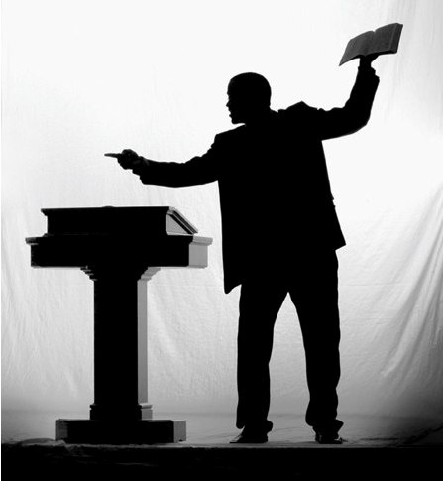
How Will You Answer?
What is the Mission of Your Life?
A Question of Obedience!
Acts 2:36-41: Baptism leads to the forgiveness of sins
Acts 22:16; Joel 2:32; Rom. 10:13
Baptism is just the beginning! (Rom. 6:4; I Pet. 2:1-3)
II Tim. 2:2, 24-26; 4:2: saints are to “preach the word”
II Cor. 5:10-11, 18-21
Rom. 10:14-15; II Tim. 4:6-8
Acts 20:24
24. "But I do not consider my life of any account as dear to myself, so that I may finish my course and the ministry which I received from the Lord Jesus, to testify solemnly of the gospel of the grace of God.
My Purpose in Life is to Teach the Good News! –
Are you focused on teaching the gospel?

Slide 13
Conclusion
Your Name Here
(Birth – )
We need to answer these questions now while the dash is still growing (while we are alive to make corrections!)
This Photo by Unknown Author is licensed under CC BY-SA

Slide 14
Conclusion
Your Name Here
(Birth – Death)
One day the dash will be fixed and we will give an account of our actions in this life!
(Rom. 14:12; II Cor. 5:10)
This Photo by Unknown Author is licensed under CC BY-SA

Slide 15
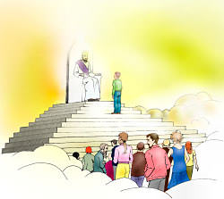
How will you answer “What was the:
What Kind Of Life?
Conclusion
Center of your life?”
Character of your life?”
Service of your life?”
Fellowship of your life?”
Mission of your life?”

Slide 16
Conclusion
Your Name Here
(Birth – Death)
A Faithful Servant of God
(Matthew 25:21, 23, 34)
This Photo by Unknown Author is licensed under CC BY-SA

Slide 17
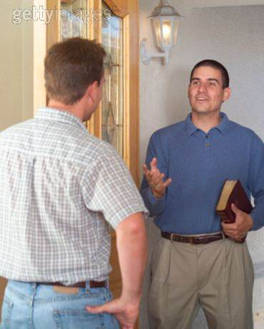
Conclusion
I Peter 3:15 (Saints are to be ready to give an answer!)
15. but sanctify Christ as Lord in your hearts, always being ready to make a defense to everyone who asks you to give an account for the hope that is in you, yet with gentleness and reverence;
What kind of life are you living?

Slide 18
Conclusion
Have you prepared to give
an account (answer) to God one day?

Slide 19
“What Must I Do To Be Saved?”
Hear The Gospel (Jn. 5:24; Rom. 10:17)
Believe In Christ (Jn. 3:16-18; Jn. 8:24)
Repent Of Sins (Lk. 13:3-5; Acts 2:38)
Confess Christ (Mt. 10:32; Rom. 10:10)
Be Baptized (Mk. 16:16; Acts 22:16)
Remain Faithful (Jn. 8:31; Rev. 2:10)
For The Erring Saint:
Repent (Acts 8:22), Confess (I Jn. 1:9),
Pray (Acts 8:22)

