Slide 1
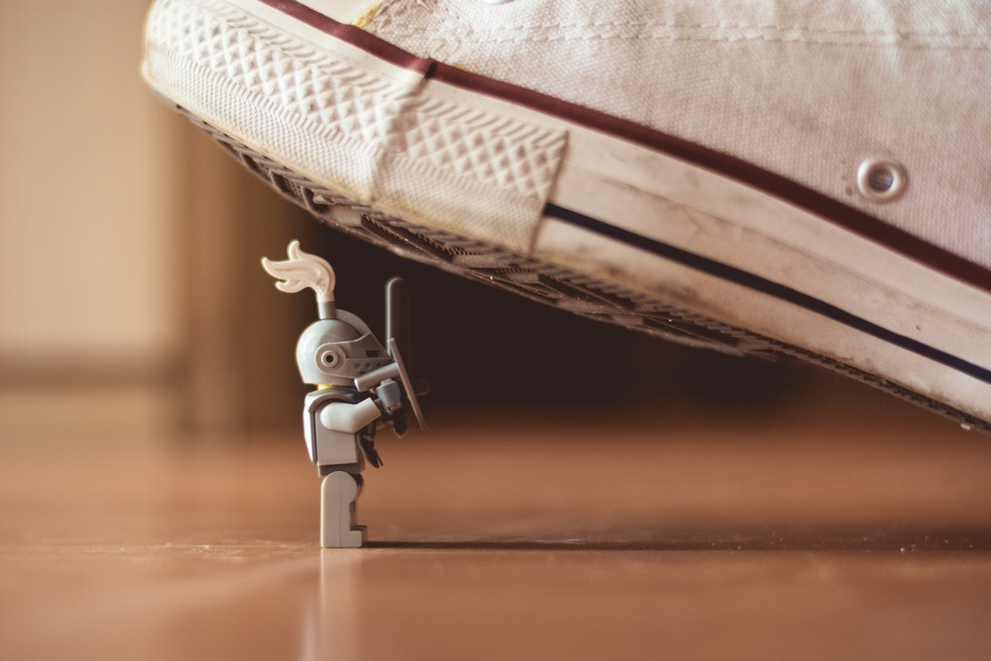
FACING
YOUR
GIANTS

Slide 2
We can look at challenges …
Through the eyes of the faithless
Or, through the eyes of the faithful
"In any situation, what you ARE determines what you SEE; what you SEE determines what you DO."

Slide 3
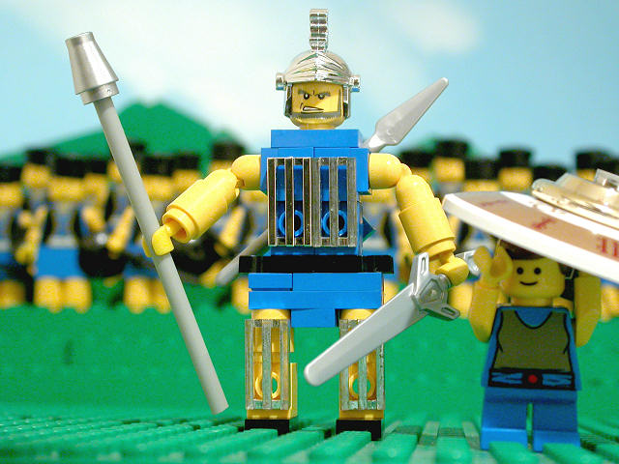
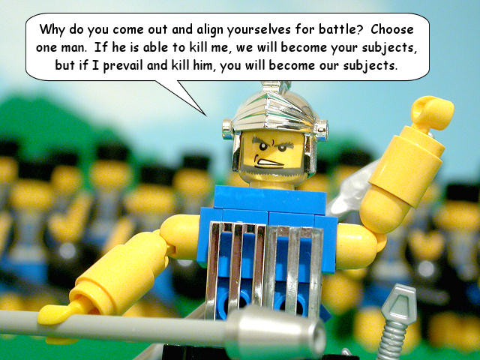
Who was Goliath?
I Samuel 17:1-7
Over 9 feet tall
125-150 pounds of armor
Spear weighed 15-17 pounds
Shield carried by a Philistine (v. 41)
He was a war machine

Slide 4
David saw what God saw
“David did not look at the size of the obstacle, but at the power of his God.”

Slide 5
What set David apart?
David listened to God
“I will hear what God the Lord will speak, for He will speak peace to His people and to His saints; but let them not turn back to folly.”
Psalm 85:8 (NKJV)

Slide 6
What set David apart?
David looked to the past
“And those who know Your name will put their trust in You; for You, Lord, have not forsaken those who seek You.”
Psalm 9:10 (NKJV)

Slide 7
What set David apart?
David was prepared
“And not only that, but we also glory in tribulations, knowing that tribulation produces perseverance; and perseverance, character; and character, hope.”
Romans 5:3-4 (NKJV)

Slide 8
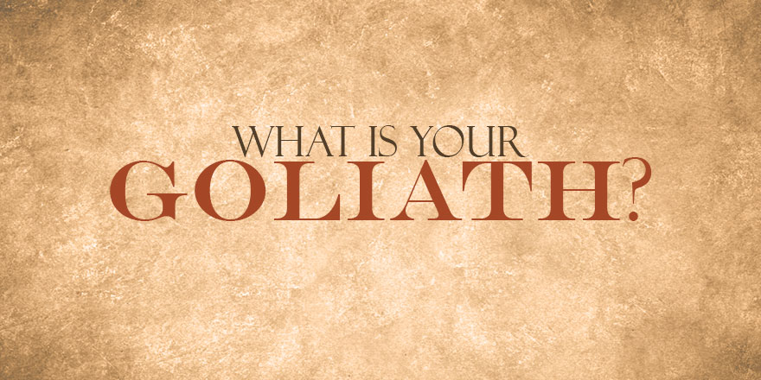

Slide 9
“If God is for us, who can be against us?”
Romans 8:31 (NKJV)
“The Lord is on my side; I will not fear. What can man do to me?”
Psalm 118:6 (NKJV)

Slide 10
GOD’S PLAN OF SALVATION
Hear (Rom. 1:16; 10:14, 17)
Believe (John 8:24; Mark 16:16; Heb. 11:6)
Repent (Acts 2:38; 3:19; 17:30)
Confess (Rom. 10:9-10; Matt. 10:32-33)
Be baptized (Acts 2:38; 22:16; Mark 16:16)
Live faithfully (Rev. 2:10; Matt. 6:33; Rom. 12:1-2; I Cor. 15:58)

