Slide 1
Text:
Paul’s Letter to Philemon
Notes:
By Nathan L Morrison
All Scripture given is from NASB unless otherwise stated
For further study, or if questions, please Call: 804-277-1983 or Visit www.courthousechurchofchrist.com

Slide 2
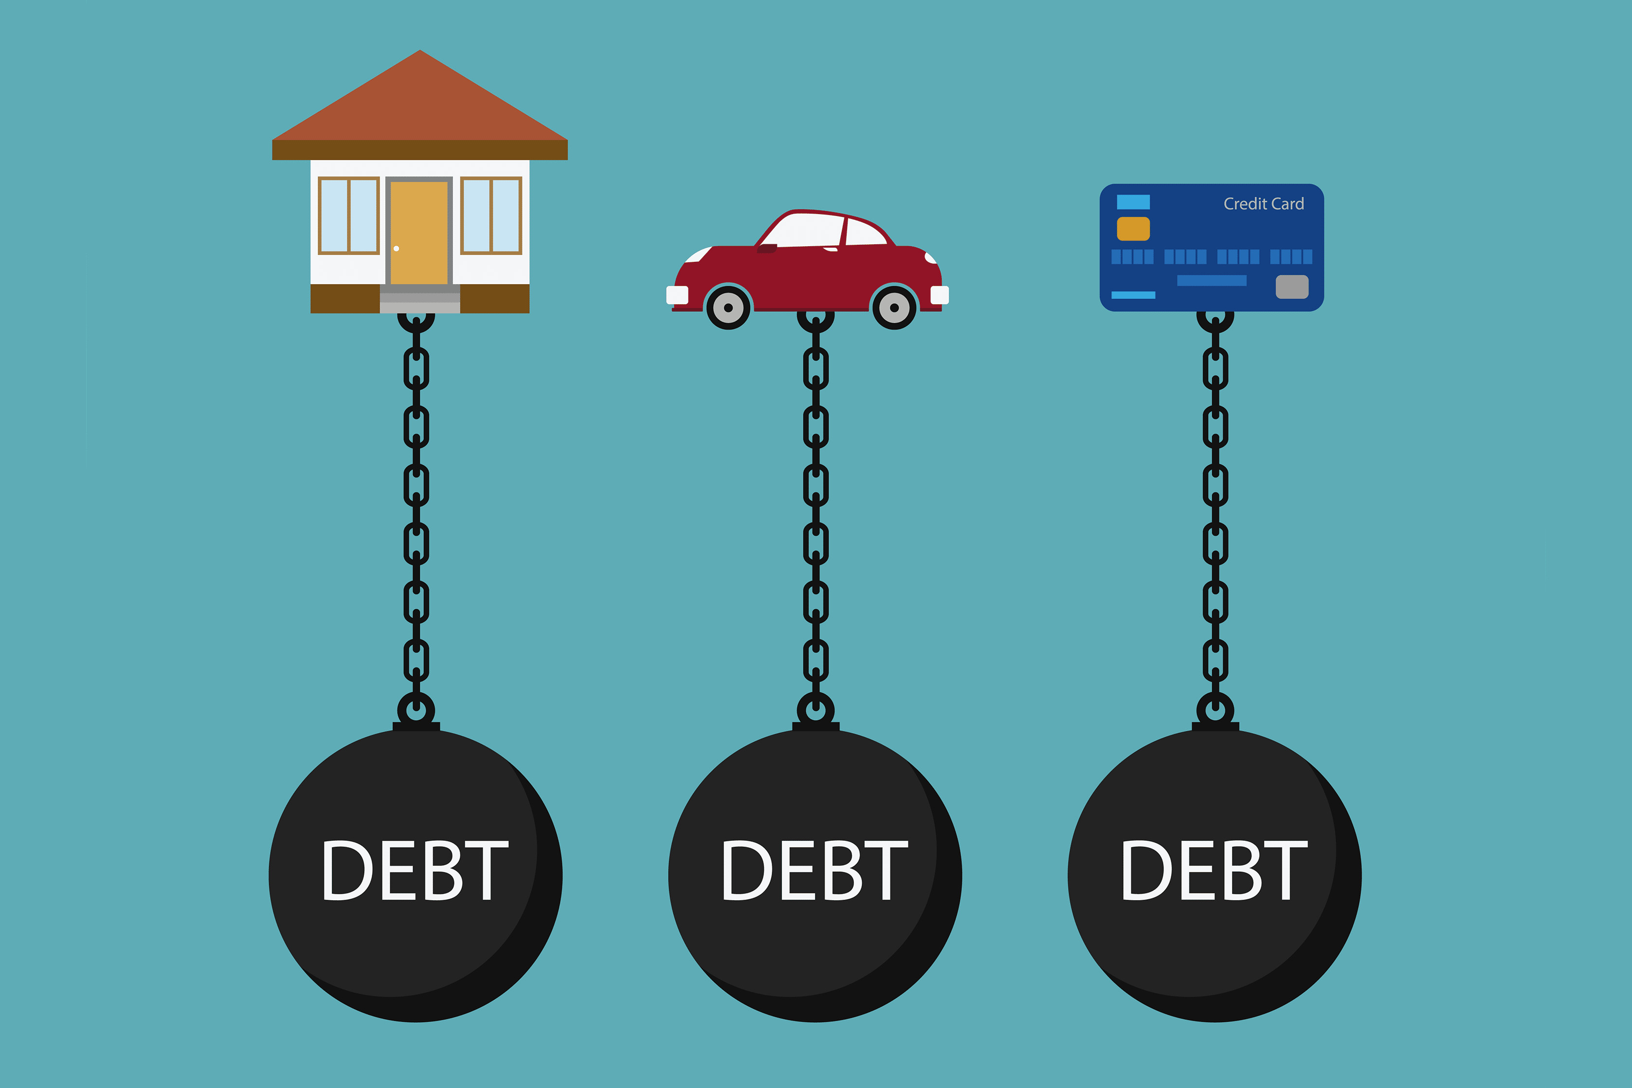
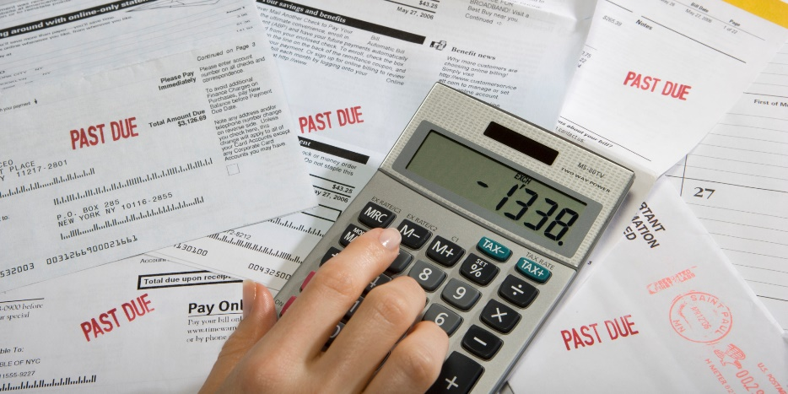
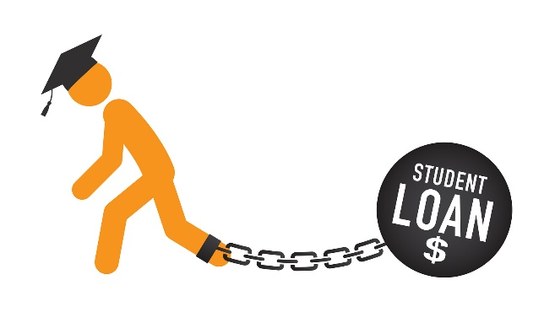
Intro
When we think of the phrase, “Paid in Full,” what do we think of?

Slide 3
Intro
This is the story of a man who committed crimes worthy of death who came into contact with another man who paid his debt and set him free!
The letter to Philemon is one of the most personal of Paul’s writing, if not the most personal!
How we love to hear those three words…

Slide 4
Paul’s Letter to Philemon
Philemon
Philemon (Str. G5371: “Friendly”)
a “beloved brother & fellow worker” with Paul – vs. 1 (vss. 23-24)
hosts the church in his house – vss. 1-3
praised for his love & faith – vss. 4-7
Philemon was a faithful saint and Paul calls upon him in faith & love to do the right thing!
Philemon 1:1-2
1. Paul, a prisoner of Christ Jesus, and Timothy our brother, To Philemon our beloved brother and fellow worker,
2. and to Apphia our sister, and to Archippus our fellow soldier, and to the church in your house:

Slide 5
Paul’s Letter to Philemon
Onesimus
Onesimus (Str. G3682: “Useful”)
Philemon’s runaway slave – vss. 8-16
once a useless slave, but now is useful! – vs. 11
Paul wants Philemon to free him – vss. 12-14
returns as a “beloved brother” – vss. 15-17
Onesimus ran away, came to Paul, and returns home a fellow brother in Christ and a free man! (HOW?)
Philemon 1:10-12
10. I appeal to you for my child Onesimus, whom I have begotten in my imprisonment,
11. who formerly was useless to you, but now is useful both to you and to me.
12. I have sent him back to you in person, that is, sending my very heart,

Slide 6
Paul’s Letter to Philemon
Paul
Paul appeals to Philemon to accept Onesimus not just as a brother, but as he would Paul himself – vs. 17
He takes the debt of Onesimus on himself – vss. 18-19
Has confidence in Philemon’s faith and love – vs. 20-21
Paul sends back a formerly useless runaway slave to his master bearing a note saying, “Paid in full!”
Philemon 1:17-19
17. If then you regard me a partner, accept him as you would me.
18. But if he has wronged you in any way or owes you anything, charge that to my account;
19. I, Paul, am writing this with my own hand, I will repay it (not to mention to you that you owe to me even your own self as well).

Slide 7
Paul’s Letter to Philemon
Paid In Full
Jesus told the Parable of the slave who was forgiven a large debt, then went out and showed no mercy to a fellow slave who owed him far less – Matthew 18:23-35
Paul learned from the slave in this story who did not forgive his fellow slave!
I Corinthians 11:1
1. Be imitators of me, just as I also am of Christ.

Slide 8
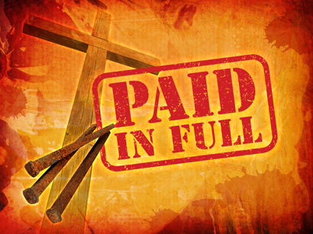
Paid In full
…but in Jesus, our debt is: Paid In Full!
I Cor. 6:19-20: We are not our own, we were bought!
I Pet. 1:18-19: The price was Christ’s blood. Paid in full with His own blood!
I Pet. 2:21-25: He bore our sins for us that we might live. Paid in full!
We are all debtors to God and slaves to sin…
Jn. 8:34: Those who practice sin are slaves to sin.
Rom. 3:21-26: We have all sinned and fallen short of the glory of God

Slide 9
Paul’s Letter to Philemon
Paid In Full
Jesus paid the ransom and set us free
Paul practiced what he preached, “Be imitators of me as I am of Christ” (I Cor. 11:1)
Christ took on our debt of sin, freed us from the wrath of God, and through His blood purchased us
Paul had compassion on a fugitive slave, taught him the gospel, and bought his freedom by offering up himself as security
What a thought we can all rejoice over!
Colossians 3:13
13. bearing with one another, and forgiving each other, whoever has a complaint against anyone; just as the Lord forgave you, so also should you.

Slide 10
Conclusion
This is a story of our lives and has three parts to it: Onesimus, Philemon, and Paul!

Slide 11
Conclusion
Onesimus
Sometimes we are like Onesimus…
A slave to our sins.
Fugitive from God.
Often hurt the ones we love.
need to take courage to go and be confronted by our sins (Repent!).
Right the wrongs we have committed.
Ask for forgiveness.

Slide 12
Conclusion
Philemon
Sometimes we are like Philemon…
When wronged it is a natural tendency to get angry and stay mad, hard to forgive.
We need to forgive when asked, to grant mercy.
We need to see and treat them as a “beloved brother,” or “beloved sister.”
We also need to remember that we are debtors to God.
Christ paid our debt, so we are to forgive one another (Eph. 4:32; Col. 3:13).

Slide 13
Conclusion
Paul
Sometimes we are like Paul…
We may need to remind someone who has hurt another to take courage and do the right thing: confront the person they sinned against and ask for forgiveness, and make amends (Repent!).
We may need to remind someone who has been hurt by another to forgive as Christ forgave them.
We may need to help someone out when they need it. (Paul paid the slave’s debt – I Cor. 11:1; Luke 14:13-14)

Slide 14
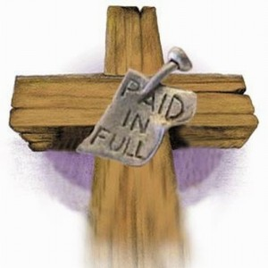
Conclusion
Jesus
The 4th part in all this is Jesus…
They were obedient to Him in that Paul was seeing to it that the wrath spoken of in that parable (Matthew 18:23-35) would not fall on these two men whom he loved as brothers
God was glorified!

Slide 15
Conclusion
This letter is a story of Christian living: repenting and forgiving!

Slide 16
“What Must I Do To Be Saved?”
Hear The Gospel (Jn. 5:24; Rom. 10:17)
Believe In Christ (Jn. 3:16-18; Jn. 8:24)
Repent Of Sins (Lk. 13:3-5; Acts 2:38)
Confess Christ (Mt. 10:32; Rom. 10:10)
Be Baptized (Mk. 16:16; Acts 22:16)
Remain Faithful (Jn. 8:31; Rev. 2:10)
For The Erring Saint:
Repent (Acts 8:22), Confess (I Jn. 1:9),
Pray (Acts 8:22)

