Slide 1
The Chinese Language
Is the oldest, continuous written language in the World
First written over 4,500 years ago
The inventors of the written language drew pictures to express words or ideas
Simple pictures were combined to make more complex thoughts
Notes:
Goals of this lesson:
Demonstrate the bible is not just an English book but refers to their history as well. It applies to them.
Tie the two languages together.
Give them a foundation of understanding and build their faith
Build their faith in the Bible as God’s word
Ensure the Chinese people read the bible in their language and work with them on the English as appropriate

Slide 2
Simple pictures were combined to make more complex thoughts
For Example…..
+
=
Mouth
Man (legs)
Older Brother
The “mouth man” or “spokes person” for the family was usually the oldest son or brother
Notes:
Building blocks MOUTH + MAN = Older Brother
Why did they choose these two words to mean this?
I’m going to give a guess, you’re free to give your own. The older brother or the oldest is the spokes person.
A book was written by a chinese man named C.H. Kang called “The Discovery of Genesis” (Concordia publishing. Kang/Nelson)

Slide 3
Simple pictures were combined to make more complex thoughts
Well known history and
common everyday things were
used to make a word so people
could remember it
For Example…..
+
=
Mouth
Man (legs)
Older Brother
The “mouth man” or “spokes person” for the family was usually the oldest son or brother
Notes:
In building the Chinese language originally, they would select items and pictures which everyone understood and were common in their era.
The “mouth man” or “spokes person” for the family was usually the oldest son or brother
Some words are simple – rock, house .. Just a picture
Some words are ‘ideas’ – harder to ‘picture’ - anger, hatred,

Slide 4
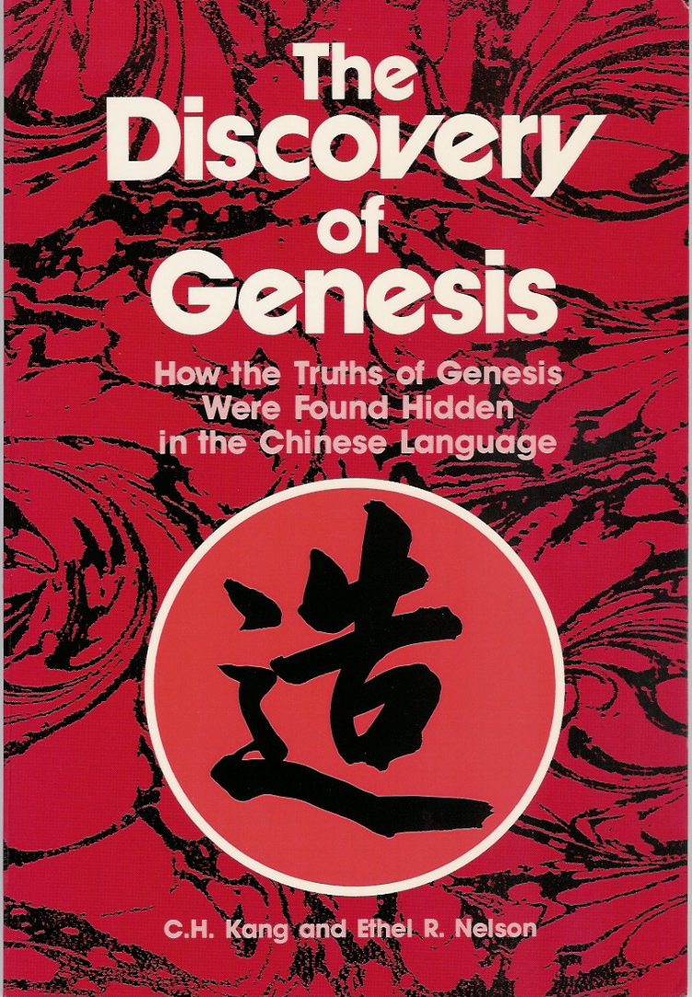
The observations in this lesson have been documented from several sources.
Chinese and Japanese scholars have made similar observations.
The authors, C. H. Kang and Ethel Nelson are experts in the Chinese written language.
C.H Kang and Ethel Nelson
Notes:
The source of this study – from people who were fluent in Chinese and who had studied the Bible…
The Discovery of Genesis C.H. Kang
Before Buddha – Chinese worshipped the same God as described in the Bible…
FOOTNOTE: There have been reviews/rebuttals – so it has gone thru several editions / changes!
There may STILL be some obscurity to all of this, but it seems likely, and we use it to create interest in learning the bible stories.

Slide 5
Word Study Problems
“atonement” = ‘at’ + one + ment
To cover over, pacify, propitiate!
Chinese PICTURES a bit different –
BUT have changed over the centuries..

Slide 6
Long before Buddha, the Chinese people worshiped the same God described in the Bible!!!!
The Proof is in the Ancient Chinese Characters
Notes:
A Time when there was ONE God – ONE people –
They all had the same ‘stories’ about their history ..
The proof of this is in the Ancient Chinese Characters

Slide 7
Long before Buddha, the Chinese people worshiped the same God described in the Bible!!!!
The Proof is in the Ancient Chinese Characters
2000 A.D.
2500 B.C.
1400 B.C.
600 B.C.
30 A.D.
Chinese language first written
Buddha
Death of Jesus
Today
First five books of Bible written
Notes:
Approx 1500 years after the flood
Chinese Language developed BEFORE – the Bible written, Buddha lived, Jesus lived
BUT the Bible tells stories about the time long before –
Before the Chinese language --

Slide 8
Long before Buddha, the Chinese people worshiped the same God described in the Bible!!!!
The Proof is in the Ancient Chinese Characters
2000 A.D.
2500 B.C.
600 B.C.
30 A.D.
Chinese language first written
Buddha
Death of Jesus
Today
“Shang Di” was the god of China before Buddha. He was the creator God and animal sacrifice was offered to him.
Notes:
Early Chinese God - a Creator God who was worshipped by animal Sacrifice …
Pronounced ‘Shung Dee’ ..

Slide 9
Long before Buddha, the Chinese people worshiped the same God described in the Bible!!!!
Shang Di
2000 A.D.
2500 B.C.
600 B.C.
30 A.D.
Chinese language first written
Buddha
Death of Jesus
Today
During the first three dynasties of China: Hsia, Shang, Chou, ……
the Chinese people worshiped Shang Di
Notes:
Shaw, Shung, Chou are the phonetic pronunciations

Slide 10
Long before Buddha, the Chinese people worshiped the same God described in the Bible!!!!
Buddha
Shang Di
2000 A.D.
2500 B.C.
600 B.C.
30 A.D.
Chinese language first written
Buddha
Death of Jesus
Today
Worship of Buddha came to China from India in about 50 B.C.
The God of the Bible was re-introduced to China when foreigners came from Europe
Notes:
The purpose of this slide is to demonstrate that Jehova/Shang Di/I am has been God in China much longer than Buddha. And Buddha is a fairly recent god.
Many people have forgotten this ancient God and the stories about him…
So…. [think the Bible is a western book ]

Slide 11
Many in China Today believe that the Bible is a Western book
They believe it is simply myth and fable written by western men
They think of it as an English book
HOWEVER!
Notes:
THIS is the point of these first 10 slides
They believe it is simply myth and fable written by western men
They think of it as an English book
--
HOWEVER! →

Slide 12
The Bible is not a Western Book
The Bible was not written in English but in Hebrew and Greek
It’s first writers were from Egypt & Babylon (Iraq)
The first five books were written by Moses, an adopted son of the king of Egypt (1400 B.C.)
These five books focus on the beginning of the nation of Israel; but the first 11 chapters of the Bible records the history that all nations have in common.
Notes:
The Bible was not written in English but in Hebrew and Greek
It’s first writers were from Egypt & Babylon (Iraq)
The first five books were written by Moses, an adopted son of the king of Egypt (1400 B.C.)
These five books focus on the beginning of the nation of Israel; but the first 11 chapters of the Bible records the history that all nations have in common

Slide 13
We will see that the
Ancestors of the modern Chinese
knew the same stories that are
in the first part of the Bible
We will now examine some stories in the Bible
Then
Show Chinese Characters which demonstrate the same story
Notes:
Emphasize that it is the stories not the bible that the ancient chinese knew
Will read (slides 13 – 14) the bibles stories.. And show that the words in Chinese language show that the chinese knew these STORIES.. That the stories were used to make some of the words they used.

Slide 14
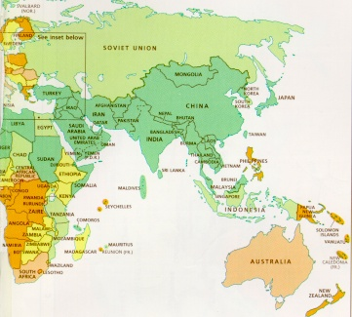
Tower of Babel
The Chinese would have migrated or walked from the west to China
N
W
E
S
Notes:
Simply shows the migration from the west TO THE EAST
We can learn this from the Chinese Language ..
[next slide illustrate word for ‘migrate’.. From this story ]

Slide 15
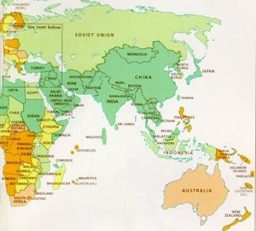
The Chinese
walked from the
west after a
great division
To Migrate, to Move
+
+
=
+
Great
Division
West
Walk
Migrate
Notes:
NOTICE: the character above for migrate is quite ancient. Some people will not recognize it, but they will not deny it typically.
You might want to ask if they recognize it –
Mention it may be coincidence. But you let me know when you no longer believe it is a coincidence.

Slide 16
GOD CREATED
Then the LORD God formed man of dust from the ground, and breathed into his nostrils the breath of life; and man became a living being. (Genesis 2:7)
Notes:
Another story that will be seen in the Chinese characters
{Page 3 Chin. Bible]

Slide 17
Then the LORD God CREATED man of dust from the ground, and breathed into his nostrils the breath of life; and man became a living being. (Genesis 2:7)
+
+
=
DUST BREATH ALIVE TO TALK
MOUTH
+
=
TO TALK WALKING TO CREATE
Notes:
Bring up the fact that the word mouth over time came to represent the whole body or the whole person – a “man”.
FIRST - to talk + walking = Create
BUT the word for TALK – adds more details from Gen. 2:7
DUST + Breath/mouth + alive = to talk
Thus this is a “Dust Man”. He did breath. Thus a “Living Dust Man”
Note that the slash for alive is also ancient and is seldom used by itself. You may need to explain this to the younger kids.
Many of these ancient characters where dropped when the Chinese language was simplified over time. The latest simplification occurred under “Mau – See – Tongue” (Mauste Tung) in approx 1971.

Slide 18
According to the Bible
The First Man was a Living Dust Man
+
+
=
ALIVE
DUST
MAN
FIRST
According to the Chinese Language, 4500 years ago this was also believed in China
Notes:
Shows they knew the story of creation --

Slide 19
Happiness or Blessing
+
+
+
God
One
Man
Garden
In the beginning God and the man had close fellowship, this leads to true happiness!
Notes:
Nice word. It has the word Shan-Di. (from earlier slide – the name of the ancient God of China – worshiped by animal sacrifice) … For example, necklaces have this word on them.
‘happy’ – one man + garden + God

Slide 20
Garden of Eden
Eden was east for Moses
West
N
W
E
S
Notes:
What you want to show the Chinese with this slide is that the people in China who came from the tower of babel would get asked by their kids where they came from they would say WEST and point toward the tower of babel.
→ West = one/first + person + enclosure/garden !

Slide 21
And God planted a garden eastward, in Eden; and there he put the man whom he had formed.
+
+
=
One, First
Person
Enclosure Garden
West
Notes:
Genesis 2:8
‘west’ = one / first + person + garden …

Slide 22
And the Lord God made a garden in the east, in Eden; and there he put the man whom he had made. And out of the earth the Lord made every tree to come, delighting the eye and good for food; and in the middle of the garden, the tree of life and the tree of the knowledge of good and evil. (Genesis 2:8-9 BBE)
How many special trees were in the middle of the garden?
TWO TREES
Notes:
This is real important when you set this up. Try to get them to read it out of their chinese bible.
ASK THE QUESTION: how many special trees ?
You’ve got to establish that God made all the trees but emphasize that god mad two special trees in the middle of the garden.
→ These two trees used in interesting words such as ‘forbidden’

Slide 23
And the Lord God gave the man orders, saying, You may freely take of the fruit of every tree of the garden: But of the fruit of the tree of the knowledge of good and evil you may not take; for on the day when you take of it, death will certainly come to you. (Genesis 2:16-17 BBE)
Man was forbidden to eat one of the two trees -- if he ate the forbidden tree the other would be taken from him also.
+
=
Two Trees
Command
Forbidden
Notes:
‘forbidden’ = two trees + command
From time to time go back and re-iterate the time line and the fact that these characters where written before the bible, and many years after these stories but not so long after that the stories were forgotten.

Slide 24
The Woman and the Forbidden Fruit
Now the snake was wiser than any beast of the field which the Lord God had made. And he said to the woman, Has God truly said that you may not take of the fruit of any tree in the garden? And the woman said, We may take of the fruit of the trees in the garden: But of the fruit of the tree in the middle of the garden, God has said, If you take of it or put your hands on it, death will come to you. And the snake said, Death will not certainly come to you: For God sees that on the day when you take of its fruit, your eyes will be open, and you will be as gods, having knowledge of good and evil. (Genesis 3:1-5)
Notes:
Get them to read through verse 11 in their bible then come back and read in English.
GOING to ‘covet / desire’ – and shows this story of EVE

Slide 25
The Woman and the Forbidden Fruit
When the woman saw that the tree was good for food, and that it was a delight to the eyes, and that the tree was desirable to make one wise, she took from its fruit and ate; and she gave also to her husband with her, and he ate. Then the eyes of both of them were opened, and they knew that they were naked; and they sewed fig leaves together and made themselves loin coverings. (Genesis 3:6-8 NASB)
+
=
Two Trees
Woman
To Covet, desire
Notes:
2 trees + woman = to covet / desire
Emphasize the red points above. Make it fun. She looked up and saw that tree and Uummmmmm. It looked good. This character also is one used with sexual connotations of lust and desire.

Slide 26
The Chinese people 4500 years ago associated the devil with a garden and two trees
+
+
+
=
Life or Motion
Secret, private
Garden
Man
Devil, Satan
=
+
+
Tempter
Devil
Two Trees
Cover
Notes:
BOTTOM: Tempter made up of 3 words put together –
Devil + two trees + cover = tempter
The word DEVIL – made up of 4 words …
Life or Motion + Secret, private + garden + man = devil, satan
Note without mentioning that the chinese call white western people the word devil/satan
NOTE: the first two characters above are ancient and more modern chinese people may not be familiar with them.
IMPORTANT: Emphasize before going to the next slide “ Now what did the man and woman realize once they ate from the forbidden tree” . Make them say the word “Naked”

Slide 27
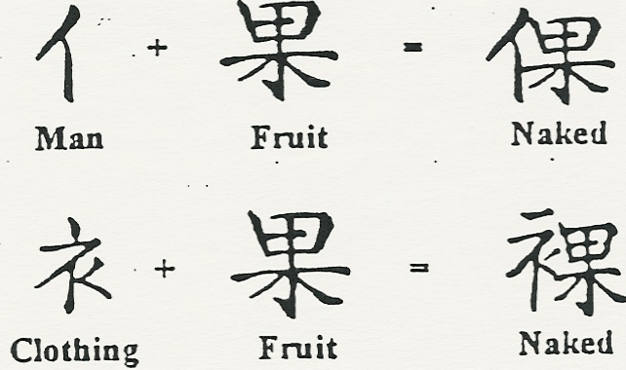
After Eating the Fruit they realized they were naked
D
D
Notes:
Isn’t it interesting that in the bible the word fruit and the word naked are connected. Can you think of any other reason or explanation for why your ancestors would connect fruit and man/clothing into the word naked.
Notice these two Chinese words for ‘naked’ -- how were they ‘combined’
→ NEXT SLIDE shows the combined characters….

Slide 28
After Eating the Fruit they realized they were naked
Notes:
‘man’ + ‘fruit’ = NAKED
‘clothing’ + ‘fruit’ = NAKED
Isn’t it interesting that in the bible the word fruit and the word naked are connected. Can you think of any other reason or explanation for why your ancestors would connect fruit and man/clothing into the word naked.

Slide 29
Genesis 3:6 … she took of the fruit thereof, and did eat; ...
Genesis 3:16 Unto the woman he said, I will greatly multiply thy pain and thy conception; in pain thou shalt bring forth children; and thy desire shall be to thy husband, and he shall rule over thee.
+
=
A piece
Two Trees
Pain
Notes:
Mikey indicated there is some problem about the word ‘a piece’ –
may be unused Ancient word ..
READ out of Chinese.. [pg 4, and top of pg 5]
Curse on woman – greatly increased pain…
Chinese word includes again the ‘2 trees’ ..
→ The first murder

Slide 30
The First Murder
The Older Brother,
Cain, killed the
Younger brother Abel
And the man had connection with Eve his wife, and she became with child and gave birth to Cain, and said, I have got a man from the Lord. Then again she became with child and gave birth to Abel, his brother. And Abel was a keeper of sheep, but Cain was a farmer. And after a time, Cain gave to the Lord an offering of the fruits of the earth. And Abel gave an offering of the young lambs of his flock and of their fat. And the Lord was pleased with Abel's offering; But in Cain and his offering he had no pleasure. And Cain was angry and his face became sad. And the Lord said to Cain, Why are you angry? and why is your face sad? If you do well, will you not have honour? and if you do wrong, sin is waiting at the door, desiring to have you, but do not let it be your master. And Cain said to his brother, Let us go into the field: and when they were in the field, Cain made an attack on his brother Abel and put him to death. (Genesis 4:1-8 BBE)
Notes:
The story of the FIRST murder .. Gen. 4:1-8 [pg. 5 and 6]
Have them read through v 15 in their own bible. Ask probing questions and clarifying questions to make sure they understand including who was the murderer and the fact that he was the OLDER brother. Emphasize that God put a mark on Cain to keep people from killing Cain. Note that one of the chinese translations mentions that the mark was on the forehead.

Slide 31
And the Lord said, Truly, if Cain is put to death, seven lives will be taken for his. And the Lord put a mark on Cain so that no one might put him to death. (Genesis 4:15)
The First Older Brother
in the Bible was violent
The words for “elder son”
and “violent” are both
Pronounced “SHUN”
+
=
MOUTH MAN ELDEST SON
Cruel,Violent
Notes:
Mouth + man = eldest son
cruel / violent = a word that is pronounced the same..
Note the mark. Further note that the pronunciation of older brother and violent is PRONOUNCED the same “Shun”. It apparently is not spelled the same. …
You may want them to say both.

Slide 32
The Great World Flood
Noah, his wife, three sons, and their wives
Eight people on
the boat
And the earth was evil in God's eyes and full of violent ways. And God, looking on the earth, saw that it was evil: .…And God said to Noah, The end of all flesh has come; ….and now I will put an end to them with the earth. Make for yourself an ark of gopher wood with rooms in it, and make it safe from the water inside and out. …..For truly, I will send a great flood of waters over the earth, …everything on the earth will come to an end. But with you I will make an agreement; and you will come into the ark, you and your sons and your wife and your sons' wives with you. (Genesis 6:11-18 BBE)
Notes:
Genesis 6:11-18 Noah and 8 souls in a boat [pg. 9]
Tell the story and make sure they understand it.
Wilson emphasized the design of the boat and modern agreement – (maybe too much detail)
and that God was merciful in his wrath –
time to repent . Time to build the boat .. 120 years..
Ask them how many were on the boat –
THEN show next ‘bubble’ - ‘Eight people on the boat’

Slide 33
GEN.6:5-8; 7:7
+
+
=
Person
Eight
Boat
Large Ship
Notes:
Eight person boat = large ship

Slide 34
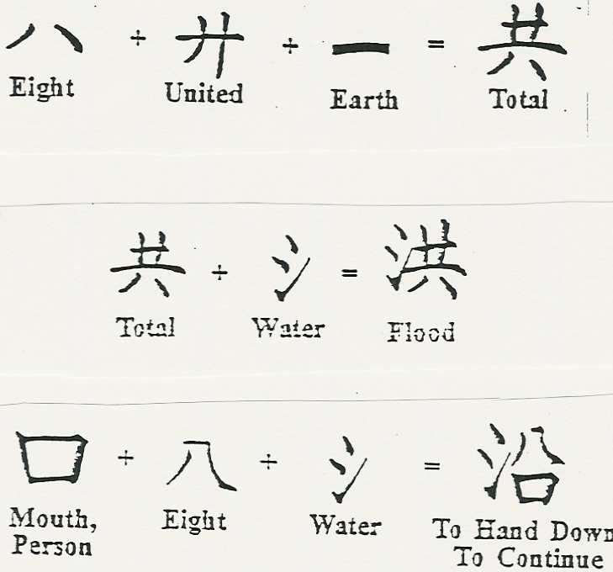

+
+
=
Person
Large Ship
How did the ancient people
Of China know these things?
They did not have a Bible!
Eight
Boat
A
Notes:
HOW did the ancient people of China know these THINGS ?
They did not have a Bible
(it was written after they had left and migrated to China … )
THEY knew the stories…
they were in fact part of the early history that we now read in the Bible.
These stories are part of the history of Chinese…

Slide 35
+
+
=
Person
Large Ship
Eight
Boat
Notes:
TOTAL -
Before showing this slide ask them the total population of the earth if the flood actually occurred.
Eight + united + earth = total
Total + water = flood
Mouth + eight + water = to hand down, to continue
Note the bible was handed down by eight people in a boat/water.

Slide 36
Many of these ancient stories went into the Chinese language.
They tell of One God – creating man
The garden - the trees – the fruit
The tell of the beginning -- west from China -- (‘East’ from Israel)
They tell of 8 people and flood and a boat
Notes:
Recap
the tower of Babel – and scattering
People took their earlier history stories – passed them down.
Chinese took these stories and are included in their language
Many Chinese words are simply combinations of various elements within these stories.
If these stories in the Chinese language are true – then the BIBLE is true.
The bible then is the story of the Chinese people’s beginning and their relationship with God.
Chinese need to study and investigate the story of the Bible and the GOD that was involved in them. The God of the Bible (these stories) was the God of the Chinese people.

Slide 37
These stories happened BEFORE the Bible was written…
These stories are Chinese stories (as well as all other people)
These stories are written in the Bible.
Notes:
Recap
the tower of Babel – and scattering
People took their earlier history stories – passed them down.
Chinese took these stories and are included in their language
Many Chinese words are simply combinations of various elements within these stories.
If these stories in the Chinese language are true – then the BIBLE is true.
The bible then is the story of the Chinese people’s beginning and their relationship with God.
Chinese need to study and investigate the story of the Bible and the GOD that was involved in them. The God of the Bible (these stories) was the God of the Chinese people.

