Slide 1
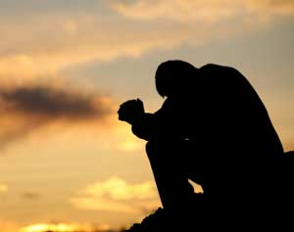
Prayer Part 5: Does Prayer Save?
Text:
Galatians 3:26-27
Notes:
By Nathan L Morrison
All Scripture given is from NASB unless otherwise stated
For further study, or if questions, please Call: 804-277-1983 or Visit www.courthousechurchofchrist.com
Some points from a lesson by Richie Thetford

Slide 2
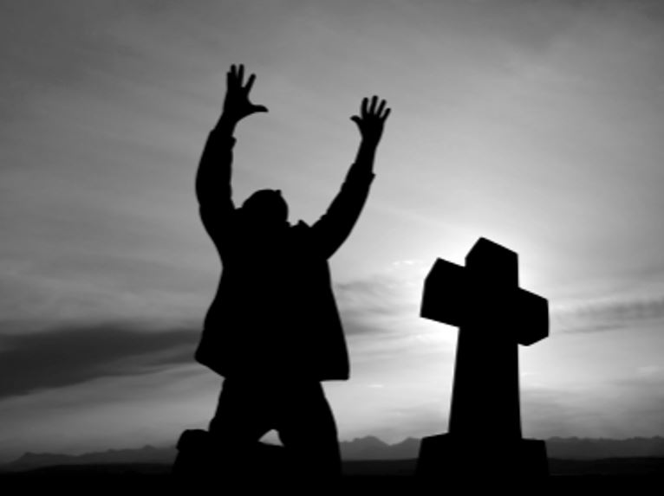
Intro
Where did the
“Sinner’s Prayer” come from?
Simple answer: it came from the mind of men, not from the mind of God!

Slide 3
Intro
In the 1700’s it became popular to use Rev. 3:20 as an appeal to obey the gospel…
Revelation 3:14, 19-20
"To the angel of the church in Laodicea write: The Amen, the faithful and true Witness, the Beginning of the creation of God, says this:
19. 'Those whom I love, I reprove and discipline; therefore be zealous and repent.
20. 'Behold, I stand at the door and knock; if anyone hears My voice and opens the door, I will come in to him and will dine with him, and he with Me.

Slide 4
Intro
John Webb on October 13, 1741 on Rev. 3:20…
“Here is a promise Union to Christ; in these words, I will come in to him, i.e. If any Sinner will but hear my Voice and open the Door, and receive me by Faith, I will come into his Soul, and unite him to me, and make him a living member of that my mystical body of which I am Head.”
The passage is directed toward lukewarm Christians, not unbelievers, and his “Sinner” became synonymous with “unbelievers” for hundreds of years!
Notes:
Source:
Christ's Suit to the Sinner, While He Stands and Knocks at the Door: A Sermon Preach'd in a Time of Great Awakening, at the Tuesday-evening Lecture in Brattle-Street, Boston, October 13, 1741, p. 14
https://books.google.com/books/about/Christ_s_Suit_to_the_Sinner_While_He_Sta.html?id=ZwsrkgAACAAJ

Slide 5
Intro
By the 1960’s the Sinner’s Prayer was so popular even a Bible version was being printed…
John 1:11-13 (NASB)
11. He came to His own, and those who were His own did not receive Him.
12. But as many as received Him, to them He gave the right to become children of God, even to those who believe in His name,
13. who were born, not of blood nor of the will of the flesh nor of the will of man, but of God.

Slide 6
Intro
Kenneth Taylor’s Living Bible (1967)…
“Even in his own land and among his own people, the Jews, he was not accepted. Only a few welcome and received him. But to all who received him, he gave the right to become children of God. All they needed to do was to trust him to save them. All those who believe this are reborn! --not a physical rebirth resulting from human passion or plan--but from the will of God”
(John 1:11-13, Living Bible, emphasis mine).
The emphasized words have no support at all in the original Greek. They are a blatant insertion placed by the translator, Kenneth Taylor!

Slide 7
Intro
Where did the Sinner’s Prayer come from?
It came from the mind of man,
and not from God!

Slide 8
Child of Satan and the Child of God
Child of Satan
Child of God
Jn. 8:41-47
Jn. 1:9-13
Mt. 6:24
Has God the Father, Christ the Son, the Holy Spirit, or any inspired writer ever told a child of Satan to pray for anything?
John 9:31; Proverbs 15:8; 28:9; I Peter 3:12

Slide 9
Child of Satan and the Child of God
Child of Satan
Child of God
Jn. 8:41-47
Jn. 1:9-13
Mt. 6:24
If a non-Christian (child of Satan) is to pray, then what are they to pray for?

Slide 10
What May A Sinner Pray For?
God’s Love?
John 3:16
Romans 5:8
Why should the sinner pray & beg for God to do something He has already demonstrated that He does?

Slide 11
What May A Sinner Pray For?
God’s Love?
Grace?
Ephesians 2:8-9
Titus 2:11
The sinner needs not pray for grace that God has already freely given, but be obedient to the gospel!

Slide 12
What May A Sinner Pray For?
God’s Love?
Grace?
Faith?
Hebrews 11:6
Romans 10:17
Acts 10:24-48
Galatians 3:26-27
The sinner can’t pray “in faith” so cannot obtain faith through prayer!

Slide 13
What May A Sinner Pray For?
God’s Love?
Grace?
Faith?
Mercy?
Isaiah 55:7
Ephesians 2:4-7
God has already shown mercy to the world, up to individuals to receive it!

Slide 14
What May A Sinner Pray For?
God’s Love?
Grace?
Faith?
Mercy?
Born Again?
John 3:3-5
Romans 6:3-4
I Peter 1:22-23
I Peter 3:21
It is useless for a sinner to pray to be born again since it is obtained through obedience to the gospel in baptism!

Slide 15
What May A Sinner Pray For?
God’s Love?
Grace?
Faith?
Mercy?
Born Again?
Salvation?
Romans 10:13
Acts 2:38
Acts 9:9-12; 22:16
Acts 10:1-2, 47-48
If prayer is the obedience called for by the gospel, why did Saul need Ananias, and why did Cornelius need Peter?

Slide 16
What May A Sinner Pray For?
We are all saved the same way: Obedience to the gospel (Mark 16:16: Believe and be baptized)
God’s Love?
Grace?
Faith?
Mercy?
Born Again?
Salvation?

Slide 17
Conclusion
Prayer is not a substitute for obedience!
Prayer will not save us: Obedience to God’s word will!
Nowhere in the Scriptures, when one asked what they needed to do to be saved, was the answer given to pray for salvation!
Acts 2:37-38: Jews on Pentecost
Acts 16:30-33: Philippian Jailer

Slide 18
Conclusion
Are you a child of Satan OR a child of God?
Child of Satan
Child of God
Mt. 25:41, 46
II Thess. 1:7-9
Mt. 25:34, 46
Obedience!

Slide 19
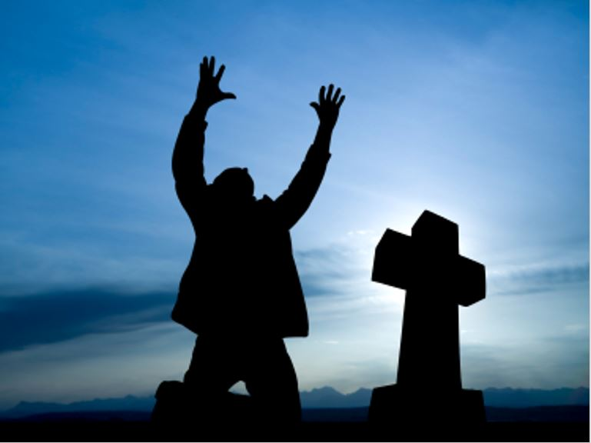
Conclusion
Let us pray to God for things in accordance with His will from a heart of thanksgiving! (Philippians 4:6)

Slide 20
“What Must I Do To Be Saved?”
Hear The Gospel (Jn. 5:24; Rom. 10:17)
Believe In Christ (Jn. 3:16-18; Jn. 8:24)
Repent Of Sins (Lk. 13:3-5; Acts 2:38)
Confess Christ (Mt. 10:32; Rom. 10:10)
Be Baptized (Mk. 16:16; Acts 22:16)
Remain Faithful (Jn. 8:31; Rev. 2:10)
For The Erring Saint:
Repent (Acts 8:22), Confess (I Jn. 1:9),
Pray (Acts 8:22)

