Slide 1
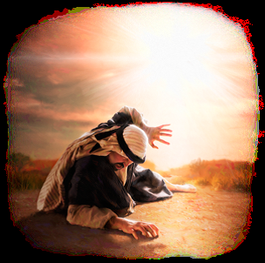
Kicking Against The Goads
Text:
Acts 26:14
Notes:
By Nathan L Morrison
All Scripture given is from the NASB, unless otherwise stated
For further study or if questions, Call: 804-277-1983, or Visit: www.courthousechurchofchrist.com

Slide 2
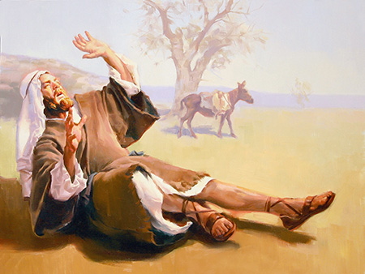
Intro
Self-preservation can cause people to do extraordinary
things (The gospel calls people for soul-preservation!)
Acts 16:25-30:
The Philippian jailer went from thinking about self-preservation (“Do yourself no harm!” – 16:28) to soul-preservation (“What must I do to be saved? – 16:29-30)
Paul knew what it was like to cause harm to himself!
Acts 26:14
14. And when we all had fallen to the ground, I heard a voice speaking to me and saying in the Hebrew language, 'Saul, Saul, why are you persecuting Me? It is hard for you to kick against the goads.'
There are ways both physically and spiritually people
harm themselves!

Slide 3
Kicking Against The Goads
Acts 26:14 (NKJ: 9:5): “It is hard for you to kick against the goads”
Jesus uses a Greek parable to tell Saul, “Stop hurting yourself!”
Greek writer Euripides:
“I, who am a frail mortal, should rather sacrifice to him who is a god, than, by giving place to anger, kick against the goads.”
Greek writer Pindar:
“To bear lightly the neck’s yoke brings strength, but kicking against the goads brings failure.”
Greek writer Terence:
“It is foolishness for you to kick against a goad.”
Notes:
Greek writers (From Barnes’ Notes on the Bible, Acts 9:5; 26:14):
Euripides (Bacchae, 791): “I, who am a frail mortal, should rather sacrifice to him who is a god, than, by giving place to anger, kick against the goads.”
Pindar (Pyth., 2:173): “To bear lightly the neck’s yoke brings strength, but kicking against the goads brings failure.”
Terence (Phome., 1, 2, 27): “It is foolishness for you to kick against a goad.”

Slide 4
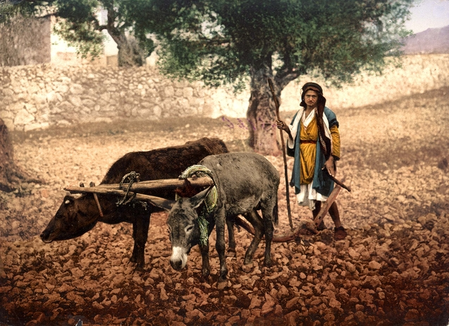
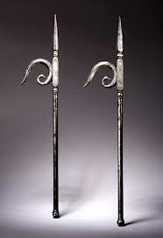
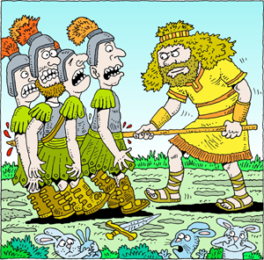
Kicking Against The Goads
Goads were sharply pointed instruments used to force stubborn animals to move ahead
It commonly means an ox-goad: a sharp piece of iron stuck into the end of a stick (Anywhere from 6-8 ft.)
Goads among the Hebrews were made very large:
Shamgar killed 600 men with one of them – Judges 3:31
Came to mean “rebellion against lawful authority”
Describes every sinner!
Kicking against the goads only hurts the one kicking – “Stop hurting yourself!”

Slide 5
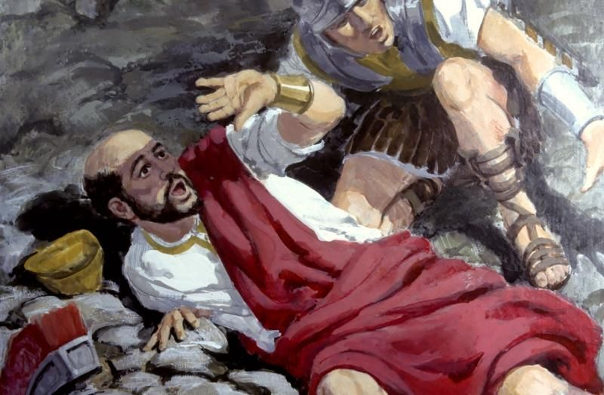
Kicking Against The Goads: Living In Sin
Sinful practices may harm one physically:
Drunkenness (Gal. 5:21)
Sexual immorality (Gal. 5:19)
A life of loose morals (I Pet. 4:15; Js. 4:1-3)
Sinful living will harm one spiritually:
The wages of sin is death! (Rom. 6:23)
Those not found in the Book of Life will suffer the 2nd death! (Rev. 20:14-15)
Christ’s message applies to those living in sin,
“Stop kicking against the goads!”

Slide 6
Kicking Against The Goads: Disobedient
Refusing to obey the gospel results in one still in sin, thus harming themselves:
Like a cancer victim that refuses treatment.
Like a drowning victim rejecting the lifeline.
I Cor. 6:9-10: The unrighteous will not inherit Heaven!
II Thess. 1:7-9: Those who do not know God and those who do not obey the gospel will be eternally separated from God!
The gospel is God’s power to save – Rom. 1:16
Christ’s message applies to those refusing to obey the
gospel, “Stop kicking against the goads!”

Slide 7
Kicking Against The Goads: Unfaithful
Some, after obeying the gospel, turn back to former way of life:
Like Simon the Sorcerer (Acts 8:18-24)
Like Diotrephes (III Jn. 9)
Like Hymenaeus & Alexander (I Tim. 1:19-20)
Some people become “lukewarm” – Rev. 3:16
Some people “hold to a form of godliness” – II Tim. 3:5
Those who are unfaithful will be held accountable – Heb. 10:26-30
Contrast the spirit of indifference, or “lukewarm” with:
Rom. 12:1-2: “Present your body a living and holy sacrifice.”
I Cor. 15:58: “Always abounding in the work of the Lord.”
Titus 2:14: “Zealous for good deeds.”
Rev. 3:19: “Be zealous and repent.”
Christ’s message applies to those living in sin,
“Stop kicking against the goads!”

Slide 8
Kicking Against The Goads: Unprepared
Life on earth is brief and uncertain – Js. 4:13-17
All are headed to one of two destinies:
Horror of Hell – Mt. 25:41, 46; Rev. 20:14-15
Happiness of Heaven – Rom. 2:7; Rev. 21:3-7
The one not preparing for eternity is harming their soul!
The gospel can save (Rom. 1:16) one’s soul from Hell:
Rom. 2:5-8: Obedient, eternal life; disobedient, wrath.
Rom. 5:9: Obeying the gospel saves one from the wrath of God.
I Pet. 1:3-4: The Christian has a reservation in Heaven!
Christ’s message applies to those not preparing for
eternity, “Stop kicking against the goads!”

Slide 9
Conclusion
The gospel appeals to one’s sense of self-preservation,
both physically and spiritually!
We are to love ourselves enough to not want to harm our
bodies (Eph. 5:28-29), and should love our souls enough
to not want to go to Hell (Mt. 25:41, 46)!
Saul stopped kicking against the goads
Acts 9:18; 22:14-16: He was baptized and fulfilled the mission God gave him.
Acts 26:16-20: He told Agrippa he did “not prove disobedient to the heavenly vision.”

Slide 10
Conclusion
If you have been “kicking against the goads,” especially if you are outside the family of God, listen to Paul,
“Do yourself no harm!”
Do the extraordinary for soul-preservation: Obey the gospel NOW!

Slide 11
“What Must I Do To Be Saved?”
Hear The Gospel (Jn. 5:24; Rom. 10:17)
Believe In Christ (Jn. 3:16-18; Jn. 8:24)
Repent Of Sins (Lk. 13:3-5; Acts 2:38)
Confess Christ (Mt. 10:32; Rom. 10:10)
Be Baptized (Mk. 16:16; Acts 22:16)
Remain Faithful (Jn. 8:31; Rev. 2:10)
For The Erring Saint:
Repent (Acts 8:22), Confess (I Jn. 1:9),
Pray (Acts 8:22)

