Slide 1
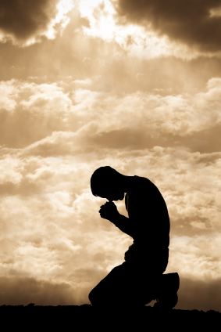
Prayer Part 2: Preparing To Pray Like The Psalmists
Text:
I Thessalonians 5:17
Notes:
By Nathan L Morrison
All Scripture given is from NASB unless otherwise stated
For further study, or if questions, please Call: 804-277-1983 or Visit www.courthousechurchofchrist.com
Adapted from Praying Like The Psalmists by Edwin Crozier, Lesson 5

Slide 2
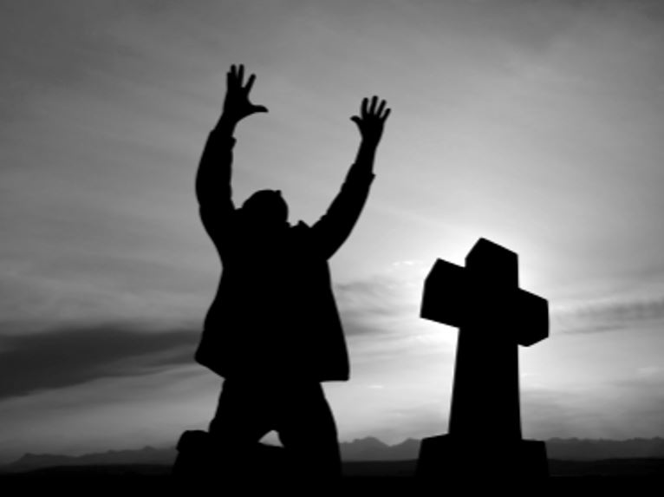
Intro
Prayer
Often misunderstood, misapplied, underestimated, overlooked, or infrequent.
Saints need to know its necessity, its power (the power of the One Who Hears!), and its value in one’s life

Slide 3
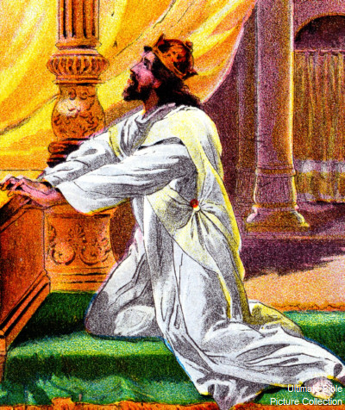
Intro
The psalms held an important place for early Christians and the New Testament!
Psalms is the most quoted O.T. book in the N.T.
At least 79 times and alluded to 333 times!
The most quoted OT passage in the NT is Psalms 110, quoted directly or indirectly about 27 times with 110:1 quoted or alluded to at least 18 times!
Notes:
Sources:
(https://www.theopedia.com/new-testament-use-of-the-old-testament)
(https://enduringword.com/bible-commentary/psalm-110/)

Slide 4
Intro
We can learn a lot about prayer through a study of the Psalms…
How they viewed God (the One who hears their prayers):
God is (Ps. 14:1-2)
God is Creator (Ps. 8)
God is the source of life and light (Ps. 36)
God is Judge (Ps. 96)
God is King (Ps. 95:3; 5:2)
God is our Protector (Ps. 18)
God is Shepherd (Ps. 23)
God is near (Ps. 34:18)
God is Love (Ps. 100:5)

Slide 5
Intro
We can learn a lot about prayer through a study of the Psalms…
How they viewed themselves before God:
Sheep in need of a Shepherd (Ps. 100:3)
Sinners in need of mercy (Ps. 51)

Slide 6
Intro
Nothing connects us to God like prayer, and no one connected to God in prayer like the psalmists!
Let us prepare to pray like the psalmists!

Slide 7
Studying God’s Word
The Psalmists Prepared to Pray by…
Psalm 1
The Book of Psalms opens by dispelling the common illusion that the sinful life is the good life.
Knowing God’s word is the way to avoid sin and stay off the path of destruction!
To be truly blessed, steer clear of the lifestyle of the wicked! (Must know God’s word to do that!)
The Psalmist meditated on the law of the Lord day and night.

Slide 8
Studying God’s Word
The Psalmists Prepared to Pray by…
Psalm 19:7-11 (Ps. 119)
These two psalms alone show much study of God’s word guides their prayers! (119:105)
In the word of God is much value and a great reward for keeping His commandments!
God’s word serves as a warning (19:11)

Slide 9
Studying God’s Word
The Psalmists Prepared to Pray by…
As disciples of Jesus we must study His word in preparation for prayer so that we might live the godly lives we are called to (Jn. 8:31-32; II Tim. 2:15)
The Scriptures teach to resist the devil (Js. 4:7), flee from temptation (II Tim. 2:22), hate sin and avoid the very appearance of evil (Eph. 5:11; I Thess. 5:22; II Tim. 2:19)
To be able to pray like the psalmists we need to prepare by studying God’s word!

Slide 10
Living God’s Word
The Psalmists Prepared to Pray by…
Psalm 26:1-3
David describes his life separated to God from the world (by walking in God’s truth) – He had consistently walked in dependence on the Lord.
In metallurgy language, he submits himself to God to be proved in the smelting furnace for the presence of dross (refined by fire)
Both as to his heart (affections) and his mind (motives), he was confident of acquittal because he had always kept the Lord's lovingkindness before him and had walked in paths of faithfulness to God's Word.

Slide 11
Living God’s Word
The Psalmists Prepared to Pray by…
Psalm 66:16-20
The psalmist here knew wickedness in his heart would hinder his prayer!
From a life that walks with God (living His truths) God heard his prayer.

Slide 12
Living God’s Word
The Psalmists Prepared to Pray by…
Psalm 130
Does the psalmist believe only the perfectly sinless can pray? (130:3)
No, the psalmists recognize we sin but here it is stated that God forgives!
By living by His word and hoping on His promises we can be forgiven and redeemed, and He will hear our prayers.

Slide 13
Living God’s Word
The Psalmists Prepared to Pray by…
To be able to pray like the psalmists we need to prepare by living God’s word!
As disciples of Jesus we must “walk in a worthy manner” of the gospel to which we are called! (Eph. 4:1; Col. 1:10; I Thess. 2:12)
I Pet. 1:6-9: Metallurgy language (Ps. 26) describes the trials of life as testing our faith and will prove our sincerity, faithfulness and love for Jesus, and ultimately the saving of our souls.

Slide 14
Having Broken & Contrite Hearts
The Psalmists Prepared to Pray by…
Ps. 51:17
David’s sin (adultery with Bathsheba) had been found out (II Sam. 11)!
Even servants of God occasionally sin and understood sin could hinder their prayers.
One who is not arrogant or proud in their sin, but broken-hearted over it, David says God will not despise.
The preparation here when one has sinned is to be grieved over it when we ask God to forgive.
Psalm 51 as a whole reminds us that when we sin and fall short (Rom. 3:23) we are to confess our sins before God with a broken and contrite heart.

Slide 15
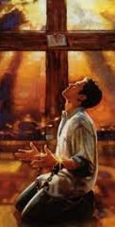
Having Broken & Contrite Hearts
The Psalmists Prepared to Pray by…
As disciples of Jesus we need to recognize where and when we fail and seek God’s forgiveness
I Jn. 1:6-10: We sin, and so when we do let us confess it to God to be forgiven
To be able to pray like the psalmists we need to prepare by praying from a broken heart over sin!

Slide 16
Surrendering to God
The Psalmists Prepared to Pray by…
Psalm 31:5
Psalm 31 is a psalm of David but because of Psalm 31:5 it is associated with Jesus:
“Into Your hand I commit my spirit; You have ransomed me, O LORD, God of truth.”
Luke 23:46: Jesus cried this with a loud voice before He died.

Slide 17
Surrendering to God
The Psalmists Prepared to Pray by…
Psalm 31:5
Considering Jesus quoted this portion of the psalm as He was about to die on the cross, in accordance with God’s plan (I Cor. 15:3-4), what does this kind of commitment and surrender mean in a person’s life?
Acts 7:59: Stephen called on Jesus and said this as he saw Him standing at the right-hand of God (7:56).
When we surrender our souls to God we mean everything that we are and will do!

Slide 18
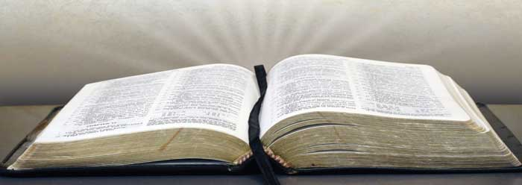
Surrendering to God
The Psalmists Prepared to Pray by…
Obedience to the Word
To be able to pray like the psalmists we need to prepare by surrendering our hearts to God!
As disciples of Jesus we are to love God with all our heart, soul, mind, and strength (Mark 12:30), and be ready to follow Him even if it means sacrificing our lives (Lk. 9:23-25)
Jesus is our example in submitting His will to the Father’s – Mt. 26:39
II Tim. 1:12: Paul stated that he continued to suffer for Jesus because he had faith in Him Whom he entrusted himself with!

Slide 19
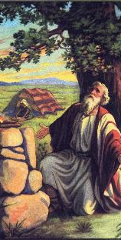
Offering a Sacrifice
The Psalmists Prepared to Pray by…
Psalm 5:3; 54:6; 66:13-15
5:1-3: A prayer to God in the morning. Giving to God of our attention and time first thing.
54:6: Sacrifice and praise go together hand-in-hand.
66:13-15: Sacrifice to God was natural response to having prayers answered

Slide 20
Offering a Sacrifice
The Psalmists Prepared to Pray by…
Sacrifice and prayer can be seen in the life of Abraham, Isaac, and Jacob
Gen. 12:8; 13:1-4, 18; 26:25; 33:20: All three built altars to God and called on His name

Slide 21
Offering a Sacrifice
The Psalmists Prepared to Pray by…
Sacrifice and prayer under the Old Law went together!
I Chr. 21:26; Is. 56:7: David sacrificed and prayed and was answered by God; God said, through Isaiah, that the people would sacrifice and His house would be a house of prayer.
The Old Law was such that their offerings (physical and figuratively) were in keeping with the word of God and so He would hear their prayers and answer them!

Slide 22
Offering a Sacrifice
The Psalmists Prepared to Pray by…
As disciples of Jesus we are to give our lives as spiritual sacrifices (Rom. 12:1-2)
Jesus is our High Priest (Heb. 10:19-23) and as His priests (I Pet. 2:4-5, 9) we are to offer up spiritual sacrifices that are pleasing to God!
Heb. 13:15-16: We can offer up spiritual sacrifices through praise, thanksgiving, and sharing with others what God has richly blessed us with.
With all of that in mind, it is important to note that only those who belong to God and offer Him sacrifices (by the way we live) can truly pray and be heard!
To be able to pray like the psalmists we need to prepare by offering our lives as sacrifice to God!

Slide 23
Conclusion
Preparing to pray is not going through certain rituals or check-lists before praying; for the disciple of Jesus it is about being in Christ, with His sacrifice as the means to enter into God’s presence

Slide 24
Conclusion
To pray like the psalmists what must we do in order to prepare our hearts for prayer?
Study God’s word, live it, be broken over sin, surrender to God, & offer up sacrifices pleasing to Him!
We need to be in the word so we even know what to pray about and for who and what.
We need to surrender to His word instead of using prayer as a means to ignore His will for our lives.
Only in Christ can we be a people prepared to pray at all times! (I Thess. 5:17)
Notes:
Sources:
(https://www.theopedia.com/new-testament-use-of-the-old-testament)
(https://enduringword.com/bible-commentary/psalm-110/)

Slide 25
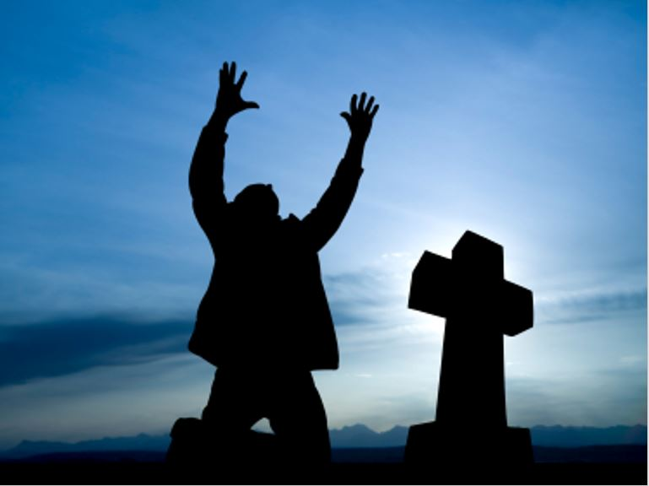
Conclusion
I Thessalonians 5:17
pray without ceasing
May we live our lives in such a way as to, like the psalmists, prepare our hearts for the habit of “praying without ceasing”
and draw nearer to God!

Slide 26
“What Must I Do To Be Saved?”
Hear The Gospel (Jn. 5:24; Rom. 10:17)
Believe In Christ (Jn. 3:16-18; Jn. 8:24)
Repent Of Sins (Lk. 13:3-5; Acts 2:38)
Confess Christ (Mt. 10:32; Rom. 10:10)
Be Baptized (Mk. 16:16; Acts 22:16)
Remain Faithful (Jn. 8:31; Rev. 2:10)
For The Erring Saint:
Repent (Acts 8:22), Confess (I Jn. 1:9),
Pray (Acts 8:22)

