Slide 1
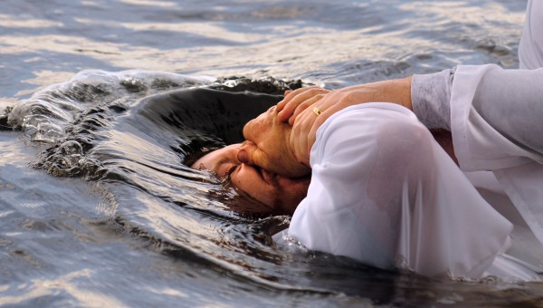
Baptism Part 3: Examples Of Conversion Text: Matthew 28:18-20; Mark 16:15-16
Notes:
By Nathan L Morrison
All Scripture given is from NASB unless otherwise stated
For further study, or if questions, please Call: 804-277-1983 or Visit Nathan L Morrison, www.courthousechurchofchrist.com

Slide 2
Intro
Jesus gave the Great Commission in…
Matthew 28:18-20
18. And Jesus came up and spoke to them, saying, "All authority has been given to Me in heaven and on earth.
19. "Go therefore and make disciples of all the nations, baptizing them in the name of the Father and the Son and the Holy Spirit,
20. teaching them to observe all that I commanded you; and lo, I am with you always, even to the end of the age."
Mark 16:15-16
15. And He said to them, "Go into all the world and preach the gospel to all creation.
16. "He who has believed and has been baptized shall be saved; but he who has disbelieved shall be condemned.

Slide 3
Intro
Acts is the record of the fulfillment of that commission – “Go” & “Teach,” making disciples of all the nations
Acts 1:8
“but you will receive power when the Holy Spirit has come upon you; and you shall be My witnesses both in Jerusalem, and in all Judea and Samaria, and even to the remotest part of the earth."
Baptism is one subject that has been much abused:
A popular teaching among the religious world on baptism is that it is not essential for salvation
When men believe that baptism is not essential to salvation, baptism is often delayed for weeks or even months
The examples of conversion recorded for us show a pattern of faith in action and an urgency to baptism!

Slide 4
Mt. 28:18-20 | Examples Of Conversion |  |  |  |  | Mk. 16:15-16
Examples | Hear | Believe | Repent | Confess | Baptized | Mark 16:16
Pentecost Acts 2:14-41 | 2:37 | 2:37 | 2:38 |  | 2:38, 41 | Believed (2:37) & Baptized (2:41)
Samaritans Acts 8:5-14 | 8:6 | 8:12 |  |  | 8:12 | Believed (8:12) & Baptized (8:12)
Simon Acts 8:13 | 8:6 | 8:13 | 8:9 |  | 8:13 | Believed (8:13) & Baptized (8:13)

Slide 5
Mt. 28:18-20 | Examples Of Conversion |  |  |  |  | Mk. 16:15-16
Examples | Hear | Believe | Repent | Confess | Baptized | Mark 16:16
Eunuch Acts 8:26-39 | 8:34-35 | 8:37 |  | 8:37 | 8:38 | Believed (8:37) & Baptized (8:38)
Saul Acts 9:1-18; 22:10-16; 26:2-21; Gal. 1:23; I Tim. 1:13 | 22:10, 15 | 9:11 | Gal. 1:23 I Tim. 1:13 | 22:10 | 22:16; 9:18 | Believed (9:11: “praying”) & Baptized (9:18)
Cornelius Acts 10:1-48 | 10:33 | 10:43 |  |  | 10:48 | Believed (10:43) & Baptized (10:48)

Slide 6
Mt. 28:18-20 | Examples Of Conversion |  |  |  |  | Mk. 16:15-16
Examples | Hear | Believe | Repent | Confess | Baptized | Mark 16:16
Sergius Paulus Acts 13:4-12 | 13:7 | 13:12 (2:38; 10:43) |  |  |  | Believed (13:12)
Lydia Acts 16:13-15 | 16:14 | 16:15 |  |  | 16:15 | Believed (16:15) & Baptized (16:15)
Jailer Acts 16:25-34 | 16:30 | 16:34 | 16:33 |  | 16:33 | Believed (16:34) & Baptized (16:33)

Slide 7
Mt. 28:18-20 | Examples Of Conversion |  |  |  |  | Mk. 16:15-16
Examples | Hear | Believe | Repent | Confess | Baptized | Mark 16:16
Corinthians Acts 18:8 | 18:8 | 18:8 |  |  | 18:8 | Believed (18:8) & Baptized (18:8)
Galatians Galatians 3:26-27 |  | 3:26 |  |  | 3:27 | Believed (3:26) & Baptized (3:27)
Ephesians Acts 19:4-5 | 19:5 | 19:4 |  |  | 19:5 | Believed (19:4) & Baptized (19:5)
Colossians Col. 1:5-10; 2:11-12 | 1:5-6 | 1:4; 2:12 |  |  | 2:12 | Believed (1:4) & Baptized (2:12)

Slide 8
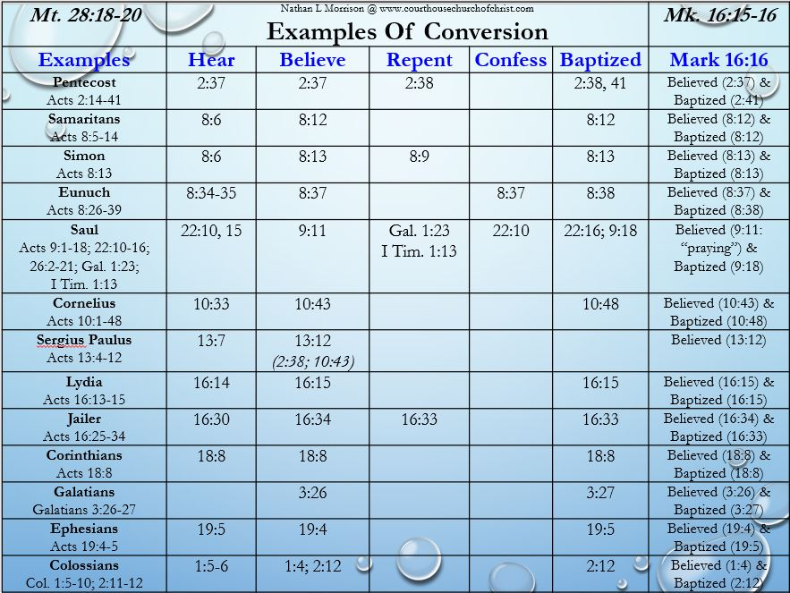
Mark 16:15-16
15. And He said to them, "Go into all the world and preach the gospel to all creation.
16. "He who has believed and has been baptized shall be saved; but he who has disbelieved shall be condemned.
In these cases we can see the commission of Jesus to “Go” & “Teach” being fulfilled with the result of men and women believing and being baptized (with an urgency)!

Slide 9
Conclusion
 | Jesus’ Teaching
Scriptures | Hear | Believe | Repent | Confess | Baptized | Obedience
Mt. 28:18-20 Mk. 16:15-16 | John 5:24 | John 3:16-18 | Luke 13:3-5 | Mt. 10:32 | Mark 16:16 | John 8:31
Jesus Himself said, “He who has believed and has been baptized shall be saved” (Mk. 16:16)
With no other source but the Scriptures one can see faith and baptism are commanded and that no other mode of baptism but immersion is recorded!
(All others are added by men)

Slide 10
Conclusion
Having heard the gospel, how long should you wait to obey it: IMMEDIATELY OR DELAY?
If you haven’t yet, why not obey the gospel NOW, recognizing that “now is ‘THE DAY OF SALVATION!’”
(II Corinthians 6:2)?

Slide 11
“What Must I Do To Be Saved?”
Hear The Gospel (Jn. 5:24; Rom. 10:17)
Believe In Christ (Jn. 3:16-18; Acts 16:31)
Repent Of Sins (Lk. 13:3-5; Acts 2:38)
Confess Christ (Mt. 10:32; Acts 8:37)
Be Baptized (Mk. 16:16; Acts 22:16)
Remain Faithful (Jn. 8:31; Rev. 2:10)
For The Erring Saint:
Repent (Acts 8:22), Confess (I Jn. 1:9),
Pray (Acts 8:22)

Slide 12
Mt. 28:18-20 | Nathan L Morrison @ www.courthousechurchofchrist.com Examples Of Conversion |  |  |  |  | Mk. 16:15-16
Examples | Hear | Believe | Repent | Confess | Baptized | Mark 16:16
Pentecost Acts 2:14-41 | 2:37 | 2:37 | 2:38 |  | 2:38, 41 | Believed (2:37) & Baptized (2:41)
Samaritans Acts 8:5-14 | 8:6 | 8:12 |  |  | 8:12 | Believed (8:12) & Baptized (8:12)
Simon Acts 8:13 | 8:6 | 8:13 | 8:9 |  | 8:13 | Believed (8:13) & Baptized (8:13)
Eunuch Acts 8:26-39 | 8:34-35 | 8:37 |  | 8:37 | 8:38 | Believed (8:37) & Baptized (8:38)
Saul Acts 9:1-18; 22:10-16; 26:2-21; Gal. 1:23; I Tim. 1:13 | 22:10, 15 | 9:11 | Gal. 1:23 I Tim. 1:13 | 22:10 | 22:16; 9:18 | Believed (9:11: “praying”) & Baptized (9:18)
Cornelius Acts 10:1-48 | 10:33 | 10:43 |  |  | 10:48 | Believed (10:43) & Baptized (10:48)
Sergius Paulus Acts 13:4-12 | 13:7 | 13:12 (2:38; 10:43) |  |  |  | Believed (13:12)
Lydia Acts 16:13-15 | 16:14 | 16:15 |  |  | 16:15 | Believed (16:15) & Baptized (16:15)
Jailer Acts 16:25-34 | 16:30 | 16:34 | 16:33 |  | 16:33 | Believed (16:34) & Baptized (16:33)
Corinthians Acts 18:8 | 18:8 | 18:8 |  |  | 18:8 | Believed (18:8) & Baptized (18:8)
Galatians Galatians 3:26-27 |  | 3:26 |  |  | 3:27 | Believed (3:26) & Baptized (3:27)
Ephesians Acts 19:4-5 | 19:5 | 19:4 |  |  | 19:5 | Believed (19:4) & Baptized (19:5)
Colossians Col. 1:5-10; 2:11-12 | 1:5-6 | 1:4; 2:12 |  |  | 2:12 | Believed (1:4) & Baptized (2:12)

