Slide 1
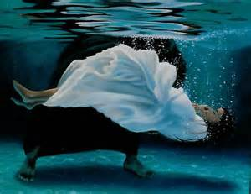
Baptism Part 2: WWW?Baptism Text: Ephesians 4:4-6
Notes:
By Nathan L Morrison
All Scripture given is from NASB unless otherwise stated
For further study, or if questions, please Call: 804-277-1983 or Visit www.courthousechurchofchrist.com
Adapted from a chart by Kyle Coe

Slide 2
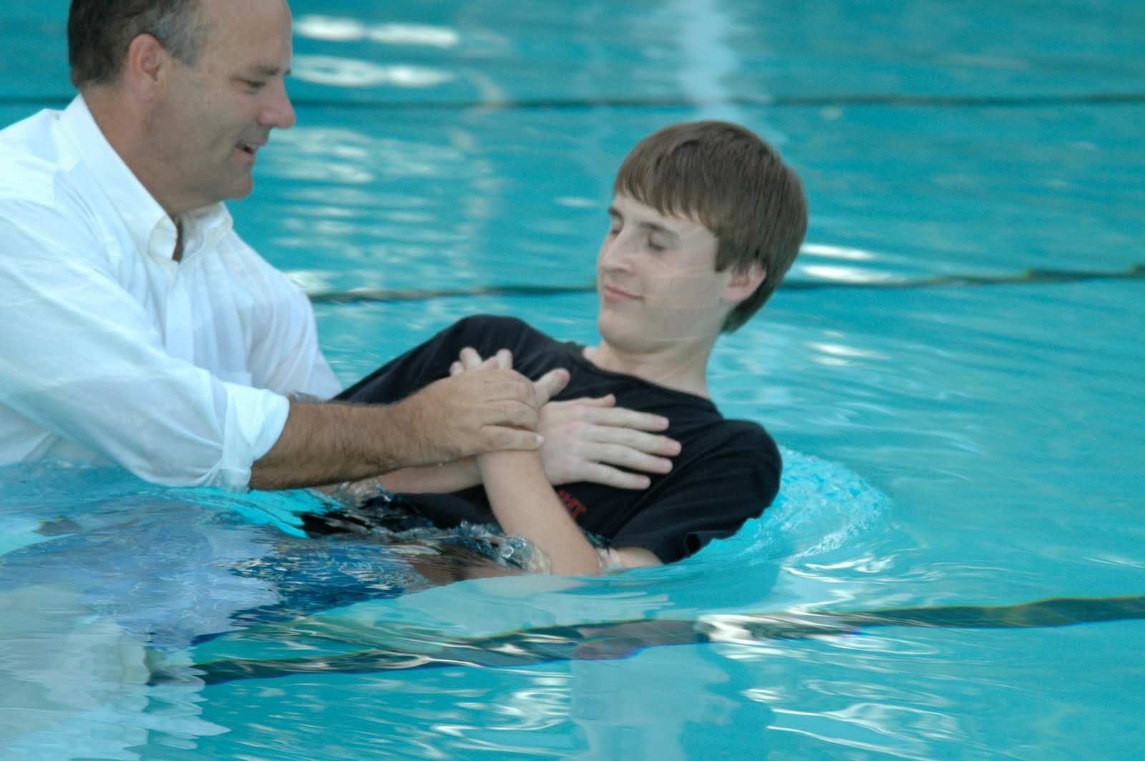
Intro
W
hy?
W
ho?
W
hat?
Of Baptism!

Slide 3
Intro
W
hat do the Scriptures say?
Ephesians 4:4-6
4. There is one body and one Spirit, just as also you were called in one hope of your calling;
5. one Lord, one faith, one baptism,
6. one God and Father of all who is over all and through all and in all.
What do the Scriptures say about the Why, Who, and What (How) concerning baptism?!

Slide 4
W
Jesus said to be baptized as an act of faith in order to be saved – Mt. 28:19; Mk. 16:16
Baptism is a command– Acts 10:48
To be saved – Mark 16:16; I Peter 3:21
For the forgiveness of sins – Acts 2:38; Col. 2:12-13
To wash away sins – Acts 22:16
To be cleansed/washed by the word – Eph. 5:26; I Cor. 6:11
To be regenerated – Titus 3:5
To walk a new life – Rom. 6:3-5
To appeal to God for a good conscience – I Pet. 3:21
To enter the one body, the church (Eph. 1:22-23; 4:4; Col. 1:18) – I Cor. 12:13 (Eph. 5:23)
H
Y
Be Baptized?

Slide 5
W
To enter the kingdom of God – John 3:5
To be born again by water and the Spirit – John 3:5 (Acts 2:38)
To get into Christ – Rom. 6:3; Gal. 3:27 (Mt. 28:19; Acts 2:38: Baptized into His name)
To share in the death, burial, and resurrection of Jesus – Rom. 6:3-9; Col. 2:9-14
To put on Christ – Gal. 3:27 (Rom. 13:14)
To seek things above – Col. 3:1-3 (raised up with Jesus = baptized into Jesus – Rom. 6:4-5; Col. 2:12; Acts 8:29)
To not reject the counsel of God – Luke 7:30
Baptism is an act of faith in Jesus – Acts 19:4-5
To justify (KJV/NKJ) God – Luke 7:29
H
Y
Be Baptized?

Slide 6
W
H
Y
Be Baptized?
Why be baptized? Jesus commands it as an act of faith (obedience) to be forgiven of sins and be saved!

Slide 7
W
Those who are taught, who hear the word of God – Mt. 28:18-20; Acts 18:8; Acts 19:4-5 (Rom. 10:14, 17)
Those who believe – Mark 16:16; Acts 8:12-13, 36-37; 18:8; 19:4-5 (Rom. 10:8-13)
Those who repent of their sins – Acts 2:38
Those who confess Jesus is the Son of God – Acts 8:36-37 (Rom. 10:8-10)
Those who receive the word of God – Acts 2:41; 8:12-14
Those who wish to enter the one body (church) through the one baptism – I Cor. 12:13 (Eph. 4:4-6)
Those who want their sins forgiven and to be saved! – Mark 16:16; Acts 2:38; 22:16
H
O
Should Be Baptized?

Slide 8
W
H
O
Should Be Baptized?
Who should be baptized? All those who want to obey the gospel (the word of God)!

Slide 9
W
Baptism is a transliteration of a Greek word, baptizo (G907).
Strong’s (G907) says, “to make whelmed (that is, fully wet); to immerse.”
Thayer says:
1) to dip repeatedly, to immerse, to submerge (of vessels sunk)
2) to cleanse by dipping or submerging, to wash, to make clean with water, to wash one’s self, bathe
3) to overwhelm
H
A
T
Is Baptism (How)?

Slide 10
W
One must go to water – Acts 8:36 (“much water” – John 3:23). People went out to John, who was baptizing at the Jordan – Mark 1:4-5
Go down into the water – Acts 8:38 (not needed if sprinkling and pouring acceptable)
A burial (sharing/uniting in the death and burial of Jesus) – Rom. 6:3-5; Col. 2:12 (rules out sprinkling and pouring, for neither of those symbolize a burial!)
Be washed – Acts 22:16; I Cor. 6:11; Eph. 5:26-27; Heb. 10:22
A new birth – John 3:5; Rom. 6:4; I Pet. 2:1-3
Raise up out of the water (sharing in Jesus’ resurrection) – Acts 8:39; Rom. 6:4-5, 8; Col. 2:12 (Rules out sprinkling and pouring as they don’t fit the example or the symbolism).
H
A
T
Is Baptism (How)?

Slide 11
W
H
A
T
What is baptism? How should one be baptized? Fully immersed in water for the forgiveness of their sins, in the name of the Father, Son, & the Holy Spirit (Mt. 28:19)!
Is Baptism (How)?

Slide 12
Conclusion
In the 1st century (NT Scriptures), there was no question as to what baptism was for, who should be baptized, and how it was done!
When people heard and received the word of God (Acts 2:41; 8:12-14), they…
repented (Acts 2:38)
confessed Jesus as the Son of God (Acts 8:36-37)
were fully immersed in water (Acts 8:38-39) for the forgiveness of their sins in the name of God the Father, the Son, and the Holy Spirit (Acts 2:38; Matthew 28:19).
When we are baptized for the forgiveness of sins, the Lord adds us to His church (Acts 2:38, 41, 47; I Cor. 12:13)!

Slide 13
Conclusion
Having heard the gospel, will you receive the word of God and obey it now?

Slide 14
“What Must I Do To Be Saved?”
Hear The Gospel (Jn. 5:24; Rom. 10:17)
Believe In Christ (Jn. 3:16-18; Acts 16:31)
Repent Of Sins (Lk. 13:3-5; Acts 2:38)
Confess Christ (Mt. 10:32; Acts 8:37)
Be Baptized (Mk. 16:16; Acts 22:16)
Remain Faithful (Jn. 8:31; Rev. 2:10)
For The Erring Child:
Repent (Acts 8:22), Confess (I Jn. 1:9),
Pray (Acts 8:22)

