Slide 1
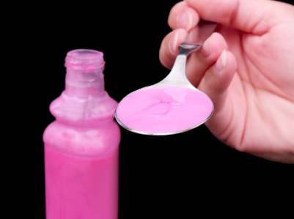
The Church That Made Jesus Sick
Text: Rev. 3:14-16
Notes:
By Nathan L Morrison
All Scripture given is from NASB unless otherwise stated
For further study, or if questions, please Call: 804-277-1983 or Visit www.courthousechurchofchrist.com

Slide 2
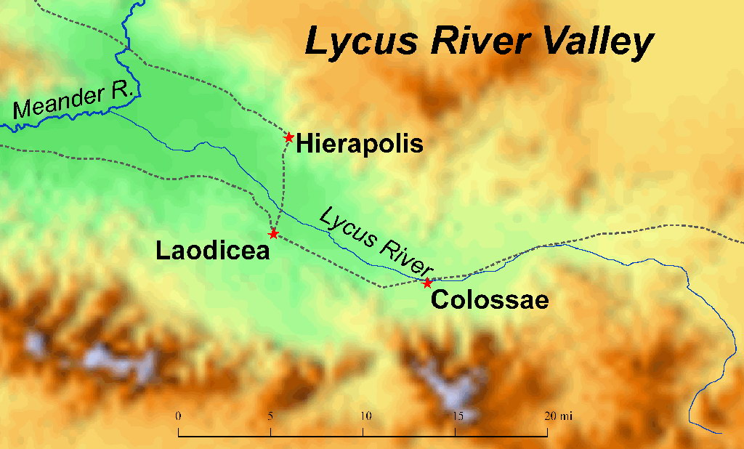
Intro
Saints are called upon to be “blameless and innocent,
children of God above reproach in the midst of a
crooked and perverse generation” (Phil. 2:15)
There was a church that didn’t do that, but became
hardly distinguishable from the world around it, and it
made Christ sick!

Slide 3
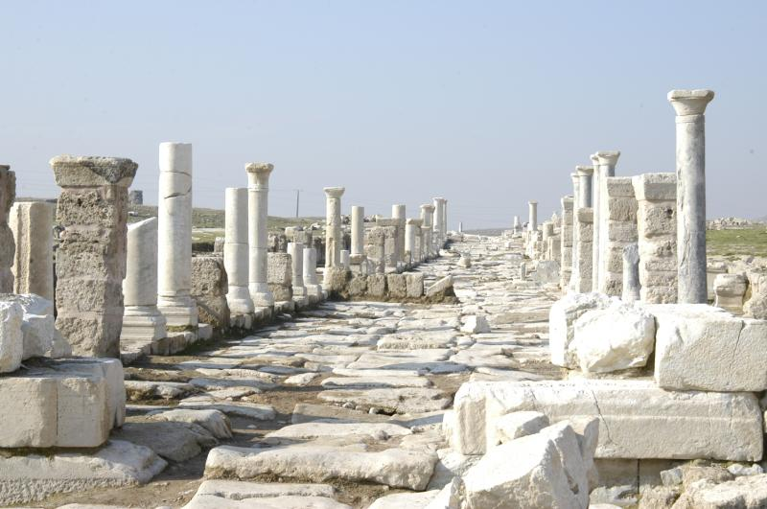
Intro
Rev. 3:14-16
14. "To the angel of the church in Laodicea write: The Amen, the faithful and true Witness, the Beginning of the creation of God, says this:
15. 'I know your deeds, that you are neither cold nor hot; I wish that you were cold or hot.
16. 'So because you are lukewarm, and neither hot nor cold, I will spit you out of My mouth.
“Spit” = emeo <em-eh’-o> (G1692): “to vomit (NKJ); Spit (NAS); (will) spue” (KJV)
Notes:
Image: Ruins of a road in Laodicea

Slide 4
Intro
Jesus expressed emotion on earth, but not like here:
Christ expressed compassion both over spiritual weakness (Mt. 9:36) and over physical needs (Mt. 15:32).
Christ expressed grief (Jn. 11:33-35: Mourned with those who mourned, wept even).
Christ expressed anger (Mk. 3:5; Jn. 2:14-15).
Here we see Him as being sick to the point of vomiting!
Who is Jesus addressing?
The church in Laodicea! (Col. 2:1; 4:13, 15, 16 – Early 50’s AD)
Nothing good to say about them!
What went wrong to cause a church to make
Jesus sick?!

Slide 5
Laodicea – What Went Wrong?
Laodicea
Laodicea was founded about 250 B.C. by Antiochus II of Syria (Seleucid), and was named after his wife Laodice who according to history later poisoned him!
The city was located about one hundred miles due east of Ephesus, nine miles west of Colossae.
Because the great Roman road ran through its center it was an important trade city!

Slide 6
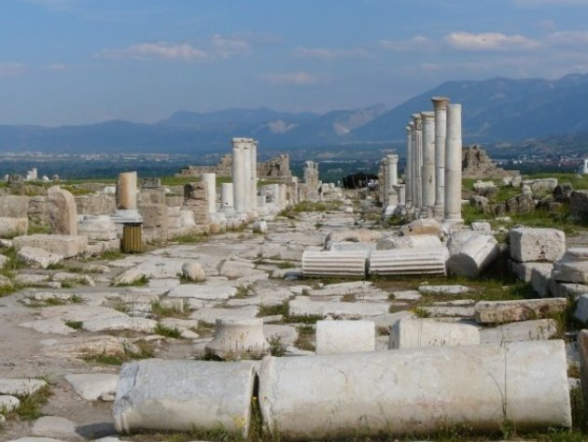
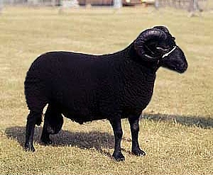
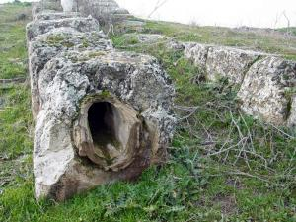
Laodicea – What Went Wrong?
Laodicea was actually known for 4 things:
Great wealth – Refused aid from Rome after AD 61 earthquake
Famous glossy black wool (dye) – Exported throughout the world
Medical School – Eye and ear salves (treated most eye diseases)
Hot Springs Water Supply – Aqueduct from 5 miles away created lukewarm, nauseating water by the time it reached the city!
Other than some water problems it sounded like a
fairly decent place to live and raise a family!
Notes:
Images:
Ruins of Laodicea
Black Ram
Aqueduct in Laodicea

Slide 7
Laodicea – What Went Wrong?
The Problem
The problem wasn’t geographic
The problem wasn’t a slumping economy
The problem was a “spiritual problem”
Jesus didn’t fault them for their organization,
their doctrine, or immorality, but rather His
gut-wrenching disgust came from their
“Half-hearted commitment”
Jesus Christ condemned them for being “lukewarm,”
indifferent!

Slide 8
The Problem with Being “Lukewarm”
The church being “Lukewarm” made Christ sick –
He would rather they were cold or hot
Why cold?
If cold, then they wouldn’t even pretend to belong to Him, but they would admit they belong to the world
If hot, then they would be declaring to the world they belong to Christ
Lukewarm meant they were indifferent!
Not against Christ, but not for Him!
II Tim. 3:5
5. holding to a form of godliness, although they have denied its power; Avoid such men as these.

Slide 9
The Problem with Being “Lukewarm”
Three reasons Christ hates luke-warmness:
He hates luke-warmness because it in itself is offensive to both God and man!
Titus 2:11-14
11. For the grace of God has appeared, bringing salvation to all men,
12. instructing us to deny ungodliness and worldly desires and to live sensibly, righteously and godly in the present age,
13. looking for the blessed hope and the appearing of the glory of our great God and Savior, Christ Jesus,
14. who gave Himself for us to redeem us from every lawless deed, and to purify for Himself a people for His own possession, zealous for good deeds.

Slide 10
The Problem with Being “Lukewarm”
Three reasons Christ hates luke-warmness:
He hates luke-warmness because it in itself is offensive to both God and man!
He hates luke-warmness because it robs its victim of all possibility of progress!
I Cor. 15:58
58. Therefore, my beloved brethren, be steadfast, immovable, always abounding in the work of the Lord, knowing that your toil is not in vain in the Lord.
Eph. 4:15
15. but speaking the truth in love, we are to grow up in all aspects into Him who is the head, even Christ,

Slide 11
The Problem with Being “Lukewarm”
Three reasons Christ hates luke-warmness:
He hates luke-warmness because it in itself is offensive to both God and man!
He hates luke-warmness because it robs its victim of all possibility of progress!
He hates luke-warmness because it kills our possibilities of usefulness!
II Tim. 2:21
21. Therefore, if anyone cleanses himself from these things, he will be a vessel for honor, sanctified, useful to the Master, prepared for every good work.

Slide 12
The Problem with Being “Lukewarm”
Three reasons Christ hates luke-warmness:
He hates luke-warmness because it in itself is offensive to both God and man!
He hates luke-warmness because it robs its victim of all possibility of progress!
He hates luke-warmness because it kills our possibilities of usefulness!
For their being lukewarm, Jesus would vomit them out!
Their souls were in danger!

Slide 13
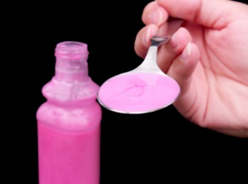
Conclusion
Once a group or individual recognizes they are “lukewarm” and have made Christ sick, is there a cure?

Slide 14
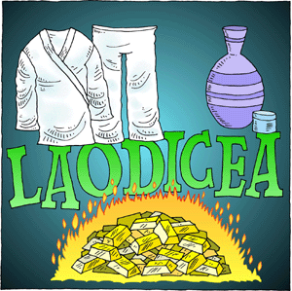
Conclusion
Jesus gave the cure to the church at Laodicea –
“Be zealous and repent!” (Rev. 3:17-22)
Gold refined by fire – Js. 1:2-3;
I Pet. 1:6-9
White garments – I Cor. 6:18;
Col. 3:5
Eye salve – I Pet. 5:8-9

Slide 15
Conclusion
There are congregations who take pride in the wrong
things: material wealth, rather than their spiritual
wealth; their numbers, rather than spiritual growth!
They become lukewarm!
Repent!
In a land of wealth and comfort, let us do all we can to
not be a church that makes Jesus Christ sick!

Slide 16
“What Must I Do To Be Saved?”
Hear The Gospel (Jn. 5:24; Rom. 10:17)
Believe In Christ (Jn. 3:16-18; Jn. 8:24)
Repent Of Sins (Lk. 13:35; Acts 2:38)
Confess Christ (Mt. 10:32; Rom. 10:10)
Be Baptized (Mk. 16:16; Acts 22:16)
Remain Faithful (Jn. 8:31; Rev. 2:10)
For The Erring Child:
Repent (Acts 8:22), Confess (I Jn. 1:9),
Pray (Acts 8:22)

