Slide 1
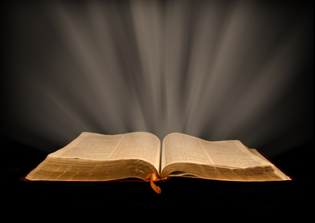
Apollos: “Mighty In The Scriptures”
Text: Acts 18:24-28
Notes:
By Nathan L Morrison
All Scripture given is from NASB unless otherwise stated
For further study, or if questions, please Call: 804-277-1983 or Visit www.courthousechurchofchrist.com

Slide 2
Intro
Intro to Apollos
Acts 18:24-28
24. Now a Jew named Apollos, an Alexandrian by birth, an eloquent man, came to Ephesus; and he was mighty in the Scriptures.
25. This man had been instructed in the way of the Lord; and being fervent in spirit, he was speaking and teaching accurately the things concerning Jesus, being acquainted only with the baptism of John;
26. and he began to speak out boldly in the synagogue. But when Priscilla and Aquila heard him, they took him aside and explained to him the way of God more accurately.
27. And when he wanted to go across to Achaia, the brethren encouraged him and wrote to the disciples to welcome him; and when he had arrived, he greatly helped those who had believed through grace,
28. for he powerfully refuted the Jews in public, demonstrating by the Scriptures that Jesus was the Christ.
There are many lessons we can learn from him!

Slide 3
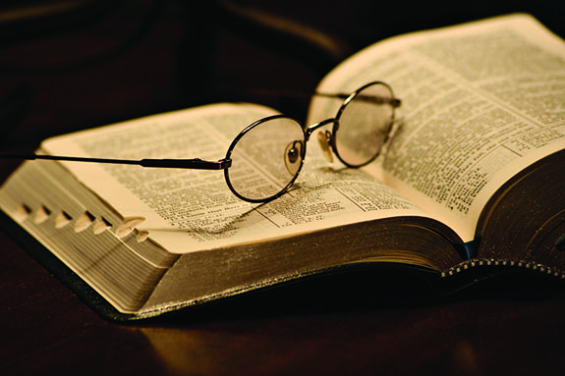
Apollos the Alexandrian
Who was Apollos? (Acts 18:24-26)
A Jew, and from all indications a disciple of John the Baptist (18:25)
He was born at Alexandria which was a chief seat of Hebrew learning (18:24)
Apollos was an “eloquent” man (18:24)
He was “mighty in the Scriptures” (18:24)
What was he doing at Ephesus? (Acts 18:24-25)
Apollos was “fervent in spirit”
He spoke and taught diligently the things of the Lord (II Tim. 2:15)
He knew only the baptism of John
He was taught a “more accurate” way (Acts 18:26)
Apollos then went to Achaia (Acts 18:27–28)
Apollos was a man “mighty in the Scriptures” & became
even more so because of the teachings of
Priscilla & Aquila!

Slide 4
The Work Of Apollos
Went to Corinth (Acts 19:1)
Extremely popular and successful!
Factions arose, through no fault of his own
(I Cor.1:10–16; 3:4–8; 4:6)
Maybe this is why he could not return (I Cor. 16:12)
In some cases there is no desire for a preacher to return! The Corinthians wanted him to return!
Apollos and Paul both labored in Corinth: Paul planted (Acts 18:1-18), and then Apollos watered (Acts 19:1) – I Cor. 3:5-9
Apollos was successful in retaining the confidence of the brethren at Corinth
What a good remark about him!
Apollos continued to work for the Lord & was a fellow
worker with Paul in furthering the gospel! (I Cor. 3:9)

Slide 5
Conclusion
Apollos should cause us to reflect upon a number of
things:
Which is more important for a preacher—college credentials or a knowledge of the Word of God? (One can be eloquent without a degree)
Am I fervent in spirit? (II Tim. 2:15)
If others corrected me according to the Word, would I be as willing as Apollos to change my preaching/teaching?
Would others recommend me to work and help others in furthering the gospel?
Would they want me to return?
Apollos was “mighty in the Scriptures” – Is that how I would be described as? (II Tim. 2:15)

Slide 6
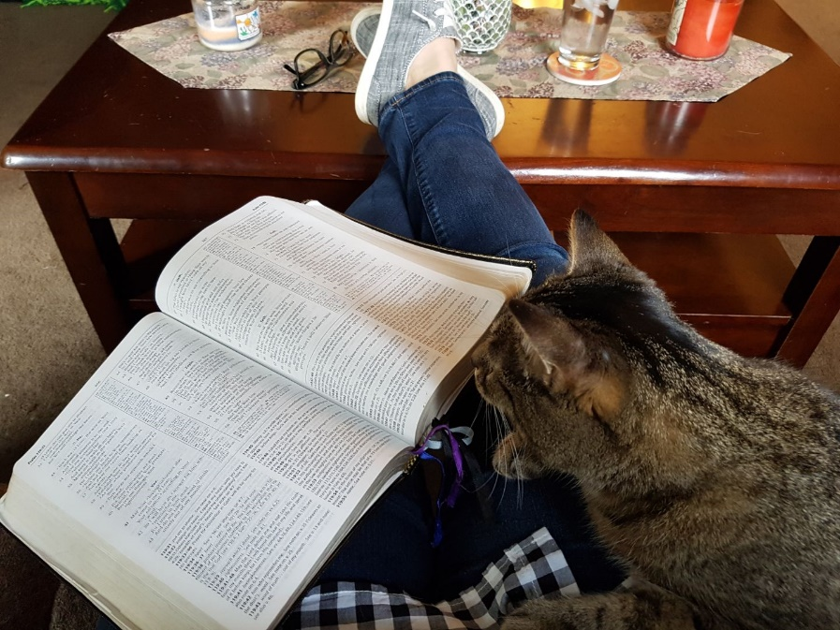
Conclusion
Apollos was “mighty” but was also found to be lacking in
some areas and was taught a “more accurate/perfect”
way – We need to have the heart to be taught no matter our maturity level!
May we strive to be “mighty in the Scriptures” and ever
learn (study) to “accurately handle the word of truth!”
(II Tim. 2:15)
II Tim. 2:15
15. Be diligent to present yourself approved to God as a workman who does not need to be ashamed, accurately handling the word of truth.

Slide 7
“What Must I Do To Be Saved?”
Hear The Gospel (Jn. 5:24; Rom. 10:17)
Believe In Christ (Jn. 3:16-18; Jn. 8:24)
Repent Of Sins (Lk. 13:35; Acts 2:38)
Confess Christ (Mt. 10:32; Rom. 10:10)
Be Baptized (Mk. 16:16; Acts 22:16)
Remain Faithful (Jn. 8:31; Rev. 2:10)
For The Erring Saint:
Repent (Acts 8:22), Confess (I Jn. 1:9),
Pray (Acts 8:22)

