Slide 1
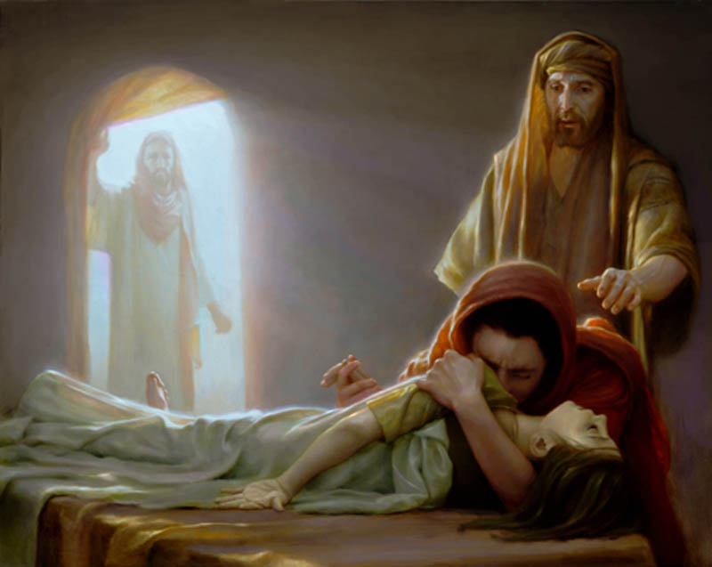
What Jairus' Daughter Saw In Her Father
Text: Lk. 8:40-56
Notes:
Prepared By Nathan L Morrison
All Scripture given is from NASB unless otherwise stated
For further study, or if questions, please Call: 804-277-1983 or Visit www.courthousechurchofchrist.com
Based on a lesson by Baxter Exum (church@fourlakescoc.org)

Slide 2
Intro
For parents, children are an enormous blessing!
(Ps. 127:3-5)
Ps. 127:3-5
3. Behold, children are a gift of the LORD, The fruit of the womb is a reward.
4. Like arrows in the hand of a warrior, So are the children of one's youth.
5. How blessed is the man whose quiver is full of them; They will not be ashamed When they speak with their enemies in the gate.

Slide 3
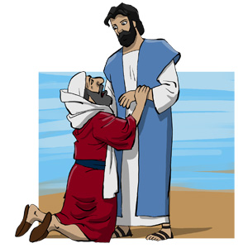
Intro
Lk. 8:40-42
40. And as Jesus returned, the people welcomed Him, for they had all been waiting for Him.
41. And there came a man named Jairus, and he was an official of the synagogue; and he fell at Jesus' feet, and began to implore Him to come to his house;
42. for he had an only daughter, about twelve years old, and she was dying. But as He went, the crowds were pressing against Him.

Slide 4
Intro
Lk. 8:49-56
49. While He was still speaking, someone came from the house of the synagogue official, saying, "Your daughter has died; do not trouble the Teacher anymore."
50. But when Jesus heard this, He answered him, "Do not be afraid any longer; only believe, and she will be made well."
51. When He came to the house, He did not allow anyone to enter with Him, except Peter and John and James, and the girl's father and mother.
52. Now they were all weeping and lamenting for her; but He said, "Stop weeping, for she has not died, but is asleep."
53. And they began laughing at Him, knowing that she had died.
54. He, however, took her by the hand and called, saying, "Child, arise!"
55. And her spirit returned, and she got up immediately; and He gave orders for something to be given her to eat.
56. Her parents were amazed; but He instructed them to tell no one what had happened.
What did Jairus’ daughter see in her father?

Slide 5
She Saw Her Father’s Love
Lk. 8:41-42
41. And there came a man named Jairus, and he was an official of the synagogue; and he fell at Jesus' feet, and began to implore Him to come to his house;
42. for he had an only daughter, about twelve years old, and she was dying. But as He went, the crowds were pressing against Him.
Jairus was “an official of the synagogue”
Jairus had an only daughter who was very sick and dying
Jairus was a father willing to do anything for his daughter
All his power and influence melted away at
the thought of losing his only daughter!
Jairus loved his daughter enough that he
was willing to do anything to make sure she
met Jesus face-to-face!

Slide 6
She Saw Her Father’s Faith in Jesus
Lk. 8:49-50
49. While He was still speaking, someone came from the house of the synagogue official, saying, "Your daughter has died; do not trouble the Teacher anymore."
50. But when Jesus heard this, He answered him, "Do not be afraid any longer; only believe, and she will be made well."
Jairus had faith Jesus could heal his little girl
Jesus offered hope and assurance
Jairus had faith in Jesus to raise his
daughter
Jairus became an example of faith,
trusting in the Lord’s words!

Slide 7
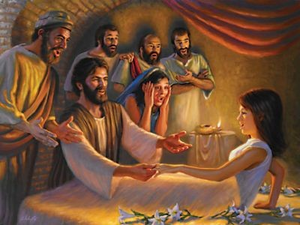
She Saw Her Father Amazed
Lk. 8:51-56
51. When He came to the house, He did not allow anyone to enter with Him, except Peter and John and James, and the girl's father and mother.
52. Now they were all weeping and lamenting for her; but He said, "Stop weeping, for she has not died, but is asleep."
53. And they began laughing at Him, knowing that she had died.
54. He, however, took her by the hand and called, saying, "Child, arise!"
55. And her spirit returned, and she got up immediately; and He gave orders for something to be given her to eat.
56. Her parents were amazed; but He instructed them to tell no one what had happened.
Jairus invited the Lord into his home of weeping and mourning
Jairus invited Jesus to his daughter’s
room
Jairus and his wife were amazed

Slide 8
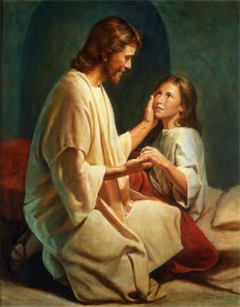
She Saw Her Father Amazed
Our God is an Amazing God!
Eph. 3:20-21
20. Now to Him who is able to do far more abundantly beyond all that we ask or think, according to the power that works within us,
21. to Him be the glory in the church and in Christ Jesus to all generations forever and ever. Amen.
Jairus and his wife were amazed
(“astonished”) at what God did for them
– their faith was rewarded!

Slide 9
Conclusion
Jairus’ daughter would have seen her father’s love for her,
his faith in Jesus, and his ability to be amazed by the
blessings of God!
Our children need to see those qualities in us, to see us
praise God and be amazed! (Col. 3:17)
True love for our children is not to buy them the newest
and greatest things, but to bring them to Jesus!
Jairus’ daughter would have seen it was so important to
her father that he was willing to do anything to bring
Jesus into his home (Lk. 8:41)
What do your children see as important to you?
Can they see your love, faith, and amazement at God?

Slide 10
“What Must I Do To Be Saved?”
Hear The Gospel (Jn. 5:24; Rom. 10:17)
Believe In Christ (Jn. 3:16-18; Jn. 8:24)
Repent Of Sins (Lk. 13:35; Acts 2:38)
Confess Christ (Mt. 10:32; Rom. 10:10)
Be Baptized (Mk. 16:16; Acts 22:16)
Remain Faithful (Jn. 8:31; Rev. 2:10)
For The Erring Child:
Repent (Acts 8:22), Confess (I Jn. 1:9),
Pray (Acts 8:22)

