Slide 1
Names Of GOD
Text: Ex. 34:23; Ps. 8:1
Notes:
By Nathan L Morrison
All Scripture given is from NASB unless otherwise stated
For further study, or if questions, please Call: 804-277-1983 or Visit www.courthousechurchofcrist.com
From The Nature Of GOD Workbook by Don Hastings & Marc Gibson

Slide 2
Intro
Names are important
Parents usually give a great deal of thought to naming their children.
We use our names throughout our lives to identify ourselves, even to the very end on our grave markers
Gen. 2:19 (Names are important from the beginning!)
19. Out of the ground the LORD God formed every beast of the field and every bird of the sky, and brought them to the man to see what he would call them; and whatever the man called a living creature, that was its name.
God changed Abram’s name to Abraham (Gen. 17:5)
Gen. 11:26: Abram (H87) = “High Father”
Gen. 17:5: Abraham (H85) = “Father of multitudes”
God changed Sarai’s name to Sarah (Gen. 17:15)
Gen. 11:29: Sarai (H8297) = “Dominative; ruler, head person”
Gen. 17:15: Sarah (H8283) = “Female noble; lady, princess, queen”

Slide 3
Intro
Jn. 1:42: Jesus said that Simon “shall be called Cephas”
(which is translated, Peter)
Simon (G4613) = From H8095; “God hears”
Cephas (G2786) = “The Rock,” or Peter (G4074 petros): “A piece of rock” (NKJ: “a stone”)
Our modern practice of naming is quite different
Any meaning of a name is generally unknown and irrelevant in its choice
Names can actually carry some meaning instead of
just being a pleasing sound!

Slide 4
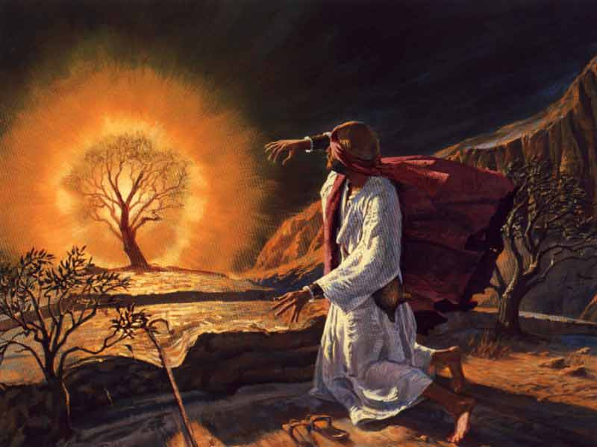
A Holy and Awesome Name
Ps. 111:9
9. He has sent redemption to His people; He has ordained His covenant forever; Holy and awesome is His name.
God’s people are to “fear this glorious and awesome
(“inspiring reverence”) name” (Deut. 28:58):
Ex. 20:7: This is why God’s name must never be “taken in vain.”
Lev. 24:11-16: The blasphemer would be put to death!
This O.T. warning should cause us to realize how much God abhors hearing His holy name blasphemed! (Many today do it!)
Ex. 3:13 (Important to know and understand the names that God has revealed for Himself)
13. Then Moses said to God, "Behold, I am going to the sons of Israel, and I will say to them, 'The God of your fathers has sent me to you.' Now they may say to me, 'What is His name?' What shall I say to them?"
We should be just as concerned that we
understand and properly use
the names of God!

Slide 5
Three Major Names for God
Three major names are used for God in the Old Testament
Elohim (H430)
Elohim is the name used in the first verse of the Bible: “In the beginning God [Elohim] created the heavens and the earth” (Gen. 1:1).
The most common designations for deity in ancient Semitic languages.
Elohim is especially descriptive of God’s power in His creative works and preservation of all things. (El [H410]: “Mighty, Almighty, power, strength)
It can also refer to false pagan deities (Ex. 20:3; 32:1; Ps. 95:3), and even human judges of Israel (Ps. 82:1, 6).
This plural word also reveals the plurality of persons sharing the essence of deity.
Gen. 1:26
26. Then God (Elohim) said, "Let Us make man in Our image, according to Our likeness; and let them rule over the fish of the sea and over the birds of the sky and over the cattle and over all the earth, and over every creeping thing that creeps on the earth."

Slide 6
Three Major Names for God
Three major names are used for God in the Old Testament
Yahweh (H3068)
This name was written originally as “YHWH”
Its original pronunciation is unknown, and Jewish tradition was to speak the word Adonay in its place so as to not take this important name in vain (Ex. 20:7).
Most modern versions translate Yahweh as “LORD” (Gen. 15:1) or “GOD” (Gen. 15:2) in all small capitals.
Sadly, most today have no fear of speaking God’s holy name in vain!
Ex. 3:14 (Jesus said the same in Jn. 8:58)
14. God said to Moses, "I AM WHO I AM"; and He said, "Thus you shall say to the sons of Israel, 'I AM has sent me to you.'"
It is believed that Yahweh is derived from the Hebrew verb havah (H1961) meaning “to be, being.”

Slide 7
Three Major Names for God
Three major names are used for God in the Old Testament
Yahweh (H3068) Continued…
Man began to call upon this name early in human history, and it was known and used by the patriarchs (Gen. 4:26; 14:22; 15:2).
Ex. 6:3
3. I appeared to Abraham, Isaac, and Jacob, as God Almighty, but by My name, LORD (H3068), I did not make Myself known to them.
Does this contradict Gen. 4:26 (men); 14:22 (Abram); 15:2 (Abram)?
No! It is not that His name, YHWH, was not used or known, but that its significance was not known to them as it was about to be in Egypt!
Yahweh is the most commonly used name (over 6800 times)
Elohim and Yahweh are oft used together (II Chron. 14:11; Ps. 19)
In older English versions, “Jehovah” is used (Latinized combination using the consonants of Yahweh and the vowels for Adonay)
The Jehovah’s Witnesses are wrong to insist that “Jehovah” is the only translation of the name of God that should be used!
Yahweh found in: “Hallelujah” (“Praise Yah”) and “Elijah” (“Yah is God”)

Slide 8
Three Major Names for God
Three major names are used for God in the Old Testament
Adonay (H136)
Adonay (H136 “The Lord”) was a common term for lord or master (From H113 adon adon: “ruler, sovereign, master, lord”). Human masters (H113) – Gen. 18:12; I Sam. 26:19; Ex. 21:5; Mal. 1:6
It indicates authority, right to act or speak, preeminence.
It is translated as “Lord” (Gen. 15:2; Ex. 34:23; Deut. 10:17; Josh. 3:11; Jud. 16:28; Ps. 110:1). Most of these contain all 3 names of God…IE:
Ex. 34:23 (All 3 names of God)
23. Three times a year all your males are to appear before the Lord (Adonay) GOD (Yahweh), the God (Elohim) of Israel.
It occurs frequently with the name Yahweh.
This name reminds us of our need to submit to God’s authority! (Ruler, Sovereign, Creator!)

Slide 9
Jesus Is GOD
O.T. verses using all three of the major names for God are quoted in the N.T. of Jesus, showing He is God!
Refutes the
doctrine of the
Jehovah’s
Witnesses that
denies Jesus is
GOD!
Elohim (G2316 Theos: God)
Heb. 1:8-9 (Quoted from Ps. 45:6-7: Elohim)
Yahweh (G2962 Kurios: Lord)
Heb. 1:10 (From Ps. 102:25-27: Yahweh; Jn. 8:58)
Jn. 8:57-58 (“I AM”: G1510 eimi [i-mee]: “I exist”)
57. So the Jews said to Him, "You are not yet fifty years old, and have You seen Abraham?"
58. Jesus said to them, "Truly, truly, I say to you, before Abraham was born, I am."
Adonay (G2962 Kurios: Lord)
Mt. 22:43-44 (From Ps. 110:1: Yahweh [H3068] said to Adonay [H136])

Slide 10
Jesus Is GOD
O.T. verses using all three of the major names for God are quoted in the N.T. of Jesus, showing He is God!
Elohim (G2316 Theos: God)
Heb. 1:8-9 (Quoted from Ps. 45:6-7: Elohim)
Yahweh (G2962 Kurios: Lord)
Heb. 1:10 (From Ps. 102:25-27: Yahweh; Jn. 8:58)
Adonay (G2962 Kurios: Lord)
Mt. 22:43-44 (From Ps. 110:1: Yahweh [H3068] said to Adonay [H136])
Jesus is the “I AM” of Ex. 3:14 and identified by
all three major names of God!

Slide 11
Other Names and Descriptions of God
El Shaddai (“Almighty God”)
Gen. 17:1; 28:3; 35:11; 43:14; 48:3; 49:25
El Elyon (“God Most High”)
Gen. 14:18, 22; Num. 24:16; Ps. 91:12; Dan. 7:18, 22, 25, 27
El Olam Olam (“Everlasting God”)
Gen. 21:33; Is. 40:28; Ps. 90:2
“Living God” (Josh. 3:10; Ps. 42:2; 84:2; Hos. 1:10)
El Roi (“God Who Sees”)
Gen. 16:13
Yahweh Sabaoth (“Lord of Hosts”)
I Sam. 1:3; II Sam. 7:27; Rom. 9:29; Js. 5:4
Abir (“Mighty One”); Pahad (“Fear”)
“Mighty God of Jacob” (Gen. 49:24; Ps. 132:2, 5; Is. 49:26; 60:16)
“Fear of Isaac” (Gen. 31:42, 53)
The very names of God describe His nature, His power,
His eternalness, His being enthroned in Heaven above, and His command of authority!

Slide 12
Conclusion
The names attributed to God reveal his character, might,
and prominence
Let us be diligent to reflect upon and learn of God from
His names, and reverently use them in praise of Him…
Ps. 8:1 (NKJ)
1. To the Chief Musician. On the Instrument of Gath. A Psalm of David. O LORD, our Lord, How excellent is Your name in all the earth, Who have set Your glory above the heavens!

Slide 13
“What Must I Do To Be Saved?”
Hear The Gospel (Jn. 5:24; Rom. 10:17)
Believe In Christ (Jn. 3:16-18; Jn. 8:24)
Repent Of Sins (Lk. 13:35; Acts 2:38)
Confess Christ (Mt. 10:32; Rom. 10:10)
Be Baptized (Mk. 16:16; Acts 22:16)
Remain Faithful (Jn. 8:31; Rev. 2:10)
For The Erring Child of God:
Repent (Acts 8:22), Confess (I Jn. 1:9),
Pray (Acts 8:22)

