Slide 1
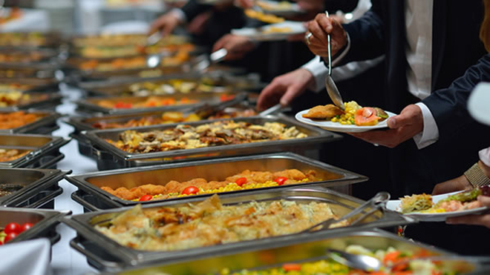
"What Do You Offer?" (A Look At The Social Gospel Buffet) Text: Rev. 21:3-7
Notes:
By Nathan L Morrison
All Scripture given is from NASB unless otherwise stated
For further study or if questions, Call: 804-277-1983, or Visit: www.courthousechurchofchrist.com

Slide 2
Intro
Many people, when looking for a church to attend, ask, “What do you offer?”
(I Tim. 4:1-3; II Tim. 4:3-4: People will no longer look for truth!)
Eph. 2:19-22 (“What can I offer to the Lord’s church?”) – 4:14-16
19. So then you are no longer strangers and aliens, but you are fellow citizens with the saints, and are of God's household,
20. having been built on the foundation of the apostles and prophets, Christ Jesus Himself being the corner stone,
21. in whom the whole building, being fitted together, is growing into a holy temple in the Lord,
22. in whom you also are being built together into a dwelling of God in the Spirit.

Slide 3
Intro
Many people, when looking for a church to attend, ask, “What do you offer?”
Rev. 21:3-7 (“What does Christ offer me?”)
3. And I heard a loud voice from the throne, saying, "Behold, the tabernacle of God is among men, and He will dwell among them, and they shall be His people, and God Himself will be among them,
4. and He will wipe away every tear from their eyes; and there will no longer be any death; there will no longer be any mourning, or crying, or pain; the first things have passed away."
5. And He who sits on the throne said, "Behold, I am making all things new." And He said, "Write, for these words are faithful and true."
6. Then He said to me, "It is done. I am the Alpha and the Omega, the beginning and the end. I will give to the one who thirsts from the spring of the water of life without cost.
7. "He who overcomes will inherit these things, and I will be his God and he will be My son.

Slide 4
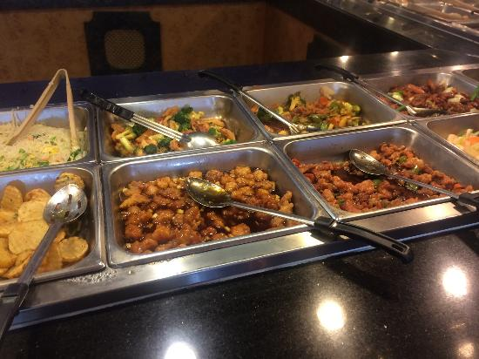
Intro
Many people who ask “What do you offer?” are looking
for a buffet line of options (offered by the Social Gospel)
We establish criteria for many of the things we look for
in life…
Boys dream of the perfect car
Girls dream of the perfect wedding
Men and women dream of the perfect spouse
Some try to find the “perfect church”
What criteria do we use when looking for the church
Jesus died to build and save?
How should/do we answer the question posed, “What do you offer?”

Slide 5
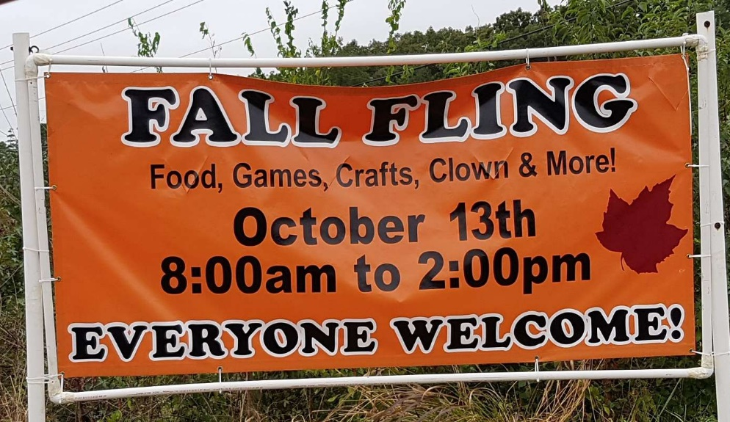
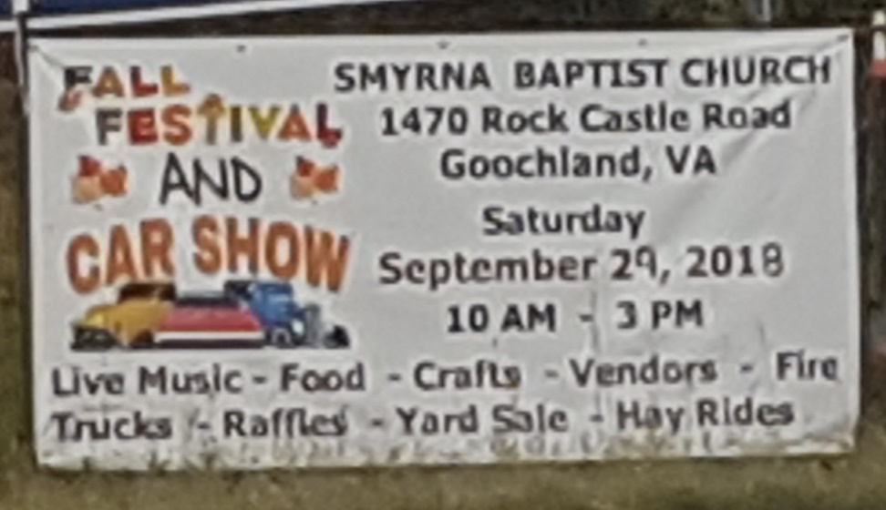
What Many Are Looking For
Social activities:
Many churches boast of their softball or volleyball team and community events

Slide 6
What Many Are Looking For
Social activities:
They want a YMCA with a little Scripture thrown in
Faithful of the O.T. & N.T. looked for something else in
their meeting places:
Heb. 11:38: The heroes of faith of the O.T. were “wandering in deserts and mountains and caves and holes in the ground.”
Mt. 8:20: The foxes & birds had homes but Jesus had nowhere to lay His head.
Acts 20:20: History records that the early Christians often met in caves, tombs, catacombs, “publicly” and “from house to house.”
Mt. 8:20
20. Jesus said to him, "The foxes have holes and the birds of the air have nests, but the Son of Man has nowhere to lay His head."

Slide 7
What Many Are Looking For
Social contacts:
They want to meet the right people
Heavily taught by “Prosperity Gospel” (focus: material wealth)

Slide 8
What Many Are Looking For
Social contacts:
They want to meet the right people
Mt. 10:22: “You will be hated by all because of My
name…”
I Cor. 6:9-11: Early church was made up of former prostitutes, idol worshippers, adulterers, homosexuals, thieves, and conmen!
Gal. 3:28: When gathered together, we are one in Christ and fellow heirs.
Acts 10:34-35: God shows no partiality to one’s social standing – the one who fears Him and does righteousness will be accepted by Him.
Mk. 10:28-30 (Lk. 8:21): Saints become family, and while there are benefits to knowing one another, what we can get out of it is not why we become Christians!
Mt. 10:22
22. "You will be hated by all because of My name, but it is the one who has endured to the end who will be saved.

Slide 9
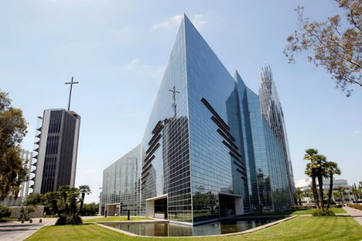
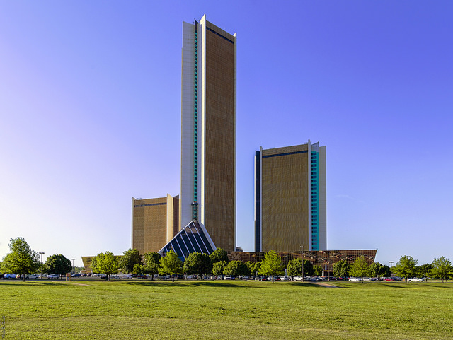
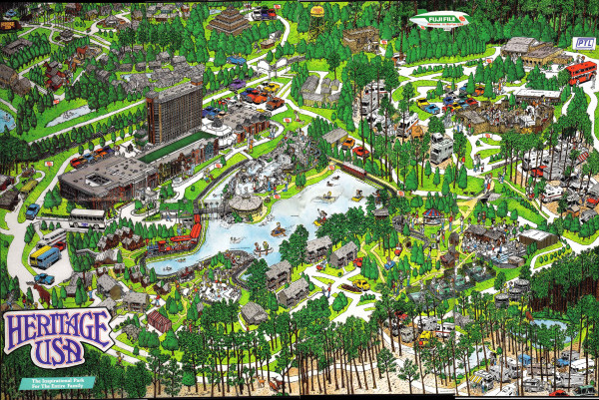
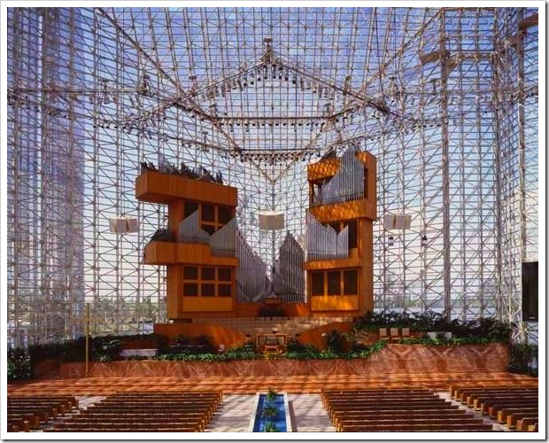
What Many Are Looking For
The biggest church in town:
They want to get lost in the crowd – Or boast about how big they are!
Oral Roberts had the biggest hospital owned by any church (1981-1989).
Robert Schuller’s Crystal Cathedral had the 5th largest pipe organ in the world! (1981-2010)
Jim and Tammy Bakker built the 3rd most-visited theme park in the USA, Heritage USA (1978-1989).
Notes:
Sources:
1. Oral Roberts’ City of Faith Medical and Research Center:
a. http://en.wikipedia.org/wiki/CityPlex_Towers#Completion
b. http://www.voiceofhealing.info/04twogiants/roberts.html
2. Robert Schuller’s Crystal Cathedral:
a. http://en.wikipedia.org/wiki/Crystal_Cathedral
b. http://sacredclassics.com/bigpipes.htm
3. Jim and Tammy Bakker’s Heritage USA:
a. http://io9.com/5882369/jim-bakkers-christian-amusement-park-is-now-a-post-apocalyptic-ghost-town
b. http://en.wikipedia.org/wiki/Heritage_USA

Slide 10
What Many Are Looking For
The biggest church in town:
They want to get lost in the crowd – Or boast about how big they are!
They forget personal responsibility!
(Gal. 6:1-10; Js. 1:26-27)
They are not looking for the presence of Christ!
Rev. 2:8-11
8. "And to the angel of the church in Smyrna write: The first and the last, who was dead, and has come to life, says this:
9. 'I know your tribulation and your poverty (but you are rich), and the blasphemy by those who say they are Jews and are not, but are a synagogue of Satan.
10. 'Do not fear what you are about to suffer. Behold, the devil is about to cast some of you into prison, so that you will be tested, and you will have tribulation for ten days. Be faithful until death, and I will give you the crown of life.
11. 'He who has an ear, let him hear what the Spirit says to the churches. He who overcomes will not be hurt by the second death.'

Slide 11
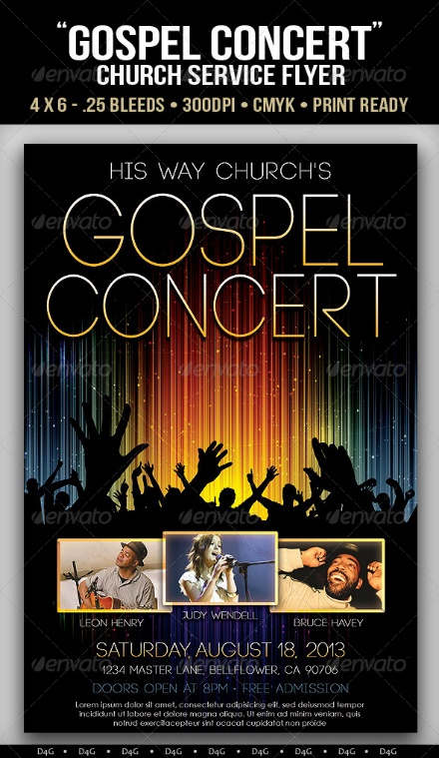
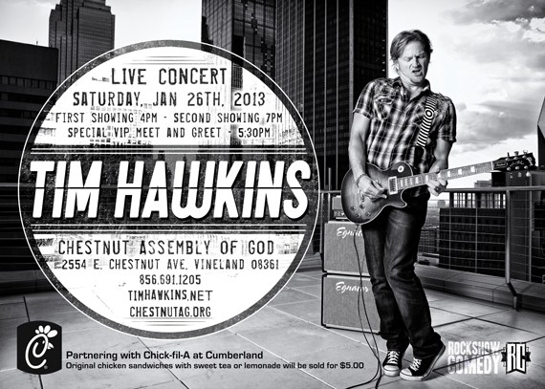
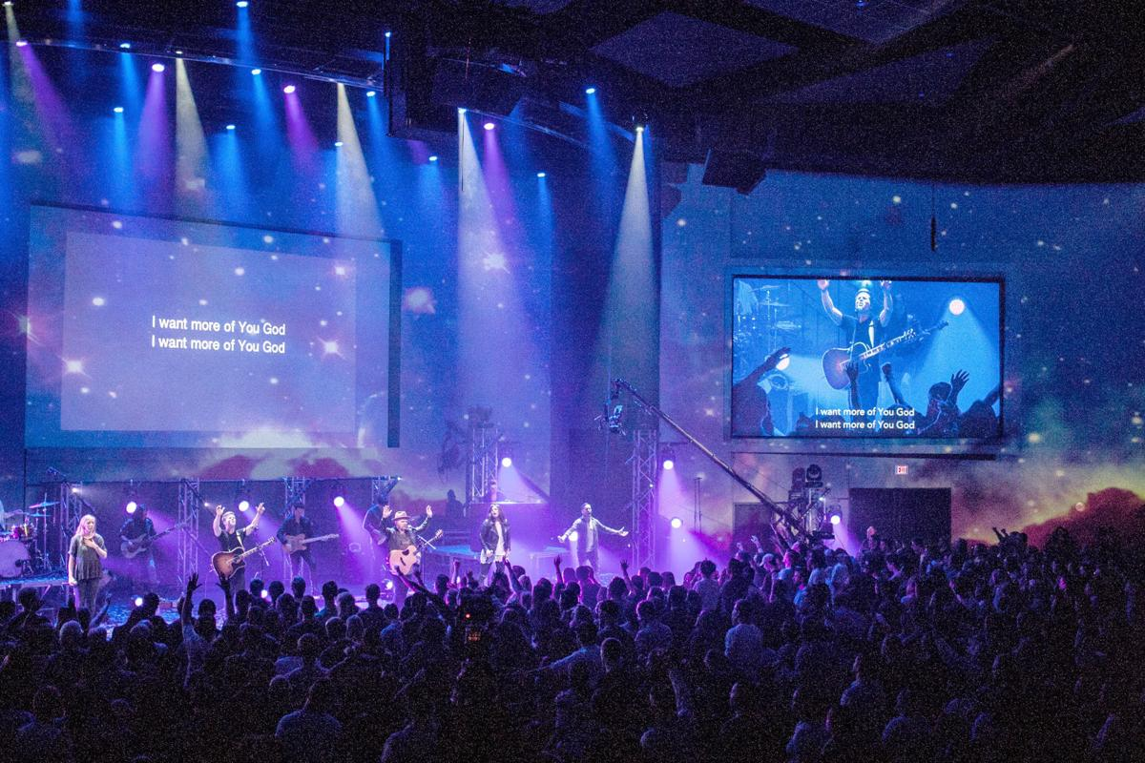
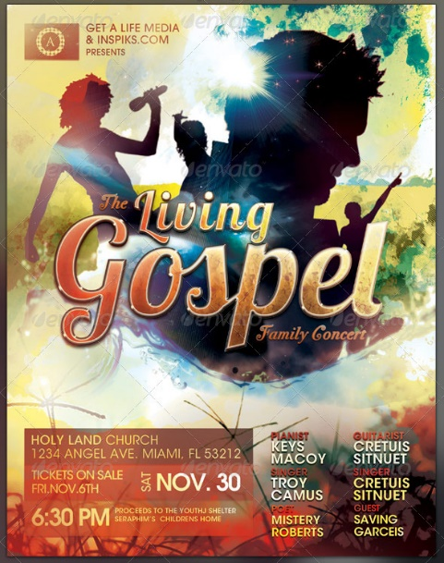
What Many Are Looking For
Entertainment:
They want to “go home feeling good.”
They mistake “fellowship” to mean coming together for the purpose of entertainment!

Slide 12
What Many Are Looking For
Entertainment:
They mistake “fellowship” to mean coming together for the purpose of entertainment.
The N.T. church was not in the entertainment business
Jn. 4:24: “God is spirit, and those who worship Him must worship in spirit and truth.”
Acts 2:42: “They were continually devoting themselves to the apostles' teaching and to fellowship, to the breaking of bread and to prayer.”
Col. 3:16: We teach and admonish each other, sing and pray.
Rom. 14:17: The kingdom of God is not eating and drinking.
I Cor. 1:10; Phil. 1:27: True fellowship in Christ is to be of one mind striving for the same purpose!
I Cor. 1:10
10. Now I exhort you, brethren, by the name of our Lord Jesus Christ, that you all agree and that there be no divisions among you, but that you be made complete in the same mind and in the same judgment.

Slide 13
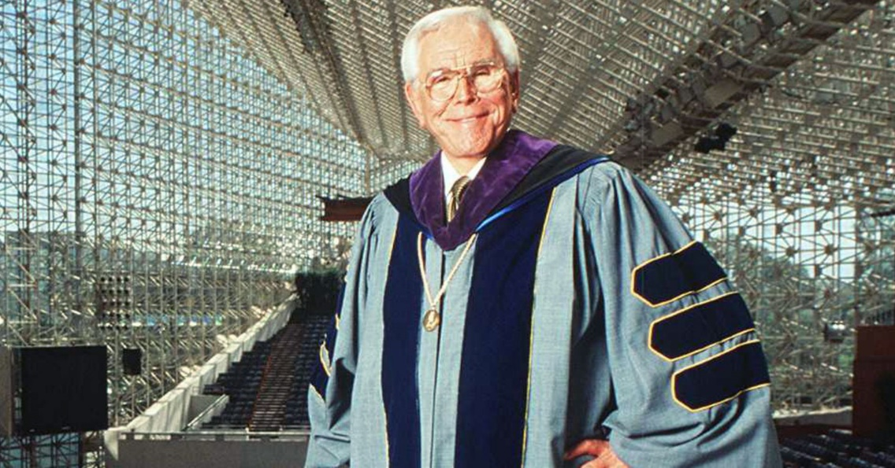
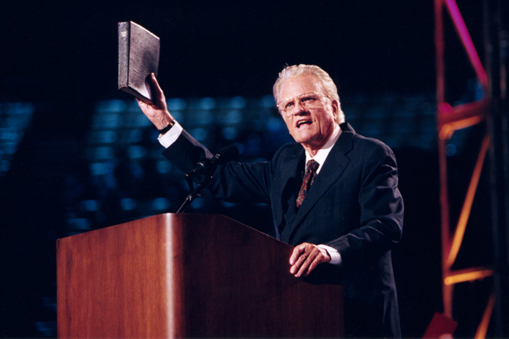
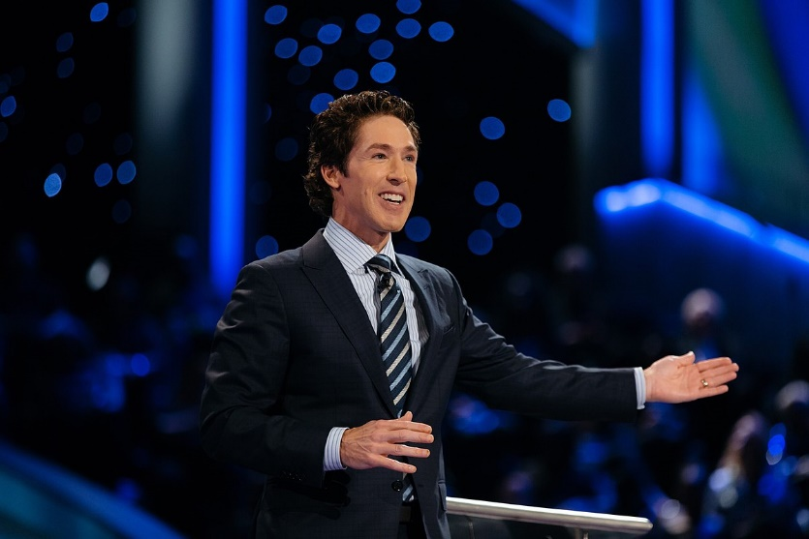
What Many Are Looking For
A good preacher (speaker):
“One who makes you laugh and cry in the same lesson.”
“He’s such a good speaker.” But they often mean the way he spoke, NOT what he spoke.
Notes:
Pics:
Top: Robert Schuller in his Crystal Cathedral
Bottom Left: Billy Graham
Bottom Right: Joel Osteen

Slide 14
What Many Are Looking For
A good preacher:
“He’s such a good speaker.” But they often mean the way he spoke, NOT what he spoke.
Would they have liked a preacher from Biblical example?
Ex. 4:10: Would they have liked Moses?
I Cor. 2:1-5: Would they have liked Paul? (Peter? – Acts 2:22-36; Stephen? – Acts 7)
I Cor. 2:1-5
1. And when I came to you, brethren, I did not come with superiority of speech or of wisdom, proclaiming to you the testimony of God.
2. For I determined to know nothing among you except Jesus Christ, and Him crucified.
3. I was with you in weakness and in fear and in much trembling,
4. and my message and my preaching were not in persuasive words of wisdom, but in demonstration of the Spirit and of power,
5. so that your faith would not rest on the wisdom of men, but on the power of God.

Slide 15
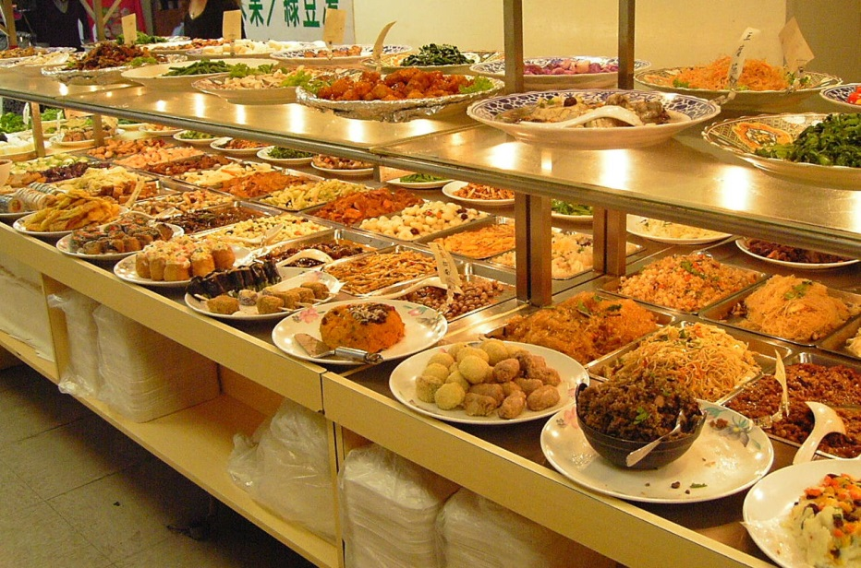
What Many Are Looking For
Social activities
Social contacts
The biggest church in town
Entertainment
A good preacher
What many people look for in a congregation has nothing to do with spiritual matters!

Slide 16
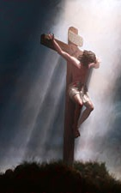
What Christ Offers
Freedom from sin
Jn. 8:31-32 (Rom. 6:16); Is. 59:1-2
I Pet. 1:18-19 (Jn. 12:32; Eph. 2:13-16)
A New way of life (Rom. 6:4)
Mt. 7:13-14: A narrow way.
Mt. 20:20-28: A way of service.
Jn. 14:27; Phil. 4:6-9: A way of peace.
I Pet. 1:14-16: A way of holiness.
Citizenship & Family
Mt. 3:1-2; Col. 1:13: He came to establish His kingdom.
Rom. 5:6-11: Citizenship gives us fellowship with the Father.
Phil. 3:20: “For our citizenship is in heaven…”
Mk. 10:28-30; Rom. 8:14-17; 12:4-5; I Tim. 3:15: Family the world over!

Slide 17
What Christ Offers
A home of eternal rest
Mt. 11:28-30: Christ says, “Come unto Me…and I shall give you rest.”
Jn. 14:1-3: Jesus said He went away to prepare a home for His followers and that He will return one day to bring them home.
Rev. 21:3-7: He who overcomes will inherit this home in glory!
Better than any social events man can offer!
The ultimate joy offered by Christ!

Slide 18
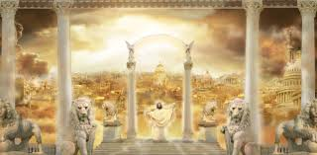
What Christ Offers
Christ offers far more than what
most people look for in a church:
Eternal Glory!

Slide 19
What Should I Look For?
The church for which Jesus died
Mt. 16:18; Eph. 1:19-23; 5:25
Sound doctrine
I Tim. 4:6; Titus 1:9; 2:1 (Contrast with: I Tim. 6:3-5; II Tim. 4:3)
Like-minded souls
I Cor. 1:10; Phil. 1:27; 2:1-5
People content to be Christians only
Acts 11:26
To do that which is pleasing to God over what is pleasing to me!
(II Cor. 5:9; Col. 1:10)

Slide 20
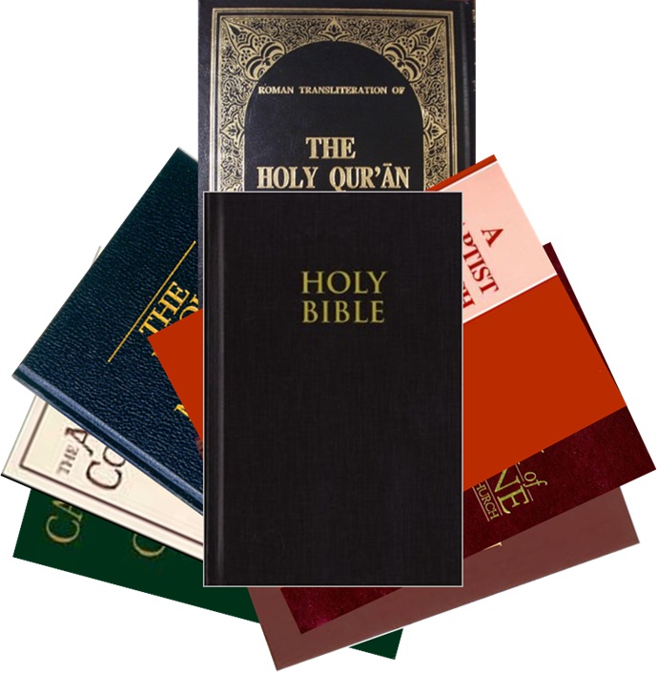
Conclusion
The temptation 2,000 years after the church established is to change the ways and reasons we do things and justify it by saying, “We are the modern church!”
I Pet. 1:22-25: The word of God does not change (Lk. 8:4-15). God’s laws that governed morality apply today as they did in times of old!
I Pet. 4:11: We have no more right to change the message than the Christians in the early church.
The seed of the kingdom is the word of God (Lk. 8:11)
Therefore to be a citizen of God’s kingdom, one must obey His seed, which is the gospel!
No room for a buffet line
of doctrines!

Slide 21
Conclusion
How do we answer, “What do you offer?”
The gospel preached (II Thess. 2:14)
Righteous living (Titus 2:11-14)
Teaching to strengthen our faith (II Tim. 3:16-17)
Teaching so that we might all get to Heaven, the Home of the Soul (Rev. 21:7)

Slide 22
“What Must I Do To Be Saved?”
Hear The Gospel (Jn. 5:24; Rom. 10:17)
Believe In Christ (Jn. 3:16-18; Jn. 8:24)
Repent Of Sins (Lk. 13:35; Acts 2:38)
Confess Christ (Mt. 10:32; Rom. 10:10)
Be Baptized (Mk. 16:16; Acts 22:16)
Remain Faithful (Jn. 8:31; Rev. 2:10)
For The Erring Child of God:
Repent (Acts 8:22), Confess (I Jn. 1:9),
Pray (Acts 8:22)

