Slide 1
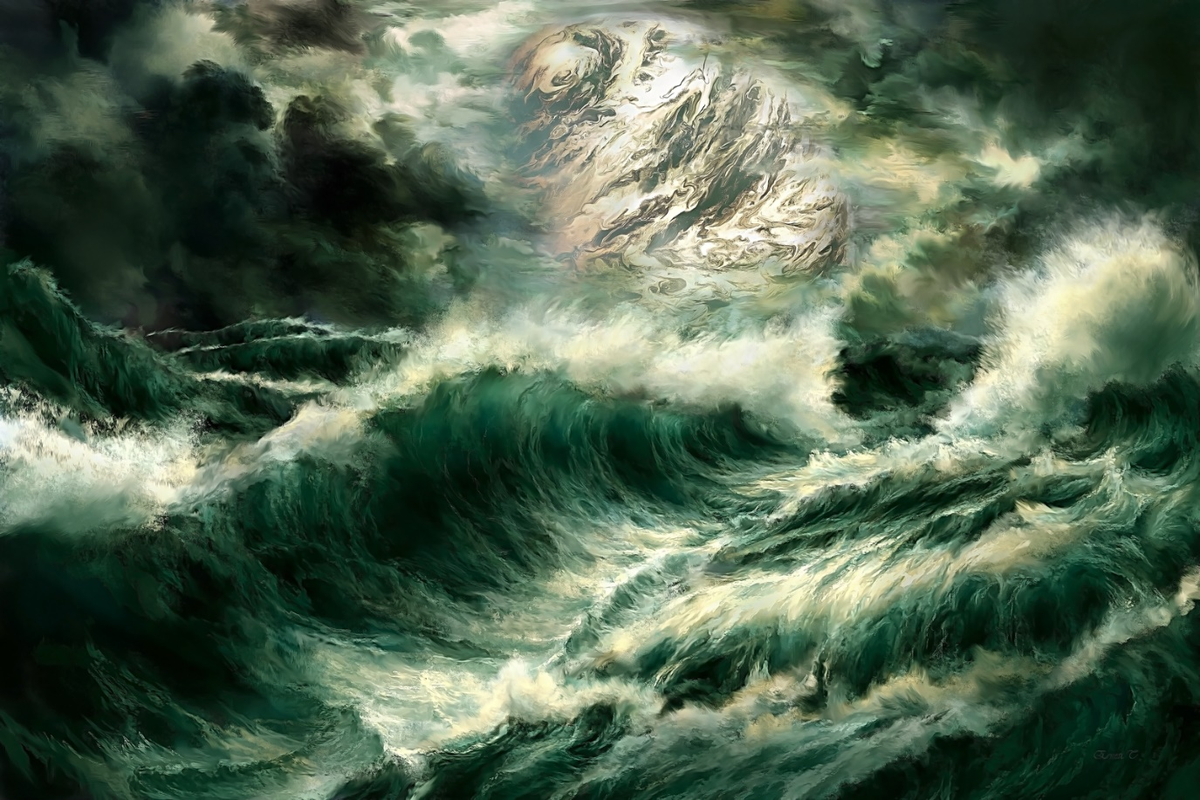
The Winds & The Waves Text: Mark 4:36-41; Matthew 14:22-33
Notes:
By Nathan L Morrison
All Scripture given is from NASB unless otherwise stated
For further study, or if questions, please Call: 804-277-1983 or Visit: www.courthousechurchofchrist.com

Slide 2
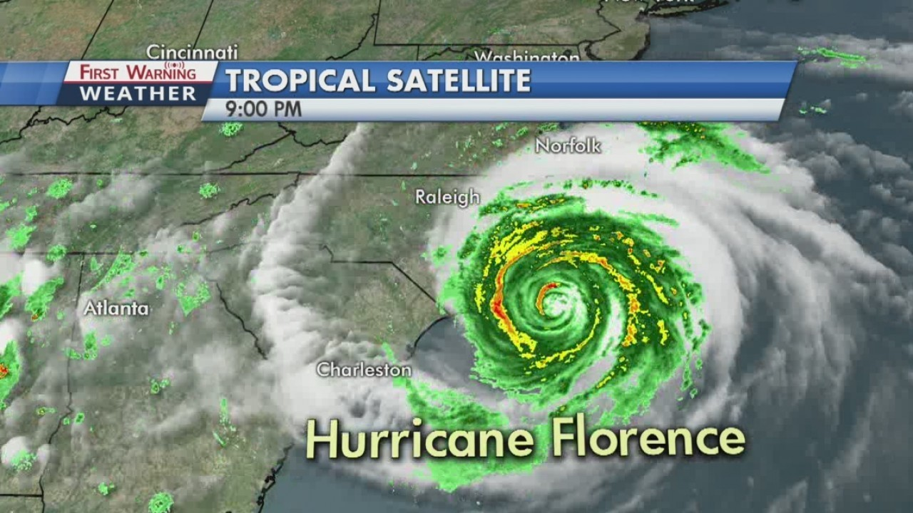
Intro
There are things in this life out of our control
We need to trust in the One who is in control and can say, “Peace, be still!”

Slide 3
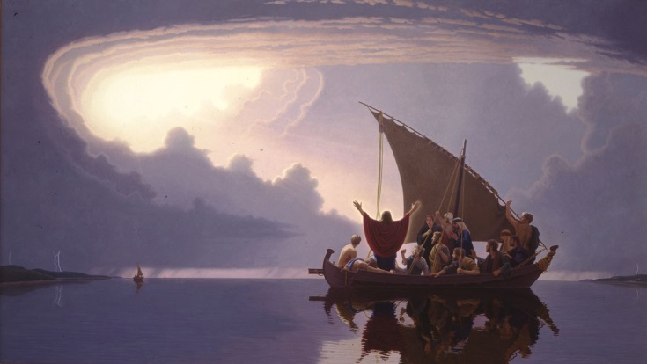
Intro
Mark 4:36-41 (NKJ)
36. Now when they had left the multitude, they took Him along in the boat as He was. And other little boats were also with Him.
37. And a great windstorm arose, and the waves beat into the boat, so that it was already filling.
38. But He was in the stern, asleep on a pillow. And they awoke Him and said to Him, "Teacher, do You not care that we are perishing?"
39. Then He arose and rebuked the wind, and said to the sea, "Peace, be still!" And the wind ceased and there was a great calm.
40. But He said to them, "Why are you so fearful? How is it that you have no faith?"
41. And they feared exceedingly, and said to one another, "Who can this be, that even the wind and the sea obey Him!"

Slide 4
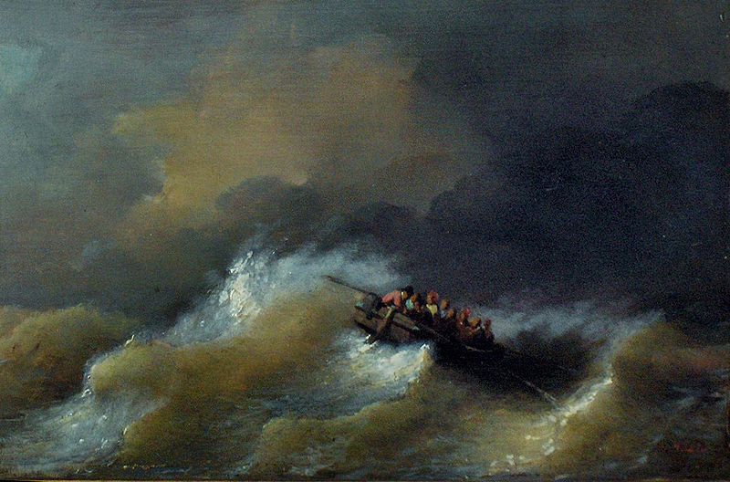
Intro
Mt. 14:22-27
22. Immediately He made the disciples get into the boat and go ahead of Him to the other side, while He sent the crowds away.
23. After He had sent the crowds away, He went up on the mountain by Himself to pray; and when it was evening, He was there alone.
24. But the boat was already a long distance from the land, battered by the waves; for the wind was contrary.
25. And in the fourth watch of the night He came to them, walking on the sea.
26. When the disciples saw Him walking on the sea, they were terrified, and said, "It is a ghost!" And they cried out in fear.
27. But immediately Jesus spoke to them, saying, "Take courage, it is I; do not be afraid."

Slide 5
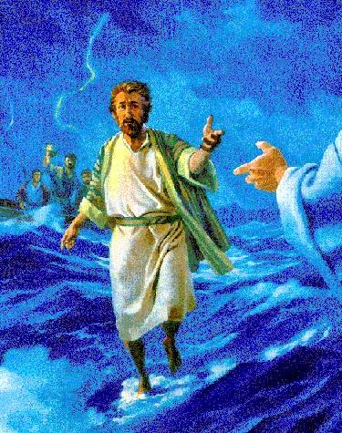
Intro
Mt. 14:28-29
28. Peter said to Him, "Lord, if it is You, command me to come to You on the water."
29. And He said, "Come!" And Peter got out of the boat, and walked on the water and came toward Jesus.
We may often remember this
account as the time Peter sank!
Peter was the only one to get out of the boat! The other apostles stayed aboard!
Peter climbed over the side of the boat to land not in the water, but on the water, for it says he “walked on the water and came toward Jesus.”

Slide 6
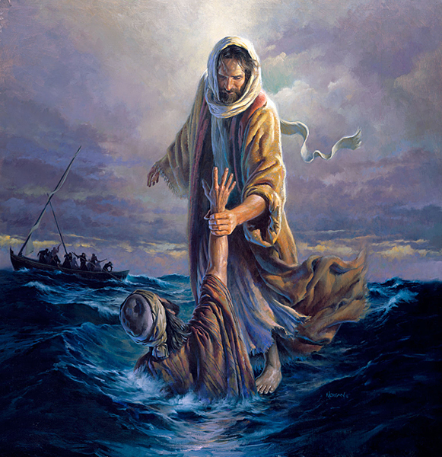
Intro
Mt. 14:30-33
30. But seeing the wind, he became frightened, and beginning to sink, he cried out, "Lord, save me!"
31. Immediately Jesus stretched out His hand and took hold of him, and said to him, "You of little faith, why did you doubt?"
32. When they got into the boat, the wind stopped.
33. And those who were in the boat worshiped Him, saying, "You are certainly God's Son!"
Jesus Caught Peter when he sank!
Jesus didn’t say, “You wanted this, and you failed so get yourself out!”
When Peter sank, it says, “Immediately Jesus stretched out His hand and took hold of him.”
Peter had great faith!
Only one of the twelve to get out of the boat and walk on the water to Jesus!
When he sank Jesus was there to lift him up!

Slide 7
Intro
Mt. 11:28-30
28. "Come to Me, all who are weary and heavy-laden, and I will give you rest.
29. "Take My yoke upon you and learn from Me, for I am gentle and humble in heart, and YOU WILL FIND REST FOR YOUR SOULS.
30. "For My yoke is easy and My burden is light."
Like Peter we want to come and have faith to do it but sometimes we get distracted and discouraged by the “winds and waves” about us and we sink out of fear and doubt!
Col. 3:1; Heb. 12:1-2: Let us recognize the winds and the waves as distractions but focus our eyes on Jesus!

Slide 8
FEAR
Fear = A feeling of reverence, awe, respect, and an
unpleasant emotion caused from a sense of danger
A harmful fear is a sense of terror or dread
Mt. 10:28: We are not to fear human beings.
This type of fear is a trait of the wicked
Prov. 28:1: The wicked flee with no one pursuing.
Rom. 13:3-4: The wicked fear authority or the government.
Jn. 19:1-16: Out of fear (19:8), Pilate, who knew Jesus was innocent (Mk. 15:14-15), sentenced Him to death.
Rev. 21:8: Cowards listed among those cast into hell. (Mt. 10:33)

Slide 9
FEAR
Eph. 5:1-2: We are to be imitators of God
Did Jesus live His life in fear?
I Cor. 11:1: Paul says, “Be imitators of me, as I am of Christ.”
Eph. 5:1-2
1. Therefore be imitators of God, as beloved children;
2. and walk in love, just as Christ also loved you and gave Himself up for us, an offering and a sacrifice to God as a fragrant aroma.

Slide 10
FEAR
Christ is there holding His hand out to us and we
sometimes just get too distracted on our way there
Rom. 8:31: Nothing to fear if on God’s side.
Rom. 8:32-39: God is on our side when we walk in righteousness
Prov. 9:10: Fear of the Lord is the beginning of wisdom.
Eccl. 12:13-14: God will judge both the wicked and the righteous
Rom. 8:31
31. What then shall we say to these things? If God is for us, who is against us?
Let us not fear to the detriment of our souls but have faith in God to accomplish His will in our lives!

Slide 11
DOUBT
Doubt = A lack of confidence, hesitation, inclination not
to believe, distrust
Many times our doubts cause us to hesitate or stop
completely (“sink”)
Jn. 20:24-29: Thomas doubted and was rebuked.
Lk. 24:36-40: Apostles were rebuked for doubting.
Rom. 3:3: Unbelief will not nullify God’s faithfulness.
Heb. 3:19: Israelites did not enter Promised Land due to their unbelief.
Mt. 13:58: Christ would not perform miracles in Hometown because of their unbelief.

Slide 12
DOUBT
Doubting causes ineffectiveness for Christ
Mt. 5:13-16: When we doubt our abilities or we are unsure of our faith, we cannot be lights unto the world!
Js. 1:6: When we doubt we cannot expect our prayers to be answered! (Js. 1:5-8)
Js. 1:6
6. But he must ask in faith without any doubting, for the one who doubts is like the surf of the sea, driven and tossed by the wind.

Slide 13
DOUBT
Phil. 4:13: Paul said he had confidence through Christ!
II Tim. 1:7-9: Confidence through Jesus! (II Cor. 3:4)
Heb. 3:6; 4:16; 10:19, 35: Confidence to approach the throne of grace!
I Jn. 2:28; 3:21; 4:17; 5:14: Confidence in prayer!
Phil. 4:13
13. I can do all things through Him who strengthens me.
Let us have confidence in our faith and see what God can do through us!

Slide 14
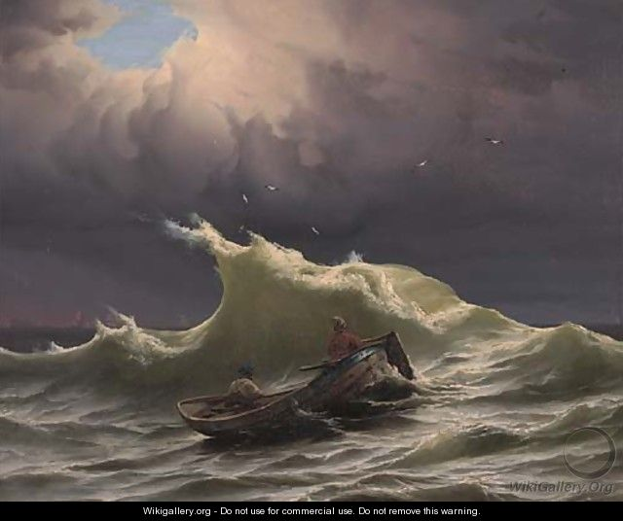
Conclusion
Seasoned sailors saw the “winds and waves” filling their boat and they were in jeopardy – they went to the only One who could stop it!
Peter walked on the water out to Christ, full of confidence, but became distracted by the winds and the waves of the storm – When he sank he called out to the only One who could save him!

Slide 15
Conclusion
II Cor. 5:6-7
6. Therefore, being always of good courage, and knowing that while we are at home in the body we are absent from the Lord--
7. for we walk by faith, not by sight--
When we walk by sight the “winds and the waves” can cause us to fear and doubt (Mt. 8:26; 14:31) and sink!
Walk by faith and focus on Jesus, the Master of the “winds and the waves,” the only One who can grant peace!

Slide 16
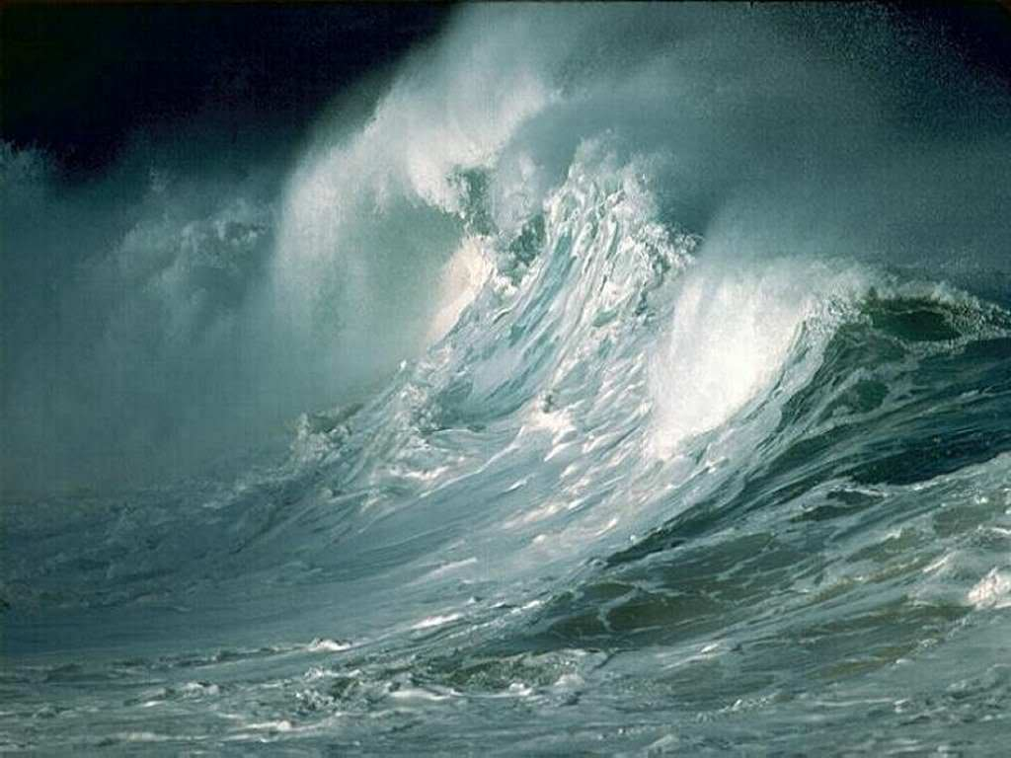
Conclusion
Let us put our trust in Jesus so that we may one day live with God Almighty in that home in Heaven He has prepared (Jn. 14:1-6)
An indescribable peace!
Is. 57:20-21: No peace for the wicked
Romans 5:1
1. Therefore, having been justified by faith, we have peace with God through our Lord Jesus Christ,
Philippians 4:7
7. And the peace of God, which surpasses all comprehension, will guard your hearts and your minds in Christ Jesus.

Slide 17
Conclusion
Jesus is the Master of the winds & waves of the sea
(Mt. 8:27), and He will be Master over your
“winds & waves” if you but come to Him and lay your
burdens at His feet (Mt. 11:28; I Pet. 5:7)!

Slide 18
“What Must I Do To Be Saved?”
Hear The Gospel (Jn. 5:24; Rom. 10:17)
Believe In Christ (Jn. 3:16-18; Jn. 8:24)
Repent Of Sins (Lk. 13:35; Acts 2:38)
Confess Christ (Mt. 10:32; Rom. 10:10)
Be Baptized (Mk. 16:16; Acts 22:16)
Remain Faithful (Jn. 8:31; Rev. 2:10)
For The Erring Child of God:
Repent (Acts 8:22), Confess (I Jn. 1:9),
Pray (Acts 8:22)

