Slide 1
Fathers: The Good, The Bad, And The Godly Text: Prov. 1:8; 6:20
Notes:
By Nathan L Morrison
All Scripture given is from the NASB unless otherwise stated
For further study, or if questions, please Call: 804-277-1983 or Visit: www.courthousechurchofchrist.com
Image of Clint Eastwood from ‘The Good, The Bad, And The Ugly’ courtesy of:
www.the20.wordpress.com/2009/12/01/5-classic-westerns.com

Slide 2
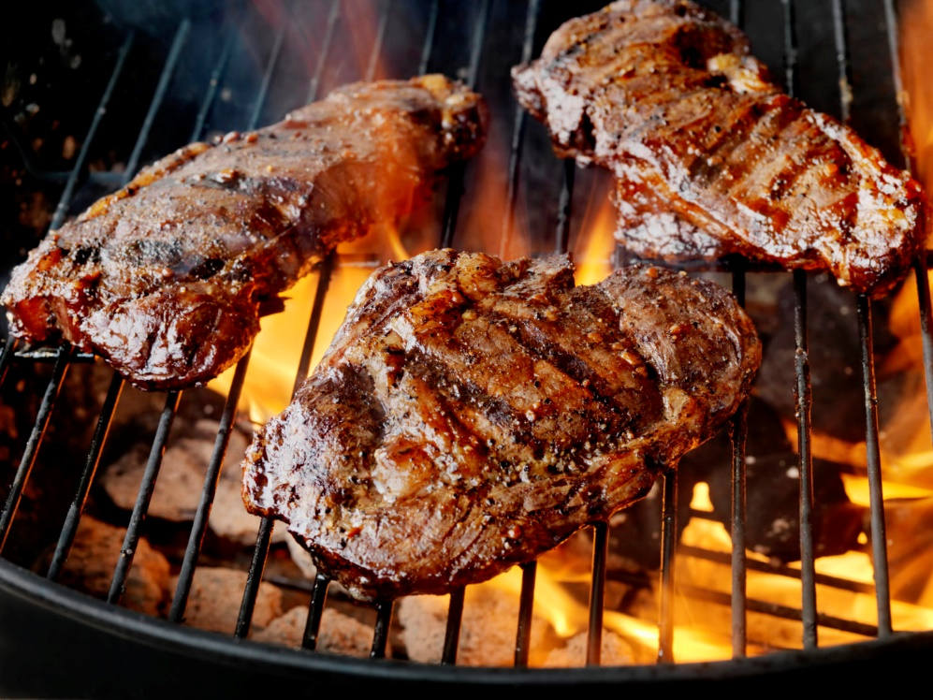
Intro
Father’s Day
1924: President Calvin Coolidge recognized Father's Day as the third Sunday in June of that year
1956: Congress officially recognized Father's Day
1966: President Lyndon Johnson declared Father’s Day as the third Sunday in June as Father's Day
1972: President Richard Nixon permanently established it
Though this is a special one-time event each year, we all should honor our fathers on a daily basis – especially those who are pleasing to God!
Notes:
The beginning of Father’s Day:
The first Father's Day was observed in the State of Washington on June 19, 1910 at the urging of Sonora Smart Dodd from Spokane, WA to honor fathers as hers raised her when her mother died.
In 1924, President Calvin Coolidge recognized Father's Day as the third Sunday in June of that year and encouraged states to do the same. Congress officially recognized Father's Day in 1956 with the passage of a joint resolution.
In 1966, President Lyndon Johnson issued a proclamation recognizing the third Sunday in June as Father's Day. (In 1972, President Richard Nixon permanently established it)
Sonora Smart Dodd lived to see her idea come to fruition. She died in 1978 at the ripe old age of 96. (A Brief History of Father's Day by Andrew Hollandbeck)
Though this is a special one-time event each year, we all should honor our fathers on a daily basis – especially those who are pleasing to God.

Slide 3
Psalm 128
A Song of Ascents
1. How blessed is everyone who fears the LORD, Who walks in His ways.
2. When you shall eat of the fruit of your hands, You will be happy and it will be well with you.
3. Your wife shall be like a fruitful vine Within your house, Your children like olive plants Around your table.
4. Behold, for thus shall the man be blessed Who fears the LORD.
5. The LORD bless you from Zion, And may you see the prosperity of Jerusalem all the days of your life.
6. Indeed, may you see your children's children. Peace be upon Israel!
Notes:
(Prov. 1:8; 6:20)

Slide 4
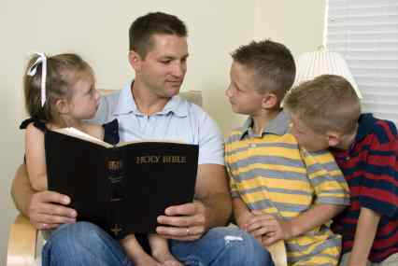
Intro
There are many lessons that we can learn
from fathers – lessons that help us define
love and sacrifice, and examples that serve
as warning of what not to do!
(Prov. 1:8) (Prov. 6:20)
We will consider the examples of fathers in light of the Good, the Bad, and the Godly!
Notes:
(Prov. 1:8; 6:20)

Slide 5
The Good – Physical Well-being
Nobleman/Jairus – Jn. 4:46-54; Lk. 8:41-42, 49-56; Mk. 5:22-23, 35-43
John 4:46-47 (Nobleman from Capernaum)
46. Therefore He came again to Cana of Galilee where He had made the water wine. And there was a royal official whose son was sick at Capernaum.
47. When he heard that Jesus had come out of Judea into Galilee, he went to Him and was imploring Him to come down and heal his son; for he was at the point of death.
Luke 8:41-42 (Jairus, official of the Synagogue)
41. And there came a man named Jairus, and he was an official of the synagogue; and he fell at Jesus' feet, and began to implore Him to come to his house;
42. for he had an only daughter, about twelve years old, and she was dying. But as He went, the crowds were pressing against Him.

Slide 6
The Good – Physical Well-being
Nobleman/Jairus – Jn. 4:46-54; Lk. 8:41-42, 49-56; Mk. 5:22-23, 35-43
Similarities:
Both sought Jesus to heal their children who were dying.
Both wanted Jesus at their child’s bedside.
Both men realized their positions (Jairus was an official of the synagogue), wealth, nobility, or leadership could not save their children
Differences:
The nobleman’s son was ill; Jairus’ daughter was ill.
Jesus did not go to the nobleman’s house (25 miles) but said, “Go; your son lives” – Nobleman did not witness the miracle, but was told about it later (John 4:51-53) & became believers with his whole house (4:53).
Jesus went to the house of Jairus, whose daughter had died – Jairus witnessed the miracle with his wife (Lk. 8:51) & they were amazed/astounded (Lk. 8:56; Mk. 5:42).
Both men were looking out for their children’s physical well-being!

Slide 7
The Good – Physical Well-being
Nobleman/Jairus – Jn. 4:46-54; Lk. 8:41-42, 49-56; Mk. 5:22-23, 35-43
Noteworthy Mentions:
Abraham (Gen. 24:1-15, 67)
Joseph (Gen. 48:13-20)
To love and want to protect your children is a good trait
for a Father to possess!

Slide 8
The Bad – Ungodly Influences
Ahab – I Kings 16:33; 21:25
I Kings 16:30-33: King Ahab of Israel married Jezebel and became an idolater!
I Kings 16:33
33. Ahab also made the Asherah. Thus Ahab did more to provoke the LORD God of Israel than all the kings of Israel who were before him.
I Kings 21:25
25. Surely there was no one like Ahab who sold himself to do evil in the sight of the LORD, because Jezebel his wife incited him.
I Kings 18:3-4: Jezebel hunted down and killed the prophets of God – Ahab didn’t restrain her!
I Kings 19:1-2: Jezebel threatened the life of Elijah!
I Kings 21:5-16: After death of Naboth, Ahab took possession of his vineyard (21:15-16)!

Slide 9
The Bad – Ungodly Influences
Ahab – I Kings 16:33; 21:25
His and his wife’s ungodly influence over their family caused their deaths:
I Kings 22:51-53: Ahaziah their son (II Kings 1:16-17).
II Kings 9:22-24, 27: Joram their son & Ahaziah their grandson
II Chr. 22:3-5: Athaliah, like her parents, was a an evil influence on her son (Ahaziah) “to his destruction” (II Chr. 22:7).
II Kings 10:1-11: Ahab’s remaining 70 sons killed.
He was a father of evil influence and
caused his family’s downfall!

Slide 10
The Bad – Ungodly Influences
Ahab – I Kings 16:33; 21:25
Dishonorable Mentions:
Isaac/Jacob (Gen. 25:28; 37:1-5)
Eli (I Sam. 2:12-17, 22-25)
These fathers are examples of
what NOT to do!

Slide 11
The Godly – Spiritual Well-being
Abraham – Gen. 18:16-19
God said He had chosen Abraham because he would teach (“command”) “his children and his household after him to keep the way of the LORD by doing righteousness and justice.”
Genesis 18:16-19
16. Then the men rose up from there, and looked down toward Sodom; and Abraham was walking with them to send them off.
17. The LORD said, "Shall I hide from Abraham what I am about to do,
18. since Abraham will surely become a great and mighty nation, and in him all the nations of the earth will be blessed?
19. "For I have chosen him, so that he may command his children and his household after him to keep the way of the LORD by doing righteousness and justice, so that the LORD may bring upon Abraham what He has spoken about him."
What a compliment and commendation towards Abraham’s character!

Slide 12
The Godly – Spiritual Well-being
Abraham – Gen. 18:16-19
God chose him to be the father of a great nation (Gen. 12:2) because he would teach them about righteousness and justice!
He was called “a friend of God” – Js. 2:23
Abraham was a father concerned for the spiritual well-being of his family!
Abraham was a godly father and godly example to many!
(Gen. 24:10-15: His servant prayed to “the God of my master Abraham”) – Jn. 15:14
Notes:
John 15:14 “You are My friends if you do what I command you.”

Slide 13
The Godly – Spiritual Well-being
Abraham – Gen. 18:16-19
Honorable Mentions:
David (I Kings 2:1-4; I Chr. 28:2-10, 20-21)
Solomon (Prov. 1:1-9; Eccl. 12:10-14)
Every child should be thankful and honored for fathers who have showed their love and duty for God first and for teaching God’s word to their family!

Slide 14
Conclusion
A godly father, along with his wife, will
diligently train his children to know God
Prov. 1:8; 6:20
1:8: Hear, my son, your father's instruction And do not forsake your mother's teaching;
6:20: My son, observe the commandment of your father And do not forsake the teaching of your mother;
A godly father will not forsake his God-given role as teacher of his children
Eph. 6:4 (Prov. 13:24; 22:15; 23:13-14; 29:15)
4. Fathers, do not provoke your children to anger, but bring them up in the discipline and instruction of the Lord.

Slide 15
Conclusion
A godly father should be a godly example
for his children
I Chronicles 28:9, 20 (Titus 2:2, 6-8; Col. 3:21)
28:9: “As for you, my son Solomon, know the God of your father, and serve Him with a whole heart and a willing mind; for the LORD searches all hearts, and understands every intent of the thoughts. If you seek Him, He will let you find Him; but if you forsake Him, He will reject you forever.”
28:20: Then David said to his son Solomon, “Be strong and courageous, and act; do not fear nor be dismayed, for the LORD God, my God, is with you. He will not fail you nor forsake you until all the work for the service of the house of the LORD is finished.”
Notes:
Walk A Little Plainer, Daddy
Written by Forrest Flowers, Jan. 13, 1969
“Walk a little plainer daddy,” Said a little boy so frail.
I’m following in your footsteps, And I don’t want to fail.
Sometimes your steps are very plain, Sometimes they are hard to see.
So walk a little plainer daddy, For your are leading me.
I know that once you walked this way, Many years ago.
And what you did along the way, I’d really like to know.
For sometimes when I’m tempted, I don’t know what to do.
So walk a little plainer daddy, For I must follow you.
Someday when I’m grown up, You are like I want to be.
Then I will have a little boy, Who will want to follow me.
And I would want to lead him right, And help him to be true.
So, walk a little plainer daddy, For we must follow you.

Slide 16
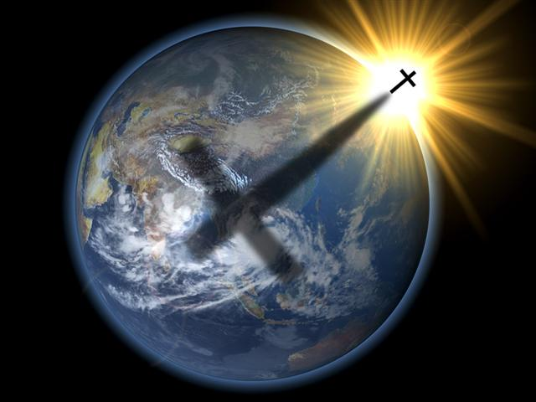
Conclusion
God the Father is our supreme example of Fatherhood
(II Cor. 6:17-18) and what fathers ought to be like
Ps. 86:15; Rom. 9:22-24; II Pet. 3:9: Compassionate, Patient, and merciful!
Lk. 11:9-13; Js. 1:17: He provides all blessings, and everything good is from Him!
Jn. 3:16-17: God, the Father, gave His only Son to save the world, to cleanse mankind of their incurable disease of sin! Sacrificial love!

Slide 17
Conclusion
Godly fathers deserve our praise and honor because they diligently watch over our souls!
What kind of father are you or will you be?

Slide 18
“What Must I Do To Be Saved?”
Hear The Gospel (Jn. 5:24; Rom. 10:17)
Believe In Christ (Jn. 3:16-18; Jn. 8:24)
Repent Of Sins (Lk. 13:35; Acts 2:38)
Confess Christ (Mt. 10:32; Rom. 10:10)
Be Baptized (Mk. 16:16; Acts 22:16)
Remain Faithful (Jn. 8:31; Rev. 2:10)
For The Erring Child:
Repent (Acts 8:22), Confess (I Jn. 1:9),
Pray (Acts 8:22)

