Slide 2
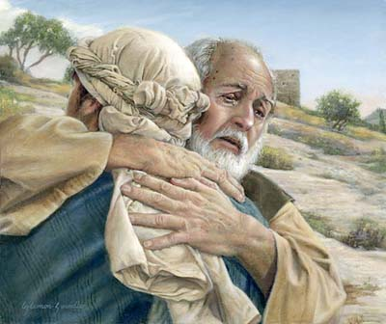
The Loving Father
Luke 15:1-32
Richie Thetford www.thetfordcountry.com

Slide 3
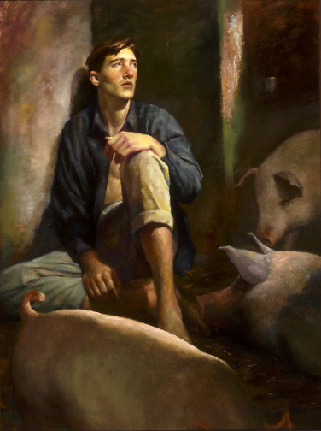
The Prodigal Son
Self-will
Selfishness
Separation
Wayward Living
Spiritual Destitution
Starvation
His Error
Richie Thetford www.thetfordcountry.com

Slide 4
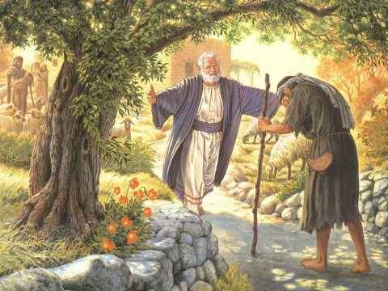
The Prodigal Son
His Return
Realization
Resolution
Repentance
Return
Repentance – “a change of mind, resulting in a change of action” (vs. 19-20)
Richie Thetford www.thetfordcountry.com

Slide 5
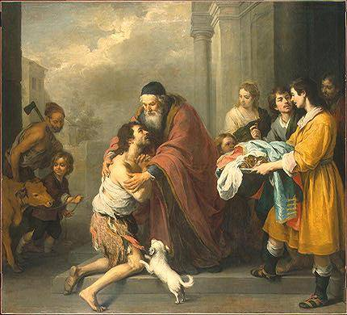
The Loving Father
Reconciliation takes place
Re-clothes him with only the best robe
Great rejoicing takes place
No matter how bad our life may have been or may be today, our loving Father will embrace us when we are repentant and return to Him!
Richie Thetford www.thetfordcountry.com

Slide 6
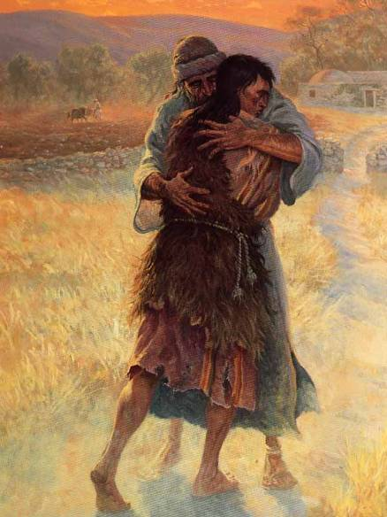
The Elder Son
Refuses to join the celebration
Father pleads for him to join in the celebration
He complains!
Served many years
Never transgressed
No celebration for me
“Son you are always with me, and all that I have is yours.” “Your brother was dead and is alive again, and was lost and is found.” (15:31-32)
Richie Thetford www.thetfordcountry.com

Slide 7
Conclusion
Pharisees’ and Scribes’ statement
“this man receives sinners and eats with them.”
The “prodigal son” shows the true devotion of the loving Father and the true colors of the Scribes and Pharisees
It shows them how they acted!
Parable also shows clearly the great love our Father has for each of us
“But God demonstrates His own love toward us, in that while we were still sinners, Christ died for us.” (Romans 5:8)
Richie Thetford www.thetfordcountry.com

Slide 8
Conclusion
Our heavenly Father LOVES His children
Especially when they return with a penitent attitude!
Joy in heaven
Joy in the presence of the angels of God
May we as Christians learn the proper way to receive the erring child who returns back to the loving Father
2 Corinthians 2:6-8
Richie Thetford www.thetfordcountry.com

