Slide 1
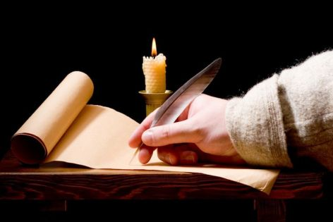
Confirmed By Three Proof For Our Faith
Text:
II Pet. 1:12-21
Scripture Reading:
Lk. 24:44-48
Notes:
By Nathan L Morrison for Sunday May 21st, 2017 (Courthouse CoC, Chesterfield, VA)
All Scripture given is from NASB unless otherwise stated
For further study or if questions, Call: 907-252-3708, or Visit: www.frr-churchofchrist-ak.org
PowerPoint Background from Rod MacArthur

Slide 2
Mankind Has Always Questioned God
Recent attempts to reject
Jesus ever existed
Writer Michael Paulkovich says, “'Jesus NEVER existed” (2014)
Claimed there is little evidence for Jesus existing.
Says he found little to no mention of Him in 126 texts from the 1st to 3rd centuries.
Says the account of Jesus in Josephus was added by later editors.
Claims Jesus was a “mythical character”
Caesar's Messiah: The Roman Conspiracy to Invent Jesus by Joseph Atwill (2011)
Says Jesus in N.T. are actually stories of Titus' campaign against the Jews
The Gospels are clever satires created by the Flavian Emperors.
The emperors created a pacifist Messiah to end the Jewish war (66-73 A.D.) with creation of Jesus.
Notes:
Writer Michael Paulkovich says, “'Jesus NEVER existed” (2014)
http://www.dailymail.co.uk/sciencetech/article-2776194/Jesus-never-existed-Writer-finds-no-mention-Christ-126-historical-texts-says-mythical-character.html http://www.blippitt.com/jesus-discovery/
Caesar's Messiah: The Roman Conspiracy to Invent Jesus by Joseph Atwill (2011)
http://www.dailymail.co.uk/sciencetech/article-2776194/Jesus-never-existed-Writer-finds-no-mention-Christ-126-historical-texts-says-mythical-character.html
http://www.amazon.com/Caesars-Messiah-Conspiracy-Flavian-Signature/dp/1461096405/ref=sr_1_1?ie=UTF8&qid=1439429961&sr=8-1&keywords=ceasar%27s+messiah

Slide 3
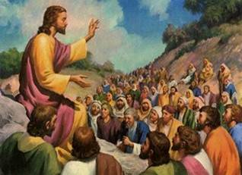
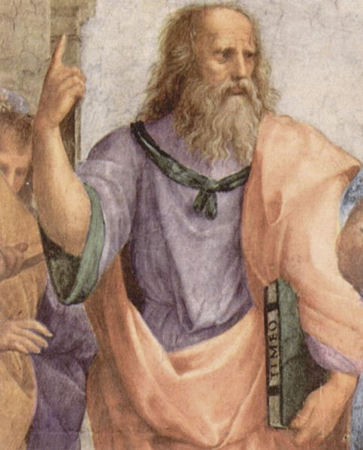
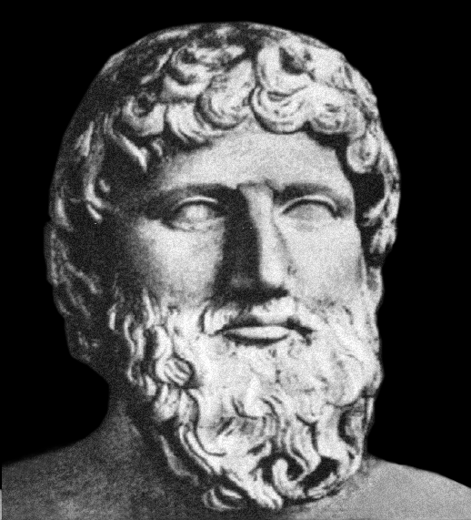
Mankind Has Always Questioned God
Peter says “the truth” is confirmed by three things &
provides proof for our faith! (II Pet. 1:12-21)
Both attempts fail in light of the overwhelming evidence that Jesus existed!
It is like taking 126 contemporary writers of Plato’s day who never mention him and then argue that he is a “mythical philosopher!”

Slide 4
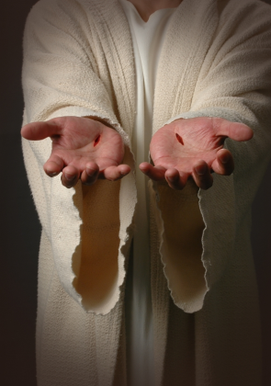
Eyewitness Testimony
Apostles “did not follow cleverly devised tales”
II Pet. 1:12, 15-16
12. Therefore, I will always be ready to remind you of these things, even though you already know them, and have been established in the truth which is present with you.
15. And I will also be diligent that at any time after my departure you will be able to call these things to mind.
16. For we did not follow cleverly devised tales when we made known to you the power and coming of our Lord Jesus Christ, but we were eyewitnesses of His majesty.
The force of human testimony rests upon three things
Honesty of witnesses: determined by general character and credibility
Competency: opportunity to obtain knowledge, ability to observe & retain facts
Number of witnesses: more than one witness = more credibility

Slide 5
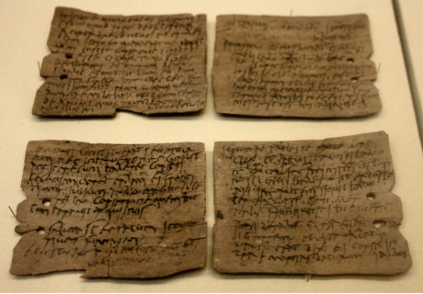
Eyewitness Testimony
More than one eyewitness?
“Newly Found Document Holds Eyewitness Account Of Jesus Performing Miracle!”
I Cor. 15:3-8:
All the apostles, and more than 500 witnesses at the same time
Jn. 20:30-31:
Not all miracles recorded but some were “…so that you may believe that Jesus is the Christ, the Son of God; and that believing you may have life in His name”
(Roman historian Marcus Velleius Paterculus)
Notes:
Source:
Headlines recently read: “Newly Found Document Holds Eyewitness Account Of Jesus Performing Miracle!”
1. http://worldnewsdailyreport.com/newly-found-document-holds-eyewitness-account-of-jesus-performing-miracle/
2. In 2012 Historian Ignazio Perrucci, was hired by the Vatican authorities to sort, analyze and classify 6,000 ancient documents that had been uncovered in the gigantic archive vaults (History repeating: Codex Vaticanus given to scholars in 1889 A.D.).
3. He found a manuscript written by the famous Roman historian Marcus Velleius Paterculus, a historian respected for his reliability, about his journey from Parthia to Rome that occurred in 31 A.D.
4. He stopped in a city called Sebaste (in modern-day West Bank) and witnessed the arrival of a great leader in the town with a group of disciples and followers, causing many of the lower class people from neighboring villages to gather around them.
5. According to Velleius, that great man’s name was Iēsous de Nazarenus, a Greco-Latin translation for Jesus of Nazareth!
6. He then described how he was an eyewitness to Jesus visiting the house of a woman named Elisheba, who had just given birth to a stillborn child. Jesus picked up the dead child and uttered a prayer in Aramaic to the heavens, which the author describes as “immensus”, meaning incomprehensible (He didn’t understand Aramaic). To the crowd’s surprise and amazement, the baby came back to life immediately, crying and squirming like a healthy newborn.
7. The composition of the parchment and ink, the literary style and handwriting have all been carefully scrutinized and were considered to be entirely legitimate, dating even the sheepskin parchment to the 1st century, more precisely from between 20-45 A.D. (Fits the historian’s 31 A.D. trip)!

Slide 6
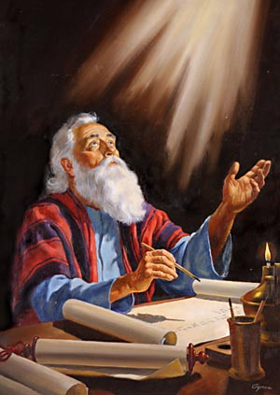
Eyewitness Testimony
The possibility of having fellowship with the apostles in knowledge of Christ:
I Jn. 1:3-4
3. what we have seen and heard we proclaim to you also, so that you too may have fellowship with us; and indeed our fellowship is with the Father, and with His Son Jesus Christ.
4. These things we write, so that our joy may be made complete.
If one refused to accept the testimony of the apostles, would they accept any testimony?

Slide 7
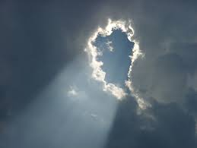
God’s Testimony
God’s voice thundered from Heaven,
confirming His Son
God’s Testimony
At time of Christ’s baptism
Mt. 3:16-17: “This is My beloved Son, in whom I am well- pleased.”
On Mt. Of Transfiguration
Mt. 17:1-8: (Vs. 5) “This is My beloved Son, with whom I am well-pleased; listen to Him!”
During Christ’s last public discourse in Jerusalem
Jn. 12:28: “Father, glorify Your name.” Then a voice came out of heaven: “I have both glorified it, and will glorify it again.”
II Pet. 1:17-18
17. For when He received honor and glory from God the Father, such an utterance as this was made to Him by the Majestic Glory, "This is My beloved Son with whom I am well-pleased"--
18. and we ourselves heard this utterance made from heaven when we were with Him on the holy mountain.
God’s audible voice was
heard by men three times
while Christ was on earth!

Slide 8
Prophecy’s Testimony
The proof of God’s omnipotence rests
in prophecy!
II Pet. 1:19-21
19. So we have the prophetic word made more sure, to which you do well to pay attention as to a lamp shining in a dark place, until the day dawns and the morning star arises in your hearts.
20. But know this first of all, that no prophecy of Scripture is a matter of one's own interpretation,
21. for no prophecy was ever made by an act of human will, but men moved by the Holy Spirit spoke from God.
Emphasis on prophecy
Acts 2:16-21
Acts 2:25-31
Acts 3:18
Acts 3:22-24
Acts 10:43
I Pet. 1:10-12

Slide 9
Prophecy’s Testimony
Prophecy shows the divine nature of
God, to show He is an omnipotent being!
Lk. 24:45-48 (Acts 3:22-24)
45. Then He opened their minds to understand the Scriptures,
46. and He said to them, "Thus it is written, that the Christ would suffer and rise again from the dead the third day,
47. and that repentance for forgiveness of sins would be proclaimed in His name to all the nations, beginning from Jerusalem.
48. "You are witnesses of these things.
A False prophet has to be wrong just once!
Deut. 18:22
Harold Camping foretold end of the world – May 21, 2011; Oct. 21, 2011
There are at least 332 prophecies concerning Christ fulfilled, and many more!
The amount of prophecies
fulfilled proclaims God’s
power and omnipotence!

Slide 10
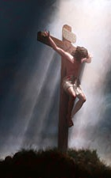
Conclusion
Jesus cited 4 testimonies as evidence in John 5
to prove that He is the Christ:
John the Baptist
(Jn. 5:33-35)
Jesus’ miracles
(Jn. 5:36; also Jn. 3:2)
God the Father
(Jn. 5:37-38)
The Scriptures
(Jn. 5:39-40, 45-47)
The force of the written message
II Pet. 1:15; 3:1-2
Jn. 12:48; Rom. 2:16
Even though the (physical) writer is long dead, the word lives on and we are accountable to it!

Slide 11
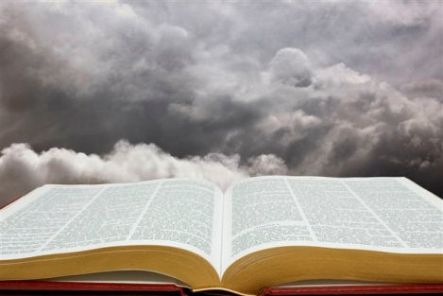
Conclusion
That is why it is so important to be “established in the truth!”
II Pet. 1:12
12. Therefore, I will always be ready to remind you of these things, even though you already know them, and have been established in the truth which is present with you.
Man will always rebel against God, but let us hold fast our faith, “established in the truth!”

Slide 12
“What Must I Do To Be Saved?”
Hear The Gospel (Jn. 5:24; Rom. 10:17)
Believe In Christ (Jn. 3:16-18; Jn. 8:24)
Repent Of Sins (Lk. 13:35; Acts 2:38)
Confess Christ (Mt. 10:32; Rom. 10:10)
Be Baptized (Mk. 16:16; Acts 22:16)
Remain Faithful (Jn. 8:31; Rev. 2:10)
For The Erring Child of God:
Repent (Acts 8:22), Confess (I Jn. 1:9),
Pray (Acts 8:22)

