Slide 1
What Adam & Eve Looked Like
Text: Genesis 1-4
Notes:
By Nathan L Morrison
All Scripture is from NASB unless otherwise stated
For further study, or if questions, please Call: 804-277-1983, or Visit: www.courthousechurchofchrist.com
Based on an article by Dan Richardson

Slide 2
Intro
What did Adam and Eve look like?
People speculate on ethnicity, culture, color of skin, racial attributes, (did they have belly buttons?), etc…!
It is all speculation since the Scriptures are silent on this point!
God’s word does answer this question from a different perspective – Consider…
Notes:
Sources:
http://creation.com/adam-and-eve
http://hamptonroads.com/2009/01/what-was-race-and-ethnicity-adam-and-eve
https://www.quora.com/What-did-Adam-and-Eve-look-like-according-to-different-cultures-or-different-portrayals

Slide 3
THEY LOOKED LIKE A MAN AND WOMAN
Gen. 1:27
27. God created man in His own image, in the image of God He created him; male and female He created them.
Gen. 2:18
18. Then the LORD God said, "It is not good for the man to be alone; I will make him a helper suitable for him."

Slide 4
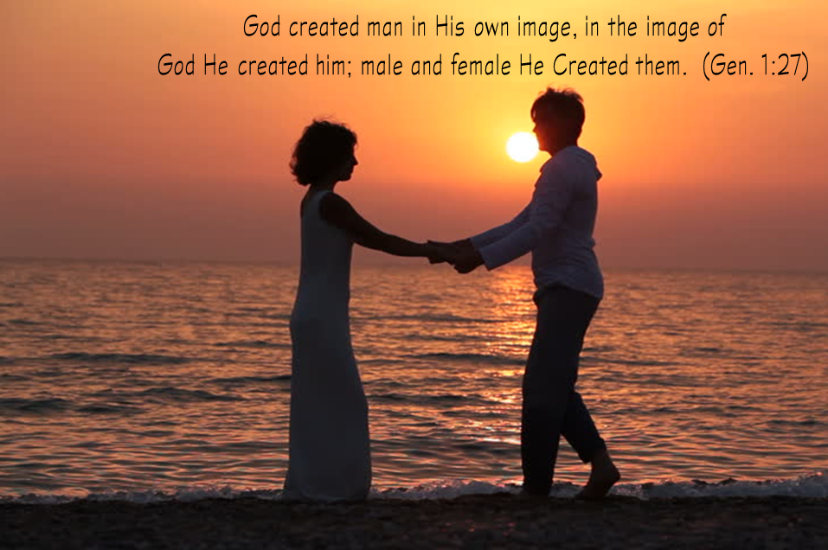
THEY LOOKED LIKE A MAN AND WOMAN
Gen. 2:18-20, 23: God made woman for man!
Adam noticed the animals he named (2:19-20) all had companions but no such “helper suitable for him” was found among all the animals!
God took a rib from Adam and created woman (2:23).
God made two genders (not 50)! (Mk. 10:6)
God made a woman for the man (I Cor. 11:8-9; I Tim. 2:13).
God didn't make for Adam another man. Homosexual relationships are declared to be “against nature” (Rom. 1:26), and “unrighteous” from which man can repent and change (I Cor. 6:9-11), and if not won’t enter into Heaven!

Slide 5
THEY LOOKED LIKE A MAN AND WOMAN
“Helper suitable” = “ezer (H5828) neged (H5048)”
H5828 ‛êzer [ay'-zer]: From H5826; aid: - help.
H5826 ‛âzar [aw-zar']: A primitive root; to surround, that is, protect or aid: - help, succour.
The word “ezer” (H5828) is a military term used 21 times in the O.T., twice to describe Eve, and three times to describe Israel in her alliances with other nations.
The remaining sixteen times that the word appears in the O.T., the word “ezer” (H5828) describes God!

Slide 6
THEY LOOKED LIKE A MAN AND WOMAN
Gen. 1:27 tells us male and female are both made in the image of God – God is called a “helper” for His people!
Ex. 18:4: Eliezer = “The God of my father was my help (ezer H5828), and delivered me from the sword of Pharaoh.”
Ps. 33:20: Our soul waits for the LORD; He is our help (H5828) and our shield.
Ps. 70:5: But I am afflicted and needy; Hasten to me, O God! You are my help (H5828) and my deliverer; O LORD, do not delay.
Ps. 121:1-2: “I lift up my eyes to the mountains—where does my help (H5828) come from? My help (5828) comes from the Lord, the Maker of heaven and earth.”
God has made women in His image and nature of a wonderful helper!
Husbands, don’t take your wives for granted!

Slide 7
THEY LOOKED LIKE A MAN AND WOMAN
Adam and Eve were man and woman (two genders)
and were made in the image of God!

Slide 8
THEY LOOKED LIKE A HUSBAND AND WIFE
Gen. 2:24 (Mk. 10:6-9)
24. For this reason a man shall leave his father and his mother, and be joined to his wife; and they shall become one flesh.

Slide 9
THEY LOOKED LIKE A HUSBAND AND WIFE
They represent God’s perfect intent for marriage—one
man and one woman in marriage for life (Mk. 10:6-9)
This repudiates all sorts of sexual sins, from homosexuality to fornication & adultery to polygamy!
Marriage is not man-made (despite what society thinks or does) but is of divine origin – It must be viewed as good for mankind and held in honor (Heb. 13:4)
Heb. 13:4
Fornication and adultery (I Cor. 6:9; Mk. 7:21; Heb. 13:4) will condemn a soul to hell (Rev. 21:8; 22:14-15)!
Paul said, “But because of immoralities, each man is to have his own wife, and each woman is to have her own husband” (I Cor. 7:2).
“Living together” (Gal. 5:19-21; Rev. 1:8; 22:14-15) leads to the “second death”

Slide 10
THEY LOOKED LIKE A HUSBAND AND WIFE
Prov. 12:4; 31:10: “An excellent wife, who can find?”
“Excellent” = chayil [khah'-yil] (H2428): From H2342; probably a force, whether of men, means or other resources; an army, wealth, virtue, valor, strength: - able, activity, (+) army, band of men (soldiers), company, (great) forces, goods, host, might, power, riches, strength, strong, substance, train, (+) valiant (-ly), valour, virtuous (-ly), war, worthy (-ily).
Prov. 12:4 & 31:10 are the only times in the O.T. in which the Hebrew word “chayil” is translated “excellent” because it refers to a woman!
It is a military term that has to do with soldiers, an army, wealth, or valor… David’s Mighty Men!
II Sam. 17:10: “…those who are with him are valiant (H2428) men.”
I Chr. 12:8: “…mighty men of valor (H2428), men trained for war…”
I Chr. 12:21: “…for they were all mighty men of valor (H2428), and were captains in the army.”

Slide 11
THEY LOOKED LIKE A HUSBAND AND WIFE
A military term is applied to the “excellent wife” (NKJ: “virtuous”) whose value is worth far above jewels!
Wives, you can excel at the nature of God within you (Gen. 1:27;
2:18) and be a blessing to your husbands (Prov. 31:28-29) in the
way David’s Mighty Men were known and feared for their valor!
Adam and Eve were husband and wife in divinely
instituted marriage, which is to be held as honorable by
all! (Heb. 13:4)

Slide 12
THEY LOOKED GUILTY
God had given Adam and Eve His law, forbidding them to
eat of the “tree of the knowledge of good and evil”
(Gen. 2:16-17)
Gen. 3:6
6. When the woman saw that the tree was good for food, and that it was a delight to the eyes, and that the tree was desirable to make one wise, she took from its fruit and ate; and she gave also to her husband with her, and he ate.
Gen. 3:11-12
11. And He said, "Who told you that you were naked? Have you eaten from the tree of which I commanded you not to eat?"
12. The man said, "The woman whom You gave to be with me, she gave me from the tree, and I ate."

Slide 13
THEY LOOKED GUILTY
Gen. 3:11-12: Blame Game
Adam's response, when confronted of his sin, was to blame his wife and, by implication, God Who gave her to him!
When man yields to temptation resulting in sin, it is a personal choice of which he must bear the burden of guilt before God (Js. 1:14-15; Rom. 14:12)
Scripture teaches that all accountable people are guilty of sin (Rom. 3:23) so repentance is required of all to please God (Acts 17:30; II Pet. 3:9).
Could say, they looked “dead”
(Gen. 2:16-17; 3:2)
Eph. 2:1-3: Those living in sin before Christ in their lives are “dead in their transgressions” – Adam and Eve spiritually died on that day and were guilty before God

Slide 14
THEY LOOKED GUILTY
When they sinned Adam and Eve looked as we all do
when we sin (Rom. 3:23) – Guilty!

Slide 15
THEY LOOKED COVERED
Gen. 3:21
21. The LORD God made garments of skin for Adam and his wife, and clothed them.

Slide 16
THEY LOOKED COVERED
Physically
Gen. 3:21: “The LORD God made garments of skin for Adam and his wife, and clothed them.”
Gen. 3:7: They made aprons from fig-leaves
God knew what they truly needed to be covered with and replaced their aprons with tunics (The necessity for modesty was here established).
Mt. 5:28; 6:22-23: Jesus taught to guard one’s thoughts & eyes from lust!
The “lust of the eyes” is part of the sinful world we must not love, and learn to put away (I John 2:15-17; II Pet. 2:14)
“Women to adorn themselves with proper clothing, modestly and discreetly” (I Tim. 2:9)

Slide 17
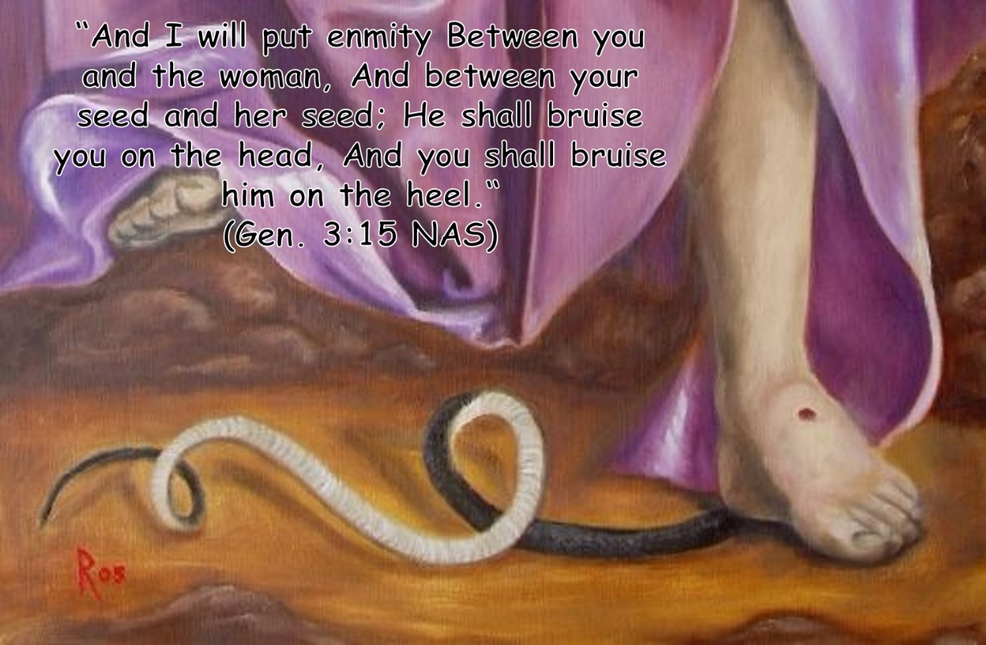
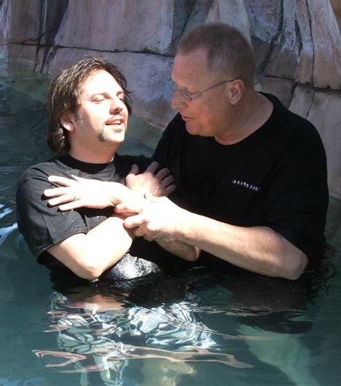
THEY LOOKED COVERED
Spiritually
As God knew what was best for Adam and Eve physically, He also knew what they needed spiritually and promised a Savior – Gen. 3:15
Jesus is the fulfillment to that promise (Gal. 4:4) and in Him we are no longer dead in sin but made alive (Eph. 2:3-7)!
The blood of Jesus replaces whatever we try to do to cover up our guilt and covers us, washing away our sin (Eph. 1:7; Acts 22:16; I Jn. 1:9)

Slide 18
THEY LOOKED COVERED
Adam and Eve left the Garden because of their sin but left covered and waiting for a Savior!

Slide 19
THEY LOOKED LIKE A FATHER & MOTHER
Gen. 4:1-2 (NKJ)
1. Now Adam knew Eve his wife, and she conceived and bore Cain, and said, "I have acquired a man from the LORD."
2. Then she bore again, this time his brother Abel. Now Abel was a keeper of sheep, but Cain was a tiller of the ground.
Gen. 5:4
4. Then the days of Adam after he became the father of Seth were eight hundred years, and he had other sons and daughters.

Slide 20
THEY LOOKED LIKE A FATHER & MOTHER
Being parents is one of the most important responsibilities entrusted to us!
Ps. 127:3-5: “Children are a gift of the LORD”
Prov. 1:8-9: God's wisdom includes both a father and mother for bringing up children, and they both are responsible as parents.
Prov. 22:6: “Train up a child in the way he should go, Even when he is old he will not depart from it.”
Eph. 6:4: “Fathers, do not provoke your children to anger, but bring them up in the discipline and instruction of the Lord.”
It doesn't take a village to raise children; it takes a father and mother! (Prov. 1:8-9)

Slide 21
THEY LOOKED LIKE A FATHER & MOTHER
Adam and Eve were parents and had the same grave responsibility parents today have concerning their children: “bring them up in the discipline and instruction of the Lord!” (Eph. 6:4)

Slide 22
CONCLUSION
Adam and Eve are a picture of what God wants for us! (Men and women working together as fellow heirs of salvation – I Pet. 3:7)

Slide 23
CONCLUSION
Their perfect home (Garden of Eden), though left for an imperfect one filled with sin and sorrow, can be had by all who overcome the trials of life (Rev. 21:7) in Heaven!
Rev. 22:1-2: The tree of life: lost at Eden, found in Heaven!
Heaven: The Perfect Home of the Soul! (I Pet. 1:4)
Rev. 22:1-4, 14, 17: The water of life & the tree of life – Saints have the right to both!

Slide 24
Conclusion
Let us learn from Adam and Eve to know what God sees us as and the home He wants to welcome us into!

Slide 25
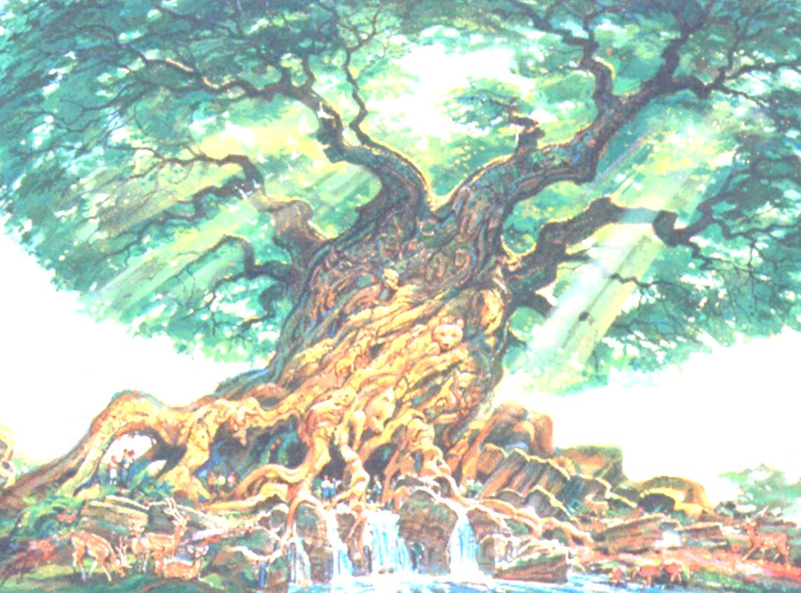
“What Must I Do To Be Saved?”
Hear The Gospel (Jn. 5:24; Rom. 10:17)
Believe In Christ (Jn. 3:16-18; Jn. 8:24)
Repent Of Sins (Lk. 13:35; Acts 2:38)
Confess Christ (Mt. 10:32; Rom. 10:10)
Be Baptized (Mk. 16:16; Acts 22:16)
Remain Faithful (Jn. 8:31; Rev. 2:10)
For The Erring Child:
Repent (Acts 8:22), Confess (I Jn. 1:9),
Pray (Acts 8:22)

