Slide 1
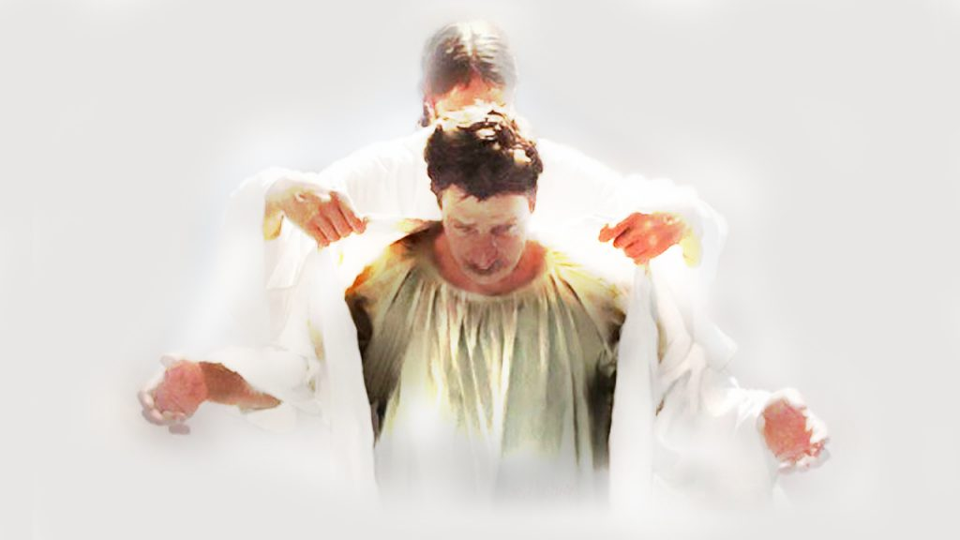
PUT ON…
(Parts 1-2) Text: Col. 3:12-14
Notes:
By Nathan L Morrison for Sunday 09/17/17 (Part 1) & 09/24/17 (Part 2)
All Scripture given is from NASB unless otherwise stated
For further study or if questions, Call: 804-277-1983, or Visit: www.courthousechurchofchrist.com

Slide 2
PART 1
PUT ON… Col. 3:12-14

Slide 3
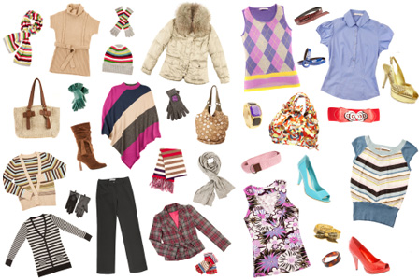
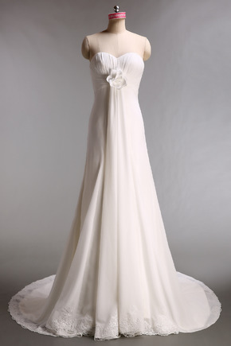
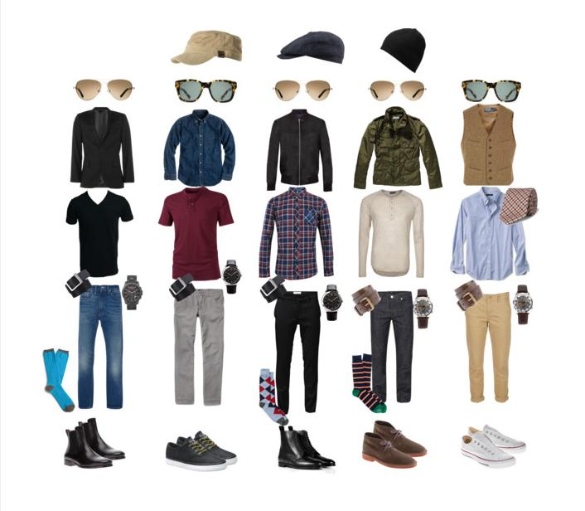
Intro
Global Fashion Industry Statistics: Valued at over 3
trillion dollars and accounts for 2 percent of the world's
Gross Domestic Product (GDP)!
The womenswear industry is valued at 621 billion dollars
The menswear industry is valued at 402 billion dollars
The retail value of the luxury goods market is 339.4 billion dollars
Childrenswear had a global retail value of 186 billion dollars
Sports footwear is valued at 90.4 billion dollars
The bridalwear industry is valued at 57 billion dollars
Notes:
Global Fashion Industry Statistics (https://fashionunited.com/global-fashion-industry-statistics)

Slide 4
Intro
After we…
We Must…
Eph. 4:22: Lay aside old self
Eph. 4:24: Put on new self
The inner person is what matters to God
I Sam. 16:7: The world judges by appearance but God sees the heart!
Eph. 4:14-19 (esp. v.16): Christ must dwell in the inner man, that is, the inner person of the heart through faith!

Slide 5
Intro
Col. 3:12-14 (“Put on” = G1746 enduō: “to envelope in, clothe with”)
12. So, as those who have been chosen of God, holy and beloved, put on a heart of compassion, kindness, humility, gentleness and patience;
13. bearing with one another, and forgiving each other, whoever has a complaint against anyone; just as the Lord forgave you, so also should you.
14. Beyond all these things put on love, which is the perfect bond of unity.
To have our hearts properly adorned let us “put on” the
complete ensemble of virtues from God!

Slide 6
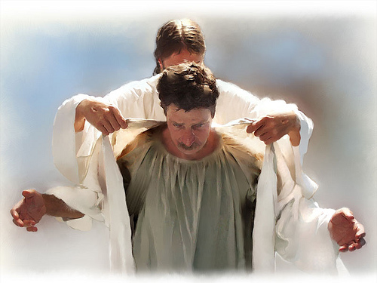
Compassion
Col. 3:12
12. So, as those who have been chosen of God, holy and beloved, put on a heart of compassion, kindness, humility, gentleness and patience;
Put on, or clothe ourselves, with hearts of compassion
(KJV: “bowels of mercies”)
Compassion = G3628 oiktirmos [oyk-tir-mos']: pity, mercy

Slide 7
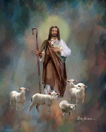
Compassion
Trait of God
This is an attribute of God, who is described as compassionate and who acted so on our behalf! (Ex. 33:19; Rom. 9:15: God revealed Himself to Moses as compassionate; II Cor. 1:3: “Father of mercies” = mercies is same word as “compassion”; Js. 5:11: “Full of compassion”)
Jesus showed compassion – Mt. 9:36; 14:14; 15:32; 20:34; Mk. 1:41; 6:34; 8:2

Slide 8
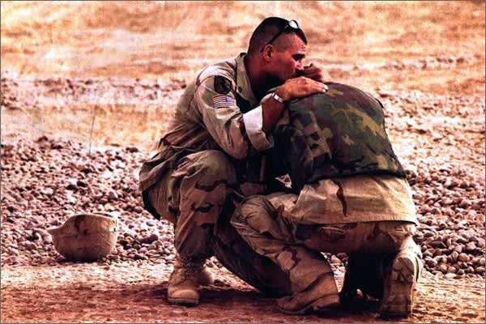
Compassion
Must show “Compassion” towards others:
Mt. 5:7: Jesus said the one who shows mercy will receive mercy! (Both merciful, G1655, and mercy, G1653, mean “compassionate”)
Jude 1:21-23: We are to show mercy (G1656, G1653: compassion) to the lost and weak in faith!
When we “put on” compassion we clothe ourselves with
Christ and share an attribute of God!

Slide 9
Kindness
Col. 3:12
12. So, as those who have been chosen of God, holy and beloved, put on a heart of compassion, kindness, humility, gentleness and patience;
Put on, or clothe ourselves, with kindness
Kindness = G5544 chrēstotēs [khray-stot'-ace]: “Usefulness, moral excellence.”

Slide 10
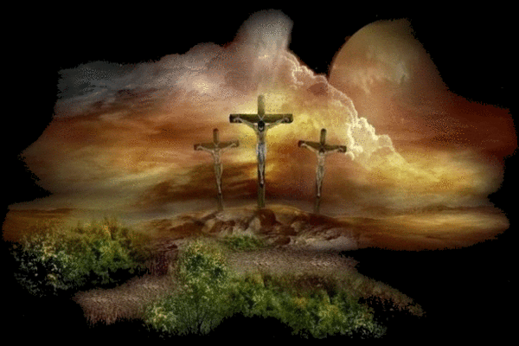
Kindness
Trait of God
Rom. 2:4; 11:22: God is a God of severity and a God of kindness!
Eph. 2:4-9; Titus 3:4-7: God showed kindness to mankind through Jesus Christ! By Jesus His kindness was extended to man in that we could be saved!

Slide 11
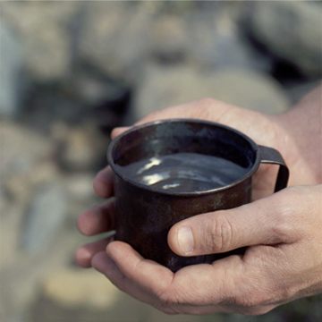
Kindness
Must show “Kindness” towards others:
It is a fruit of the Spirit (Gal. 5:22-23).
Vine’s says, “Mildness of temper, calmness of spirit, an unruffled disposition, and a disposition to treat all with politeness.”
Acts 9:36, 39: Tabitha (Dorcas) showed kindness by thinking of others and seeing to their needs! (Mt. 10:42)
II Cor. 6:4-7: Kindness must be a trait even while suffering!
Eph. 4:32: We are to be kind, tenderhearted and forgiving to others!
When we “put on” kindness we clothe ourselves with
Christ and share an attribute of God!

Slide 12
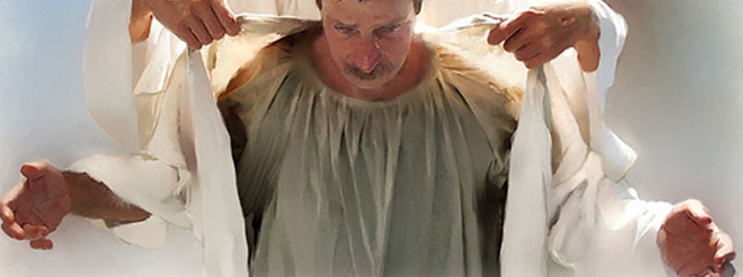
Humility
Col. 3:12
12. So, as those who have been chosen of God, holy and beloved, put on a heart of compassion, kindness, humility, gentleness and patience;
Put on, or clothe ourselves, with humility
(KJV: “humbleness of mind”)
Humility = G5012 tapeinophrosunē [tap-i-nof-ros-oo'-nay]: “humiliation of mind, that is, modesty.”
Modesty here refers not to clothing but to our own esteem.

Slide 13
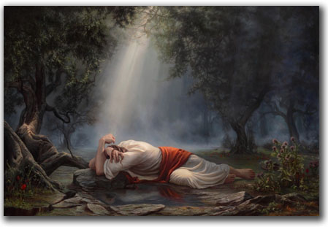
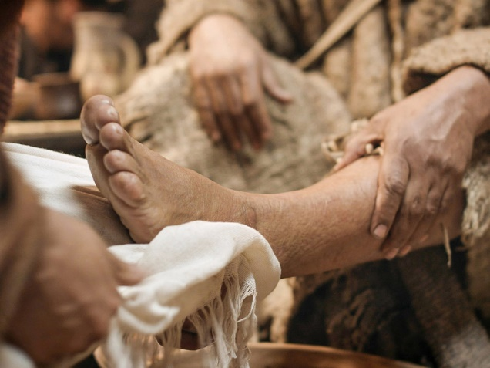
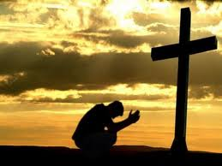
Humility
Required of mankind towards God
Acts 20:18-19: Paul told the elders of Ephesus (20:17) he served the Lord in “humility” (KJV: “humility of mind”).
I Pet. 5:5: All saints are to have this humility to each other and to God: He resists the proud but gives grace to the humble!
Js. 4:10: Humble = G5013 tapeinoō [tap-i-no'-o]: figuratively to humiliate (in condition or heart): - abase, bring low, humble (self).
Jesus, our example:
As Christ humbled Himself (Mt. 11:29: G5011 tapeinos; 26:39; Phil. 2:5-11; Heb. 5:8), so believers ought to humble themselves in service to the Lord and Savior (Phil. 2:5; Heb. 5:9).
Jn. 13:3-17: Jesus washed His apostles’ feet as an example for them!

Slide 14
Humility
Must show “Humility” towards others:
Eph. 4:2: “Humility” is “lowliness”in the KJV and is humility of the mind (G5012).
Phil. 2:3: “Humility of mind” will regard others as more important than oneself!
I Pet. 5:5: Must “clothe” ourselves in (“Put on…”) humility to each other and to God.
When we “put on” humility we clothe ourselves with
Christ and submit to God!

Slide 15
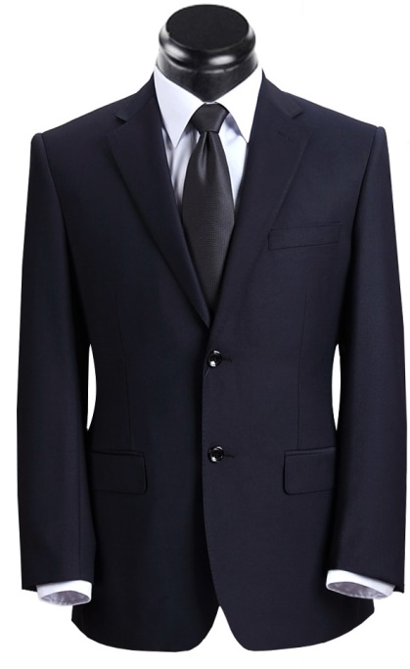
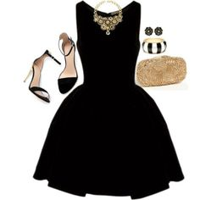
Conclusion (Part 1)
Do we spend all our time, money, and energy on only our
physical appearance?
Our eternity is dependent on how much time we spend on
our spiritual appearance!
II Pet. 1:10-11: “As long as you practice these things...” (II Pet. 1:5-9)
These are the important “adornments” we should want to spend time on!

Slide 16
Conclusion (Part 1)
World: Outer Appearance is all important –
Fashion, cosmetics, surgeries, etc.
God: Inner Appearance is all important –
Compassion, Kindness, Humility, etc.
Whose “fashion advice” will we listen to?

Slide 17
Conclusion (Part 1)
The world? Going through life only concerned with our outer appearance will not make us pleasing to God and will lead to eternal destruction! (II Jn. 2:15-17)
God? Obedience to the gospel will cause us to “clothe ourselves with Christ” in baptism (Gal. 3:27), and then we will clothe our hearts with His virtues!

Slide 18
Conclusion (Part 1)
Let us “put on” the clothing of Christ by adorning
our hearts in obedience to God!

Slide 19
“What Must I Do To Be Saved?”
Hear The Gospel (Jn. 5:24; Rom. 10:17)
Believe In Christ (Jn. 3:16-18; Jn. 8:24)
Repent Of Sins (Lk. 13:35; Acts 2:38)
Confess Christ (Mt. 10:32; Rom. 10:10)
Be Baptized (Mk. 16:16; Acts 22:16)
Remain Faithful (Jn. 8:31; Rev. 2:10)
For The Erring Child of God:
Repent (Acts 8:22), Confess (I Jn. 1:9),
Pray (Acts 8:22)

Slide 20
PART 2
PUT ON… Col. 3:12-14

Slide 21
Intro
After we…
We Must…
Col. 3:12-14
12. So, as those who have been chosen of God, holy and beloved, put on a heart of compassion, kindness, humility, gentleness and patience;
13. bearing with one another, and forgiving each other, whoever has a complaint against anyone; just as the Lord forgave you, so also should you.
14. Beyond all these things put on love, which is the perfect bond of unity.

Slide 22
Gentleness
Col. 3:12
12. So, as those who have been chosen of God, holy and beloved, put on a heart of compassion, kindness, humility, gentleness and patience;
Put on, or clothe ourselves, with gentleness
(KJV: “meekness”)
Gentleness = G4240 prautēs [prah-oo'-tace]: mildness, that is, (by implication) humility: - meekness (NKJ: “meekness”).
The distinction between “gentleness, or meekness” (G4240) and “patience” (G3115) is slight.
Gentleness (G4240) is said to be the temper which accepts God’s dealings, or evil inflicted by men as His instruments, without resistance (Expositor’s Bible Commentary).
Patience/Longsuffering (G3115) is said to be the long holding out of the mind before it gives way to a temptation to action, or passion (Expositor’s Bible Commentary).

Slide 23
Gentleness
Col. 3:12
12. So, as those who have been chosen of God, holy and beloved, put on a heart of compassion, kindness, humility, gentleness and patience;
Put on, or clothe ourselves,
with gentleness
(KJV: “meekness”)
Gentleness/Meekness is often misunderstood to be weakness.
Not spineless but full of conviction! (Moses – Num. 12:3: KJV – Meek & NAS – Humble)
It is strength under control!
Notes:
Fictional character: Superman. A teaser poster promoting the film, ‘Man of Steel’ (2013) came out showing Superman in handcuffs and escorted by soldiers. Critics and fans alike noted the lack of “Kryptonite” (His known weakness) and had critics using the word “humility.” I made a “Humility” poster out of it!

Slide 24
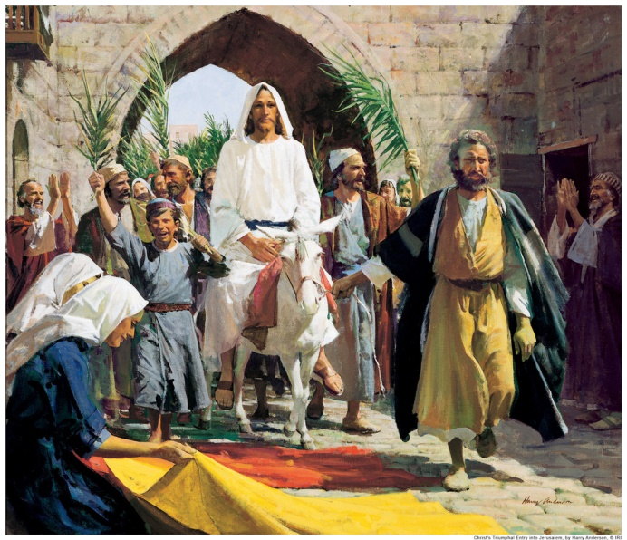
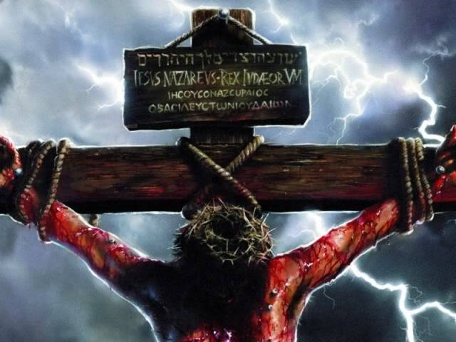
Gentleness
Trait of God and of Jesus, our example!
I Kings 19:11-13: God spoke to Elijah, not out of a mighty wind, an earthquake or fire, but a gentle wind!
II Cor. 10:1: Christ is meek (G4240) and gentle (G1932).
Mt. 11:28-30: Jesus is “Gentle” (G4239 praus: mild, meek, humble) and “Humble” (G5011 tapeinos: humble, lowly, fig. or lit. humiliated) – Mt. 21:1-5: A Gentle King! (Zech. 9:9)
Jesus displayed such humility on the cross!
He had the authority to lay down His life and take it back (Jn. 10:18), He submitted to the Father’s will yet had the power to stop it (Mt. 26:39, 53), and allowed Himself to die on the cross (Lk. 23:46).

Slide 25
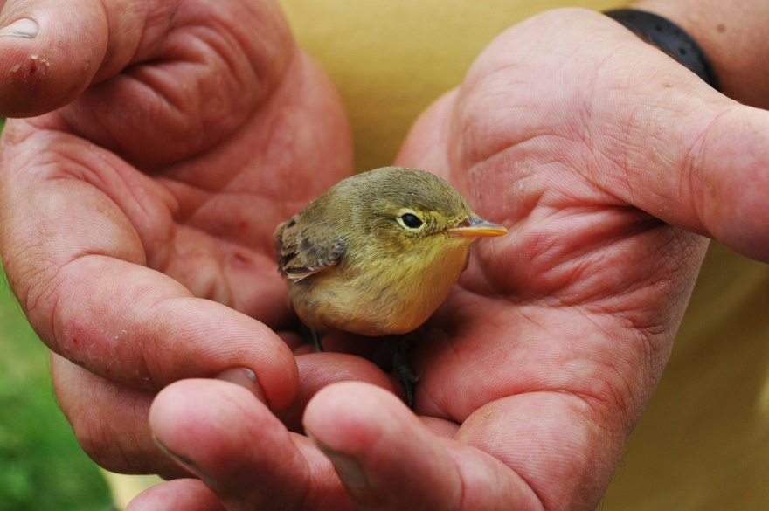
Gentleness
Must show “Gentleness” towards others:
Mt. 5:5: Jesus said blessed are the gentle (meek) for they will inherit the earth!
I Tim. 3:3: Elders are to be “gentle.”
I Pet. 3:1-4: Wives are to have a “gentle spirit.”
Phil. 4:5: All saints are to have a “gentle spirit.” (Gal. 5:22: Fruit of the Spirit!)
Gal. 6:1: Saints are to restore the fallen or the weak in gentleness!
(II Tim. 2:24-26: Correct in gentleness)
Eph. 4:1-3: To walk in a “worthy manner” of the gospel requires saints to be gentle (meek)!
When we “put on” gentleness we
clothe ourselves with
Christ and share an attribute
of God!

Slide 26
Patience
Col. 3:12
12. So, as those who have been chosen of God, holy and beloved, put on a heart of compassion, kindness, humility, gentleness and patience;
Put on, or clothe ourselves, with patience
(KJV: “longsuffering”)
Patience = G3115 makrothumia [mak-roth-oo-mee'-ah]: “Forbearance or (subjectively) fortitude: - longsuffering, patience.”

Slide 27
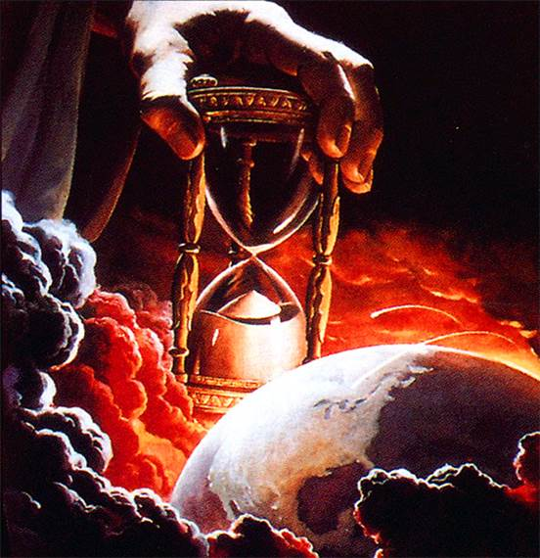
Patience
Trait of God and of Jesus, our example!
Ex. 34:6: “Compassionate and slow to anger” (KJV: “Longsuffering”) from a combination Heb. word that means, “patient, slow to anger, long-suffering” (H750, H639).
Ps. 86:15: “Slow to anger” (KJV: “Longsuffering”)
Rom. 2:4: Don’t take for granted God’s patience! (I Pet. 3:20: Days of Noah)
II Pet. 3:9, 15: Jesus, the Lord, is patient (KJV: “Longsuffering”), not willing for any to perish but to come to repentance!

Slide 28
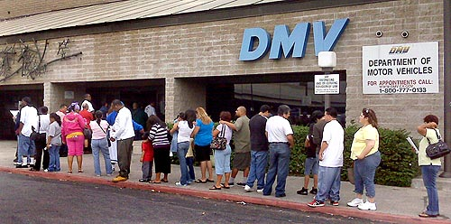
Patience
Must show “Patience” towards others:
Gal. 5:22: Patience (Longsuffering) is a fruit of the Spirit!
Eph. 4:2; Col. 1:11; I Thess. 5:14: Saints are to be patient with each other, and all men!
II Tim. 2:24; 4:2: Saints are to correct and teach with “great patience!”
I Tim. 3:3: Elders are to be patient, longsuffering.
Rom. 12:12; James 5:7-8: Be patient in trials and in waiting for Jesus’ 2nd Coming!
When we “put on” patience we clothe ourselves with
Christ and share an attribute of God!

Slide 29
Love
Col. 3:14
14. Beyond all these things put on love, which is the perfect bond of unity.
Put on, or clothe ourselves, with love (KJV: “charity”)
Love = G26 agapē [ag-ah'-pay]: “love, that is, affection or benevolence; specifically (plural) a love feast: - (feast of) charity ([-ably]), dear, love (a selfless, sacrificial love).
Much can be said of love, for it is the trait of God and of Jesus and what we are to exhibit!

Slide 30
Love
Trait of God and of Jesus, our example!
I Jn. 4:8, 10: “God is love!” (Jn. 3:16; Rom. 5:8: God’s love is shown in sending Jesus!)
Jesus, our example:
Jn. 13:34-35: Jesus set the standard in knowing and showing love: as He loved us!

Slide 31
Love
Must show “Love” towards others:
Mt. 6:24: Cannot serve two masters: must choose to love God! (Jn. 14:15)
Eph. 5:25; Titus 2:3-5: Husbands to love (G26 agapē) their wives and wives to love (G5362 philandros, from phileo: “tender affection”) their husbands and their children!
Mt. 5:43-48; 22:39; Rom. 12:19-21: We are to love our neighbors and even our enemies!
Gal. 5:22: Love is a fruit of the Spirit (Eph. 4:2; I Jn. 4:7, 16: We are to love one another!)
I Pet. 2:17: Saints are to “love the brotherhood!” (Eph. 1:15; Col. 1:4: Love for all the saints)
When we “put on” love we clothe ourselves with Christ and share
an attribute of God!

Slide 32
Conclusion (Part 2)
Clothing ourselves with the new nature (Col. 3:10)
affects how we treat others!
Col. 3:12-14 (Eph. 4:32)
12. So, as those who have been chosen of God, holy and beloved, put on a heart of compassion, kindness, humility, gentleness and patience;
13. bearing with one another, and forgiving each other, whoever has a complaint against anyone; just as the Lord forgave you, so also should you.
14. Beyond all these things put on love, which is the perfect bond of unity.
The key to forgiving others is to:
Remember how much the Lord forgave (Mt. 18:32-34) us and do likewise!

Slide 33
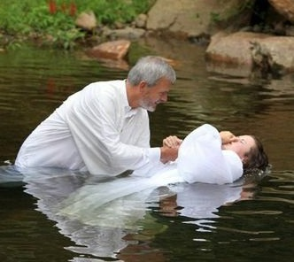
Conclusion (Part 2)
Gal. 3:27
27. For all of you who were baptized into Christ have clothed yourselves with Christ.

Slide 34
Conclusion (Part 2)
Saints must continually make sure we are “putting on” the character of Christ! (Col. 3:12-14)
Let us “put on” Christ by adorning our hearts in His character and in obedience to God!

Slide 35
“What Must I Do To Be Saved?”
Hear The Gospel (Jn. 5:24; Rom. 10:17)
Believe In Christ (Jn. 3:16-18; Jn. 8:24)
Repent Of Sins (Lk. 13:35; Acts 2:38)
Confess Christ (Mt. 10:32; Rom. 10:10)
Be Baptized (Mk. 16:16; Acts 22:16)
Remain Faithful (Jn. 8:31; Rev. 2:10)
For The Erring Child of God:
Repent (Acts 8:22), Confess (I Jn. 1:9),
Pray (Acts 8:22)

